Slide 1


Slide 2
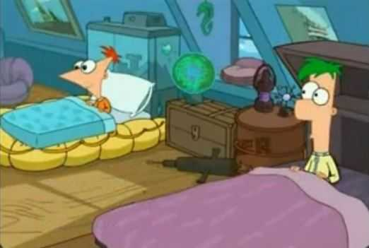
Phineas and Ferb usually get up at 8:00 am.

Slide 3
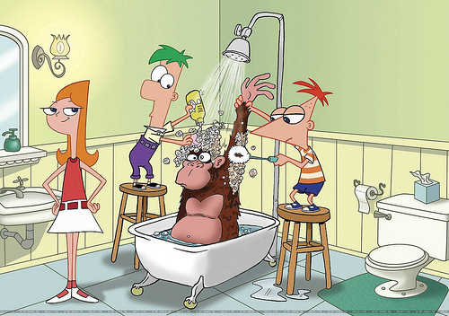
They take a shower at 8:30 am.

Slide 4


After taking a shower, Phineas and Ferb get dressed.

Slide 5
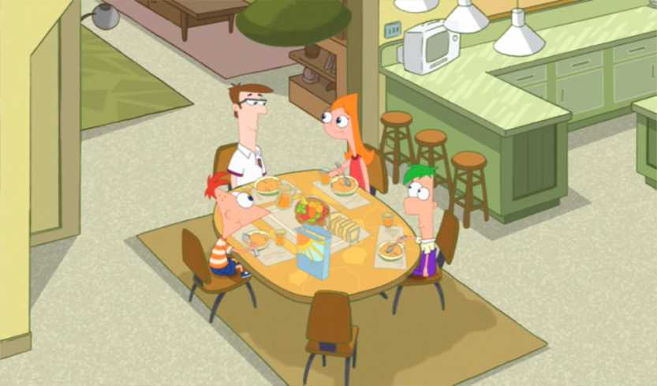
Phineas and Ferb have breakfast at 9:30 am.
What do they like to have for breakfast?

Slide 6
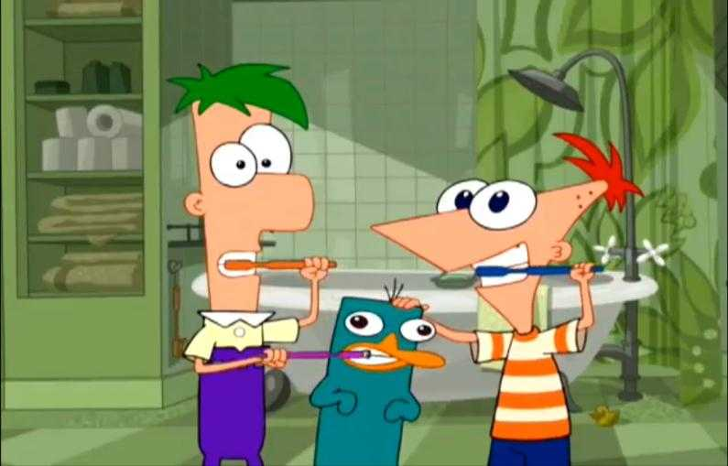
After having breakfast, Phineas and Ferb brush their teeth.

Slide 7
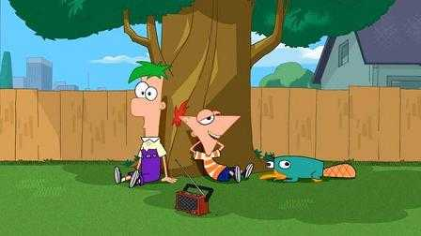
Phineas and Ferb never go to school!
It’s summer vacation!

Slide 8
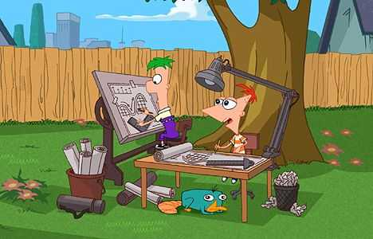
They stay at home planning different projects.

Slide 9
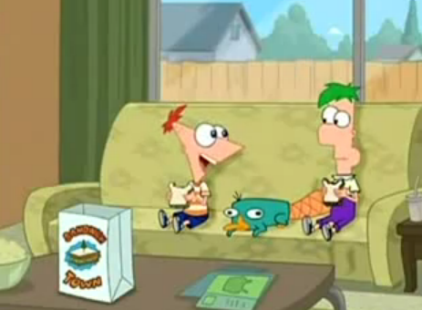
Sometimes, Phineas and Ferb have lunch at 12:00 pm.
They like to have a sandwich for lunch!

Slide 10
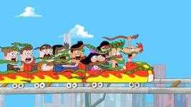
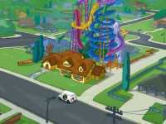
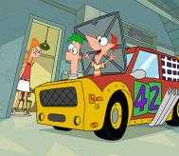
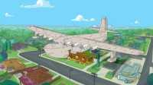
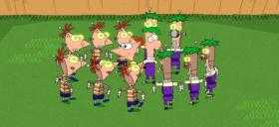
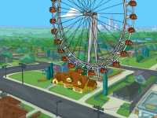
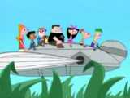
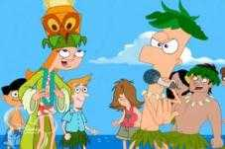
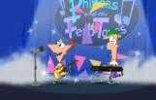
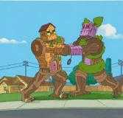
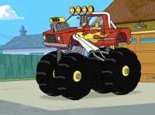
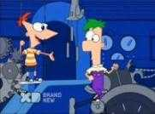
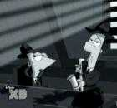

They build amazing things everyday!

Slide 11
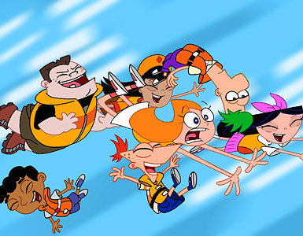
Phineas and Ferb always have a lot of fun with their friends!
They never get bored!

Slide 12
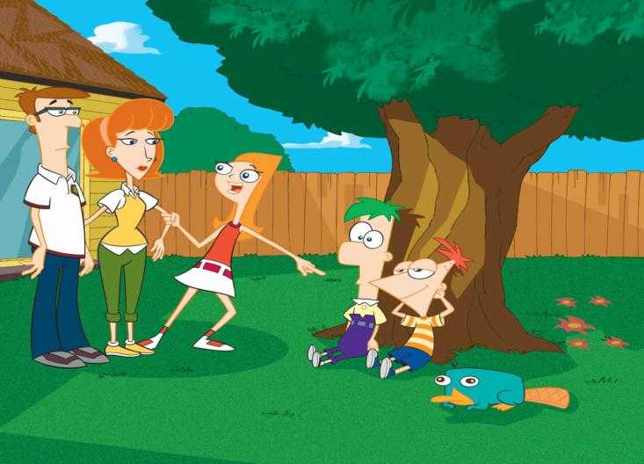
They finish playing with their friends at 5:00 pm.

Slide 13
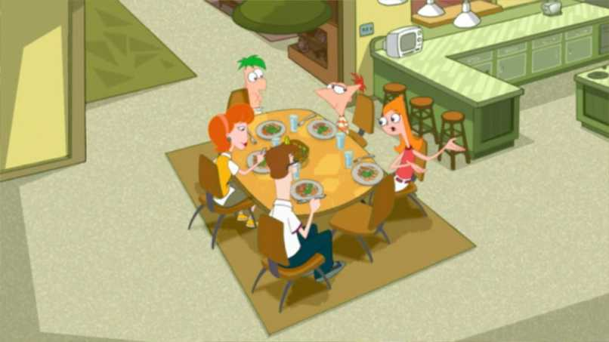
Phineas and Ferb often have dinner with their family at 7:00 pm.

Slide 14
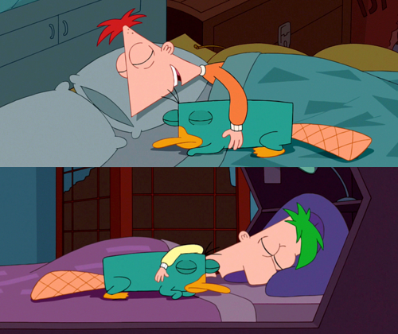
Phineas and Ferb go to bed at 9:00 pm.

Slide 15
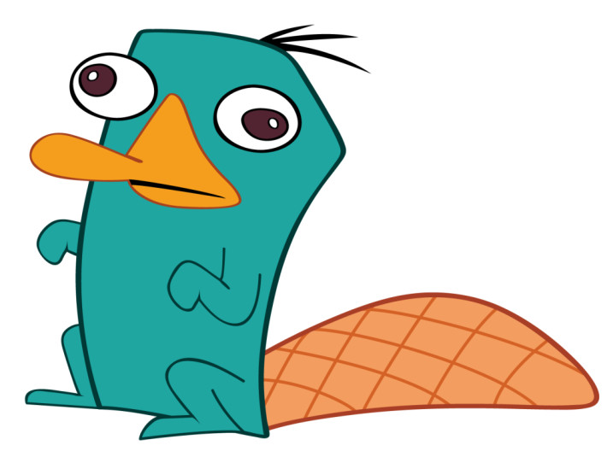
«Hey, where is Perry?»

Slide 16
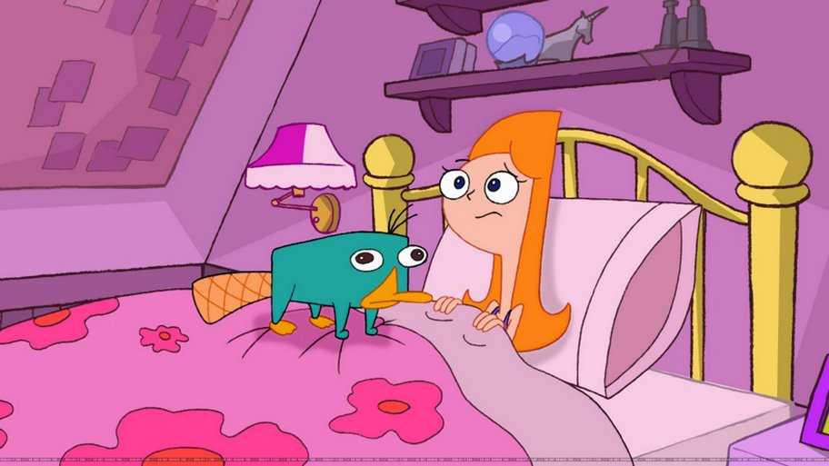
gets up/usually/ Perry/ at 7:00 am/.

Slide 17
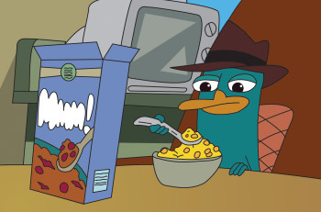
cereal/He/has/ for breakfast/always/.

Slide 18
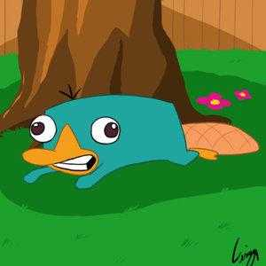
goes/to the backyard/Perry/at 9:00am.

Slide 19
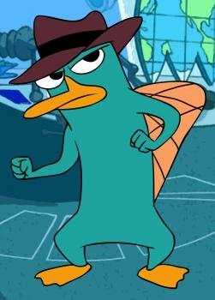
a secret agent/ works /Perry / as /.

Slide 20
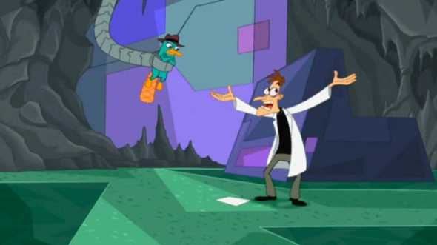
against Doofenshmirtz/ everyday/ Perry/ fights /.

Slide 21
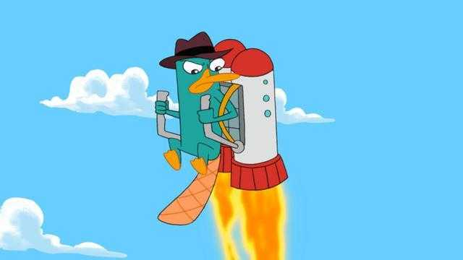
home/goes back/ at 5:00 pm/ Perry /.

Slide 22
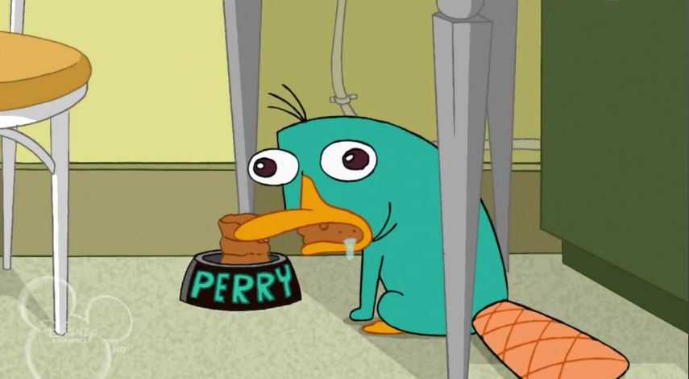
has/at 7:00 pm /Perry / dinner /.

Slide 23
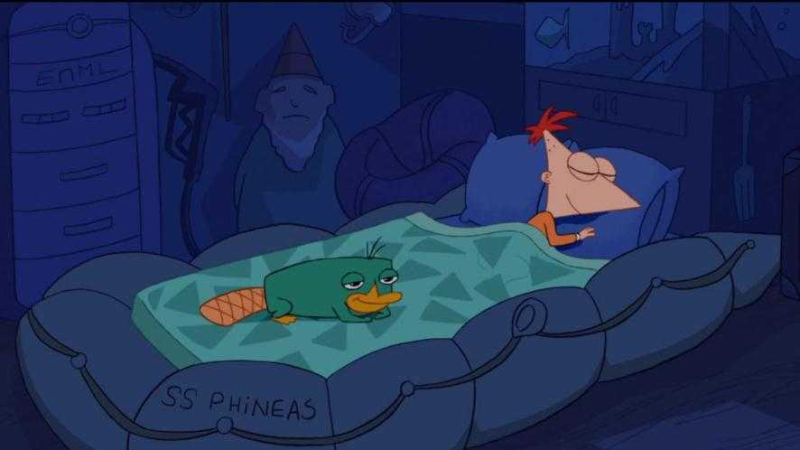
Finally, he/to bed/ at 9:00 pm/ goes /.

