Slide 1
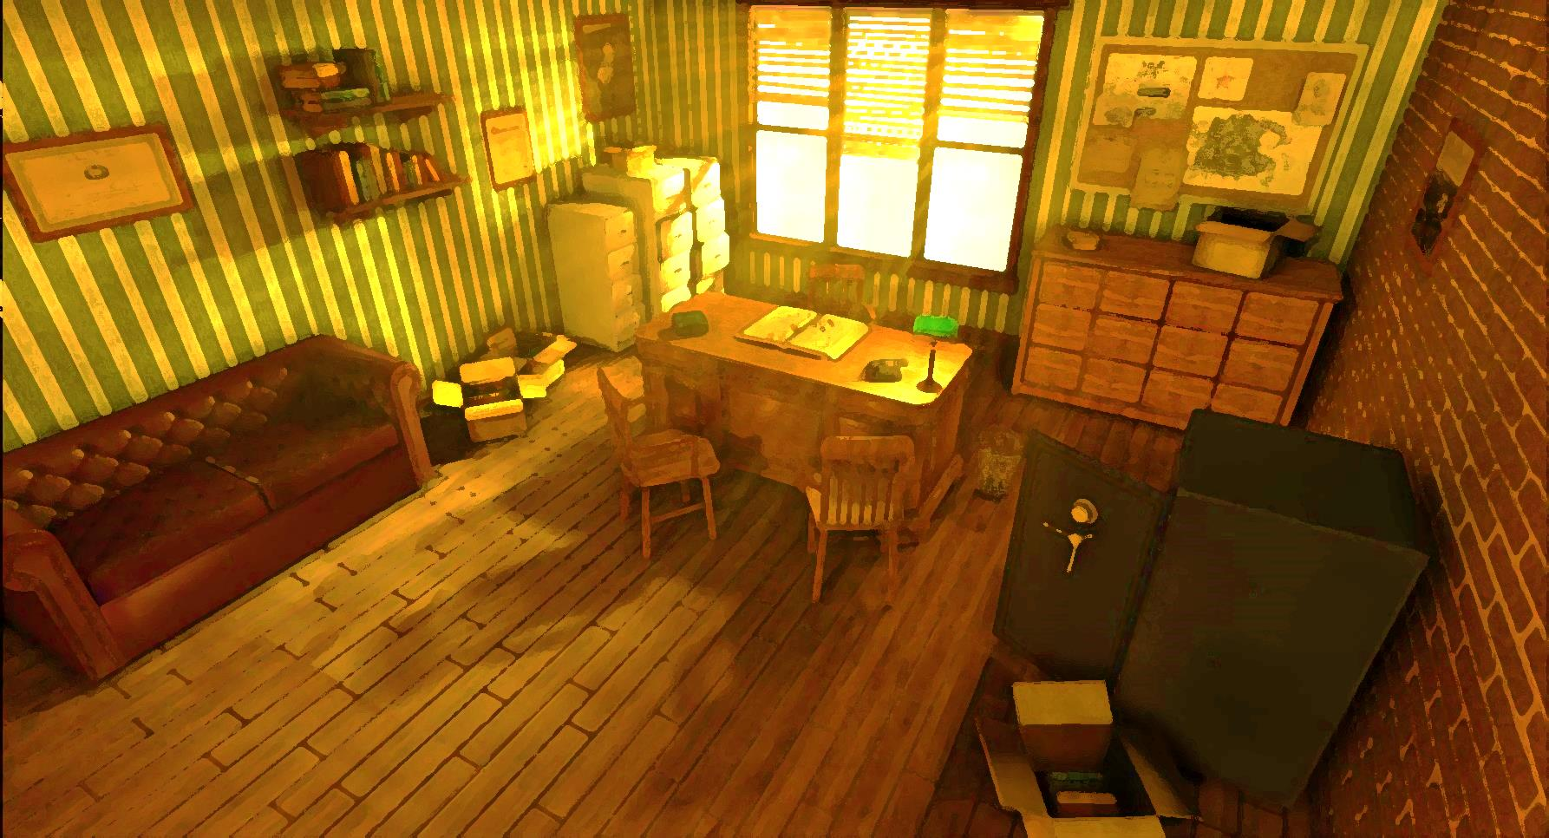


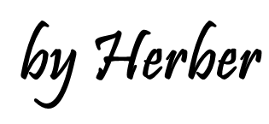

MEMORY GAME
There was/There wasn’t
Prepositions of place

Slide 2


Hi, my name’s Slouth, Johnny Slouth.
Mr. Sleuth is back in his office.
He is trying to remember the things he saw before a bomb exploded at the crime scene.
Can you help him?
Look at the picture carefully for 30 seconds. Are the statements true or false?

Slide 3
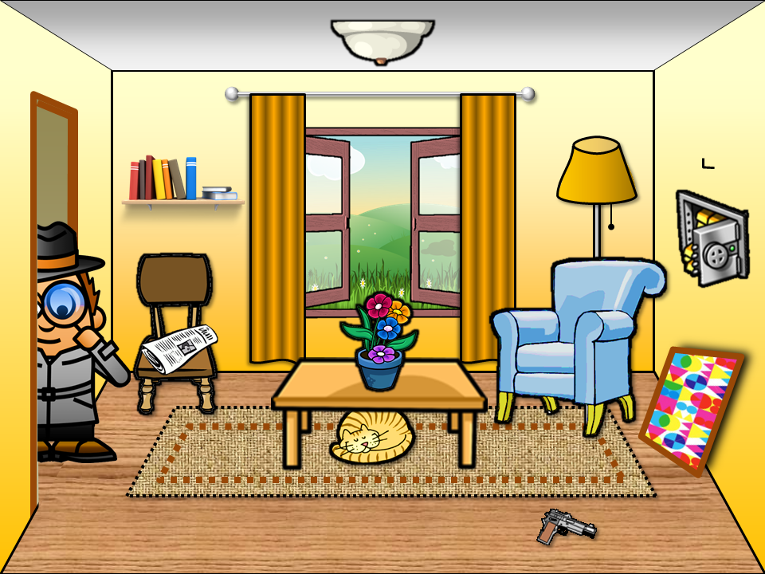


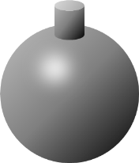

Slide 4

You are right.
It’s true.
You are wrong.
It’s true!
There was a flower pot on the table.
TRUE
FALSE

Slide 5
You are right.
It’s true.
You are wrong.
It’s true!
There was a newspaper on the chair.
TRUE
FALSE

Slide 6
There was a bookshelf above the chair.
You are right.
It’s false.
You are wrong.
It’s false!
There was a bookshelf below the chair.
TRUE
FALSE

Slide 7
You are wrong.
It’s true!
You are right.
It’s true.
There was an open window.
TRUE
FALSE

Slide 8
There was a cat under the table.
You are right.
It’s false.
You are wrong.
It’s false!
There was a dog under the table.
TRUE
FALSE

Slide 9
There was a lamp behind the armchair.
You are right.
It’s false.
You are wrong.
It’s false!
There wasn’t a lamp behind the armchair.
TRUE
FALSE

Slide 10
There was a cup of coffee on the table.
You are right.
It’s false.
You are wrong.
It’s false!
There wasn’t a cup of coffee on the table.
TRUE
FALSE

Slide 11
You are right.
It’s true.
You are wrong.
It’s true!
There was a gun on the floor.
TRUE
FALSE

Slide 12
There was a picture on the floor.
You are right.
It’s false.
You are wrong.
It’s false!
There was a picture hanging on the wall.
TRUE
FALSE

Slide 13
You are right.
It’s true.
You are wrong.
It’s true!
There was an open safe in the wall.
TRUE
FALSE

Slide 14
Describe the scene
EXIT

