Slide 1
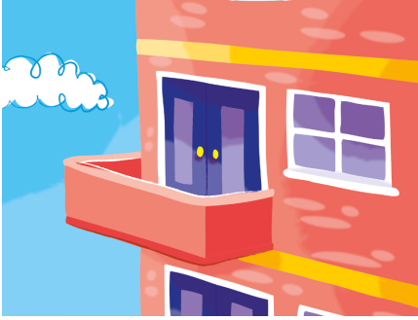
1. He lives in the flat. –
He doesn’t live in the flat.

Slide 2
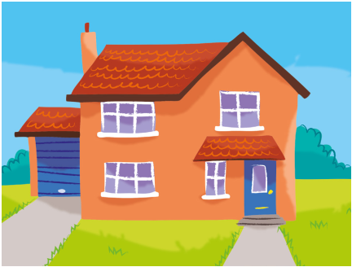
2. She lives in the house.

Slide 3
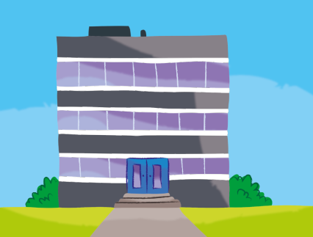
3. He works in a big building.

Slide 4
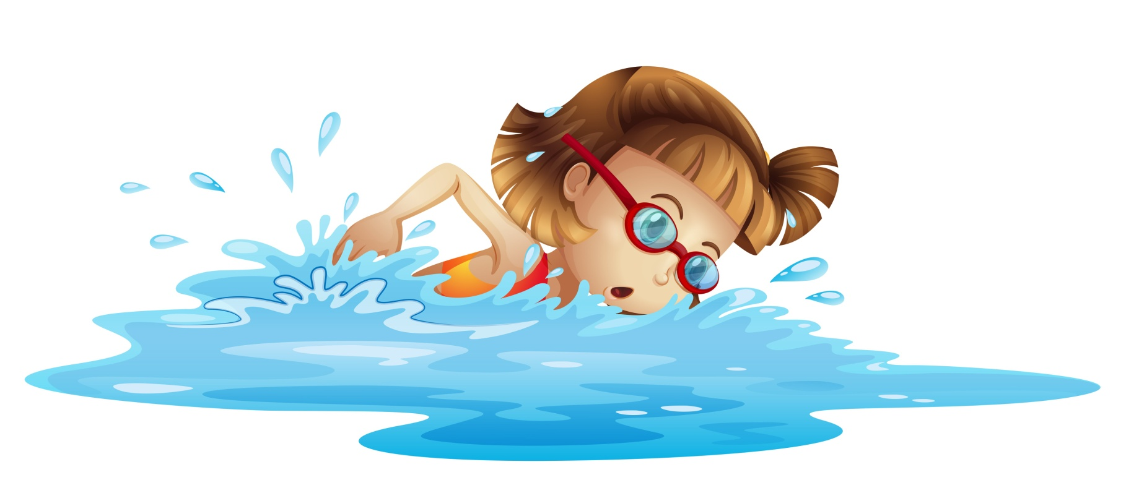
4. She swims in the swimming pool.

Slide 5
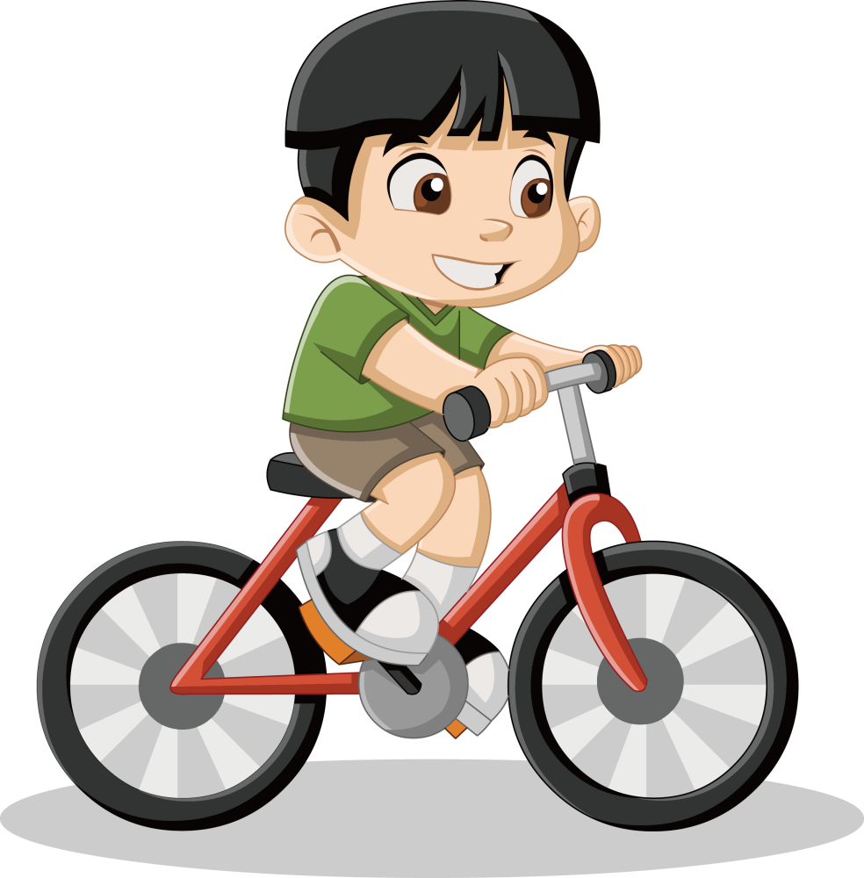
5. He rides a bike.

Slide 6
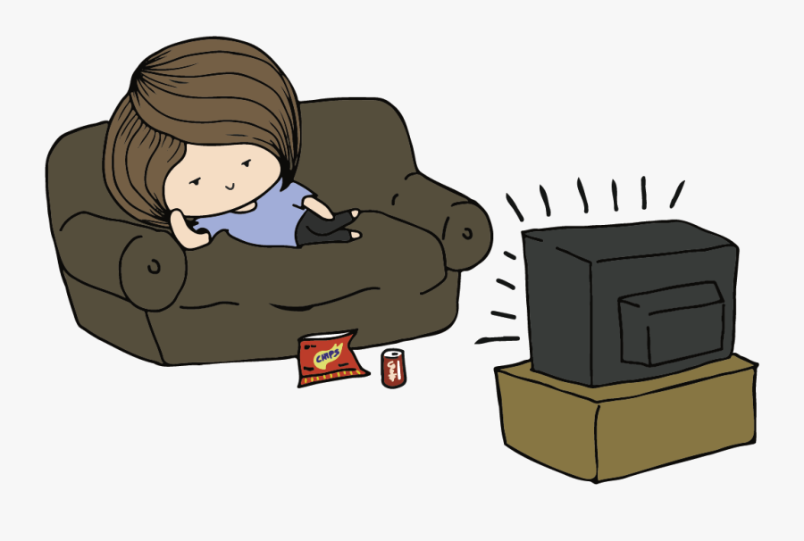
6. She watches cartoons.

Slide 7
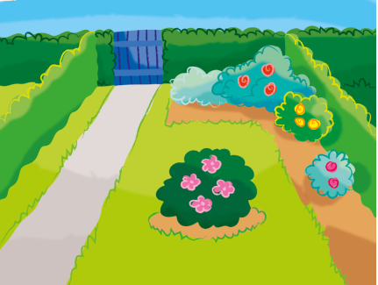
7. He runs in the garden.

Slide 8
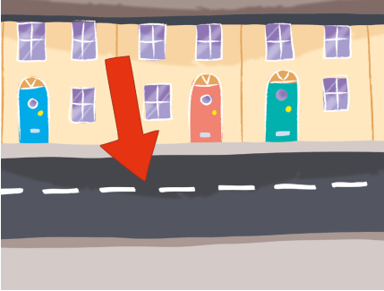
8. She lives on Green Street.

Slide 9
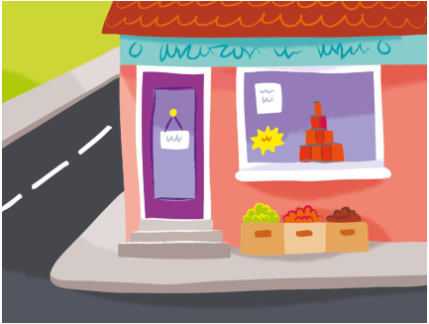
9. He works in the shop.

Slide 10
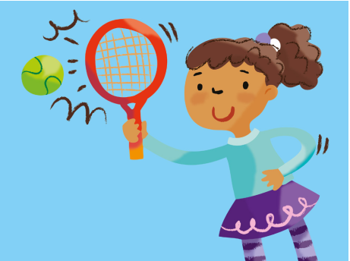
10. She plays tennis.

Slide 11
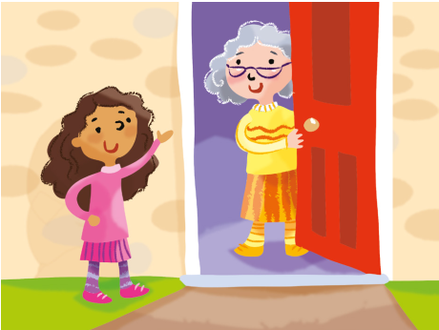
11. She visits his Grandma on Tuesday.

Slide 12

12. She starts school at 9 o’clock.

