Slide 1
Far-fetched or feasible

Slide 2
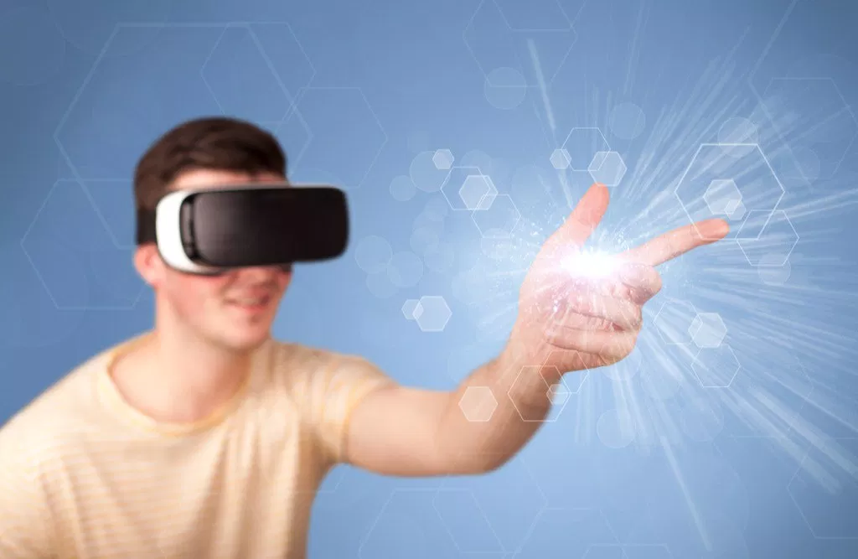
You'll communicate with dead relatives via virtual reality.

Slide 3
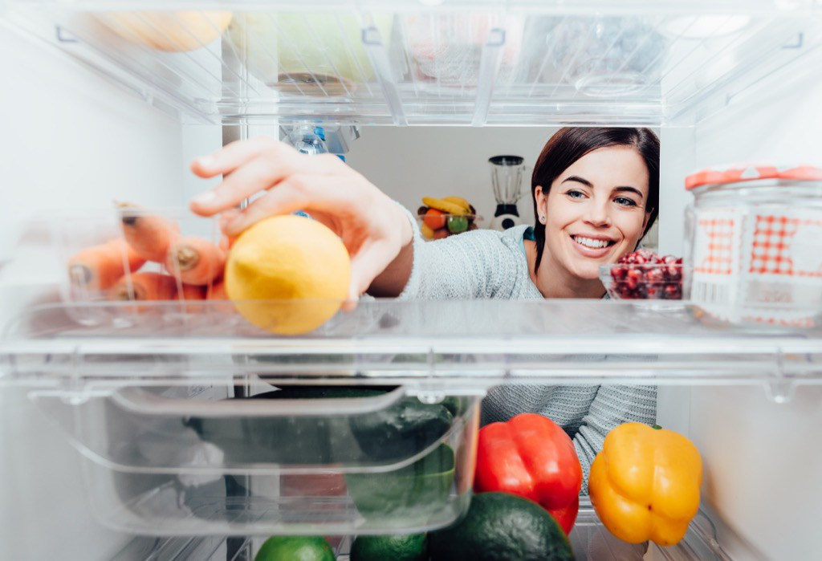
Your kitchen will restock itself.

Slide 4
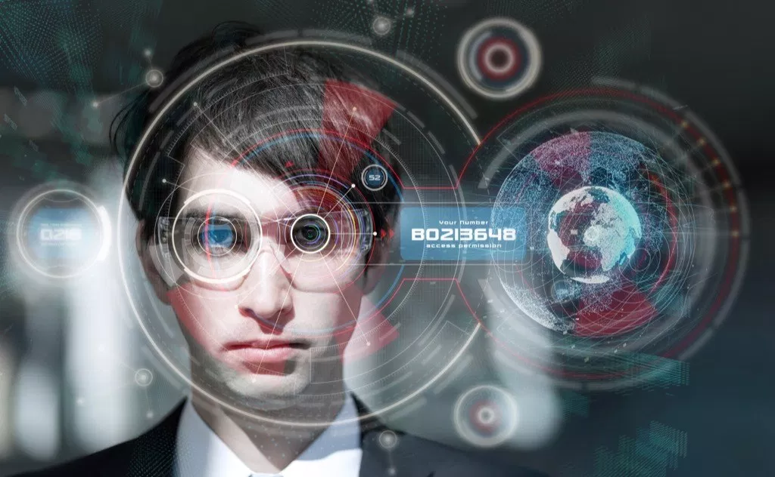
You'll check email with your contact lenses.

Slide 5

We'll be communicating with thoughts.

Slide 6
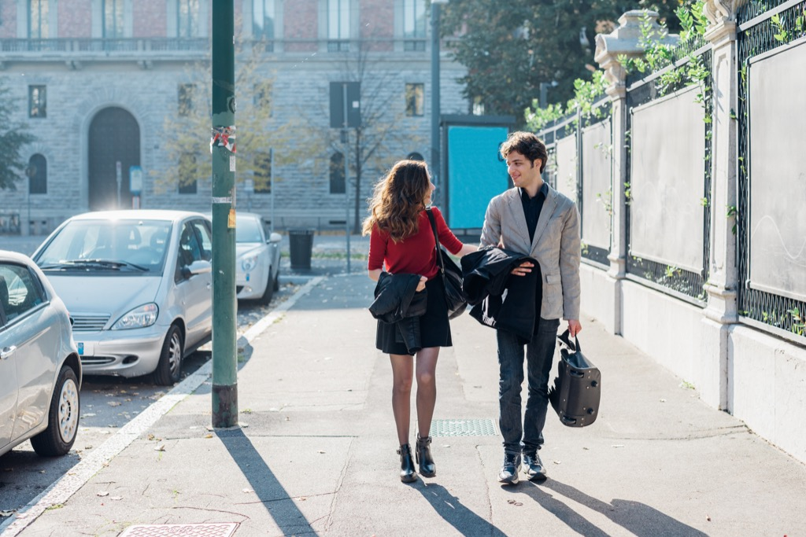
Your every move will be monitored by dust spies.

Slide 7
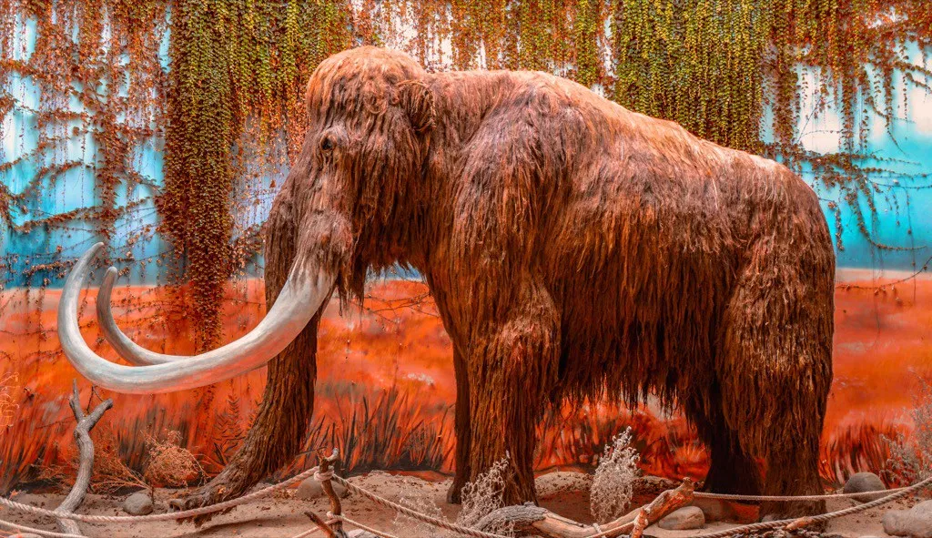
We'll have dinosaur zoos with real woolly mammoths.

Slide 8
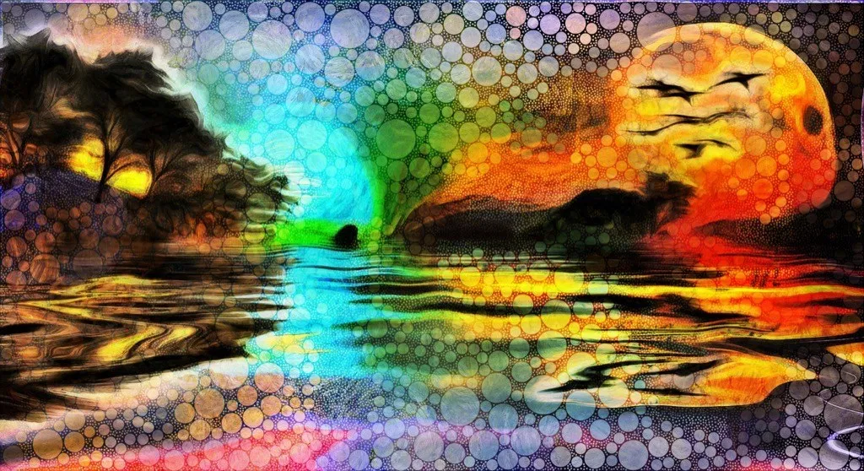
Artificial intelligence will replace artists.

Slide 9

Pills will be able to detect cancer.

Slide 10
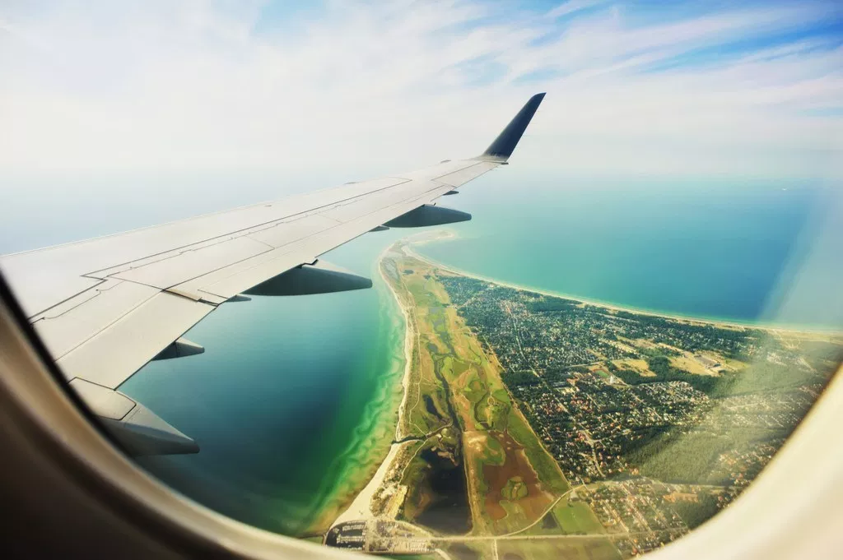
You'll fly in planes that are literally all window.

Slide 11
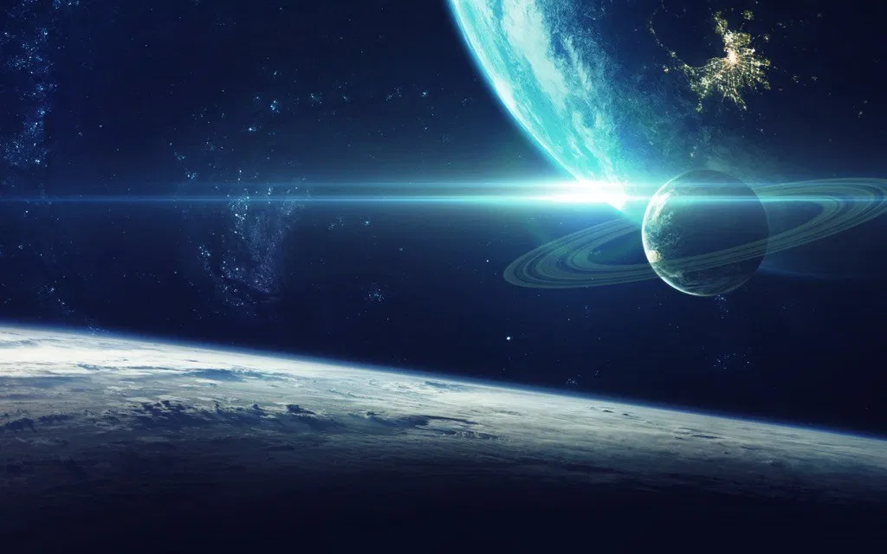
We'll have interplanetary Internet.

Slide 12
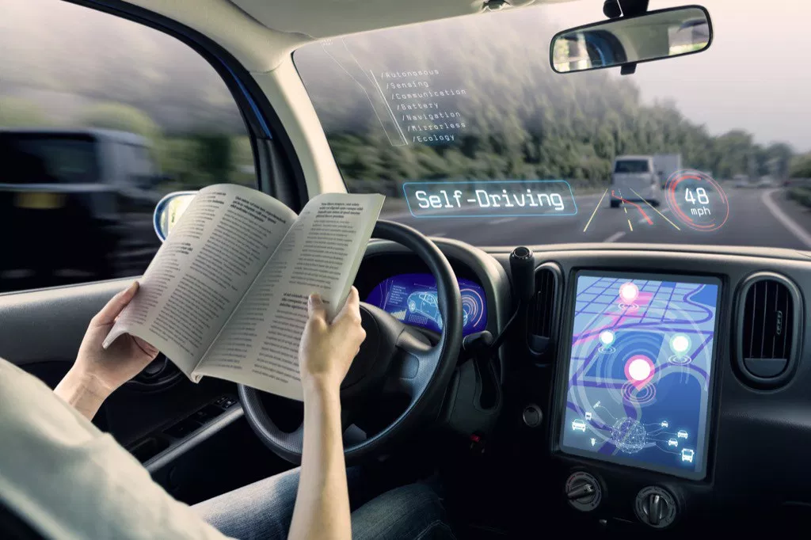
Driving yourself will be considered unsafe.

Slide 13
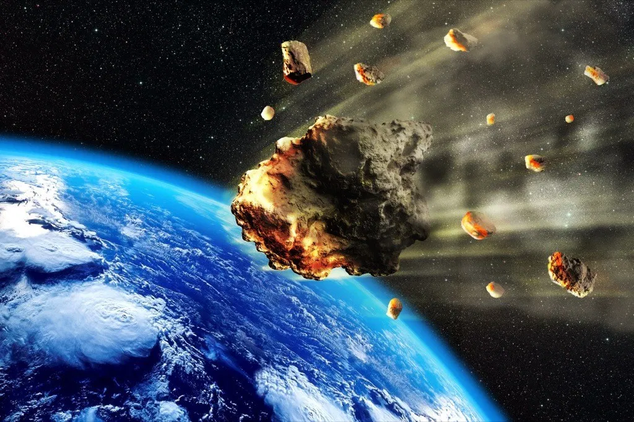
An asteroid "might" destroy us in 862 years.

Slide 14

You'll be able to smell your favorite TV shows.

