Slide 1


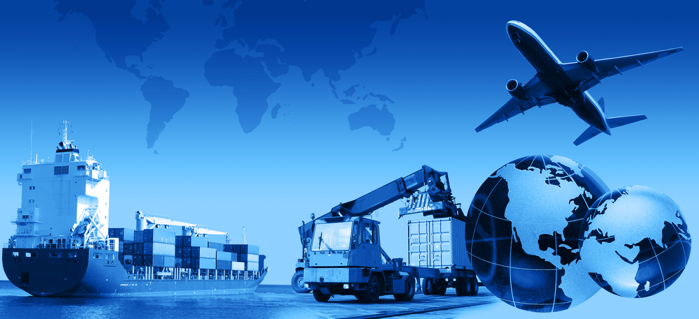
GUESS
THE
TRANSPORT
PLAY
BY HERBER

Slide 2
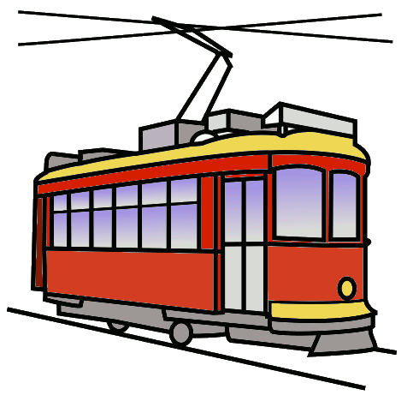


MEANS OF TRANSPORT
It‘s a …
train
tram
bus
What‘s this?
NEXT

Slide 3
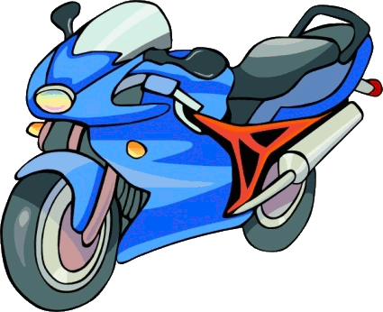
MEANS OF TRANSPORT
It‘s a …
bicycle
scooter
motorbike
What‘s this?
NEXT

Slide 4
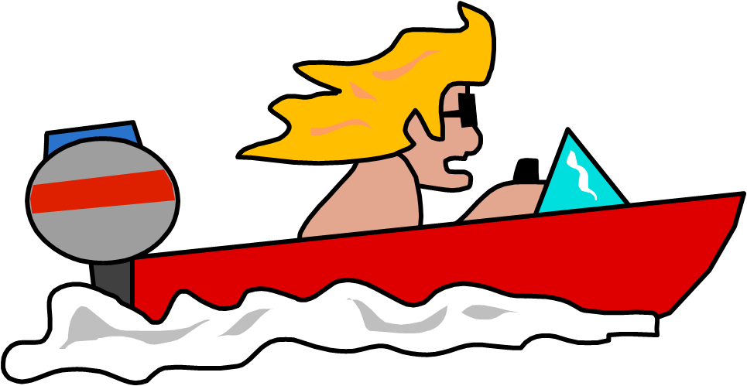
MEANS OF TRANSPORT
It‘s a …
motorboat
motorhome
motorbike
What‘s this?
NEXT

Slide 5
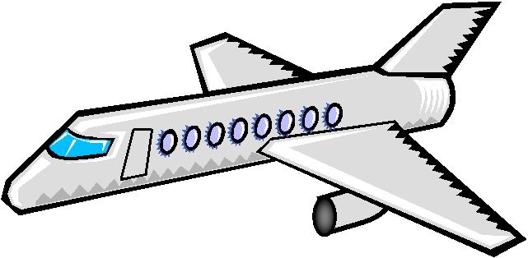
MEANS OF TRANSPORT
It‘s an …
rocket
spaceship
plane
What‘s this?
NEXT

Slide 6
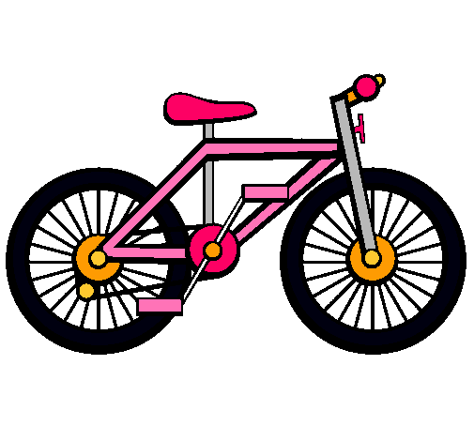
MEANS OF TRANSPORT
It‘s a …
motorbike
bike
scooter
What‘s this?
NEXT

Slide 7
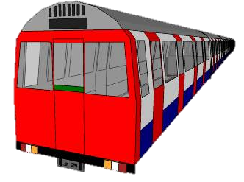
MEANS OF TRANSPORT
It‘s the …
tram
bus
underground
What‘s this?
NEXT

Slide 8
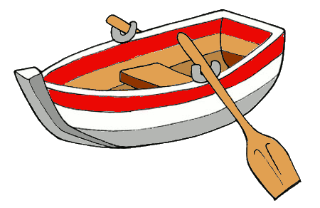
MEANS OF TRANSPORT
It‘s a …
sail boat
boat
rubber raft
What‘s this?
NEXT

Slide 9
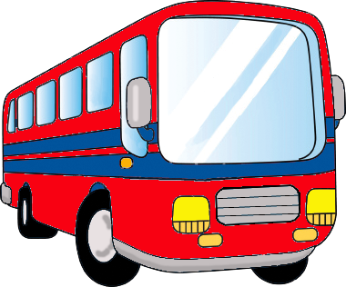
MEANS OF TRANSPORT
It‘s a …
tow truck
bus
van
What‘s this?
NEXT

Slide 10
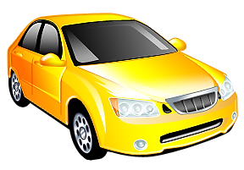
MEANS OF TRANSPORT
It‘s a …
truck
limousine
car
What‘s this?
EXIT

