Slide 1
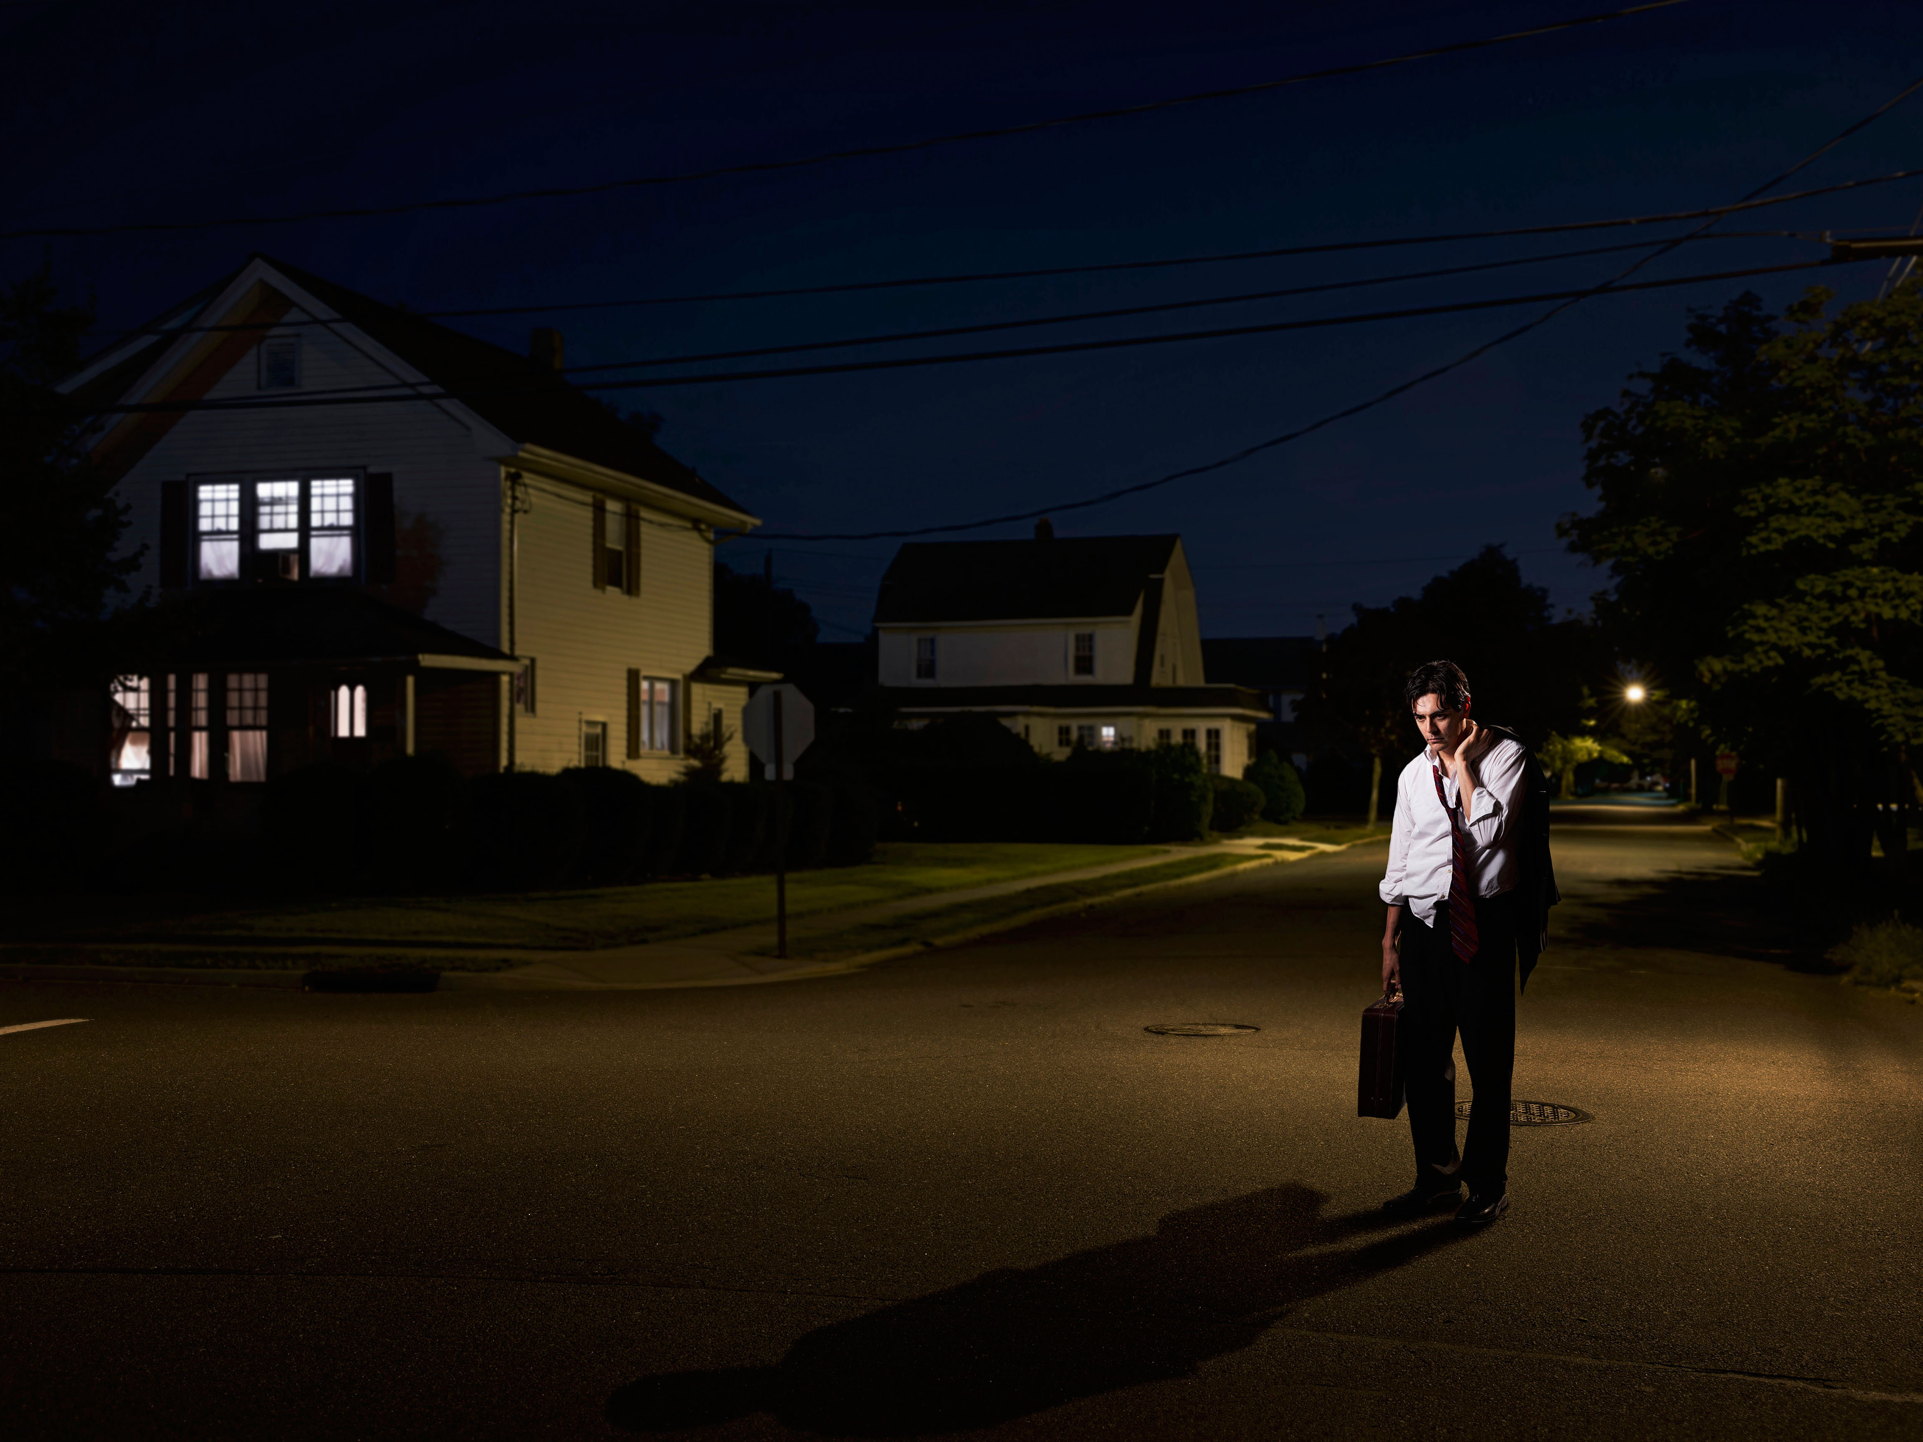

____Mike ____ ( come) home late yesterday?

Slide 2

____Mike ____ ( come) home late yesterday?

Slide 3

___ you ___ ( go) travelling around the world last year?

Slide 4

___ you ___ ( go) travelling around the world last year?

Slide 5
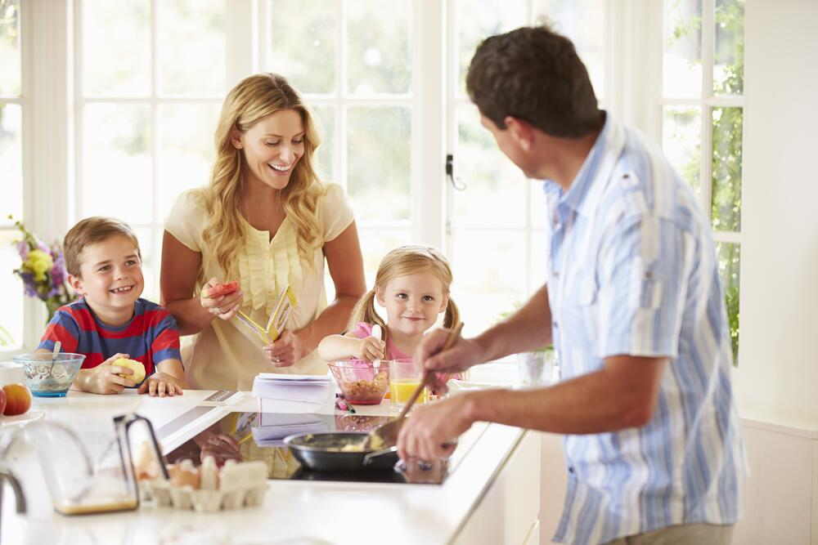

___ they ___ (have) breakfast at 8 yesterday?

Slide 6

___ they ___ (have) breakfast at 8 yesterday?

Slide 7
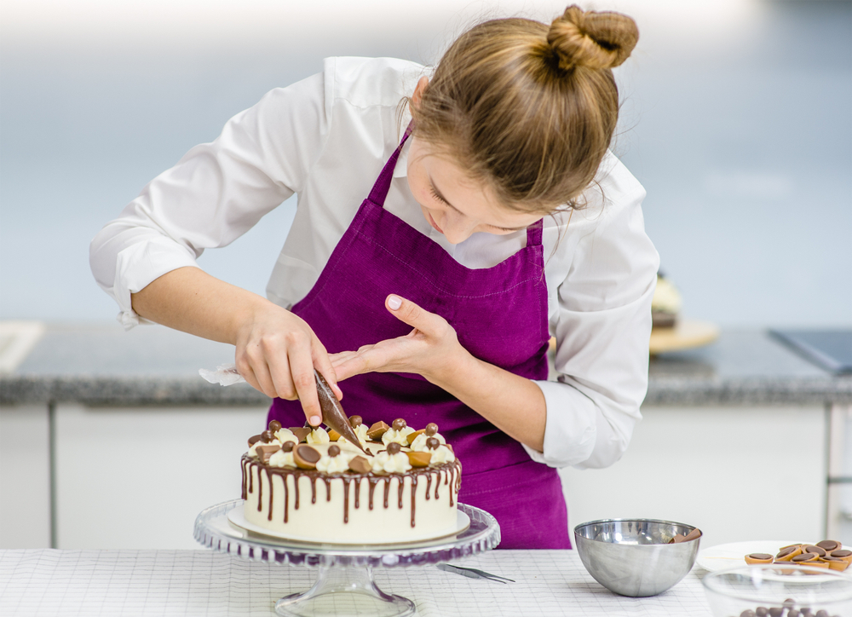

___Mum ___ (make) a cake for my birthday?

Slide 8

___Mum ___ (make) a cake for my birthday?

Slide 9
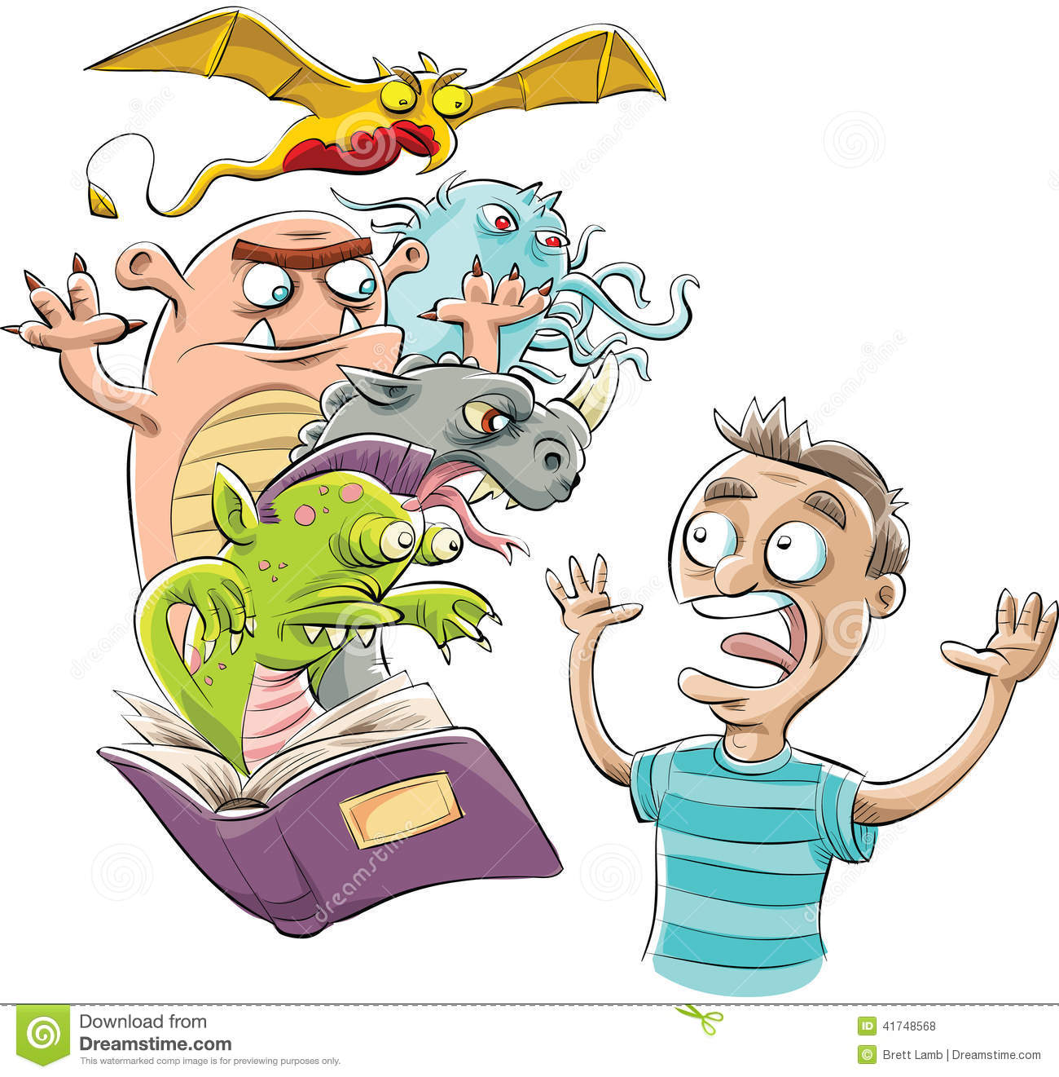

___Sam ___ (read) a horror story last night?

Slide 10

___Sam ___ (read) a horror story last night?

Slide 11
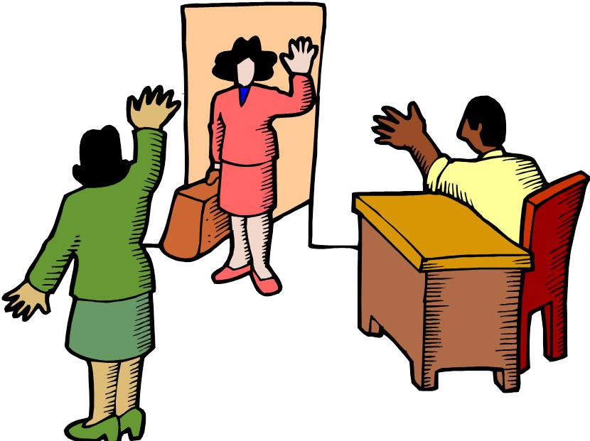

___Linda ___ (say) goodbye and __ (go) home?

Slide 12

___Linda ___ (say) goodbye and __ (go) home?

Slide 13
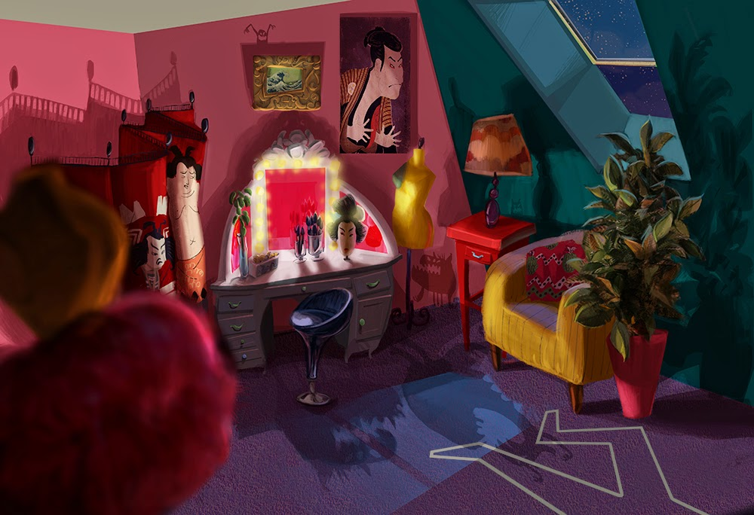

___ you ___ (see) a monster in my room last night?

Slide 14

___ you ___ (see) a monster in my room last night?

Slide 15
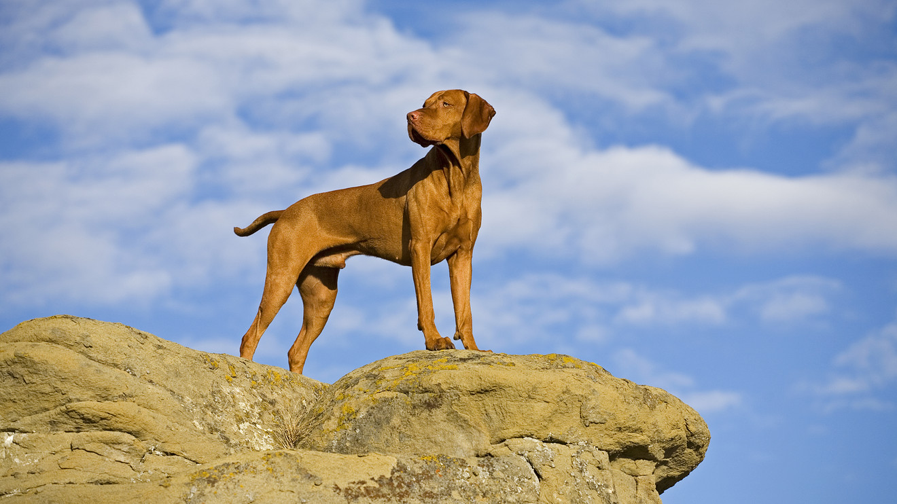

___ your dog ___ (stand) on the rock?

Slide 16

___ your dog ___ (stand) on the rock?

Slide 17
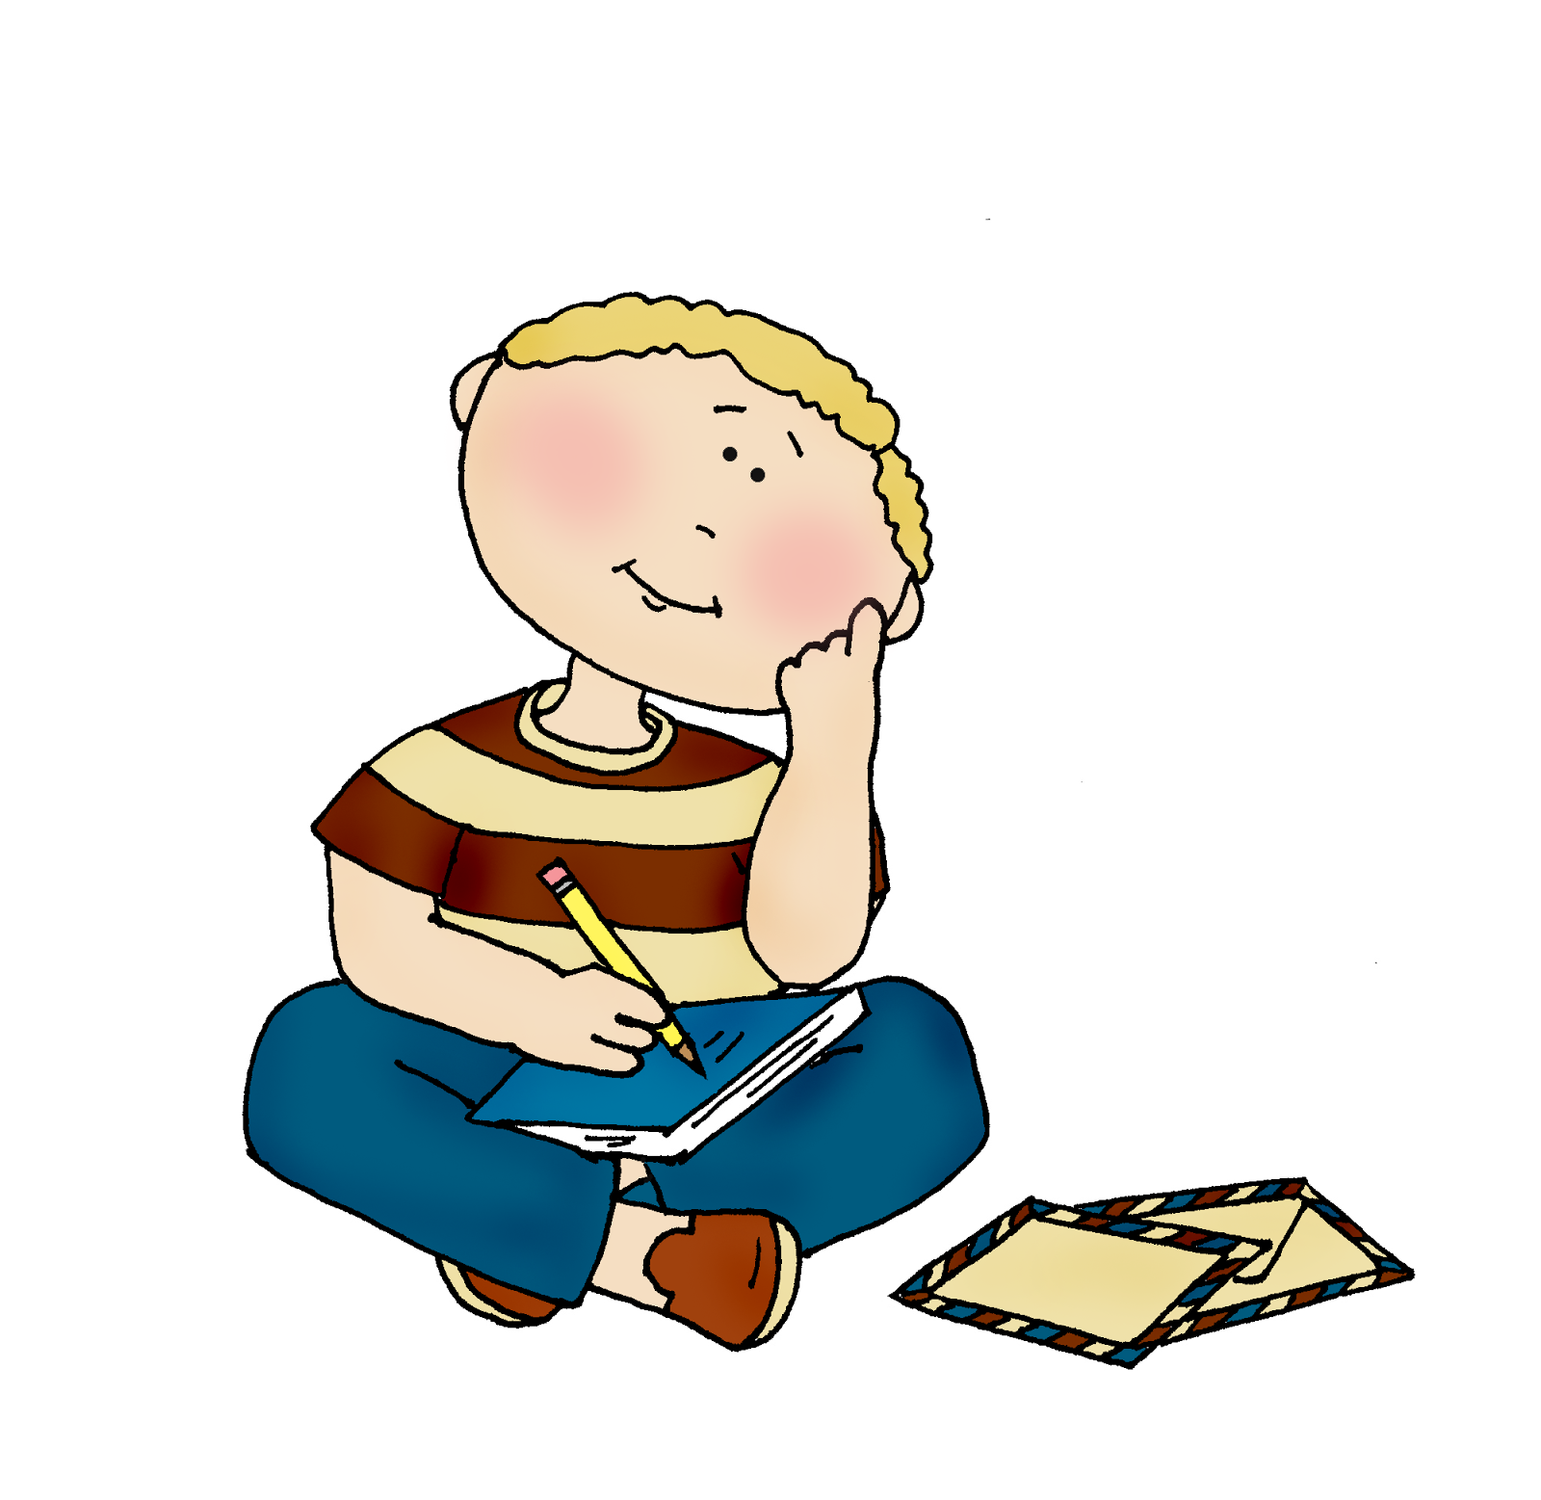

___ he ___ (think) about his friends?

Slide 18

___ he ___ (think) about his friends?

Slide 19
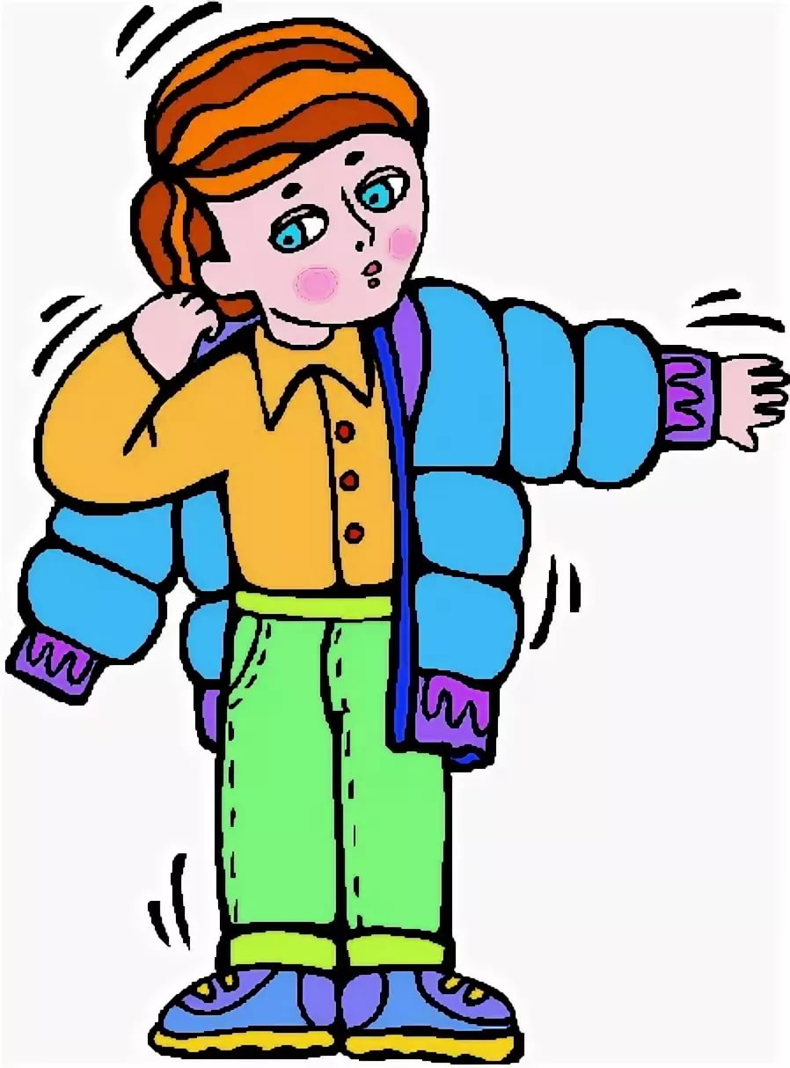

___ he ___ (wear) a coat because it was cold?

Slide 20

___ he ___ (wear) a coat because it was cold?

Slide 21
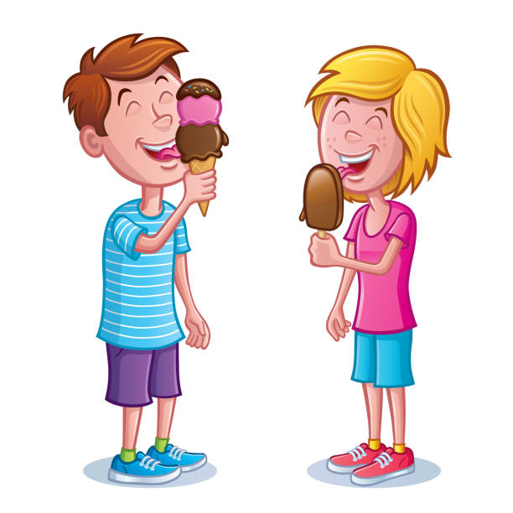

___ you ___ (eat) ice cream last weekend?

Slide 22

___ you ___ (eat) ice cream last weekend?

Slide 23


__ she ___ (drink) lemonade at the party?

Slide 24

__ she ___ (drink) lemonade at the party?

