Slide 1
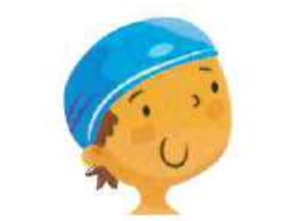
I don’t / doesn’t have to wear a swimming cap.

Slide 2
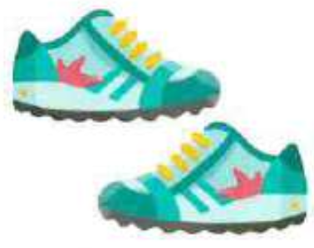
Bob don’t / doesn’t have to wear trainers.

Slide 3
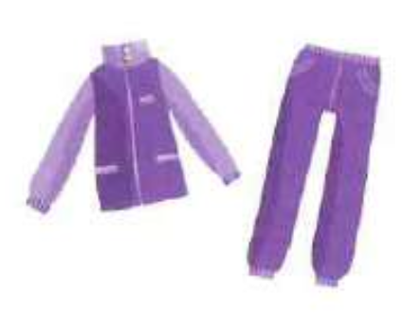
You don’t / doesn’t have to wear a tracksuit.

Slide 4
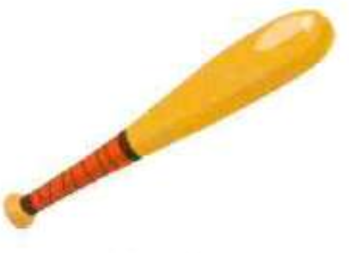
Mike don’t / doesn’t have to bring a bat.

Slide 5
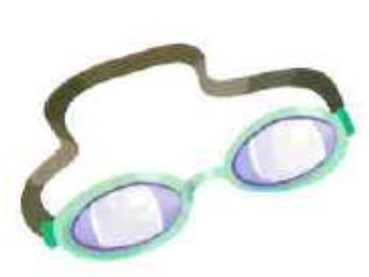
They don’t / doesn’t have to wear goggles.

Slide 6
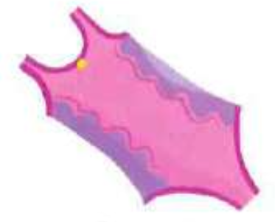
Lara don’t / doesn’t have to wear a swimming costume.

Slide 7
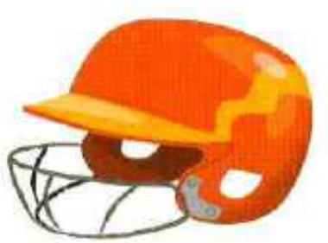
We don’t / doesn’t have to wear helmets.

Slide 8

You don’t / doesn’t have to bring a glove.

Slide 9
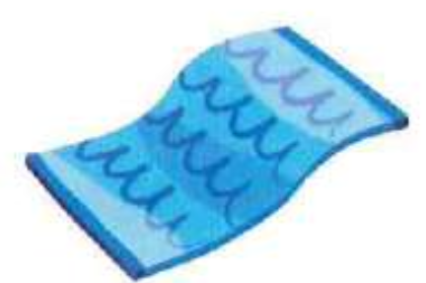
My sister don’t / doesn’t have to bring a towel.

Slide 10
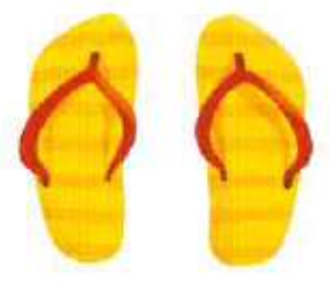
I don’t / doesn’t have to wear flip flops.

