Slide 1
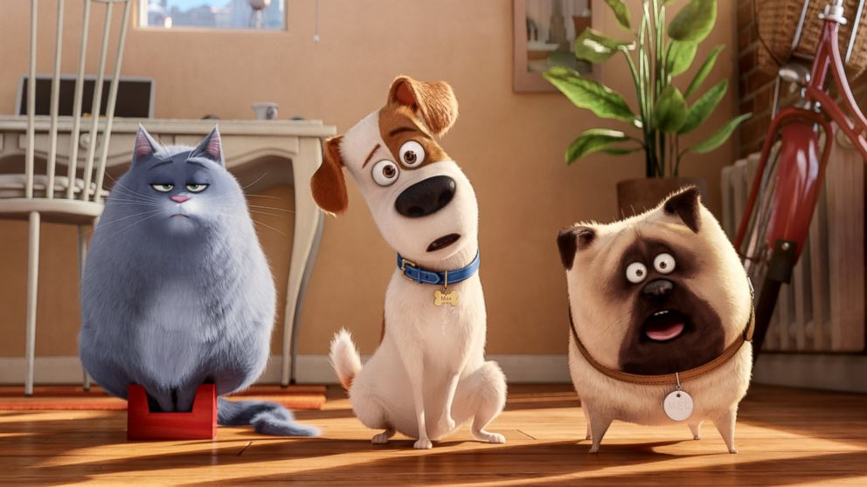
THE SECRET
LIFE OF
PeTs
Present
Continuous

Slide 2



she
you
I
he
it
we
they
am
is
are
V
ing
It is raining now.
Mushrooms can’t grow without rain.
It can’t rain without clouds.
All mushrooms consist of caps and stipes.
So don’t forget all these parts while using Present Continuous.

Slide 3
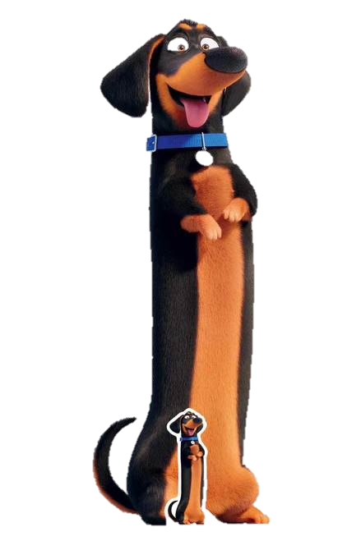
I am
He
She is
It playing
We
You are
They
Now
At the moment
This week

Slide 4
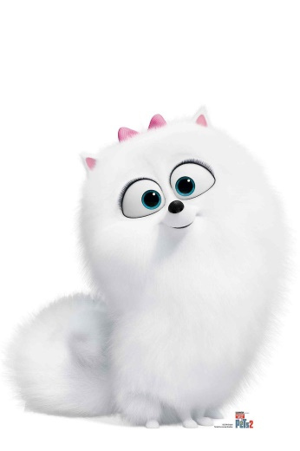
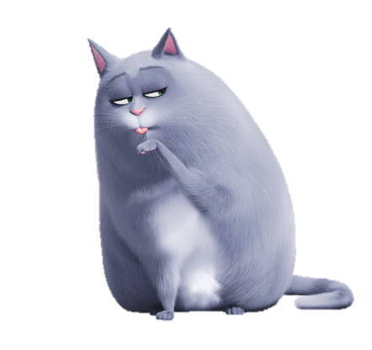
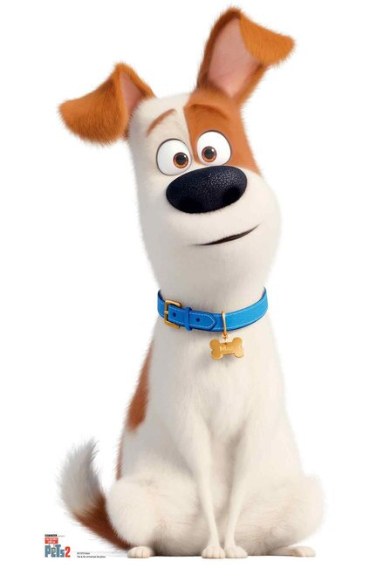
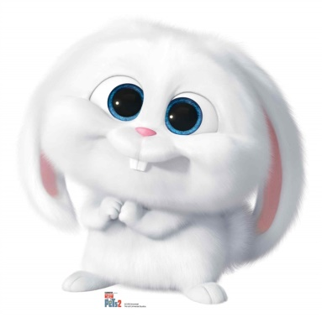
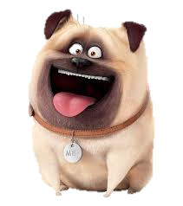
Gidget
Chloe
Max
Mel
Snowball
Meet the characters

Slide 5
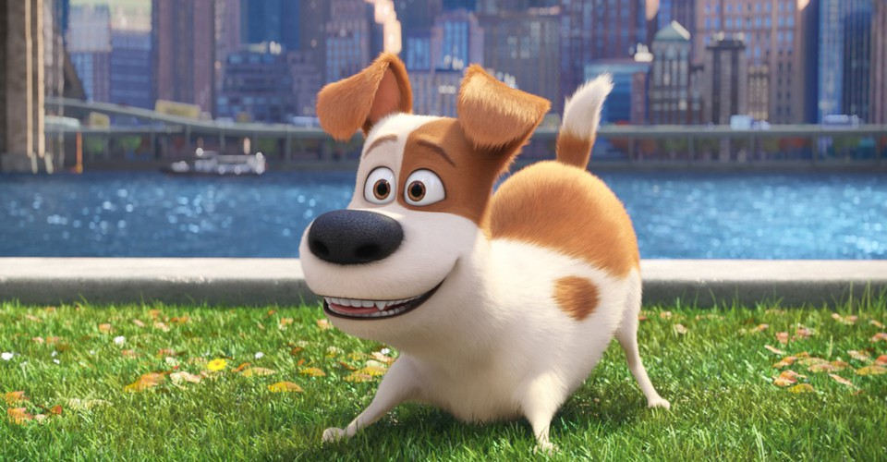
Max is smiling

Slide 6
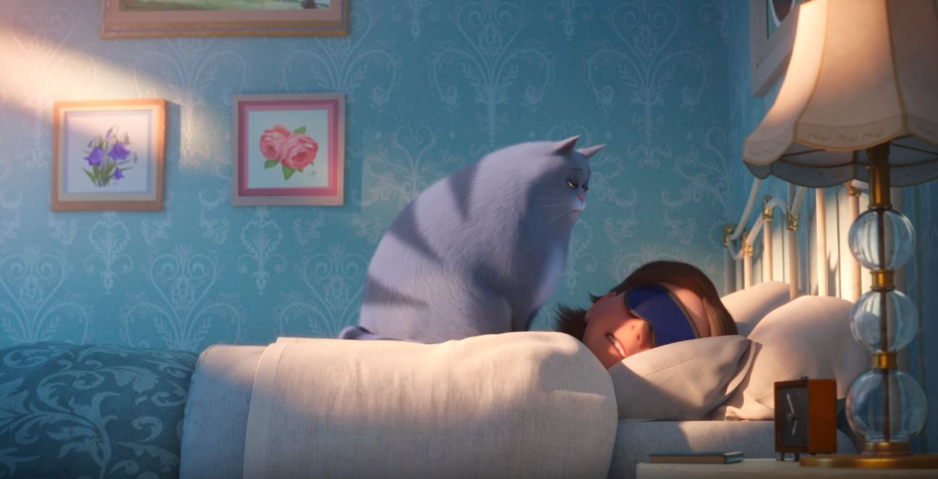
Chloe is sitting

Slide 7
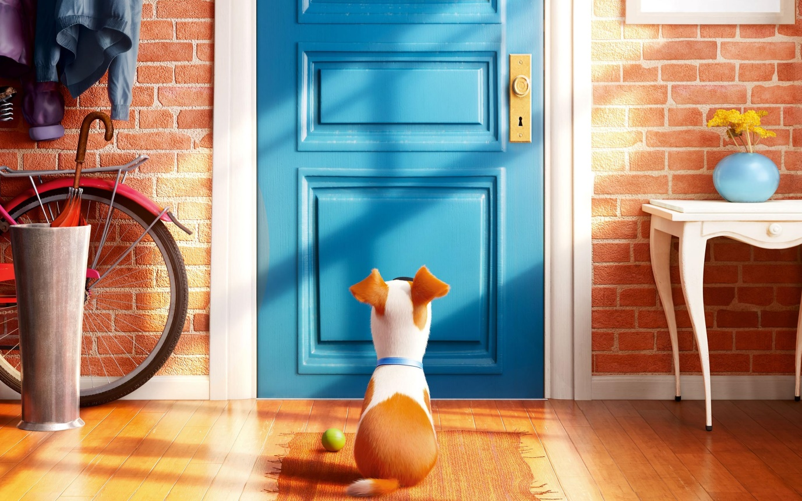
Max is waiting for Katie

Slide 8
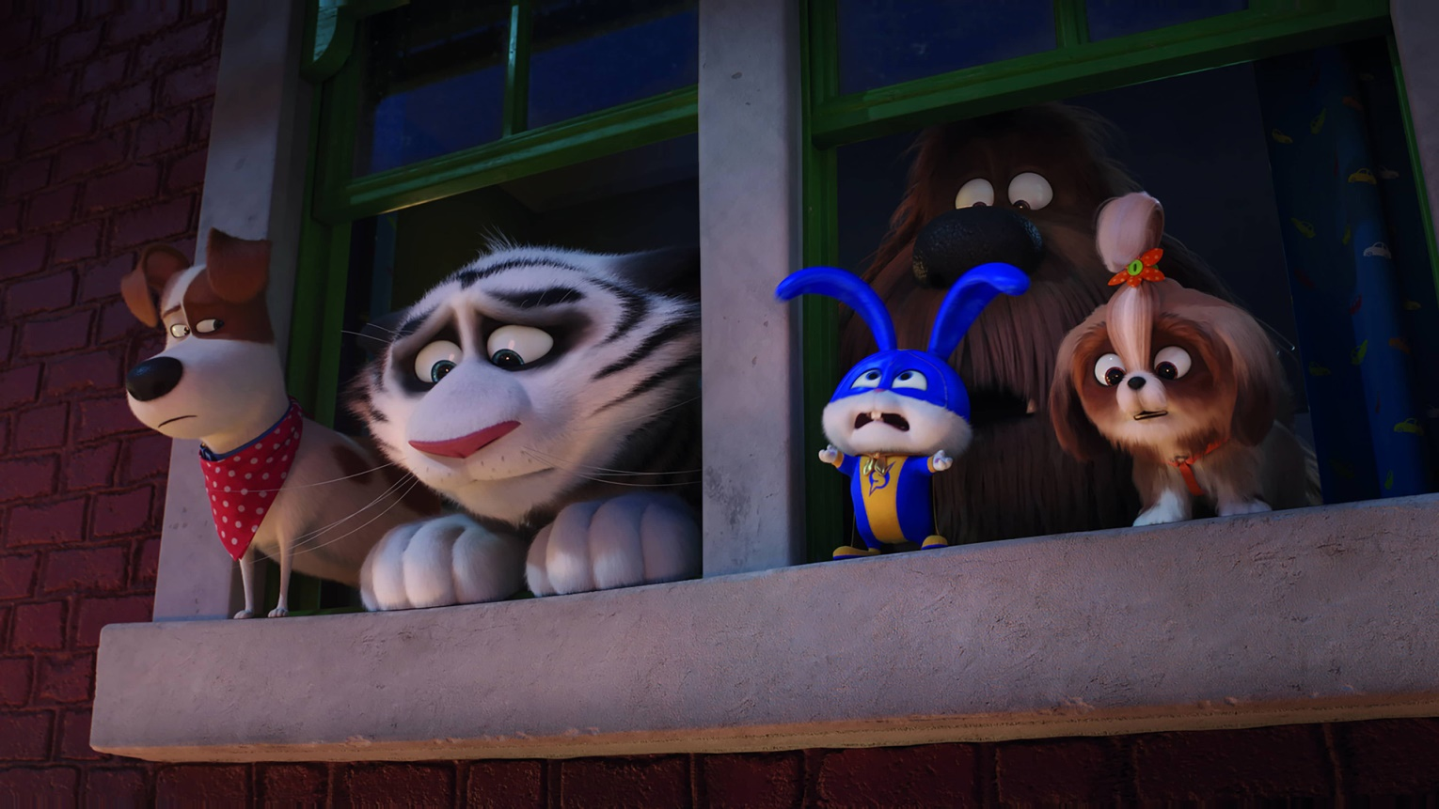
They are looking out of the window

Slide 9
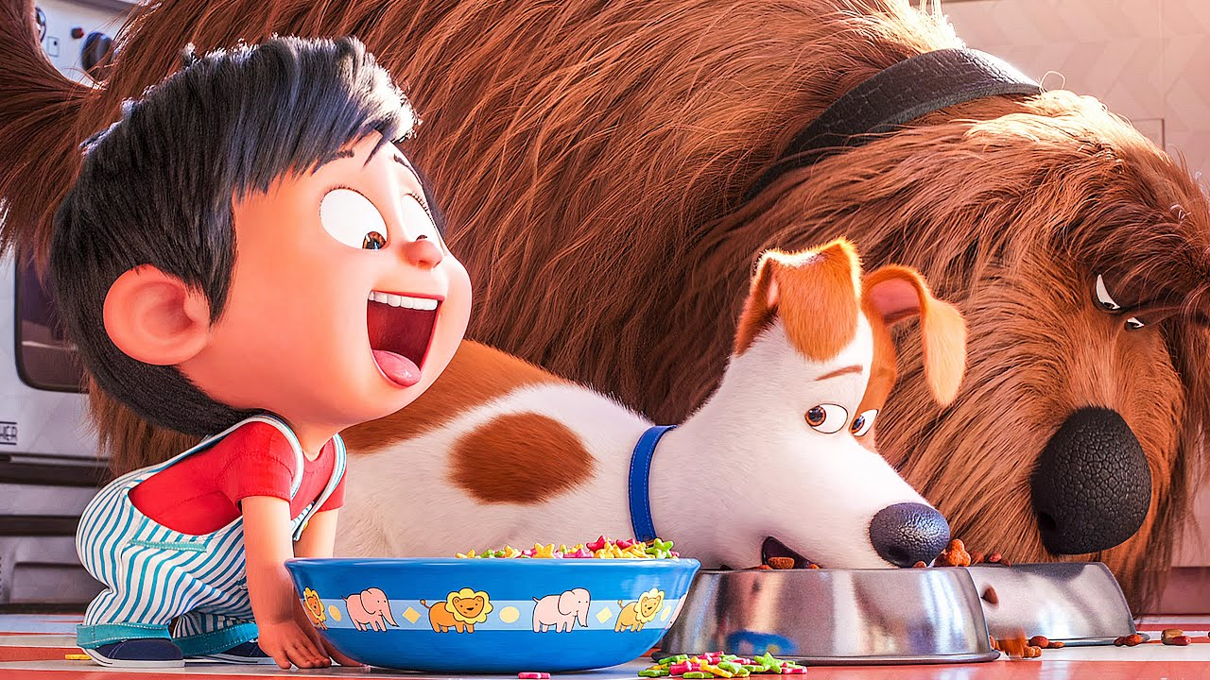
Look! I am eating!

Slide 10
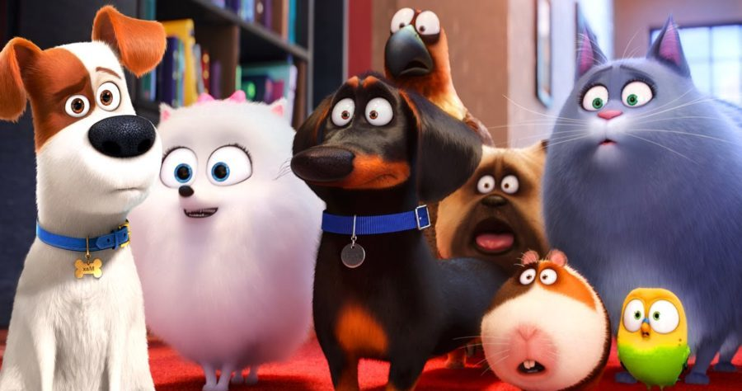
Test yourself!

Slide 11
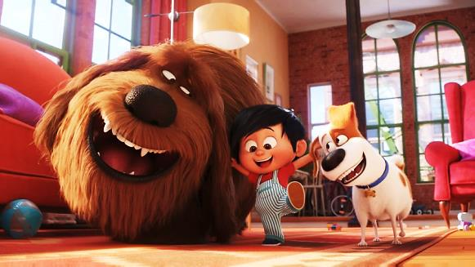
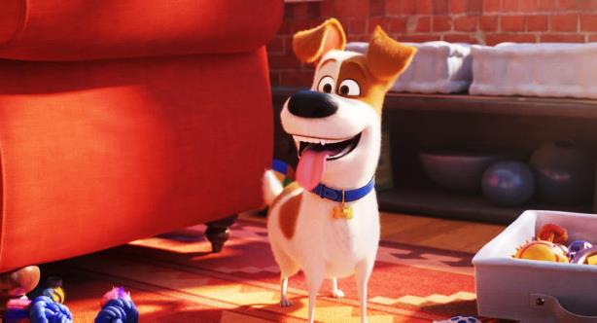
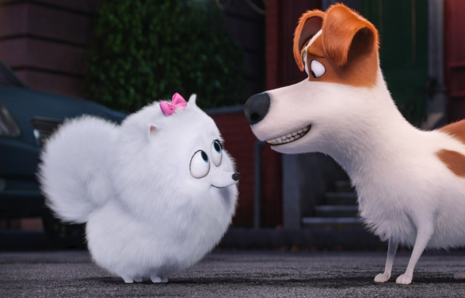
They ……………… having fun
am/is/are
Max ……………… playing
am/is/are
Hey! I ……………… listening to you
am/is/are

Slide 12
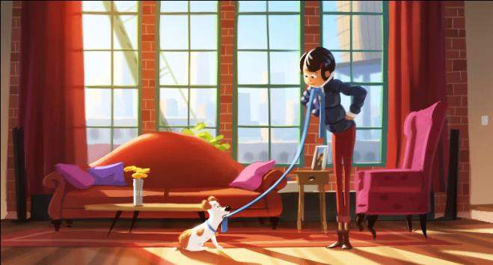
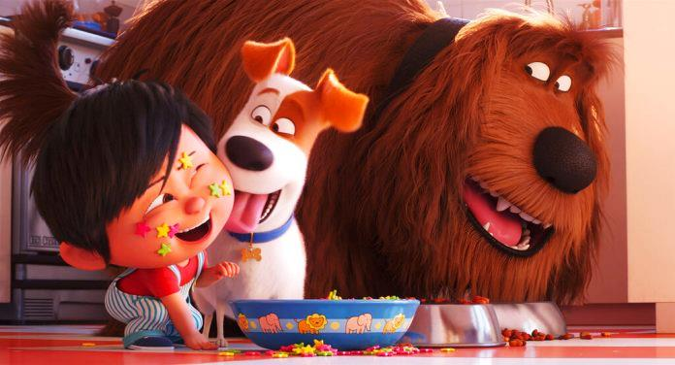
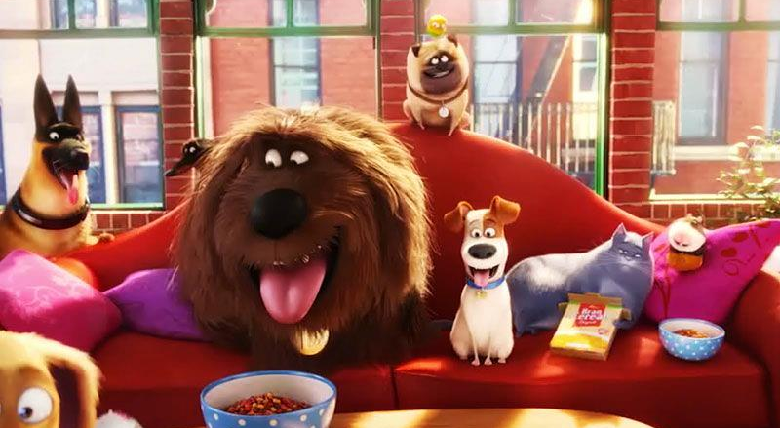
Katie ………….. …………………………. at Max.
look
Maх ………….. …………………………. Liam.
lick
They ………….. …………………………. on the sofa.
sit

