Slide 1

1. where / he / does / live / ?

Slide 2
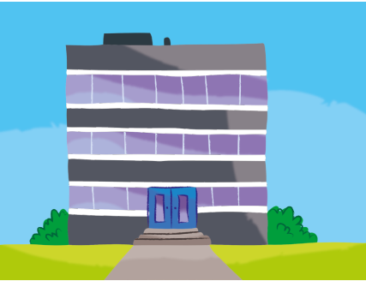
2. work / she / where / does / ?

Slide 3
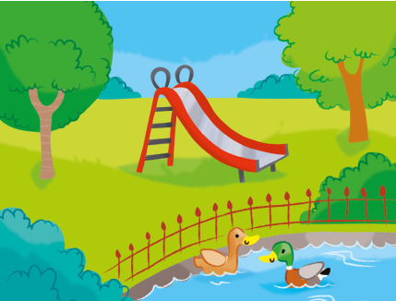
3. he / does / where / play / ?

Slide 4
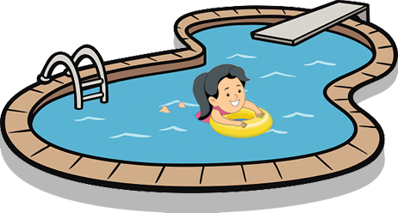
4. where / swim / she / does / ?

Slide 5

5. school / what / he / does / to / go / ?

Slide 6
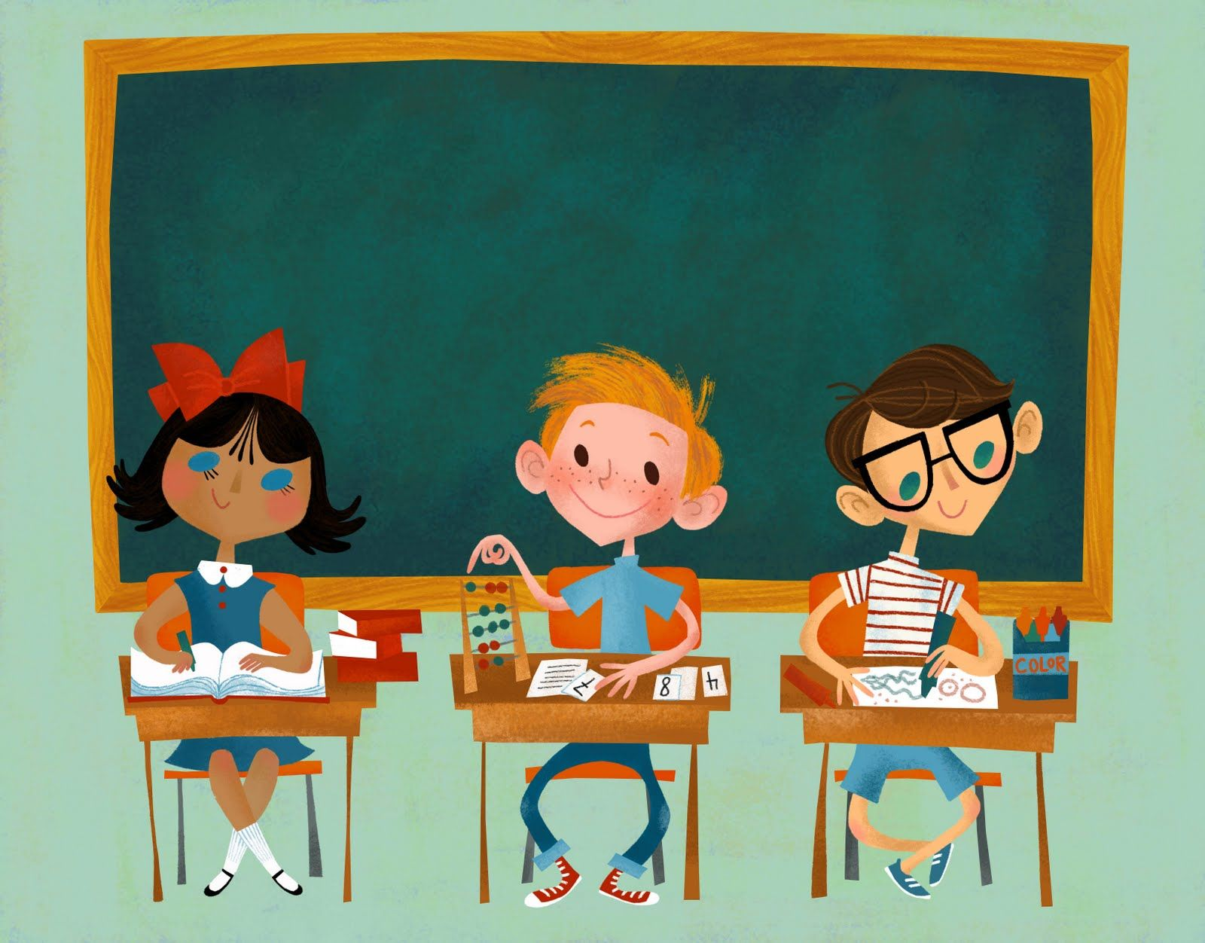
6. time / start / she / what / does / ?

Slide 7
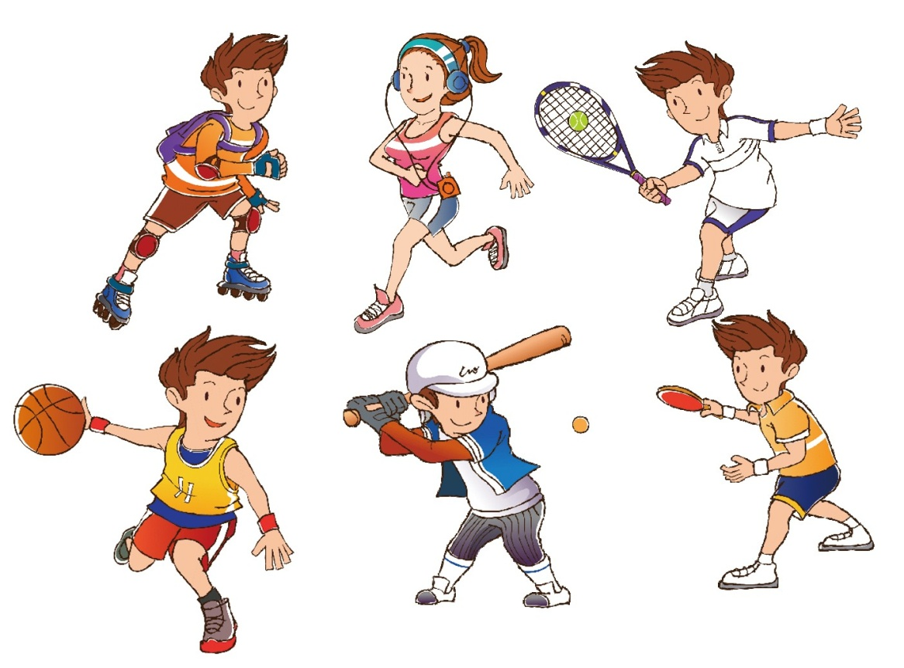
7. does / what / she / do / sport /?

