Slide 1

Days of the week
Months of the year
Ordinal numbers

Slide 2


What’s the date today?
1/20
Today is …
JANUARY
Monday, the first of January.
1
MONDAY
CHECK

Slide 3
What’s the date today?
2/20
Today is …
JANUARY
Sunday, the twentieth of January.
20
SUNDAY
CHECK

Slide 4
What’s the date today?
3/20
Today is …
FEBRUARY
2
Tuesday, the second of February.
TUESDAY
CHECK

Slide 5

What’s the date today?
4/20
Today is …
FEBRUARY
Monday, the fourteenth
of February.
14
MONDAY
CHECK
Saint Valentine’s Day

Slide 6
What’s the date today?
5/20
Today is …
MARCH
3
Wednesday, the third of March.
WEDNESDAY
CHECK

Slide 7
What’s the date today?
6/20
Today is …
MARCH
Tuesday, the twenty-fifth of March.
25
TUESDAY
CHECK

Slide 8
What’s the date today?
7/20
Today is …
APRIL
12
Thursday, the twelfth of April.
THURSDAY
CHECK

Slide 9
What’s the date today?
8/20
Today is …
MAY
5
Friday, the fifth of May.
FRIDAY
CHECK

Slide 10
What’s the date today?
9/20
Today is …
MAY
30
Sunday, the thirtieth of May.
SUNDAY
CHECK

Slide 11

What’s the date today?
10/20
Today is …
JULY
4
Friday, the fourth of July.
FRIDAY
CHECK
Independence Day

Slide 12
What’s the date today?
11/20
Today is …
JUNE
6
Saturday, the sixth of June.
SATURDAY
CHECK

Slide 13
What’s the date today?
12/20
Today is …
JUNE
Sunday, the thirteenth of June.
13
SUNDAY
CHECK

Slide 14

What’s the date today?
13/20
Today is …
JULY
7
Wednesday, the seventh of July.
WEDNESDAY
CHECK

Slide 15
What’s the date today?
14/20
Today is …
AUGUST
8
Monday, the eighth of August.
MONDAY
CHECK

Slide 16
What’s the date today?
15/20
Today is …
SEPTEMBER
Thursday, the nineth of September.
9
THURSDAY
CHECK

Slide 17
What’s the date today?
16/20
Today is …
OCTOBER
10
Friday, the tenth of October.
FRIDAY
CHECK

Slide 18

What’s the date today?
17/20
Today is …
OCTOBER
Saturday, the thirty-first of October.
31
SATURDAY
CHECK
Halloween

Slide 19
What’s the date today?
18/20
Today is …
NOVEMBER
Saturday, the eleventh of November.
11
SATURDAY
CHECK

Slide 20
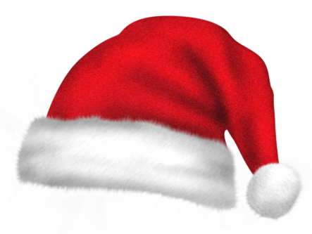
What’s the date today?
19/20
Today is …
DECEMBER
Wednesday, the twenty-fifth of December.
25
WEDNESDAY
CHECK
Christmas Day

Slide 21

What’s the date today?
20/20
Today is …
DECEMBER
Friday, the thirty-first of December.
31
FRIDAY
CHECK
New Year’s Eve
EXIT

