Slide 1
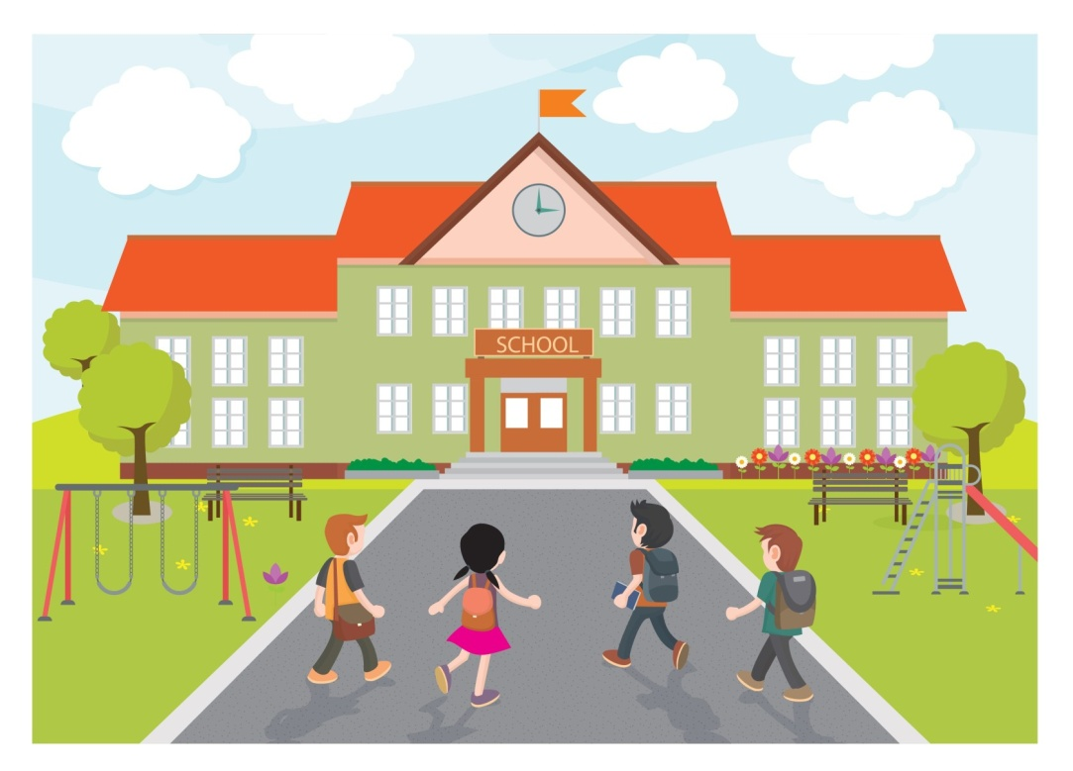
I / go to school. (+)

Slide 2
I / go to school (-)

Slide 3
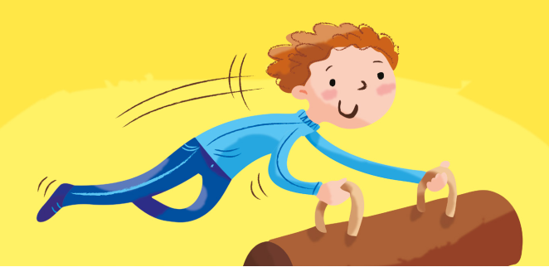
I / do gymnastics. (+)

Slide 4
I / do gymnastics. (-)

Slide 5
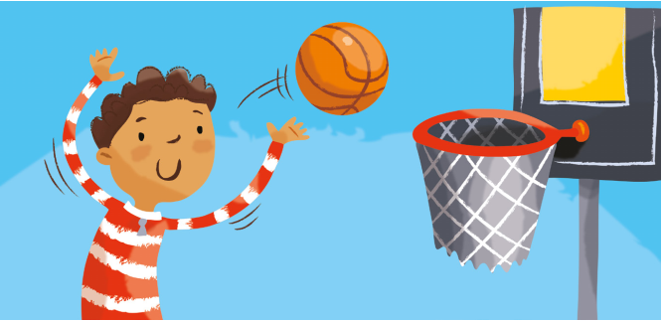
I / play basketball. (+)

Slide 6
I /play basketball (-)

Slide 7
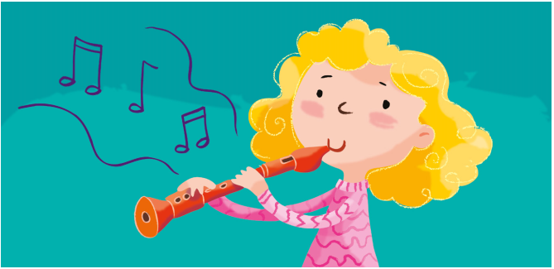
I / have a music lesson (+)

Slide 8
I / have a music lesson (-)

Slide 9
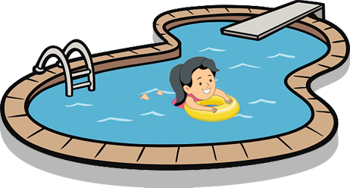
I / swim in the pool (+)

Slide 10
I / swim in the pool (-)

Slide 11
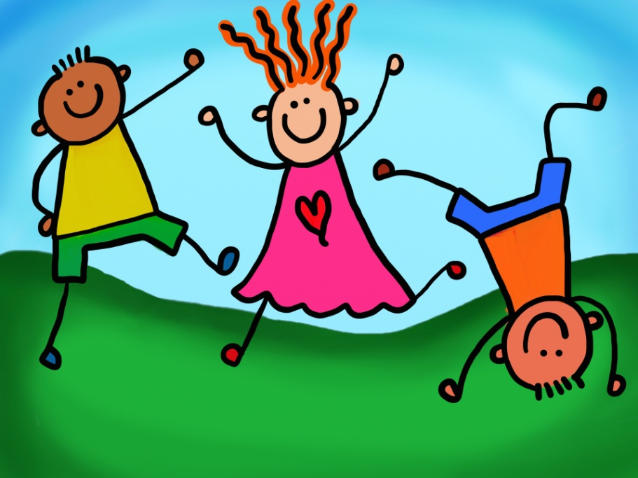
I / have a great day (+)

Slide 12
I / have a great day (-)

Slide 13
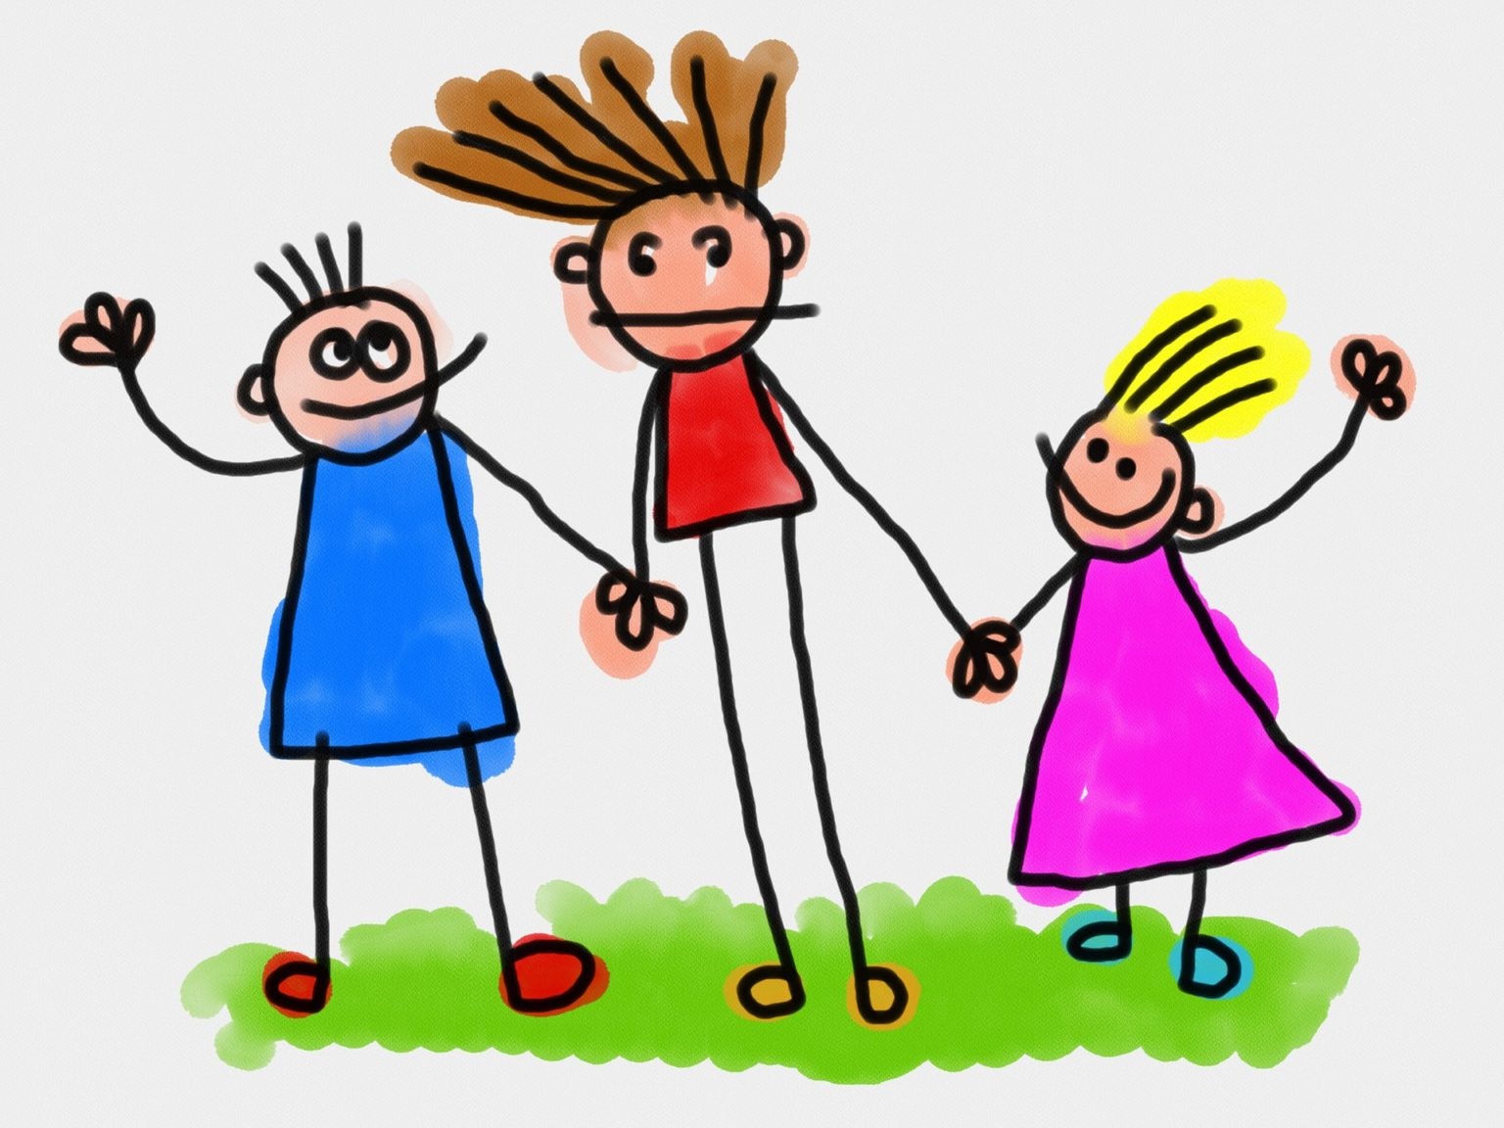
I /go out with my friends (+)

Slide 14
I /go out with my friends (-)

Slide 15
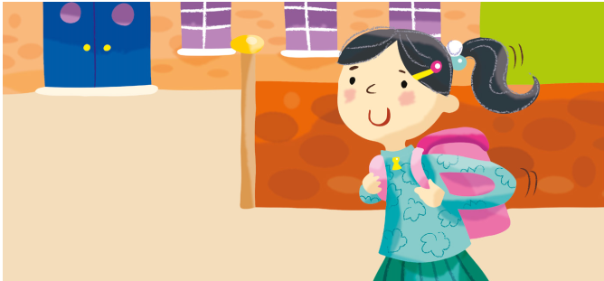
We / go to school. (+)

Slide 16
We / go to school (-)

Slide 17
We / do gymnastics. (+)

Slide 18
We / do gymnastics. (-)

Slide 19
We / play basketball. (+)

Slide 20
We /play basketball (-)

Slide 21
We / have a music lesson (+)

Slide 22
We / have a music lesson (-)

Slide 23
We / swim in the pool (+)

Slide 24
We / swim in the pool (-)

Slide 25
We / have a great day (+)

Slide 26
We / have a great day (-)

Slide 27
We /go out with our friends (+)

Slide 28
We /go out with our friends (-)

Slide 29
They / go to school. (+)

Slide 30
They / go to school (-)

Slide 31
They / do gymnastics. (+)

Slide 32
They / do gymnastics. (-)

Slide 33
They / play basketball. (+)

Slide 34
They /play basketball (-)

Slide 35
They / have a music lesson (+)

Slide 36
They / have a music lesson (-)

Slide 37
They / swim in the pool (+)

Slide 38
They / swim in the pool (-)

Slide 39
They / have a great day (+)

Slide 40
They / have a great day (-)

Slide 41
They /go out with their friends (+)

Slide 42
They /go out with their friends (-)

Slide 43
You / go to school. (+)

Slide 44
You / go to school (-)

Slide 45
You / do gymnastics. (+)

Slide 46
You / do gymnastics. (-)

Slide 47
You / play basketball. (+)

Slide 48
You /play basketball (-)

Slide 49
You / have a music lesson (+)

Slide 50
You / have a music lesson (-)

Slide 51
You / swim in the pool (+)

Slide 52
You / swim in the pool (-)

Slide 53
You / have a great day (+)

Slide 54
You / have a great day (-)

Slide 55
You /go out with your friends (+)

Slide 56
You /go out with your friends (-)

