Slide 1
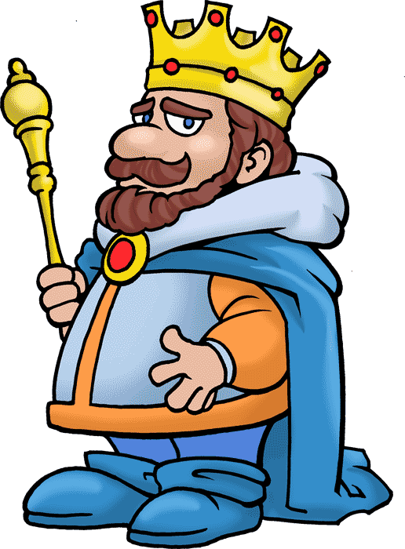

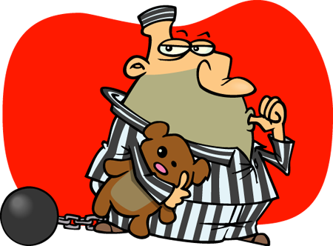
PAST SIMPLE
The life of a prisoner and king talking about past routines

Slide 2
Click the pictures to check your sentences.
FRANK
SEBASTIAN
not be a very happy prisoner
Frank wasn’t a very happy prisoner.
be a very happy king
Sebastian was a very happy king.

Slide 3
Click the pictures to check your sentences.
FRANK
SEBASTIAN
always wake up at 6 o’clock
Frank always woke up at 6 o’clock.
never wake up early
Sebastian never woke up early.

Slide 4
Click the pictures to check your sentences.
FRANK
SEBASTIAN
not have a big breakfast
Frank didn’t have a big breakfast.
always have breakfast in bed
Sebastian always had breakfast in bed.

Slide 5
Click the pictures to check your sentences.
FRANK
SEBASTIAN
only eat a bowl of porridge
Frank only ate a bowl of porridge.
not get out of bed before 11 o’clock
Sebastian didn’t get out of bed
before 11 o’clock.

Slide 6
Click the pictures to check your sentences.
FRANK
SEBASTIAN
wash the dishes
Frank washed the dishes.
listen to his ministers before lunch
Sebastian listened to his ministers before lunch.

Slide 7
Click the pictures to check your sentences.
FRANK
SEBASTIAN
clean the showers
Frank cleaned the showers.
eat lunch with his secretary
Sebastian ate lunch with his secretary .

Slide 8
Click the pictures to check your sentences.
FRANK
SEBASTIAN
have lunch with the prison gang
Frank had lunch with the prison gang.
sleep for an hour in the afternoon
Sebastian slept for an hour in the afternoon.

Slide 9
Click the pictures to check your sentences.
FRANK
SEBASTIAN
work in the laundry
Frank worked in the laundry.
play chess with his queen
Sebastian played chess with his queen.

Slide 10
Click the pictures to check your sentences.
FRANK
SEBASTIAN
meet his wife during visiting hours
Frank met his wife during visiting hours.
not visit his brother in prison
Sebastian didn’t visit his brother in prison.

Slide 11
Click the pictures to check your sentences.
FRANK
SEBASTIAN
not watch TV in the evening
Frank didn’t watch TV in the evening.
sometimes invite friends for a party
Sometimes Sebastian invited friends for a party.

Slide 12
Click the pictures to check your sentences.
FRANK
SEBASTIAN
make his bed
Frank made his bed.
not drive his friends home
Sebastian didn’t drive his friends home.

Slide 13

Click the pictures to check your sentences.
FRANK
SEBASTIAN
go to bed at 9 o’clock
Frank went to bed at 9 o’clock.
take a hot bath before going to bed
Sebastian took a hot bath before going to bed.

