Slide 1

I’d like _____ beans.

Slide 2
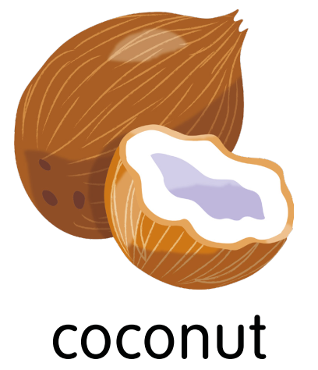
I’d _____ a coconut.

Slide 3

I’__ like some grapes.

Slide 4

___ ’d like a lemon.

Slide 5
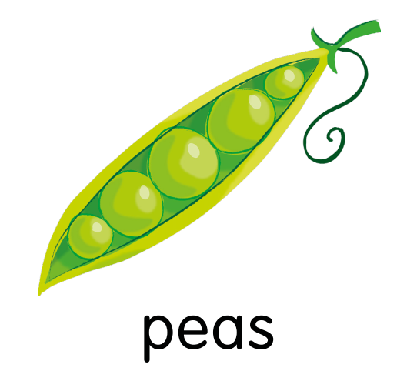
_____ you like some peas.
Yes, please.

Slide 6

Would ____ like a pepper?
No, thank you.

Slide 7
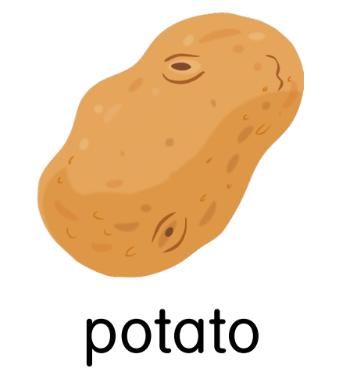
Would you ____ a potato?
Yes, please.

Slide 8

Would you like ___ watermelon?
No, thank you.

Slide 9

Would you like a strawberry?
Yes, _______.

Slide 10
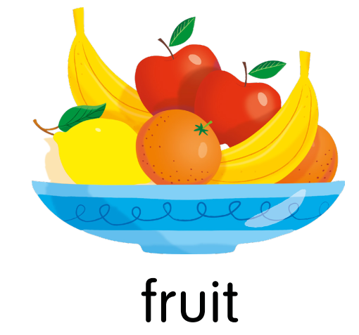
Would you like some fruit?
No, thank ____.

Slide 11

Would you like some vegetables?
____, please.

Slide 12

Would you like an apple?
No, _____ you.

Slide 13
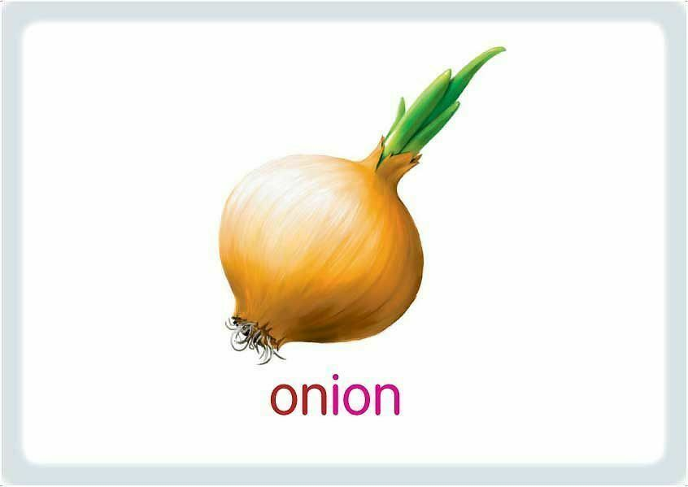
Would you like an onion?
____, thank you.

Slide 14
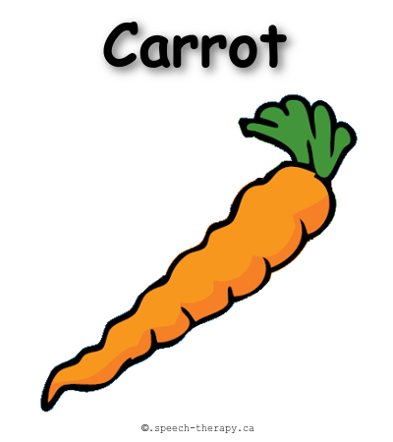
Would you like a _______?
Yes, please.

