Slide 1
Present Simple
Let’s correct the mistakes!

Slide 2
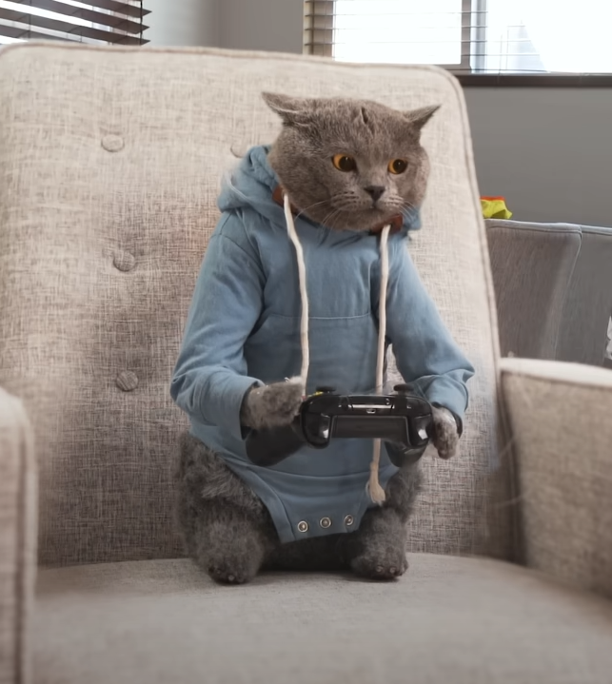
Michael usually plays football in the morning.
Make the sentences negative
Michael doesn’t play football.
He plays computer games in the morning.

Slide 3
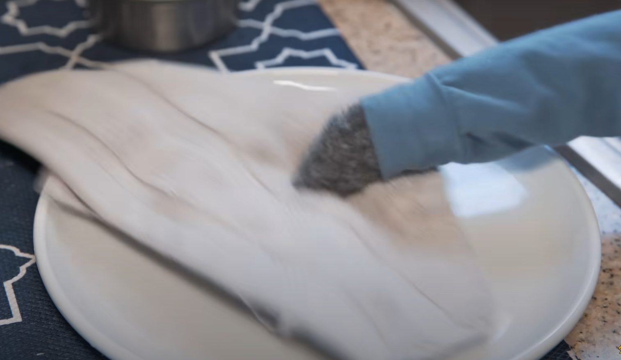
Michael dusts after dinner.
Make the sentences negative
Michael doesn’t dust after dinner.
He washes up after dinner.

Slide 4
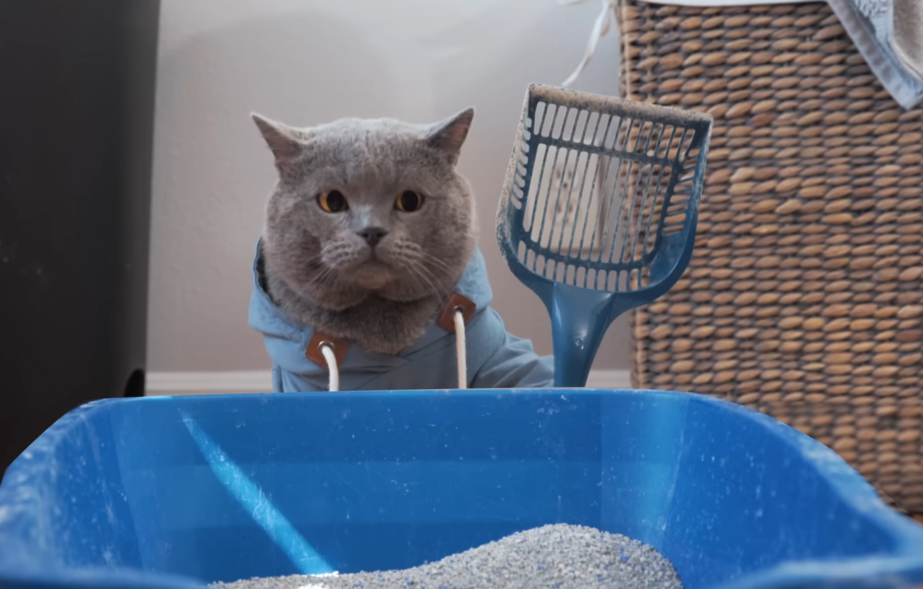
Michael always cleans his cat house.
Make the sentences negative
Michael doesn’t clean his cat house.
He always cleans his cat litter.

Slide 5
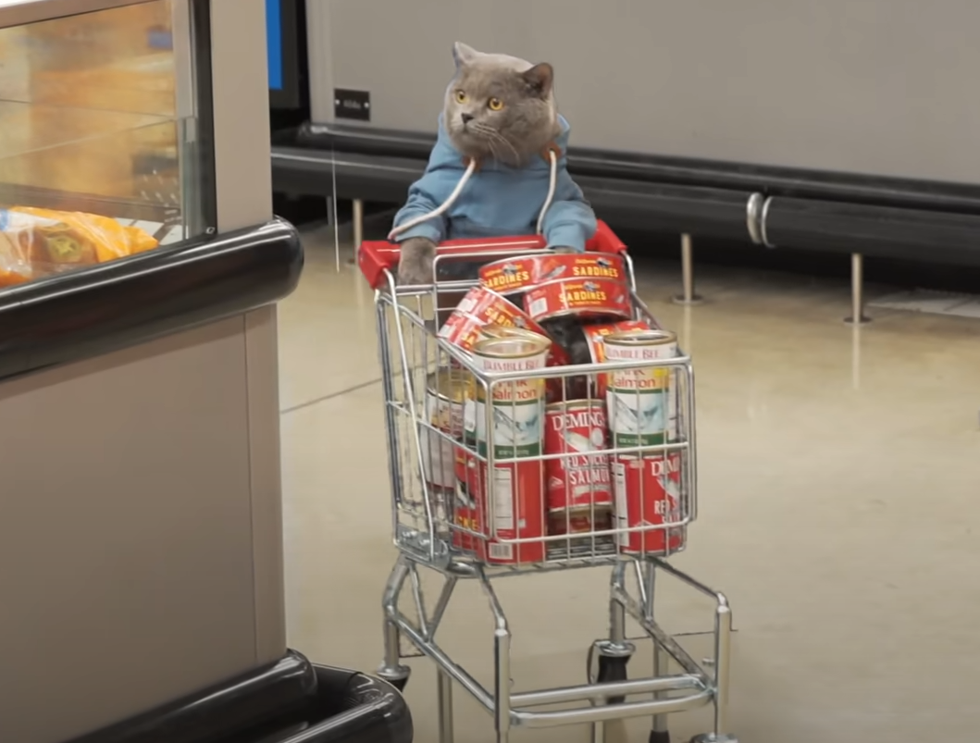
Michael goes to the park on Sundays.
Make the sentences negative
Michael doesn’t go to the park.
He goes shopping on Sundays.

Slide 6
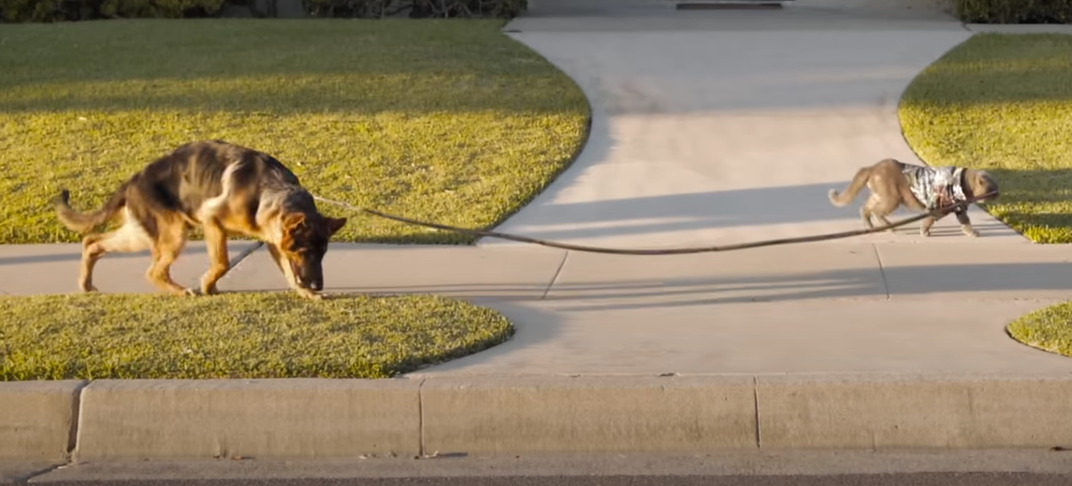
Michael walks a hamster twice a day.
Make the sentences negative
Michael doesn’t walk a hamster.
He walks a dog twice a day.

Slide 7
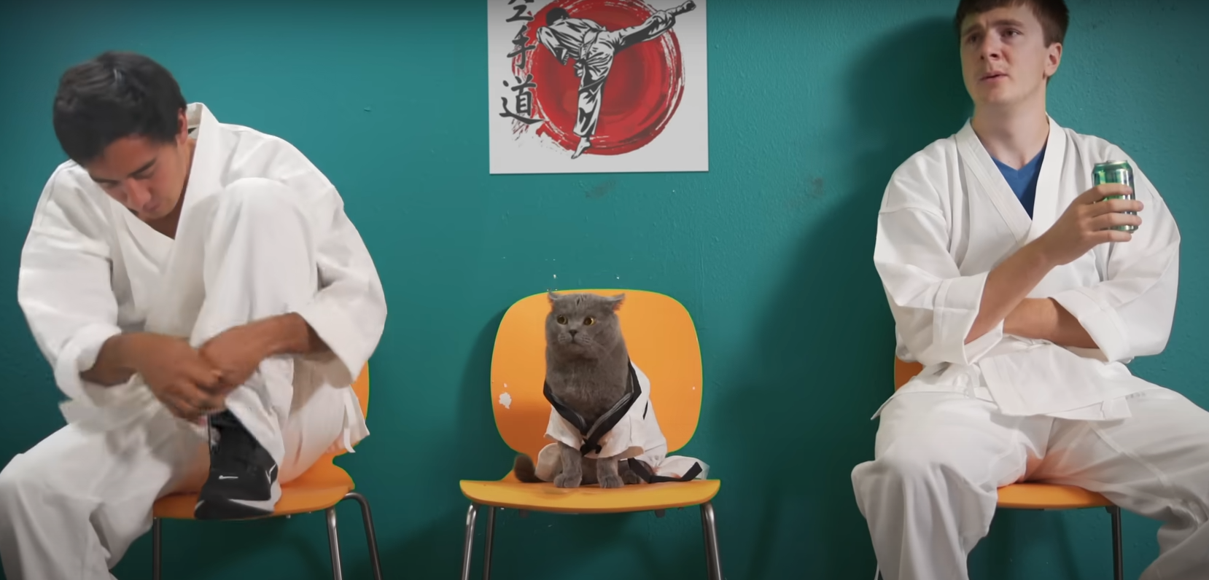
Michael plays chess on Fridays.
Make the sentences negative
Michael doesn’t play chess.
He does karate on Fridays.

Slide 8
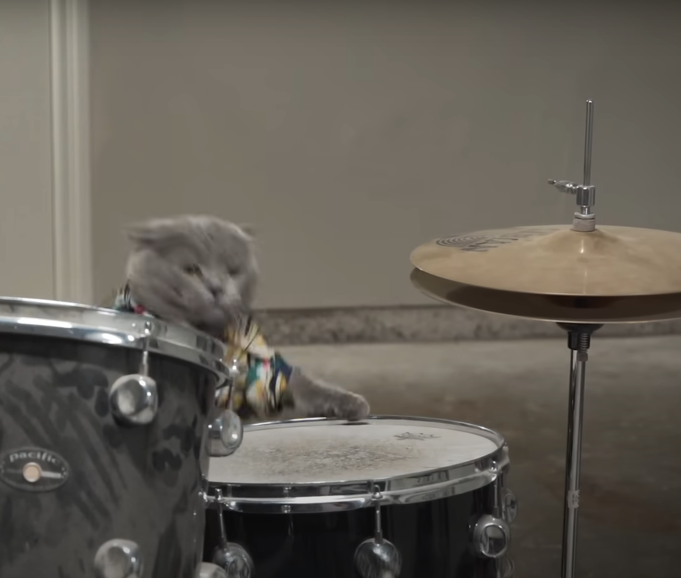
Michael plays the guitar in a band.
Make the sentences negative
Michael doesn’t play the guitar.
He plays the drums in a band.

Slide 9
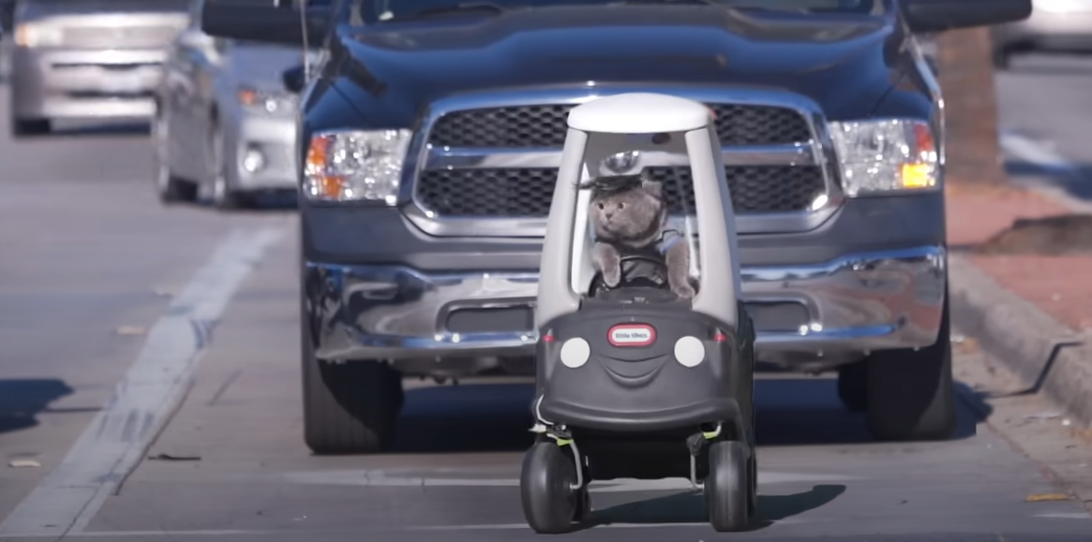
Michael rides a bike to work every day.
Make the sentences negative
Michael doesn’t ride a bike.
He drives to work every day.

Slide 10
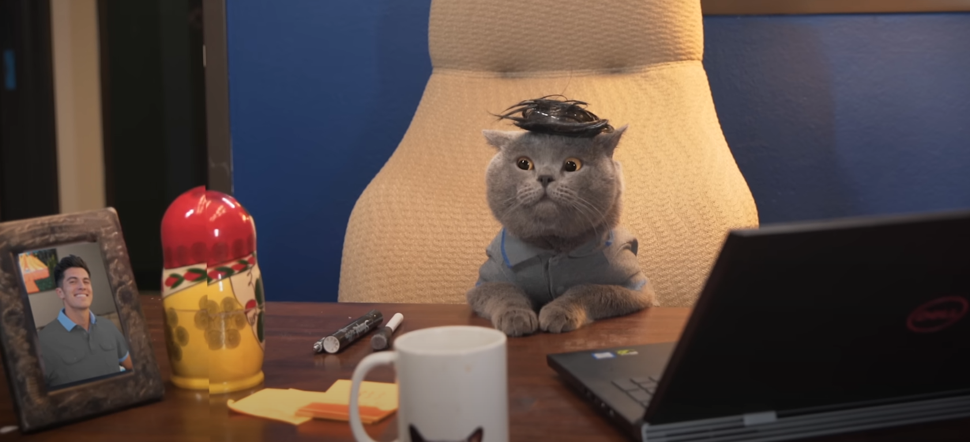
He works in a cafe.
Make the sentences negative
He doesn’t work in a cafe.
He works in an office.

Slide 11
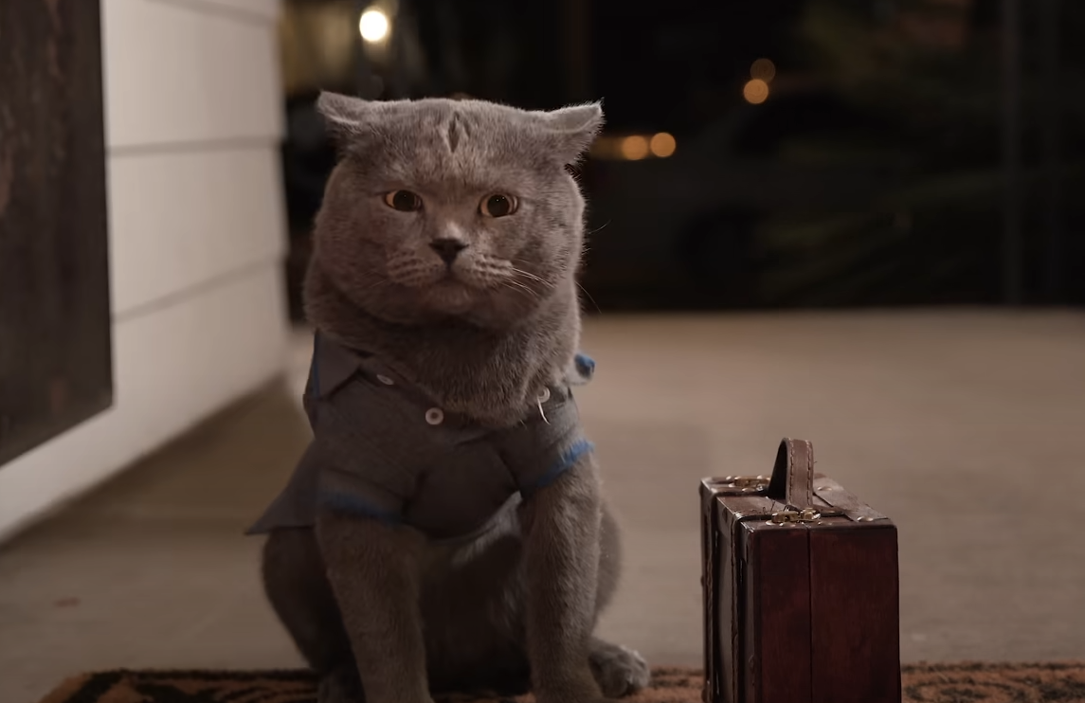
Michael comes back home at 7 p.m.
Make the sentences negative
He doesn’t come back home at 7 p.m.
9 p.m.
He comes back home at 9 p.m.

Slide 12
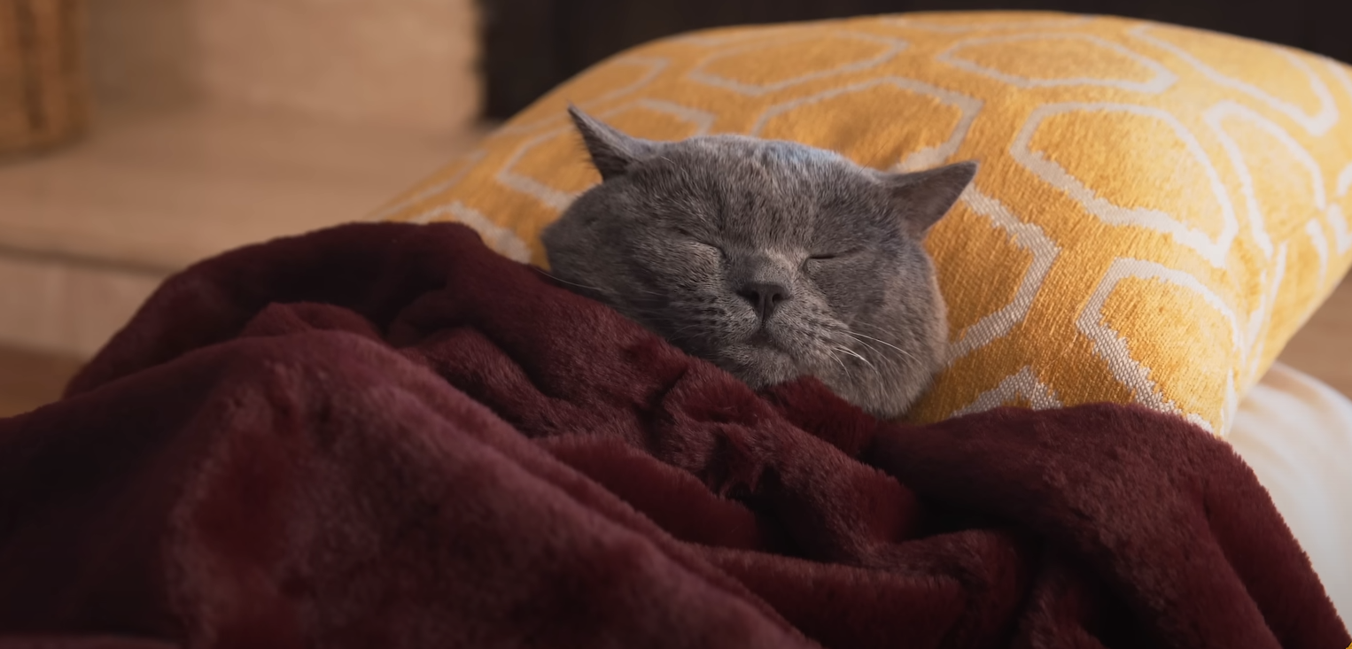
Michael goes to bed at 8 p.m.
Make the sentences negative
He doesn’t go to bed at 8 p.m.
11 p.m.
He goes to bed at 11 p.m.

