Slide 1
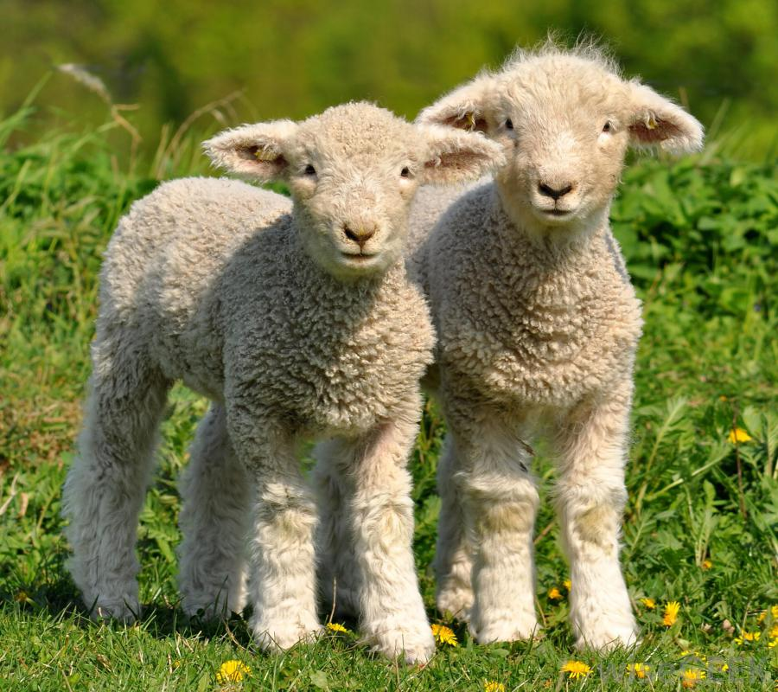

Would you like to feed the
Notes:
Would you like to feed the lambs? Yes, please.

Slide 2
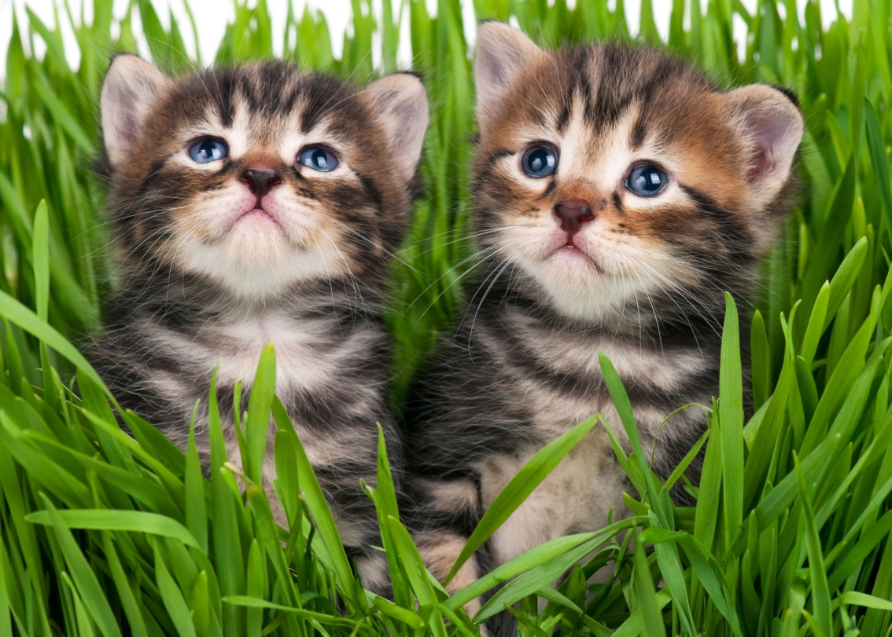

Would you like to feed the

Slide 3
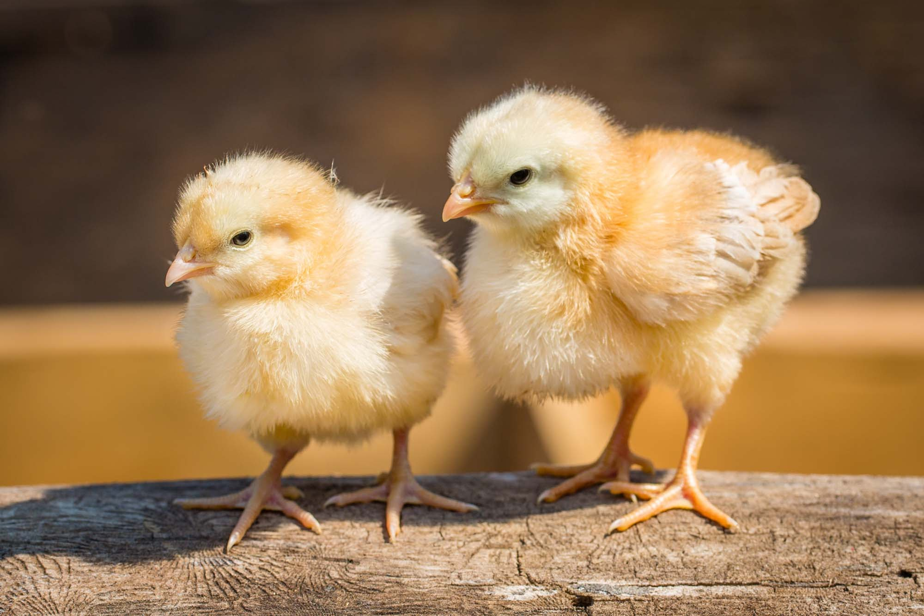
Would you like to feed the

Slide 4
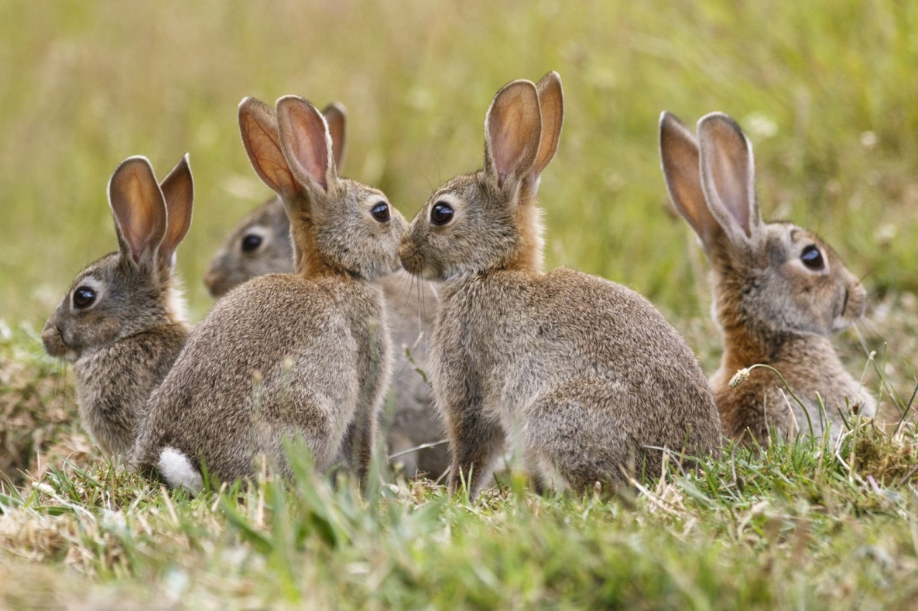
Would you like to feed the

Slide 5
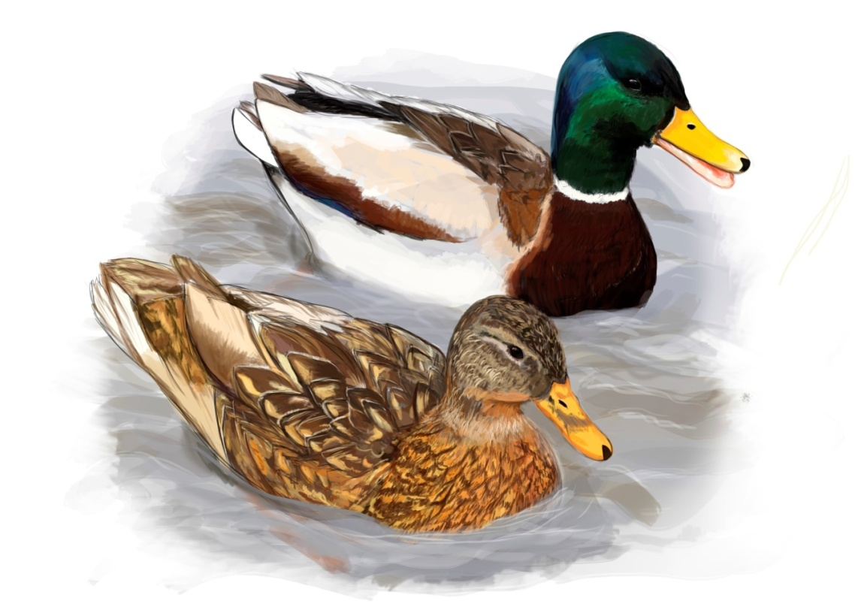
Would you like to feed the

Slide 6
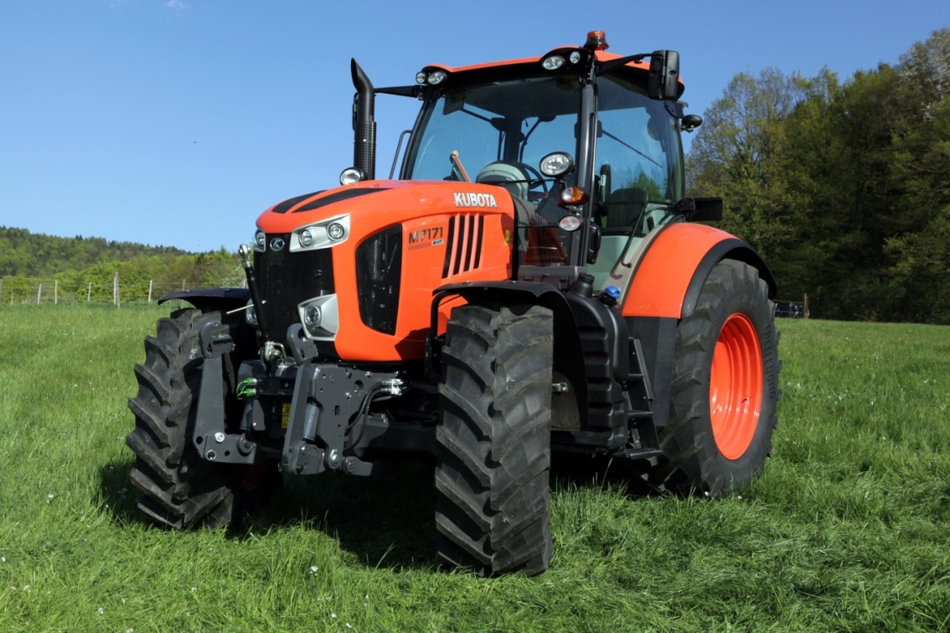
Would you like to ride on a

Slide 7
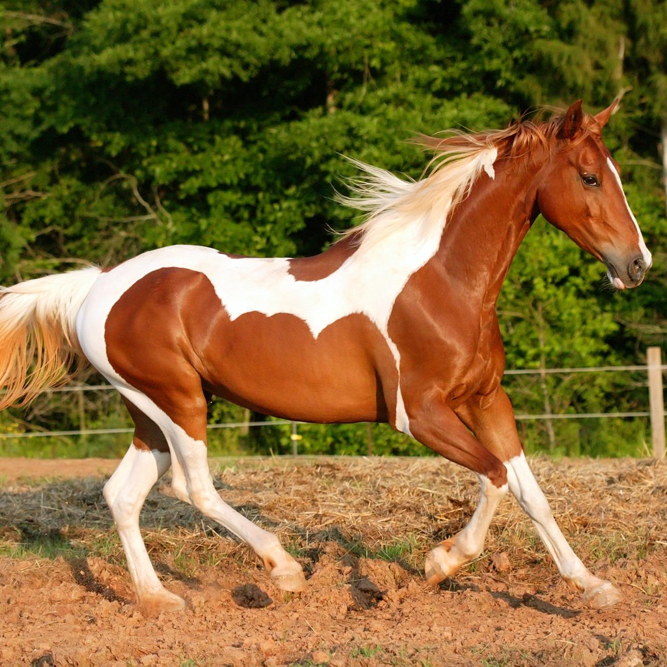
Would you like to ride on a

Slide 8
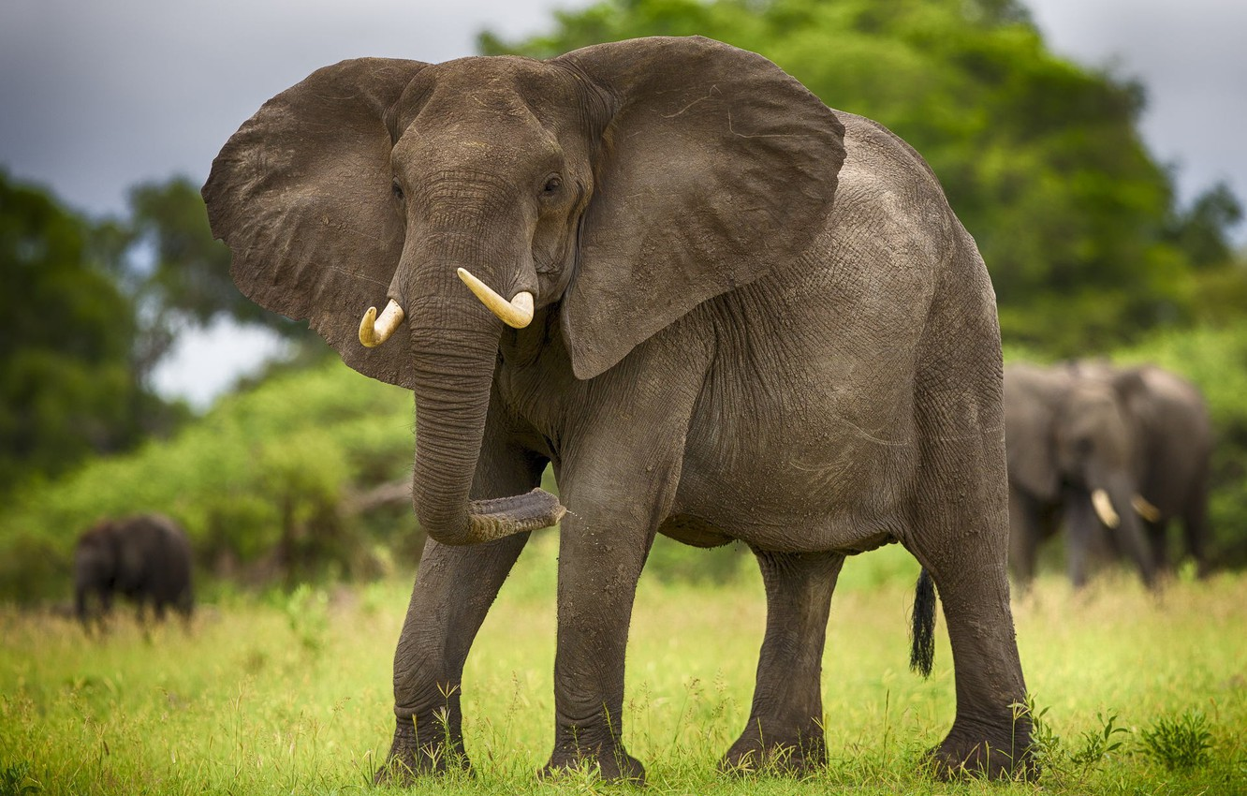

Would you like to ride on a

Slide 9
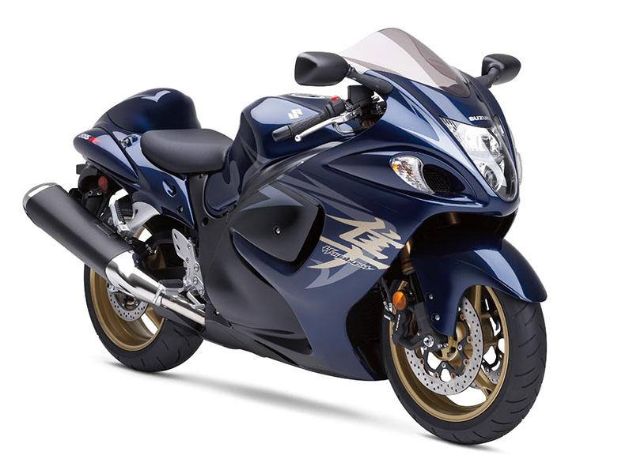
Would you like to ride on a

Slide 10
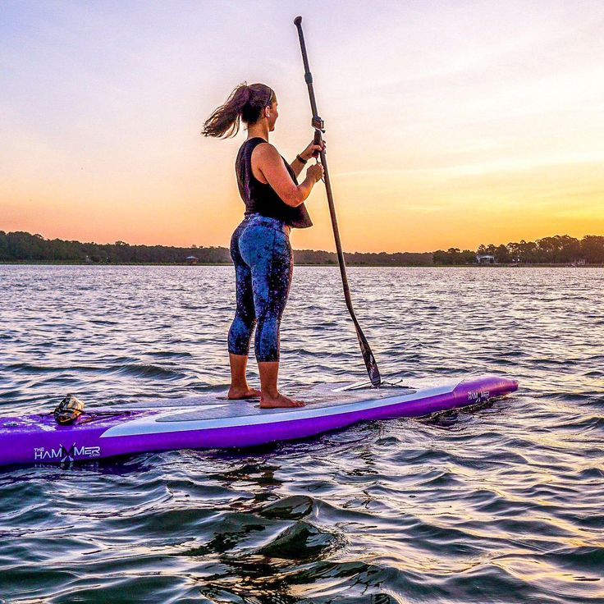
Would you like to ride on a

Slide 11
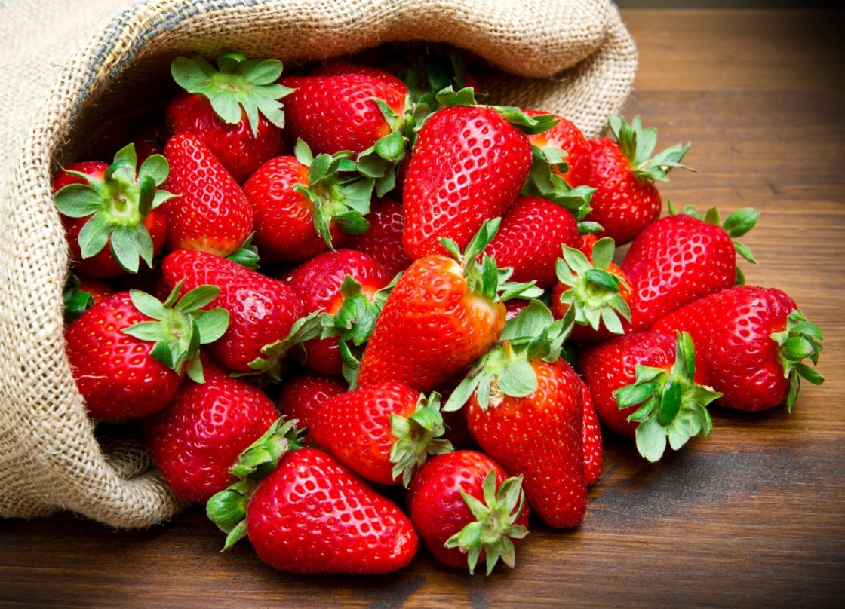
Would you like to pick some

Slide 12
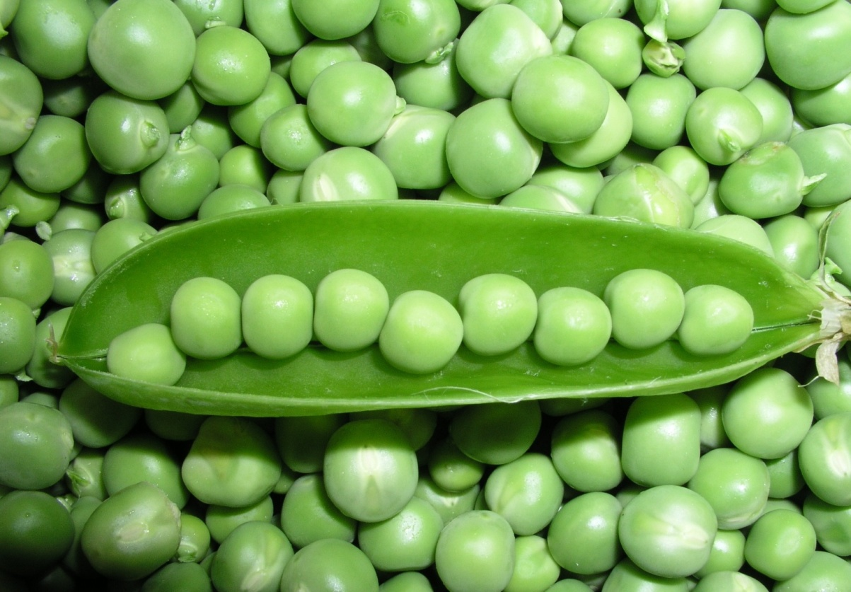
Would you like to pick some

Slide 13

Would you like to pick some

Slide 14

Would you like to pick some

Slide 15
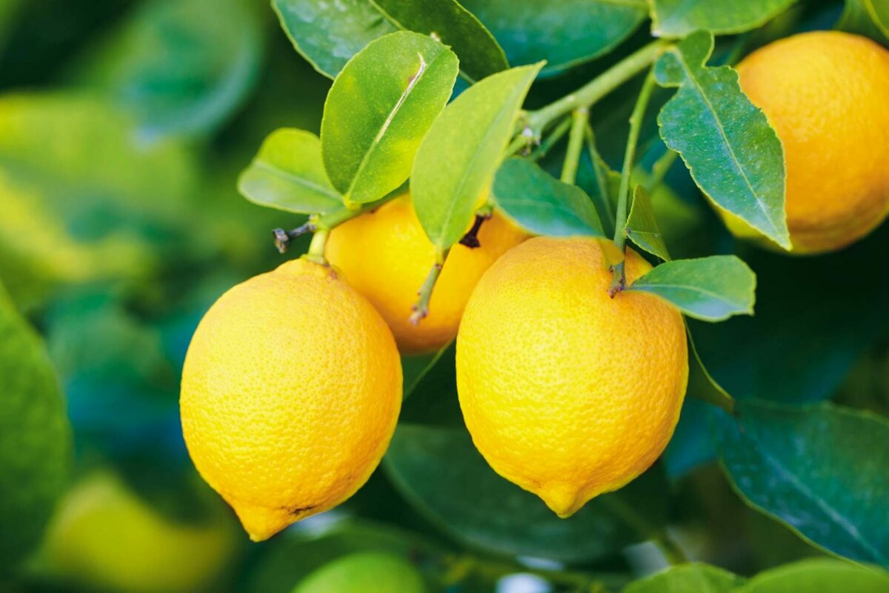
Would you like to pick some

Slide 16
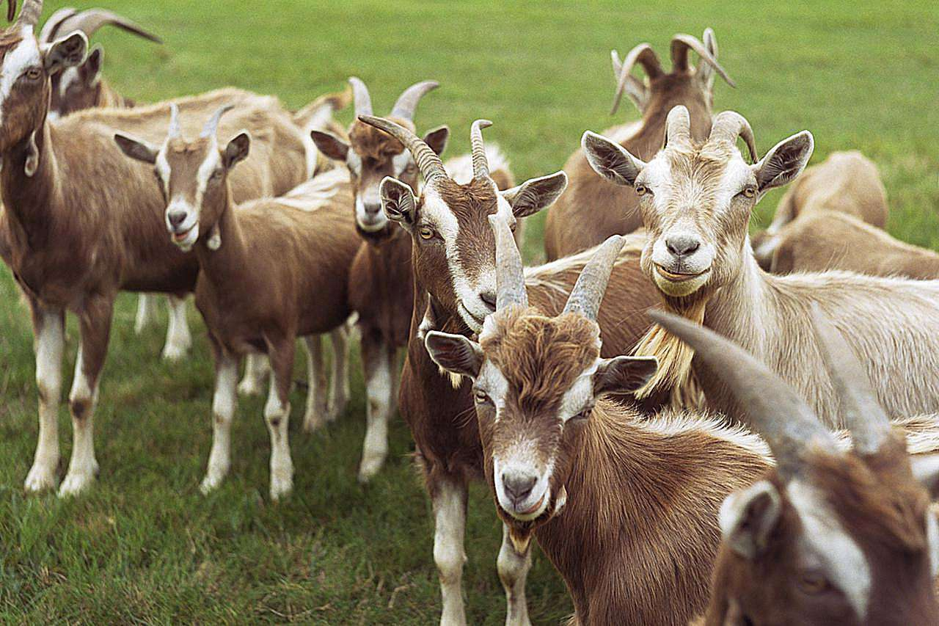
Would you like to see the

Slide 17
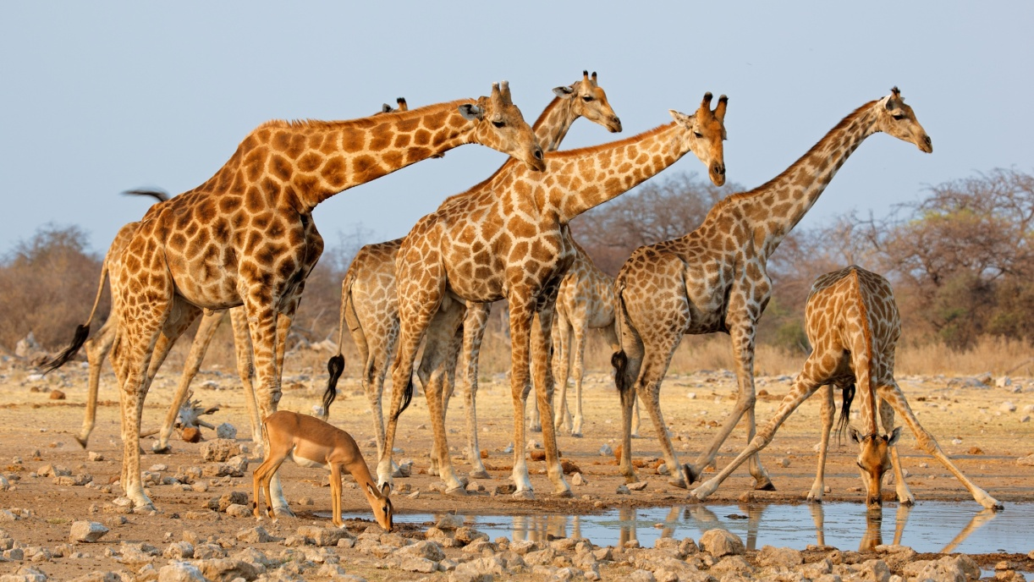
Would you like to see the

Slide 18
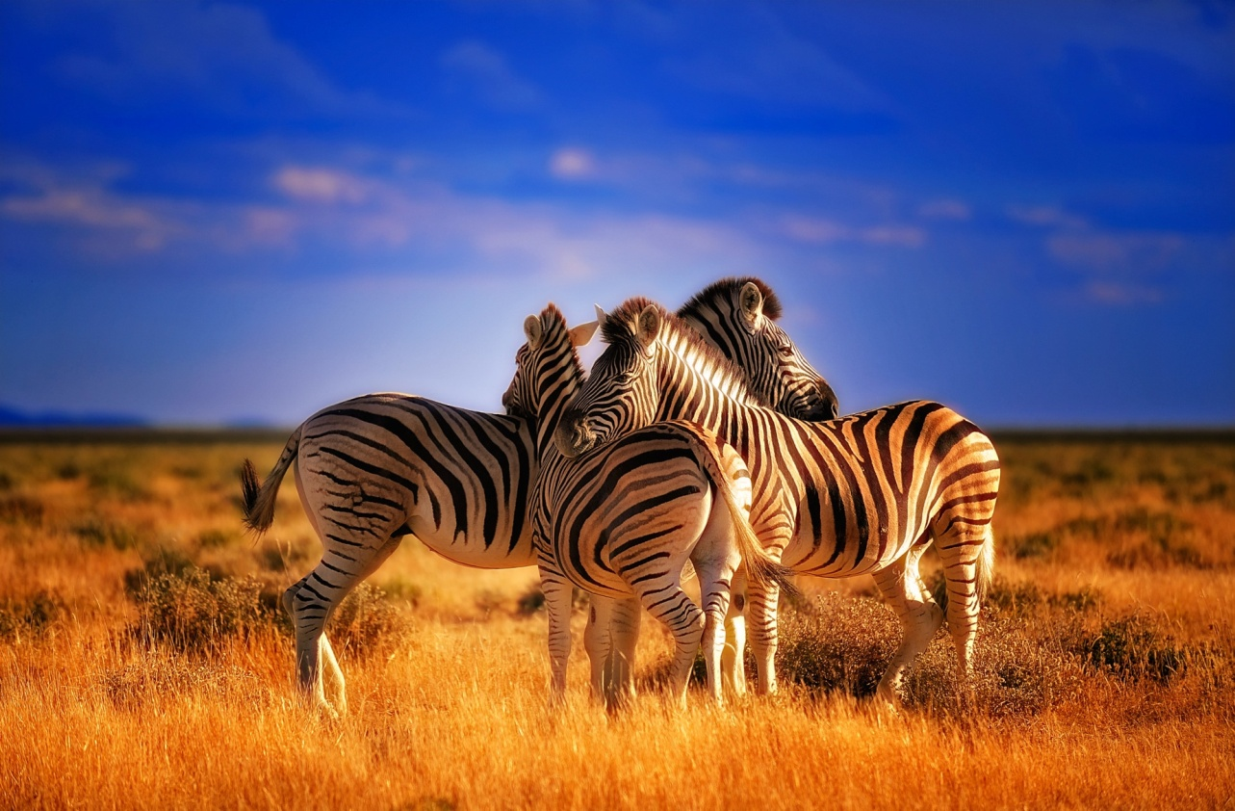
Would you like to see the

Slide 19
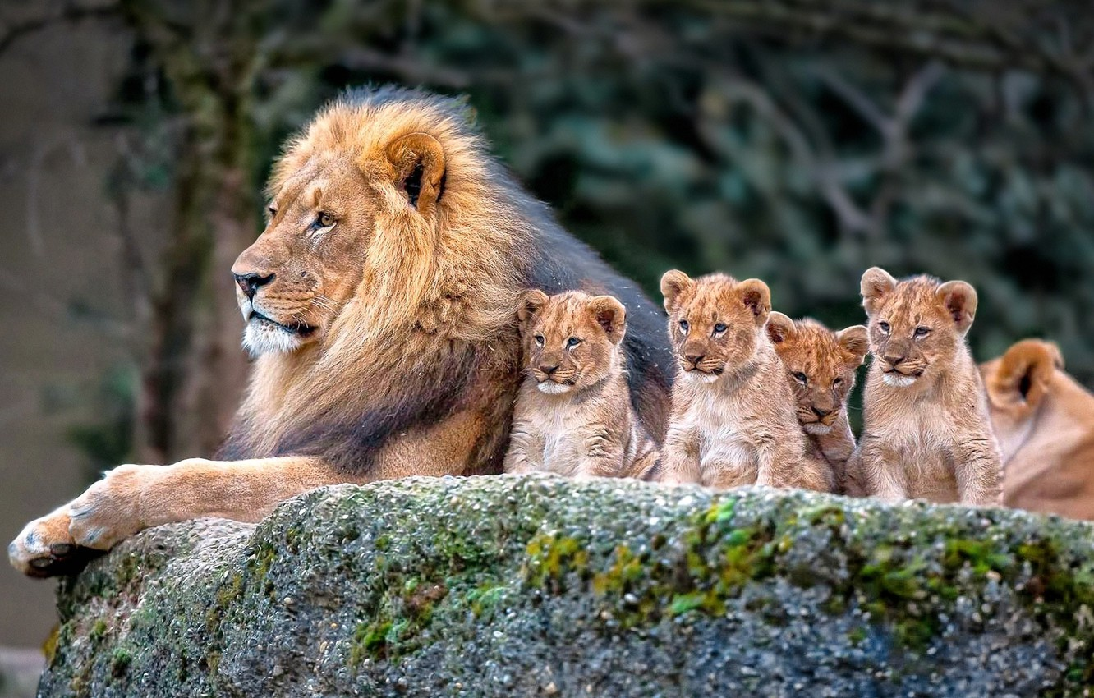
Would you like to see the

Slide 20
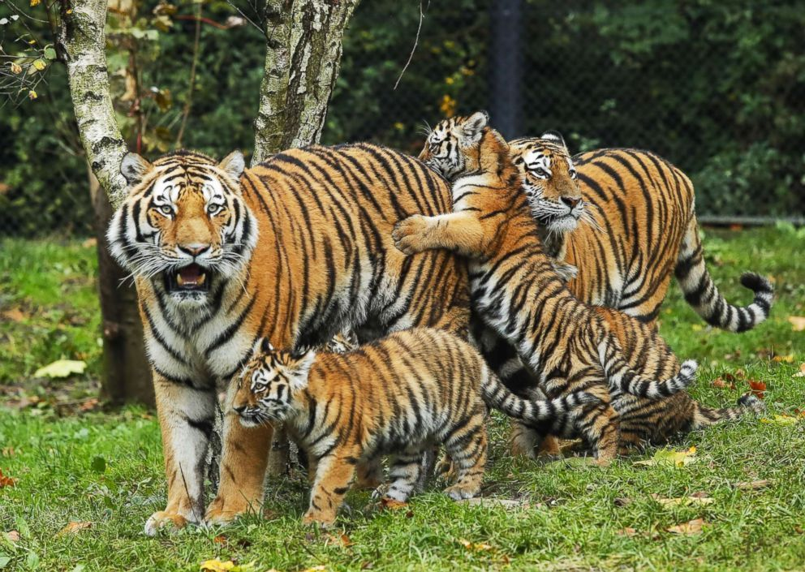
Would you like to see the

