Slide 1


BE GOING TO
for future intentions
and predictions
WHAT ARE THEY GOING TO DO?
WHAT IS GOING TO HAPPEN?

Slide 2

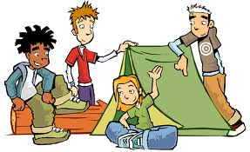


What are they going to do?
click
here
They ____ going to ____
camping.
are
go

Slide 3
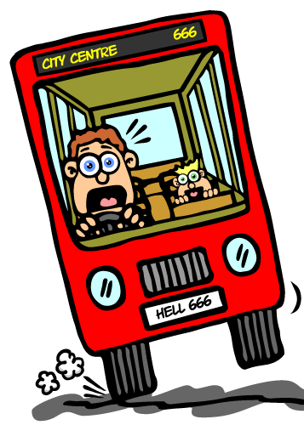
What is going to happen?
click
here
He ____ going to ____
an accident.
is
have

Slide 4

What are you going to do?
click
here
I ____ going to ____
a picture of you.
am
take

Slide 5
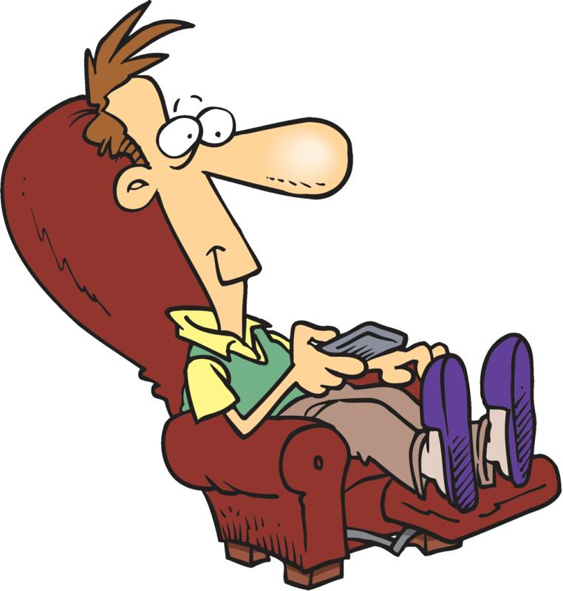
What is he going to do?
click
here
He ____ going to ____
TV.
is
watch

Slide 6
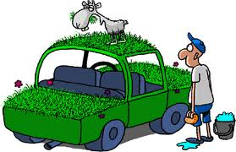
What is Tom going to do?
click
here
Tom ____ going to _______
his car.
is
clean/wash

Slide 7
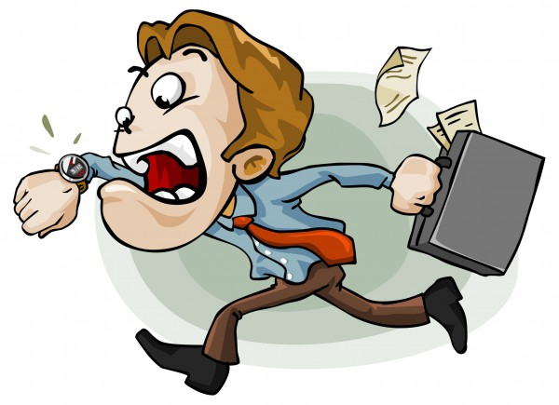
What is going to happen?
click
here
He ____ going to ____
late for work.
is
be

Slide 8
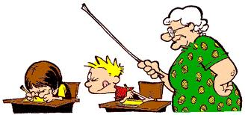
What is Calvin going to do?
click
here
He ____ going to __________
in his English test.
is
cheat/copy

Slide 9
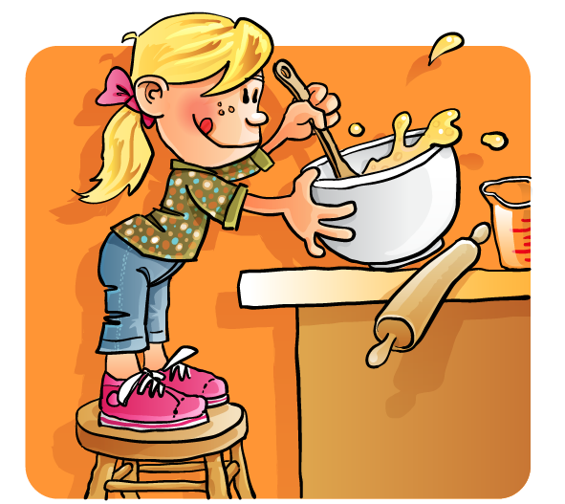
What are you going to do?
click
here
I ___ going to _________
a cake.
am
make/bake

Slide 10
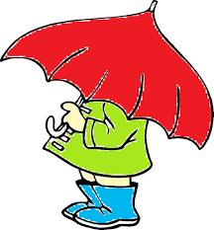
What is going to happen?
click
here
It ____ going to _____ .
is
rain

Slide 11

What is she going to do?
click
here
She ____ going to ____
a short story.
is
write

Slide 12
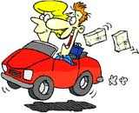
What are you going to do?
click
here
We ____ going to ____
to Spain tomorrow.
are
drive

Slide 13
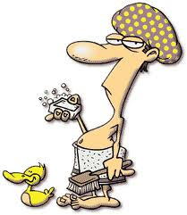
What are you going to do?
click
here
I ____ going to _______
a shower.
am
take/have

Slide 14
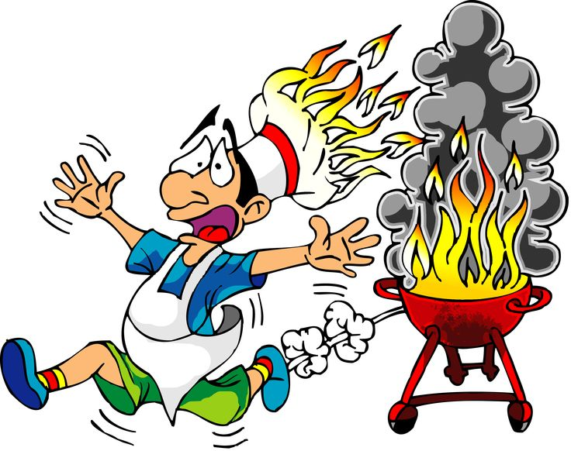
What is going to happen?
click
here
He ____ going to ____
himself.
is
burn

Slide 15
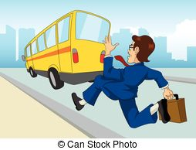
What is going to happen?
click
here
He ____ going to ____
the bus.
is
miss

Slide 16
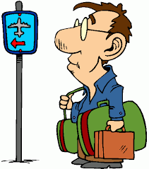
What are you going to do?
click
here
I ____ going to ____
a plane.
am
catch

Slide 17
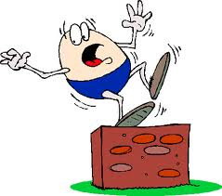
What is going to happen?
click
here
Humpty Dumpty ____ going to _____ .
is
fall

Slide 18
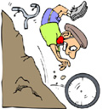
What is going to happen?
click
here
He ____ going to ____
every single bone.
is
break

Slide 19

What is she going to do?
click
here
She ____ going to ____
abroad.
is
travel

Slide 20
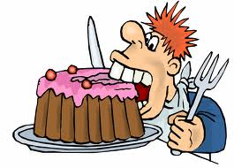
What are you going to do?
click
here
I ____ going to ____
this cake all by myself.
am
eat

Slide 21
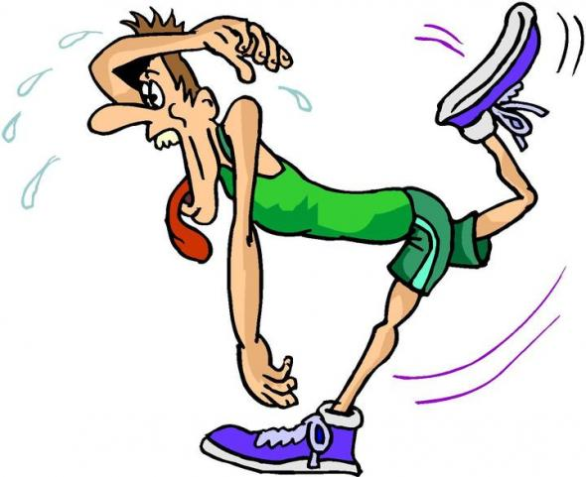

What is going to happen?
click
here
He ____ going to ____
this race.
is
lose

