Slide 1
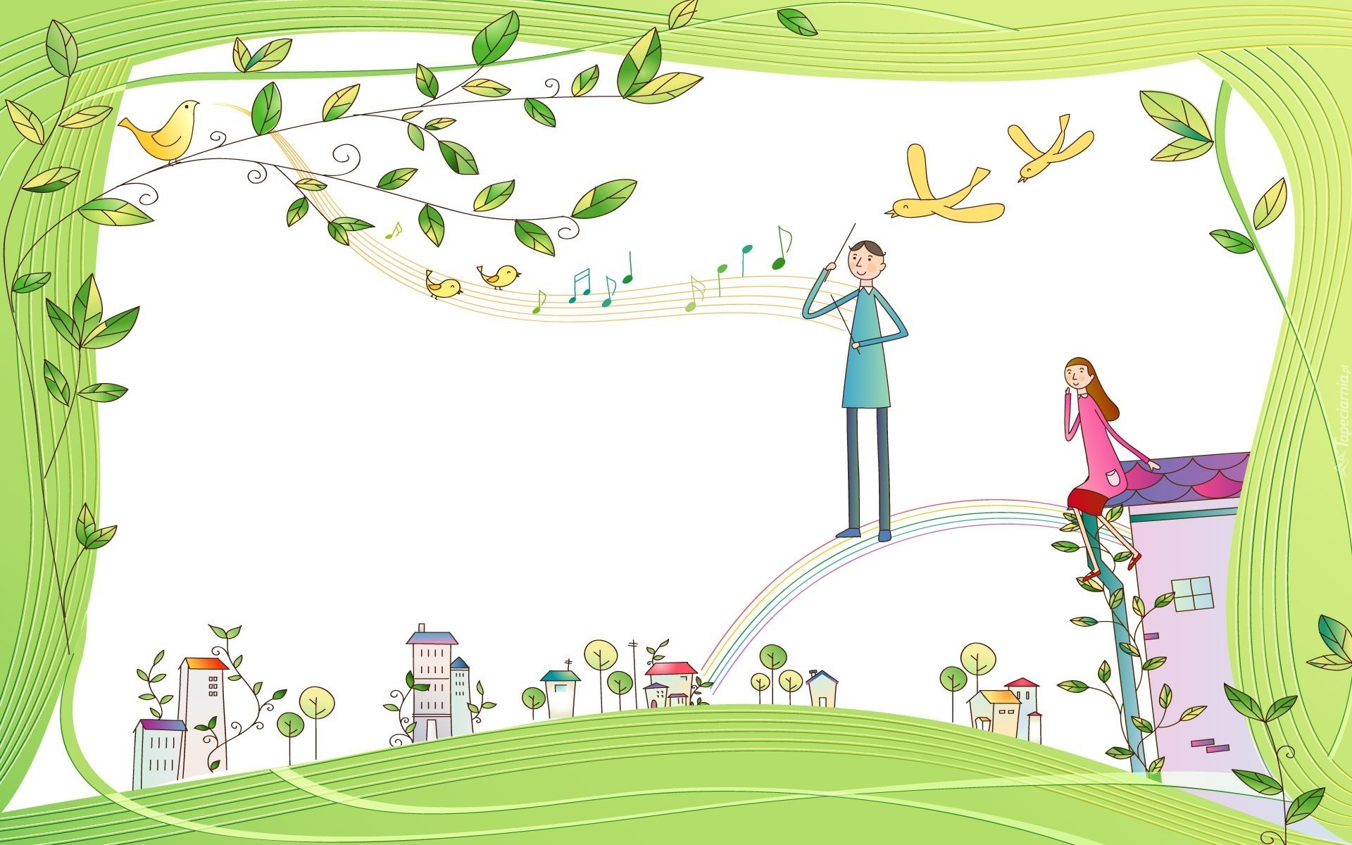




IrinaPapakhinac

Slide 2


1. What do you do to relax?
2. Do you read books to relax?
3. Do you play an instrument to relax?
4. Do you play video games to relax?
IrinaPapakhinac

Slide 3

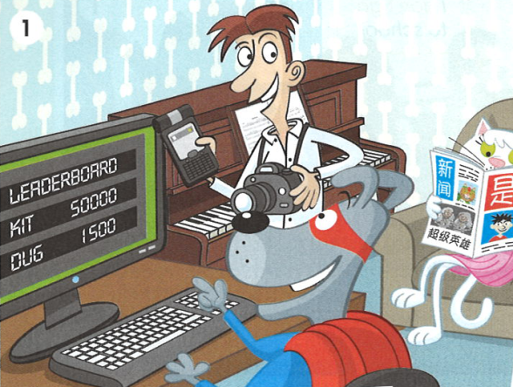

Look at the picture.
Who can play computer games very well?
Who can speak Chinese?
GUESS!
3. Who can play the piano?
4. Who can sing?
Listen and check your answers.
IrinaPapakhinac

Slide 4
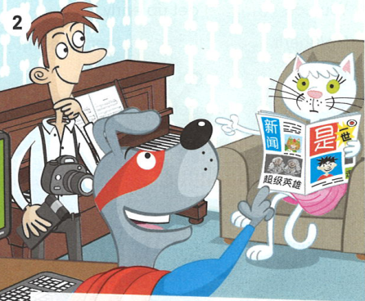
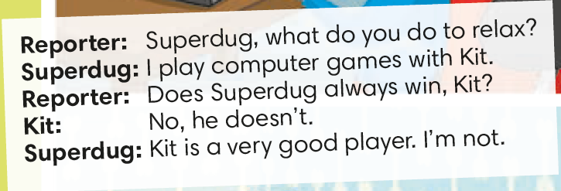
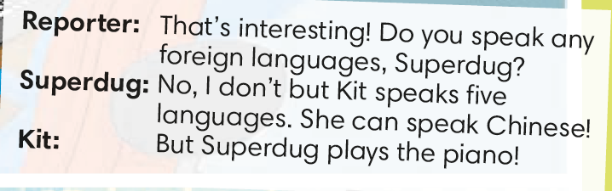
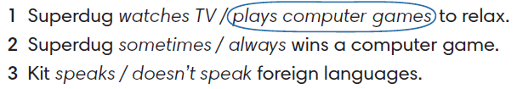
Circle the correct answer.
IrinaPapakhinac

Slide 5
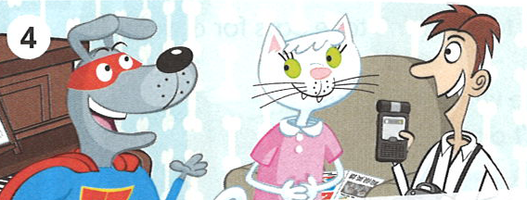
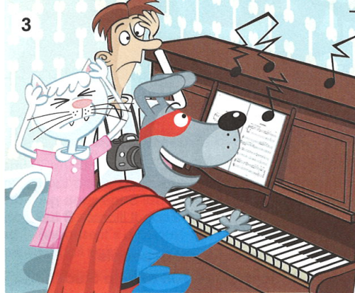
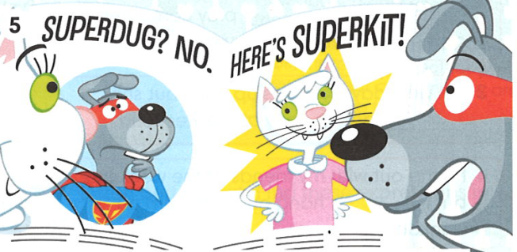
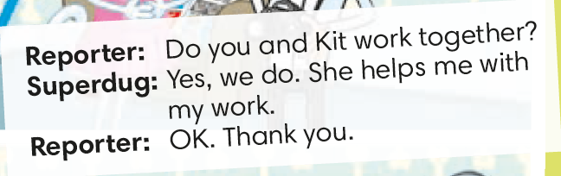

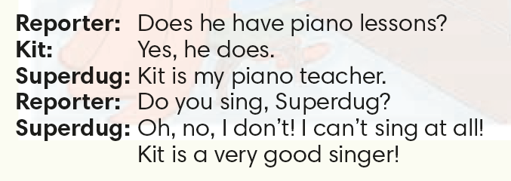

Circle the correct answer.
IrinaPapakhinac

Slide 6
Complete the sentences.
Does
_______ Superdug always win, Kit?
_______ you speak any foreign languages?
Do
IrinaPapakhinac

Slide 7
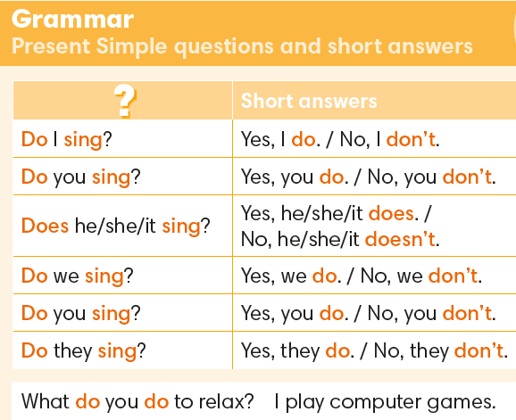
IrinaPapakhinac

Slide 8

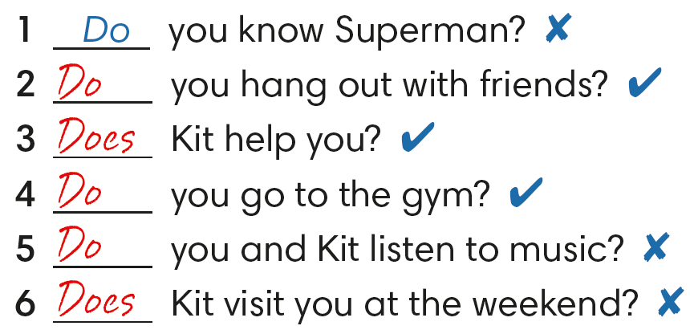

No, I don’t.
Yes, I do.
Yes, she does.
Yes, I do.
No, we don’t.
No, she doesn’t.
IrinaPapakhinac

Slide 9
Answer the questions for you.
IrinaPapakhinac

Slide 10
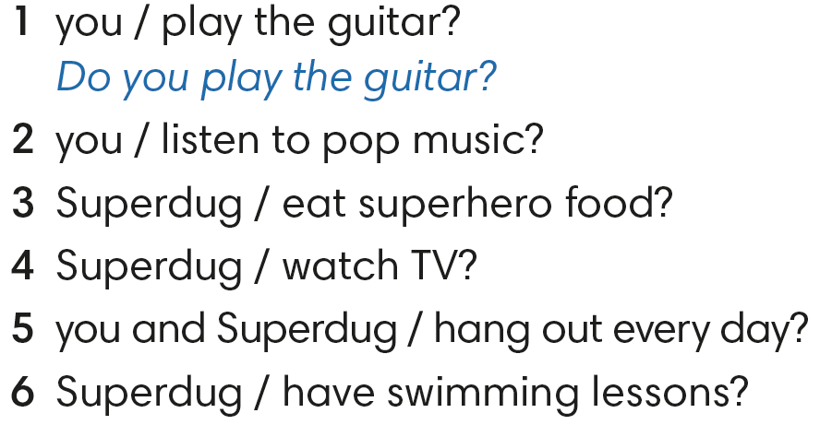


Make the questions to Kit.
Listen to Kit’s answers.
No, I don’t.
2. Do you listen to pop music?
Yes, I do.
3. Does Superdug eat superhero food?
No, he doesn’t.
4. Does Superdug watch TV?
Yes, he does.
5. Do you and Superdug hang out every day?
No, we don’t.
6. Does Superdug have swimming lessons?
No, he doesn’t.
3. Tell about Superdug.
IrinaPapakhinac

Slide 11
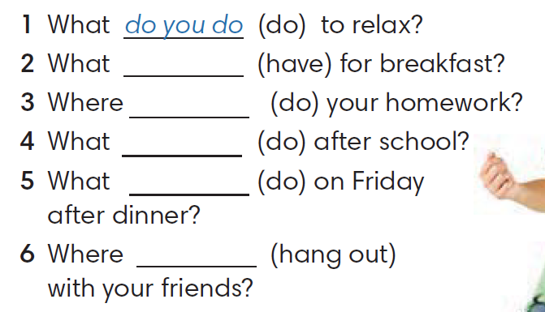
Complete the questions.
do you have
do you do
2. Guess your friend’s answers.
do you do
do you do
A: Do you watch TV to relax?
B: Yes, I do. / No, I don’t.
do you hang out
IrinaPapakhinac

Slide 12
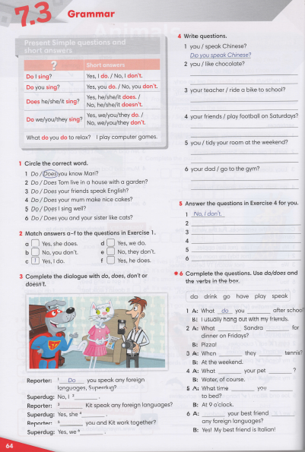


IrinaPapakhinac

Slide 13
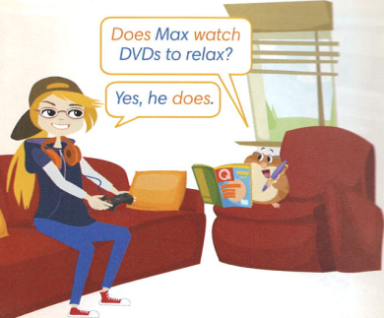

Look at the picture.
Does Max watch DVDs to relax?
2. GUESS: What kind of music does he like?
Watch the video and check your answers
IrinaPapakhinac

Slide 14
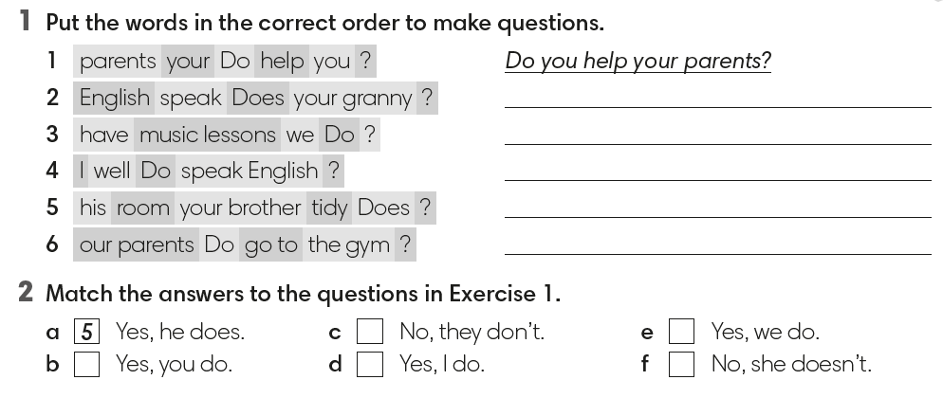
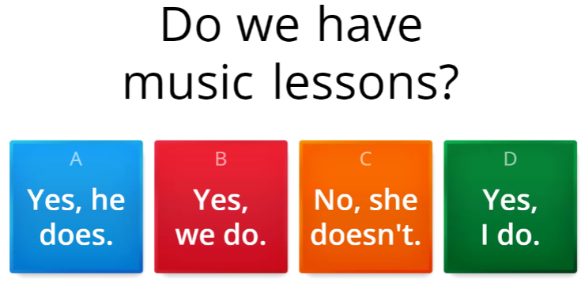

Does your granny speak English?
Do we have music lessons?
Do I speak English well?
Does your brother tidy his room?
Do our parents go to the gym?
6
3
4
1
2
IrinaPapakhinac

Slide 15
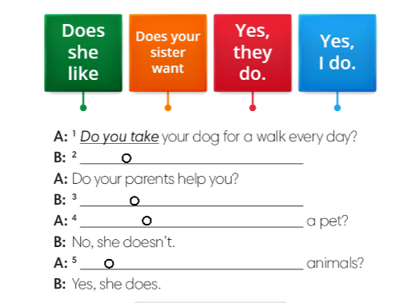
IrinaPapakhinac

Slide 16
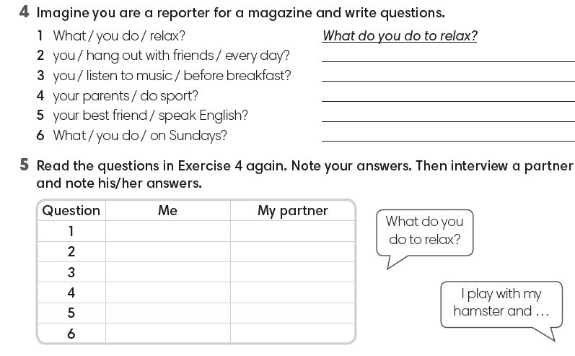
Do you hang out with friends every day?
Do you listen to music before breakfast?
Do your parents do sport?
Does your best friend speak English?
What do you do on Sundays?
IrinaPapakhinac

