Slide 1
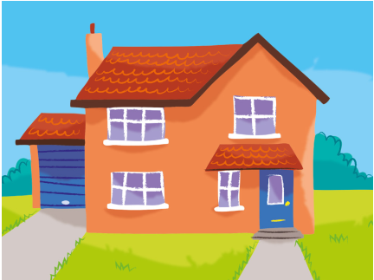
1. She lives / goes in the house.

Slide 2
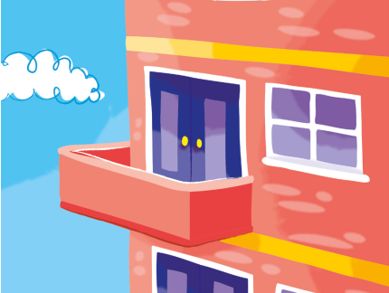
2. She swims / lives in the flat.

Slide 3
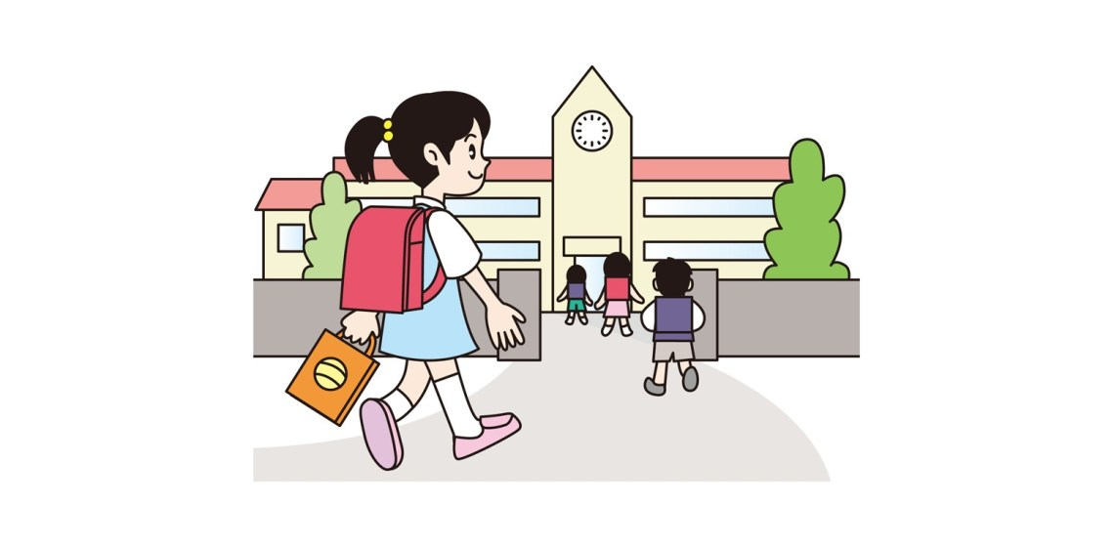
3. She goes / does to my school.

Slide 4
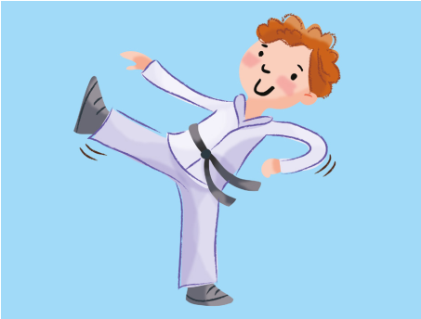
4. He does / plays karate.

Slide 5
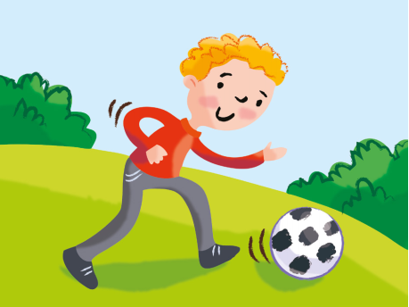
5. He does / plays football.

Slide 6
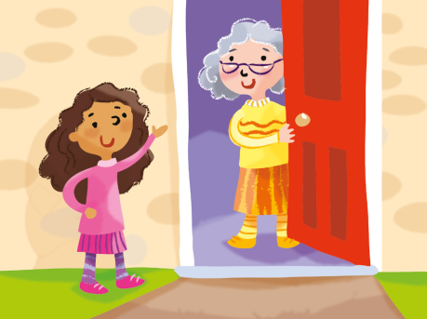
6. She plays / visits her grandma on Sunday.

