Slide 1
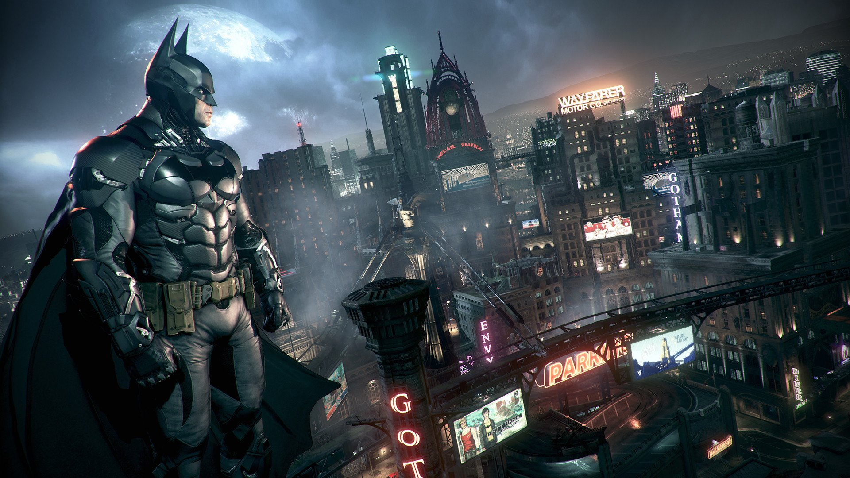

THE PRESENT PERFECT
GAME
Teacher Fernando Pérez

Slide 2
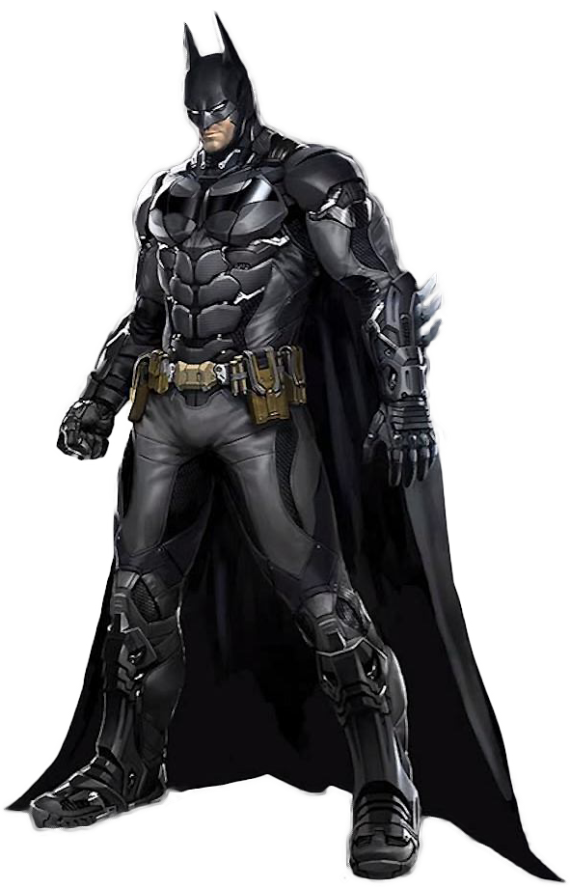
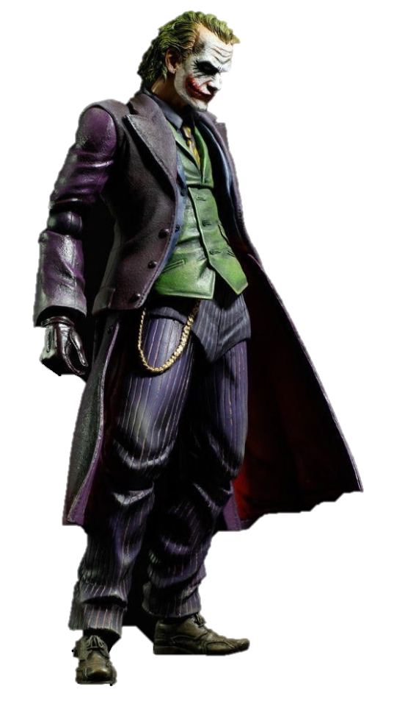
I _____ won the nobel prize.
has
have
won’t

Slide 3
David _____ bought a new car.
will
have
has

Slide 4
Andrew and Ann ____ played windsurf.
have
has
were

Slide 5
Kelly and me _____ gone to the gym.
has
have
was

Slide 6
You _____ caught a lot of fish.
have
has
did

Slide 7
I have _____ television.
listened
got
watched

Slide 8
We have _____ cumbia in the party.
become
played
danced

Slide 9
Amber has _____ to music.
listened
watched
cried

Slide 10
Jean has _____ to Texas.
eaten
traveled
drunk

Slide 11
Bill and Katty have _____ in the beach.
loved
walked
climbed

Slide 12
Kim has ____ to a concert in Florida.
gone
seen
spoken

Slide 13
Sonya has _____ karate and judo.
played
fought
sung

Slide 14
I have ____ crazy for your love.
been
read
destroyed

Slide 15
Tina has _____ a hot dog.
watched
played
eaten

