Slide 1

I’d like a / an / some

Slide 2

I’d like a / an / some

Slide 3

I’d like a / an / some

Slide 4

I’d like a / an / some

Slide 5

I’d like a / an / some

Slide 6

I’d like a / an / some

Slide 7
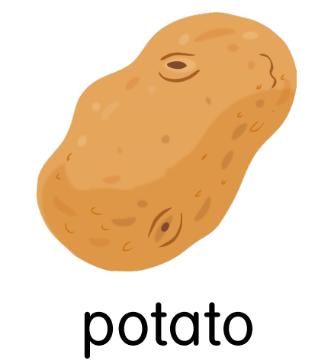
I’d like a / an / some

Slide 8

I’d like a / an / some

Slide 9

I’d like a / an / some

Slide 10
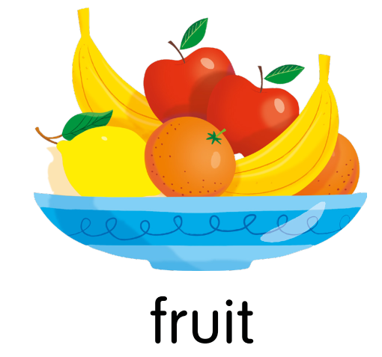
I’d like a / an / some

Slide 11

I’d like a / an / some

Slide 12

I’d like a / an / some

Slide 13
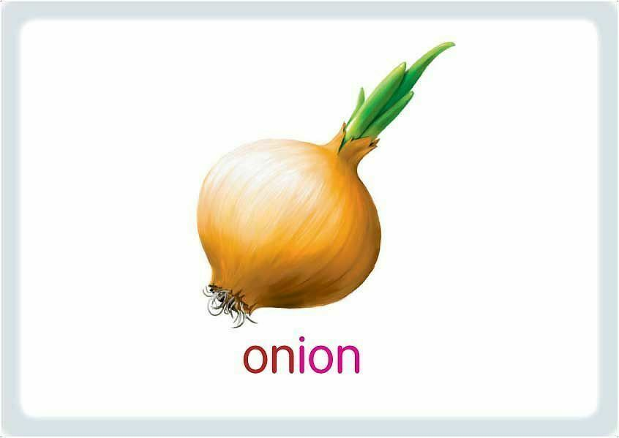
I’d like a / an / some

Slide 14

I’d like a / an / some

