Slide 1
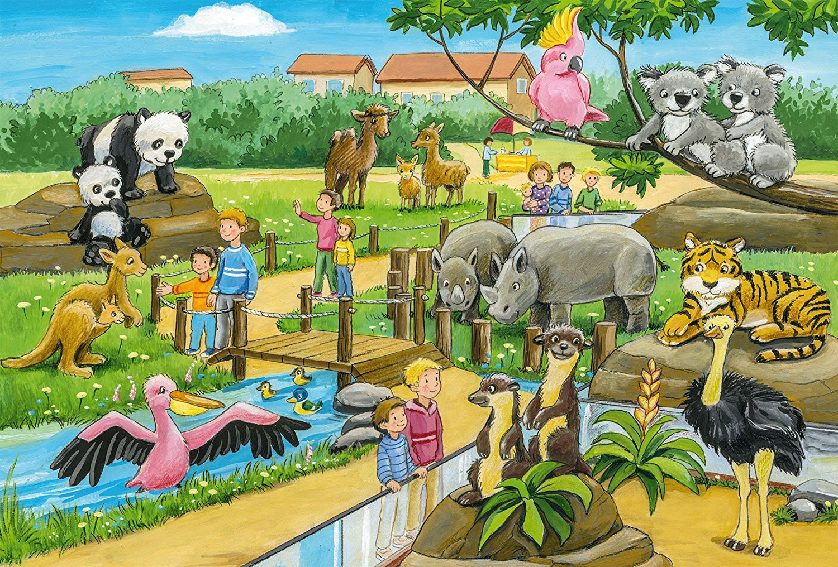
Are there any pandas?

Slide 2
Are there any dogs?

Slide 3
Are there any coalas?

Slide 4
Are there any camels?

Slide 5
Are there any cats?

Slide 6
Are there any kangaroos?

Slide 7
Are there any birds?

Slide 8
Are there any insects?

Slide 9
Are there any tigers?

Slide 10
Are there any bears?

Slide 11
Are there any rhinos?

Slide 12
Are there any elephants?

Slide 13
Are there any wolves?

Slide 14
Are there any crocodiles?

Slide 15
Are there any foxes?

