Slide 1





START

Slide 2

ROUTINES
SPIN
1/22
CHECK

Slide 3

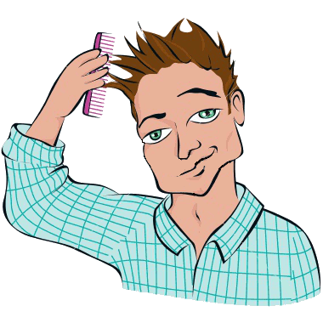

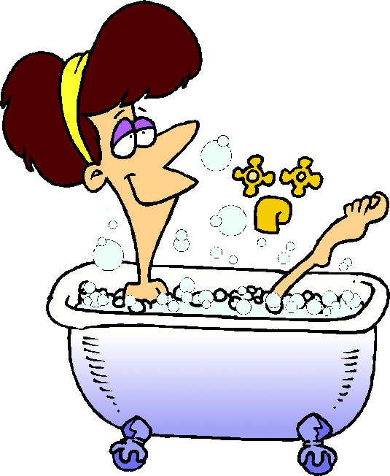
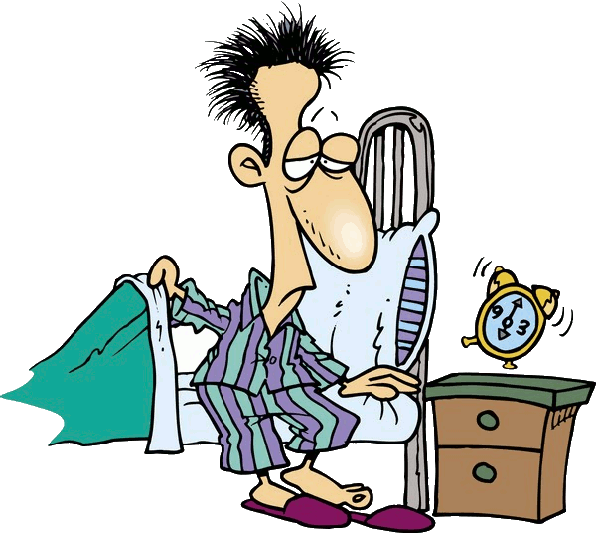


ROUTINES
SPIN
wakes up
He _________ at 7.30.
1/22
CHECK

Slide 4
SPIN
gets up
He _________ at 7.35.
2/22
CHECK

Slide 5


SPIN
takes a shower
He ____________ at 7.40.
3/22
CHECK

Slide 6

SPIN
takes a bath
She ____________ at 7.45.
4/22
CHECK

Slide 7

SPIN
gets dressed
He ____________ at 7.50.
5/22
CHECK

Slide 8

SPIN
combs his hair
He ____________ everyday.
6/22
CHECK

Slide 9

SPIN
has breakfast
He ____________ at 7.55.
7/22
CHECK

Slide 10
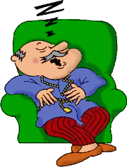
SPIN
He _____________ at 8.00.
brushes his teeth
8/22
CHECK

Slide 11

SPIN
goes to school
He _____________ at 8.05.
9/22
CHECK

Slide 12
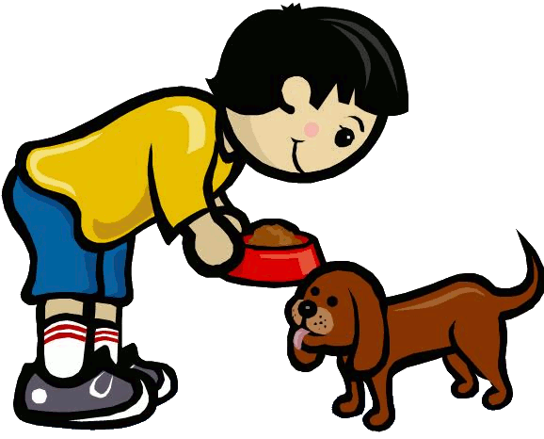
SPIN
goes home
He ___________ at 14.30.
10/22
CHECK

Slide 13

SPIN
washes his hands
He often _______________.
11/22
CHECK

Slide 14

SPIN
has lunch
He __________ at home.
12/22
CHECK

Slide 15

SPIN
takes a nap
He ____________
in the afternoon.
13/22
CHECK

Slide 16

SPIN
does his homework
He ___________________
at 17.00.
14/22
CHECK

Slide 17

SPIN
feeds the dog
He _____________ everyday.
15/22
CHECK

Slide 18

SPIN
walks the dog
He _____________ in the evening.
16/22
CHECK

Slide 19

SPIN
hangs out with his friends
He _______________________
in the afternoon.
17/22
CHECK

Slide 20
SPIN
surfs the web
He ______________
in the evening.
18/22
CHECK

Slide 21
SPIN
plays video games
He __________________
in the evening.
19/22
CHECK

Slide 22
SPIN
has dinner
He ___________ at 20.30.
20/22
CHECK

Slide 23
SPIN
watches TV
He ___________
in the evening.
21/22
CHECK

Slide 24

EXIT
goes to bed
She ____________ at 10.30.
22/22
CHECK

