Slide 1
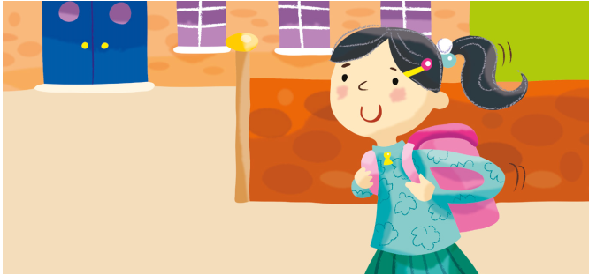
Where / you / go?
I / go / to school

Slide 2
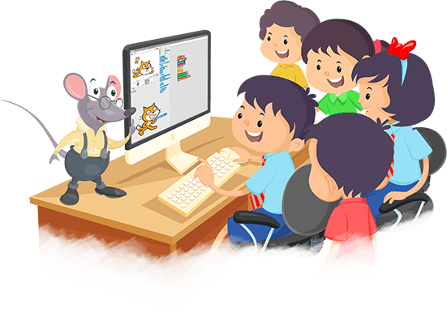
What / you/ do?
We / play/computer games.

Slide 3
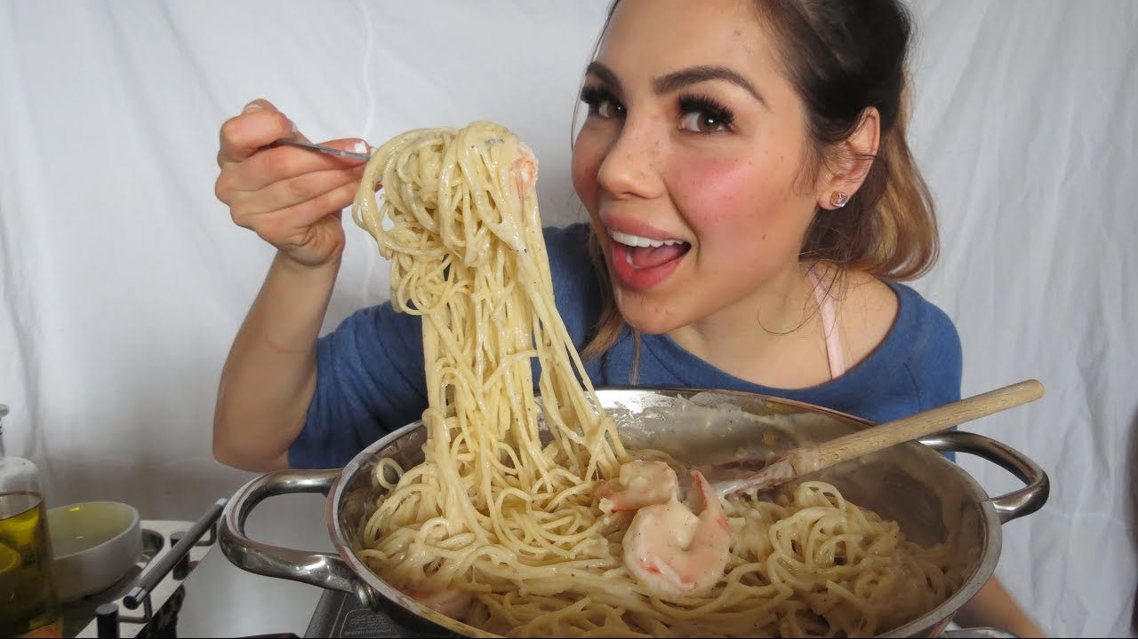
What / she / cook?
She / cook / pasta.

Slide 4
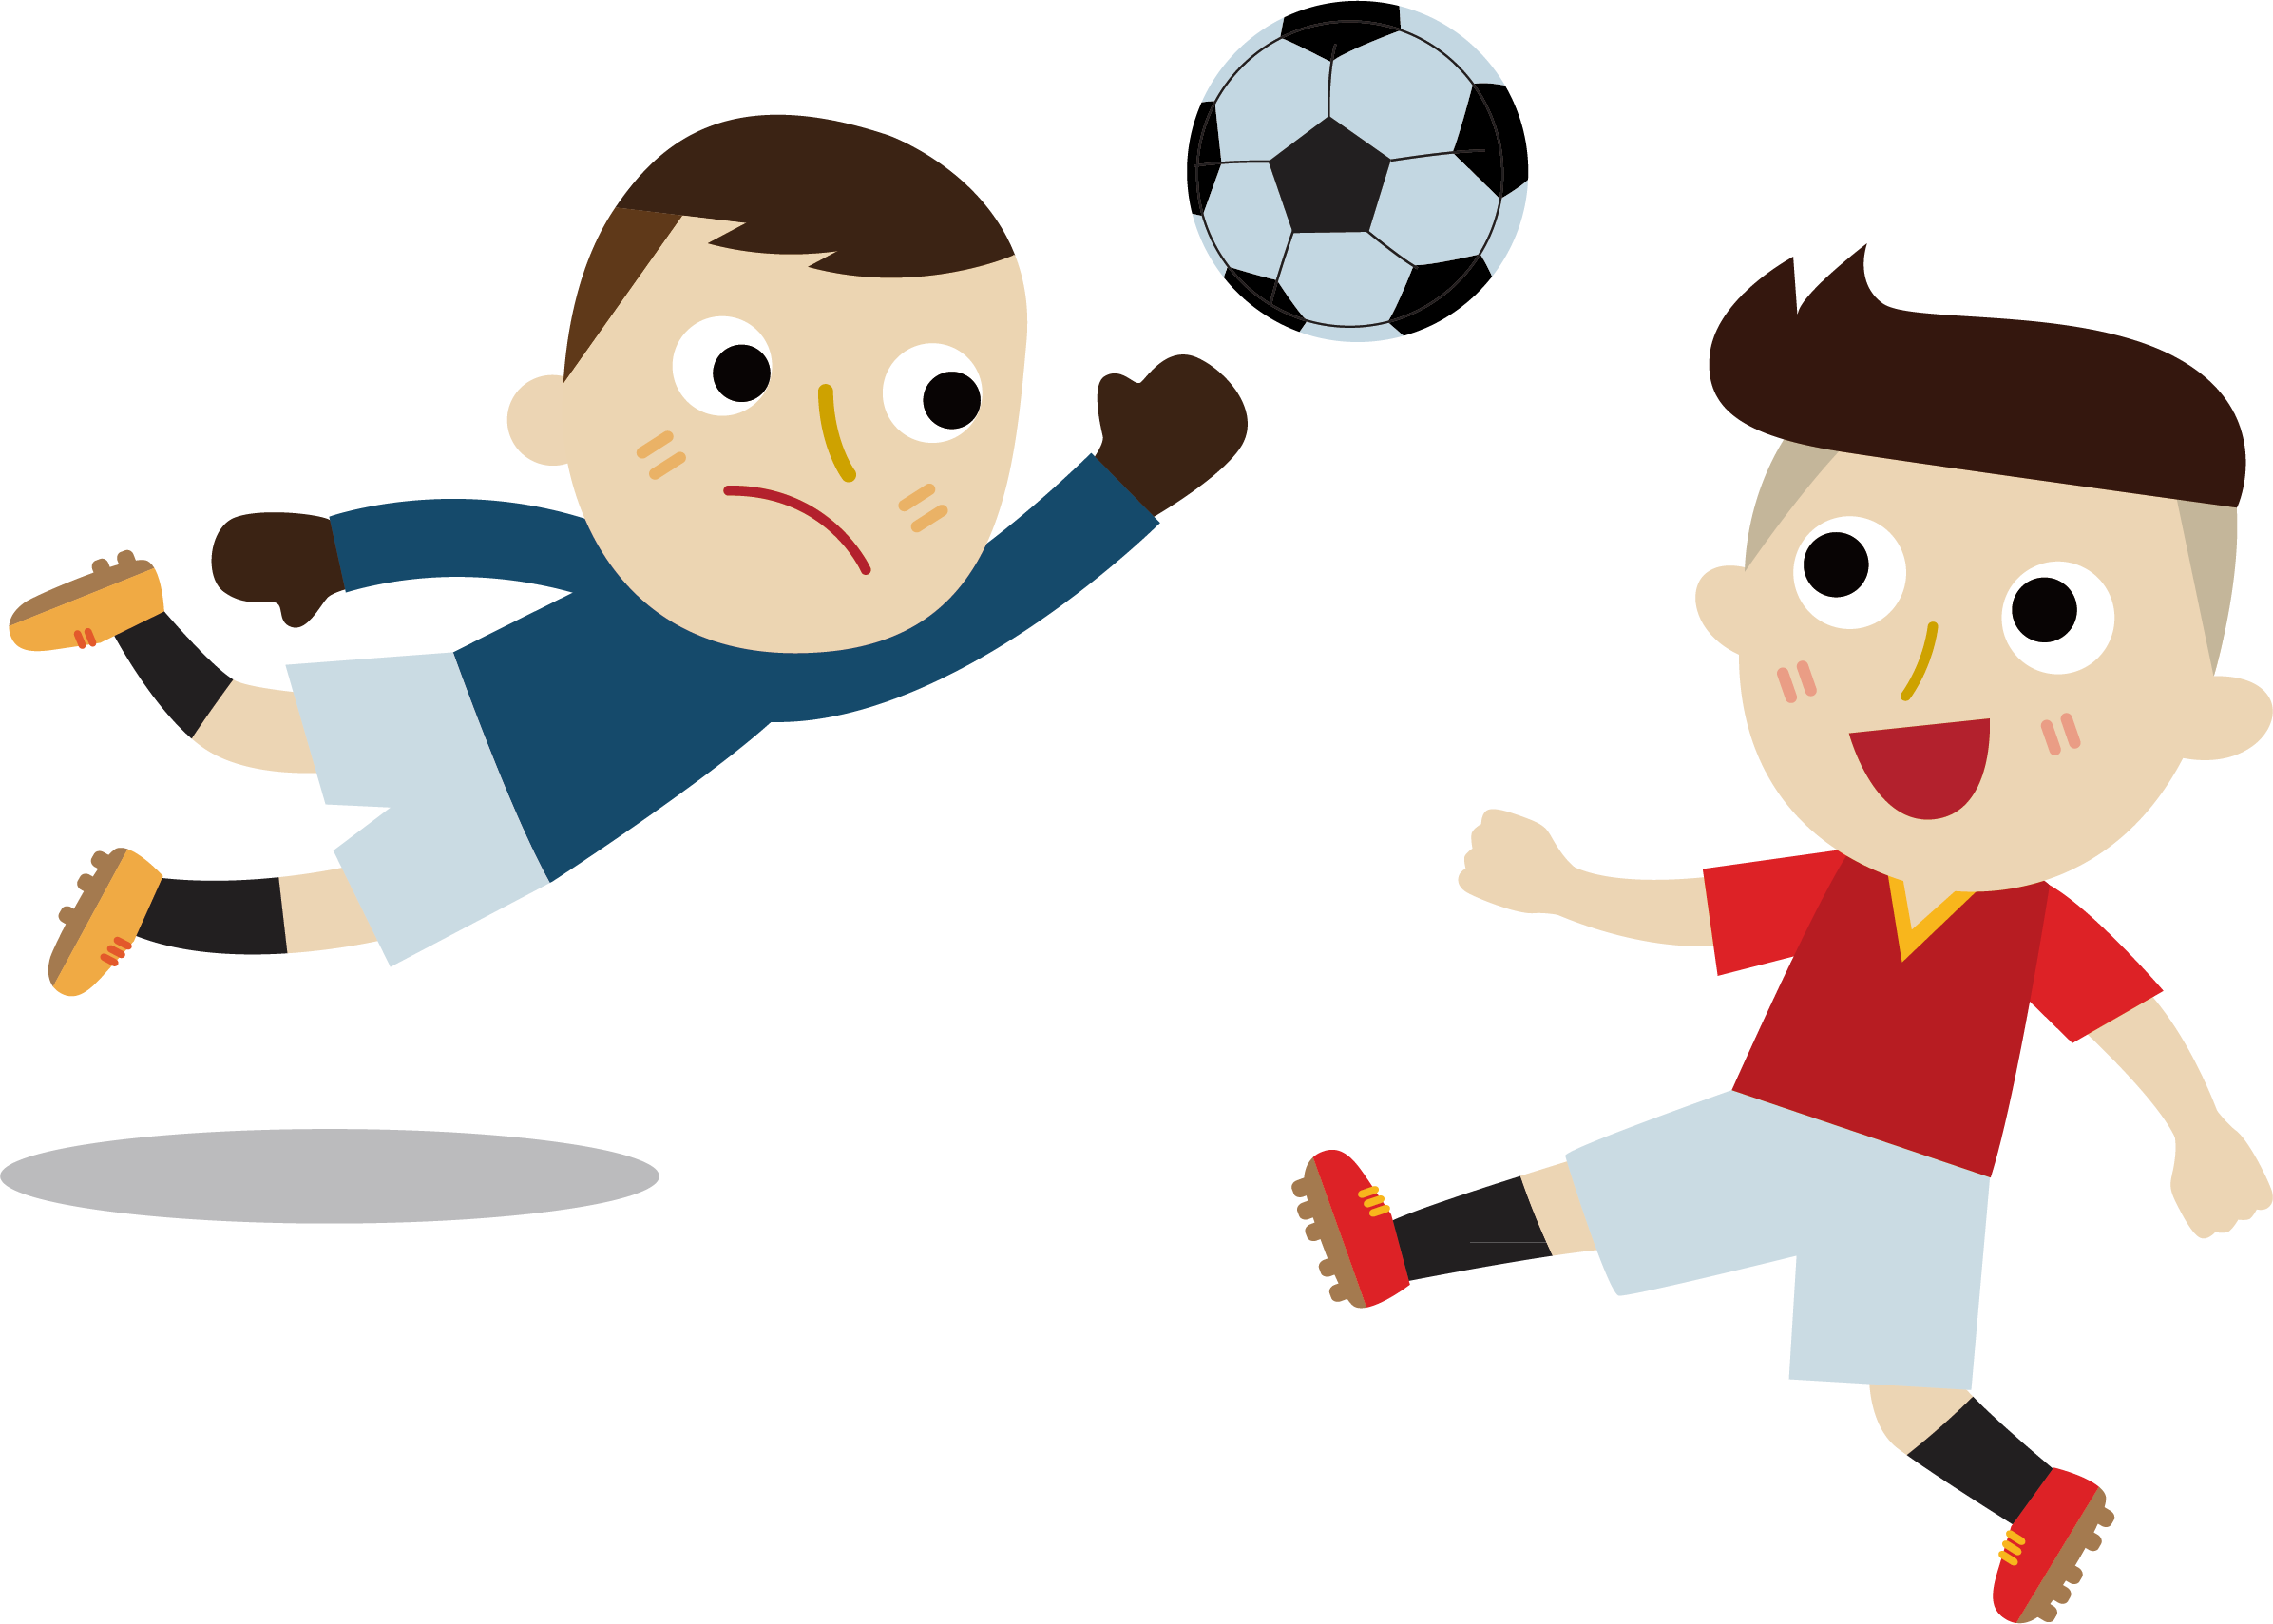
Where / he / play football
He / play football / on the playground

Slide 5

What / they / watch?
They / watch / cartoons.

