Slide 1
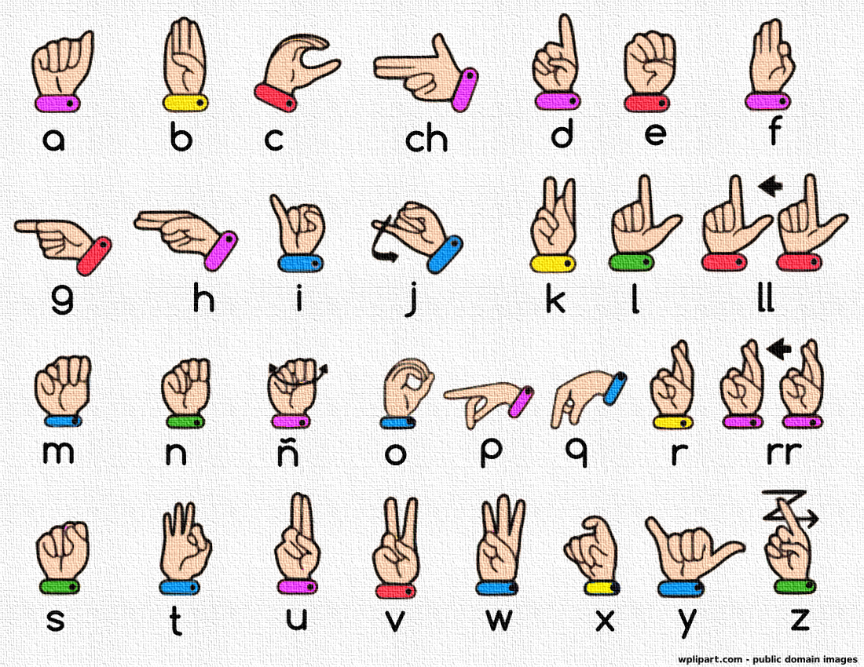



IrinaPapakhinac

Slide 2

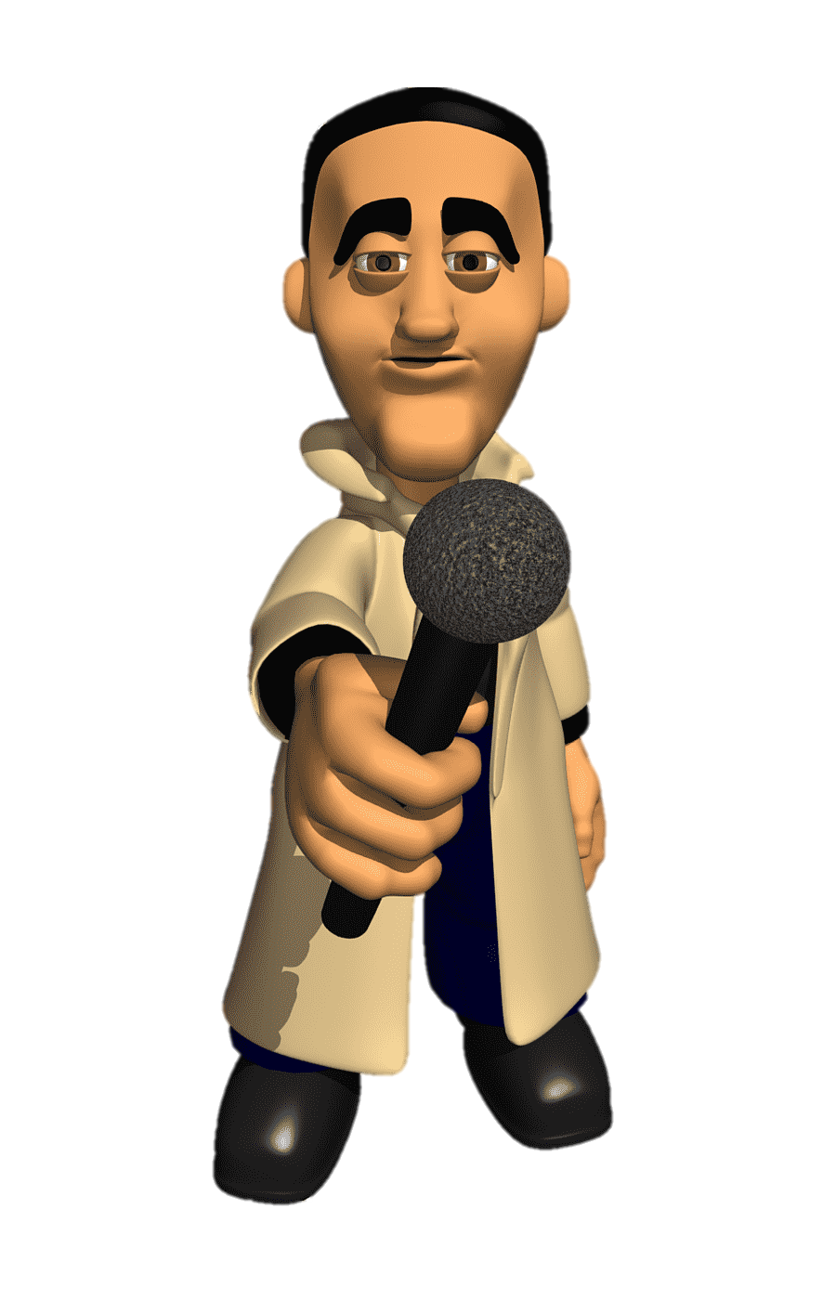
1. Can you speak sign language?
2. Do you know anyone who can speak sign language?

Slide 3



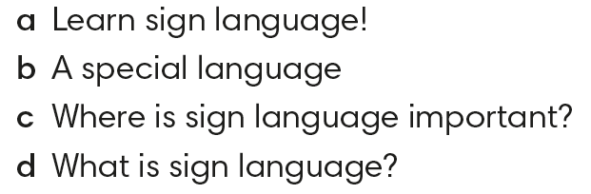

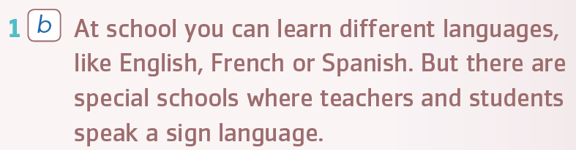
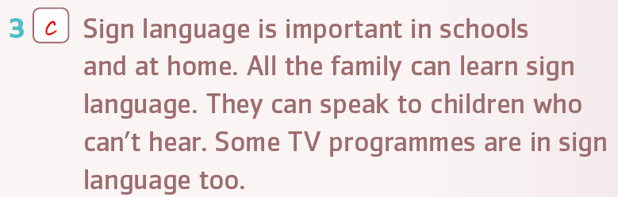
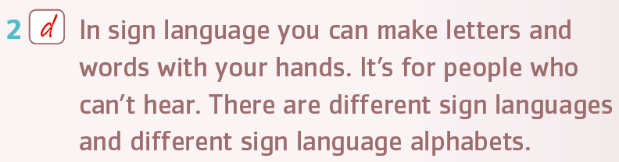
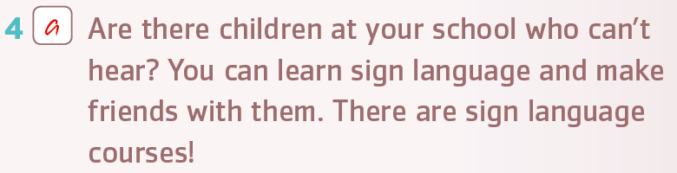
IrinaPapakhinac

Slide 4
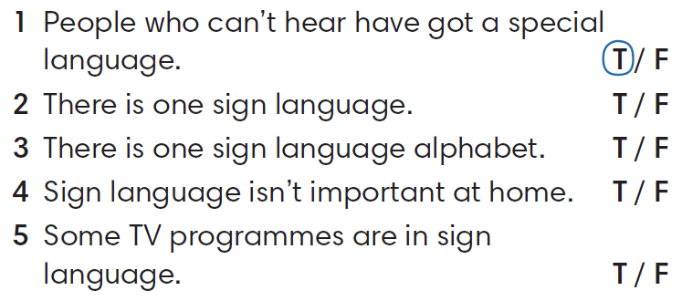
IrinaPapakhinac

Slide 5
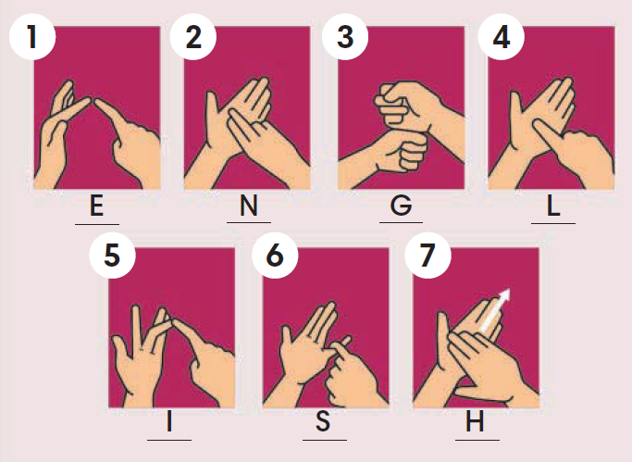
Can you say the following words in sign language?
English
is
his
in
egg
legs
sign
sing
gin
gel
IrinaPapakhinac

Slide 6
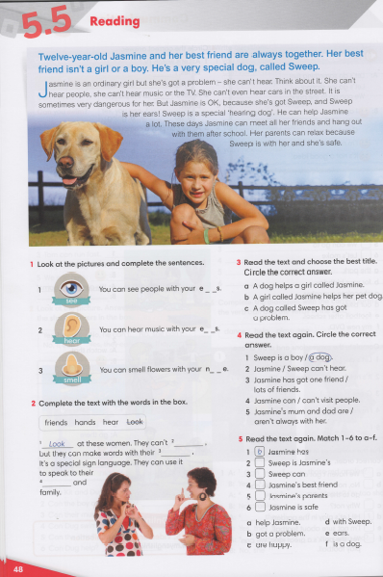


IrinaPapakhinac

