Slide 1




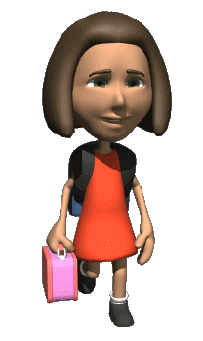

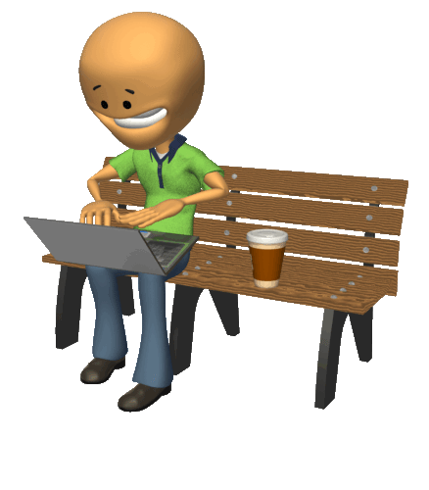

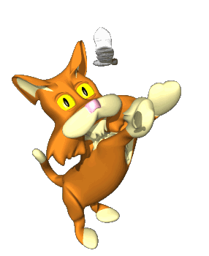

Every day a girl takes the bus to school. She can get off the bus at 2 stops.
The first one is 100 metres before her school. The second stop is 200 metres after her school.
She always rides past the first stop and gets off at the second.
Try to guess why.
NEXT

Slide 2
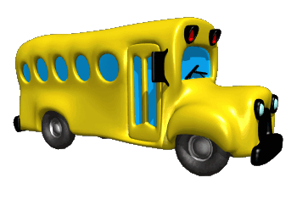
Read this explanation and say whether it’s relevant or not.
Click SOME or ANY.
She doesn’t want to get to school on time, because she still has some / any homework to do.
NEXT

Slide 3

Read this explanation and say whether it’s relevant or not.
Click SOME or ANY.
Her boyfriend comes from the opposite direction.
He gets off at the same stop as her and always needs to give her something / anything.
NEXT

Slide 4
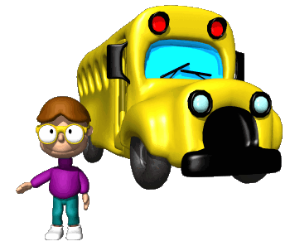
Read this explanation and say whether it’s relevant or not.
Click SOME or ANY.
3. Her school is a school just for girls; it doesn’t have some / any boys.
NEXT

Slide 5
Read this explanation and say whether it’s relevant or not.
Click SOME or ANY.
4. She doesn’t have some / any lessons in the first hour.
NEXT

Slide 6
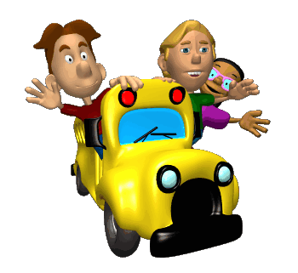
Read this explanation and say whether it’s relevant or not.
Click SOME or ANY.
5. It doesn’t cost her some / any more money to get off at the second stop.
NEXT

Slide 7
Read this explanation and say whether it’s relevant or not.
Click SOME or ANY.
6. Her school is half way up a hill and she doesn’t want to do some / any exercises.
NEXT

Slide 8
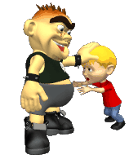
Read this explanation and say whether it’s relevant or not.
Click SOME or ANY.
She doesn’t want to arrive at school early because
there are some / any people that she doesn’t like who wait for her outside the entrance.
NEXT

Slide 9
Read this explanation and say whether it’s relevant or not.
Click SOME or ANY.
8. She doesn’t have some / any friends.
NEXT

Slide 10
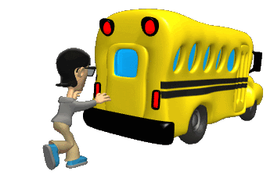

Read this explanation and say whether it’s relevant or not.
Click SOME or ANY.
9. it’s Sunday and there isn’t someone / anyone there.

