Slide 1


Slide 2
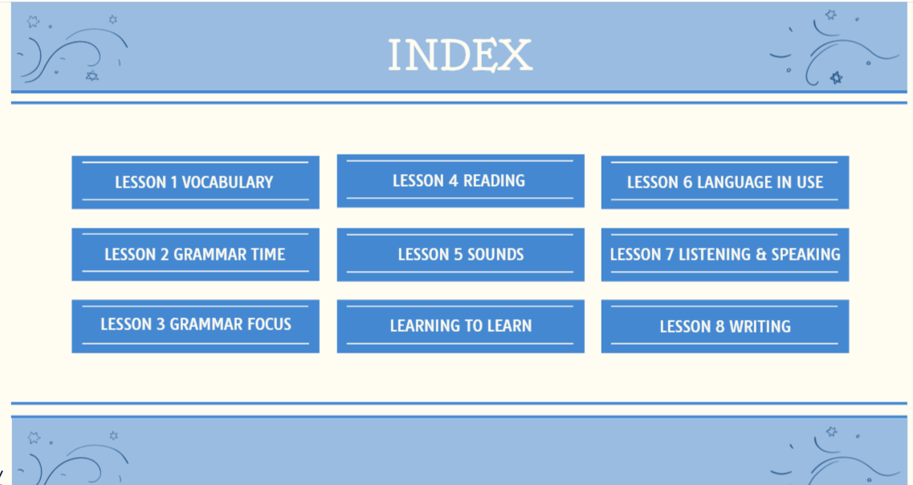

Slide 3


Slide 4


Slide 5
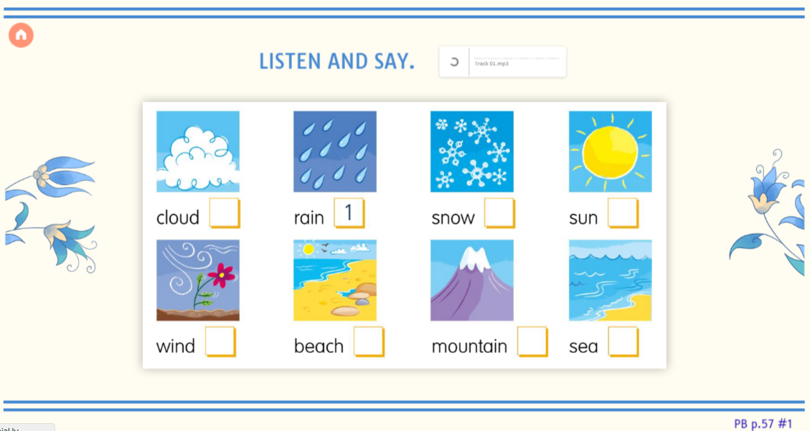

Slide 6
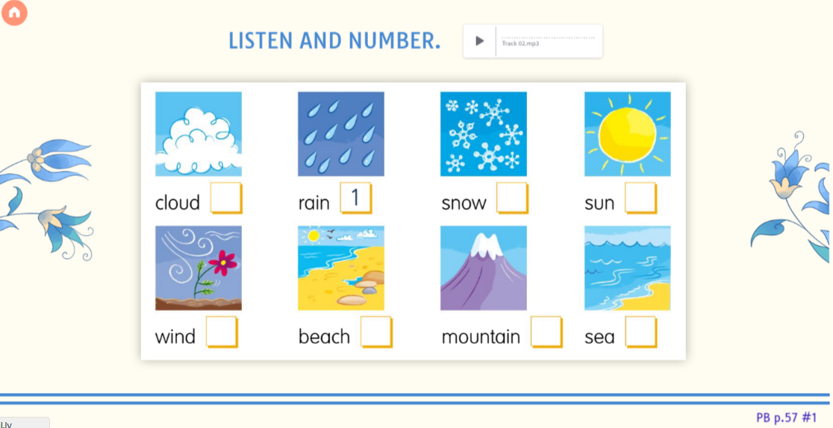

Slide 7
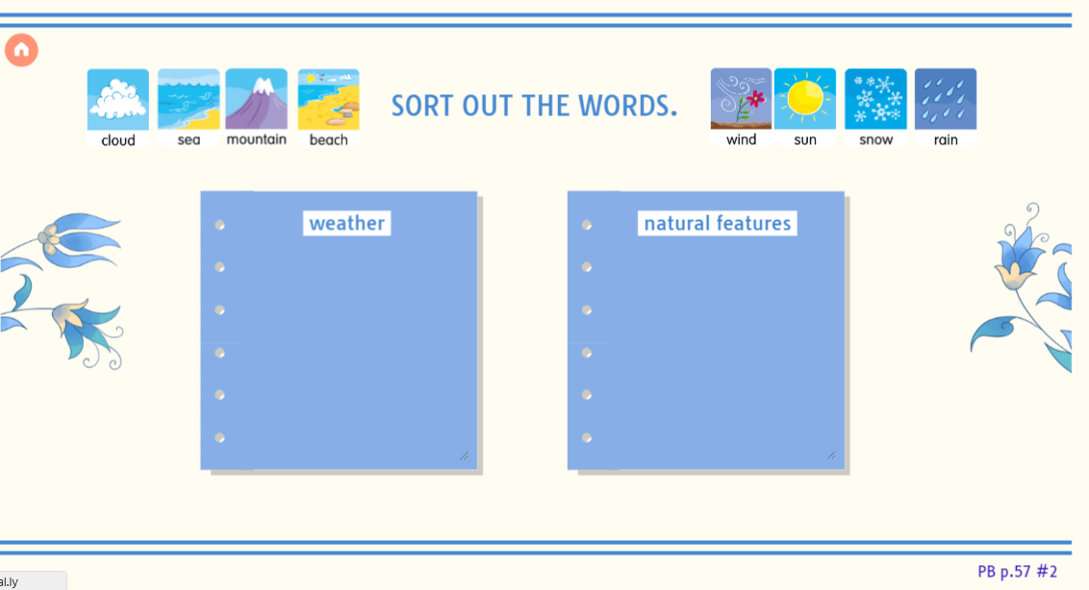

Slide 8


Slide 9
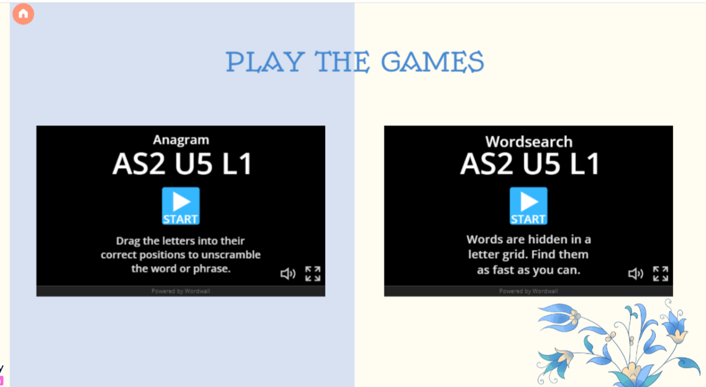

Slide 10
https://wordwall.net/resource/29489686/as2-u5-l1

Slide 11
https://wordwall.net/resource/17237412/as2-u5-l1

Slide 12
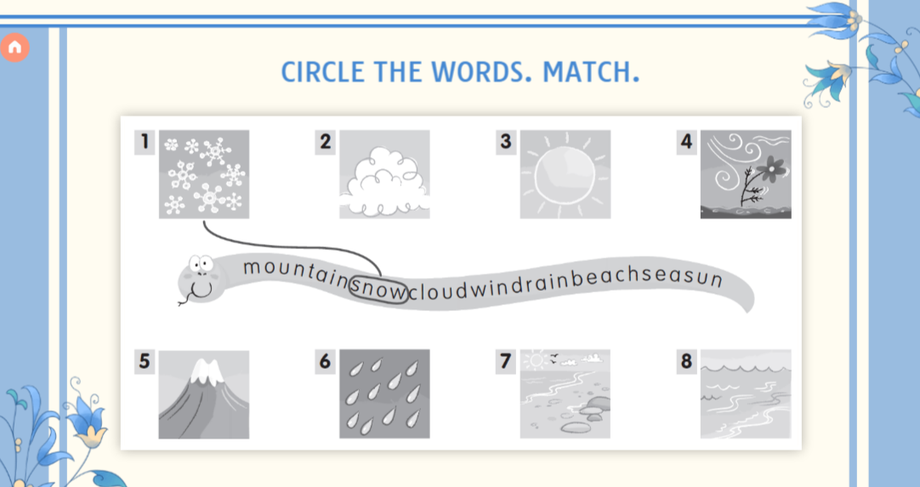

Slide 13
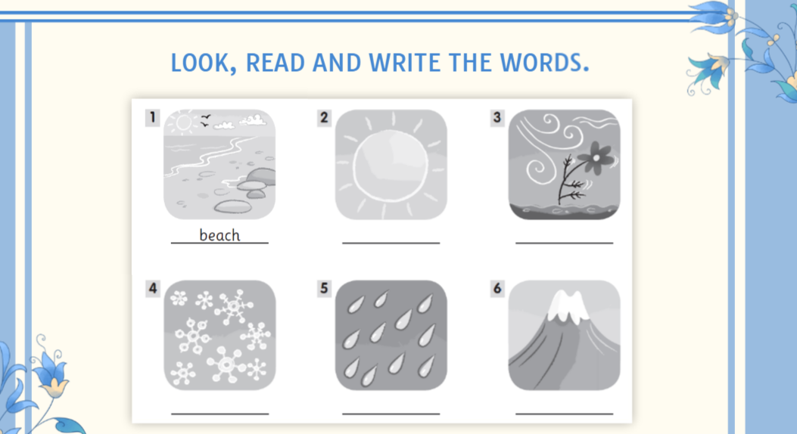

Slide 14
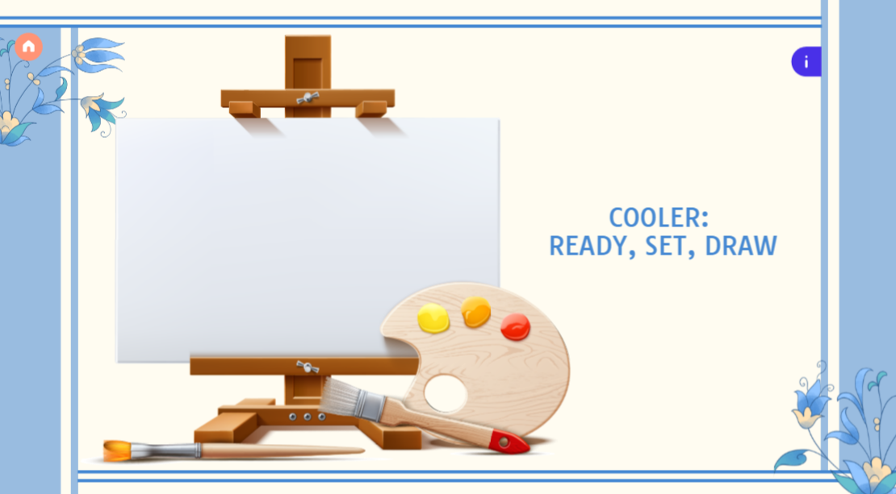

Slide 15
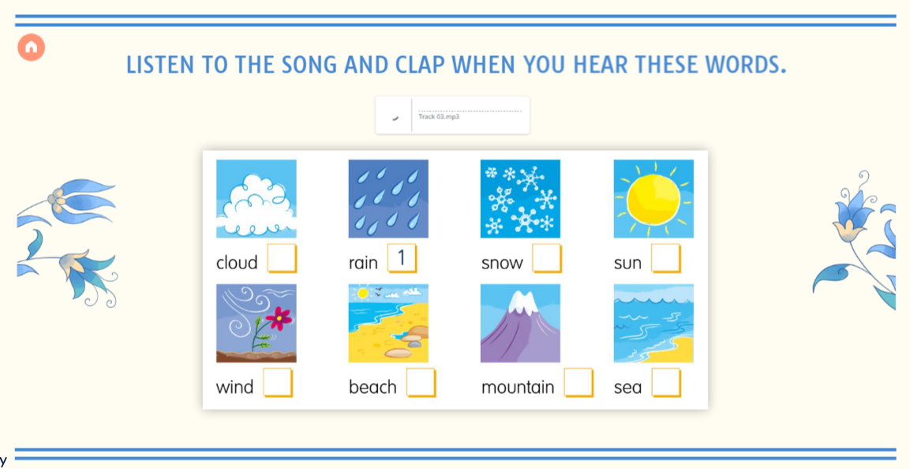

Slide 16
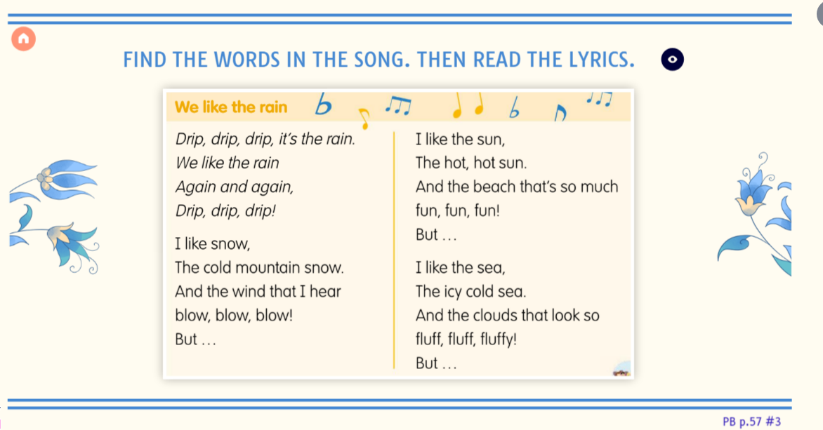

Slide 17
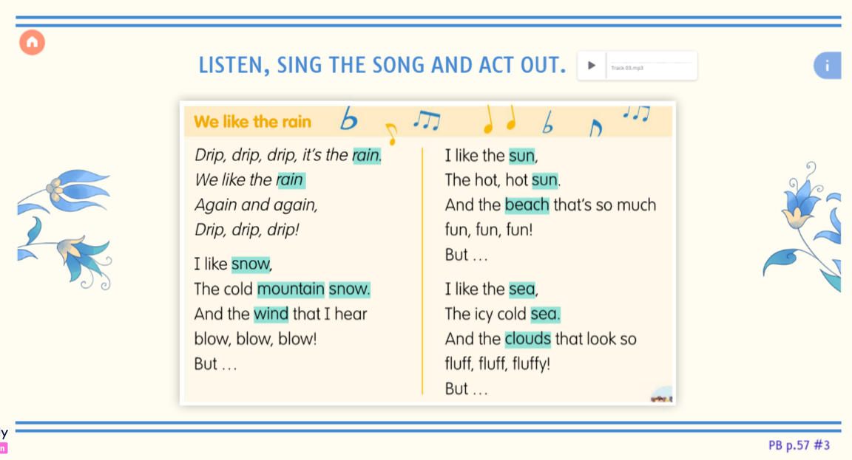

Slide 18


Slide 19
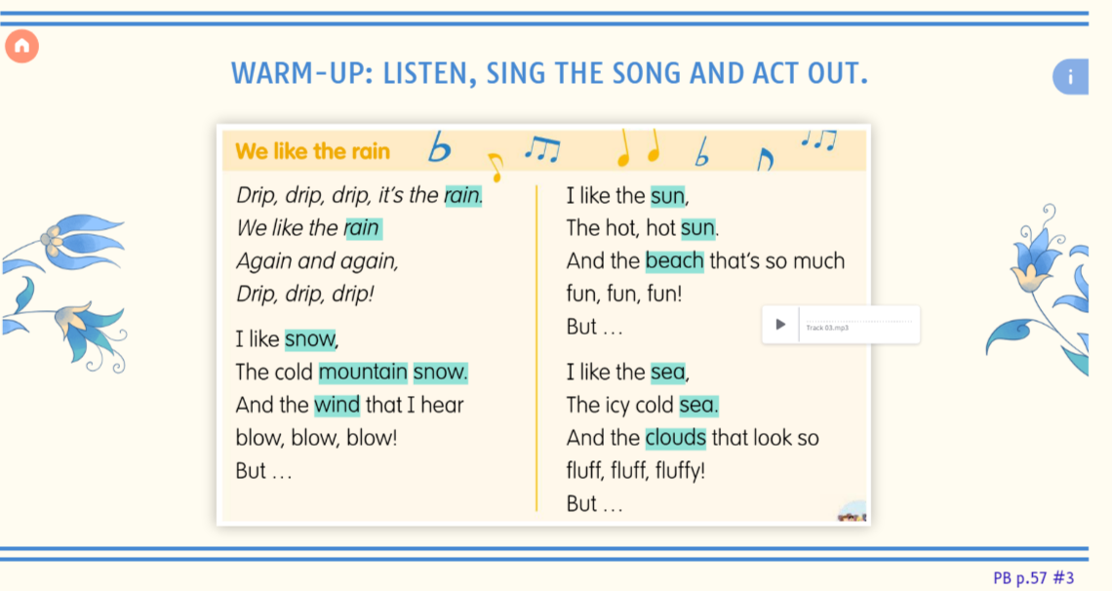

Slide 20
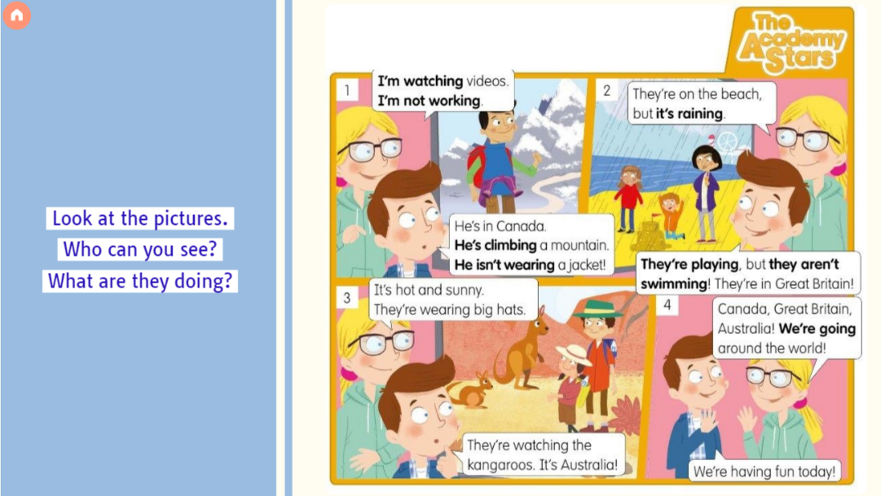

Slide 21
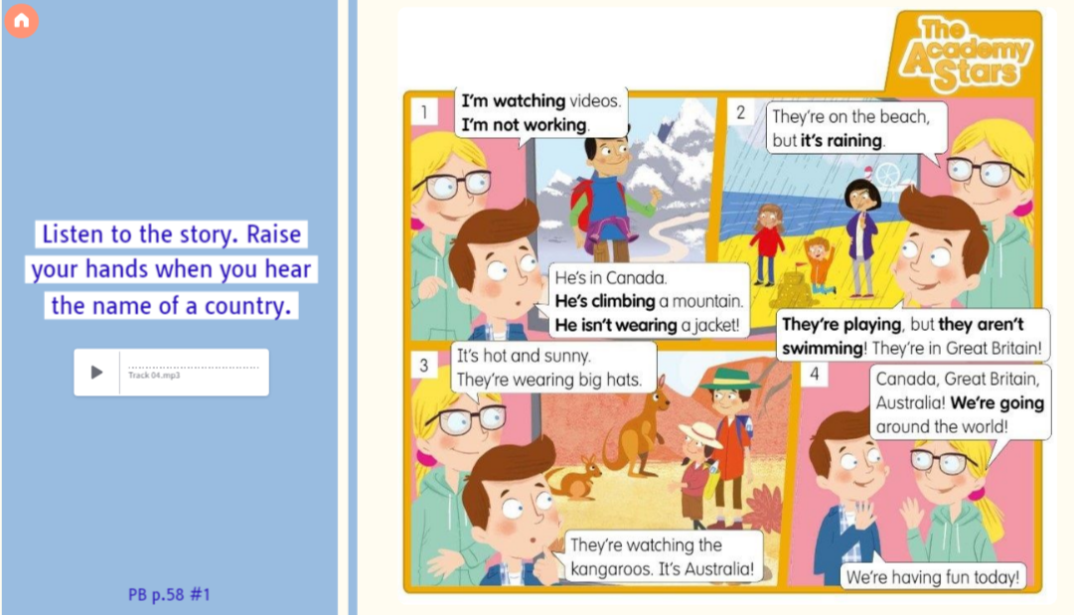

Slide 22
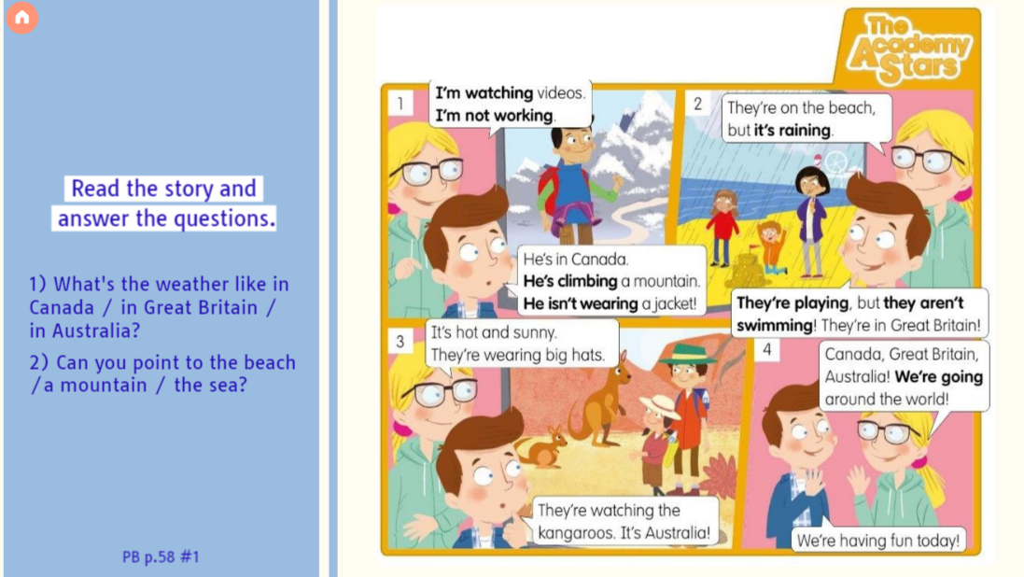

Slide 23


Slide 24
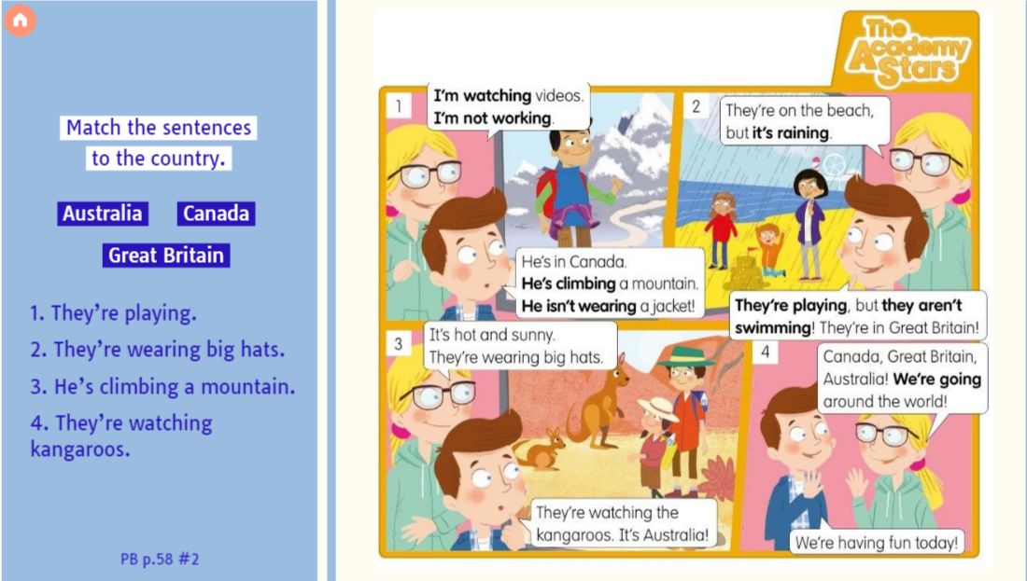

Slide 25
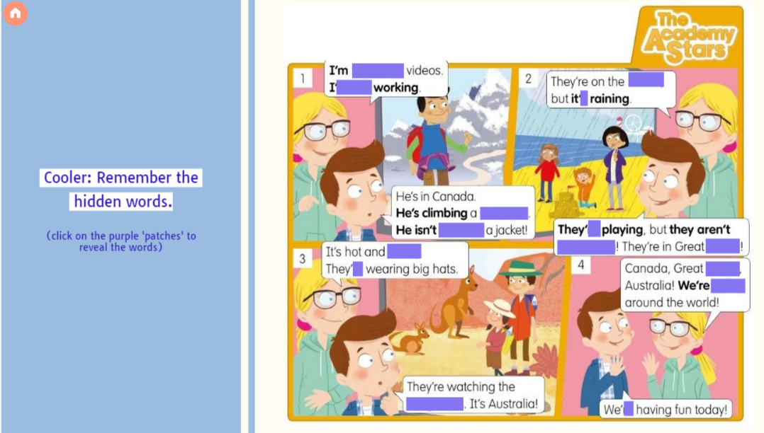

Slide 26
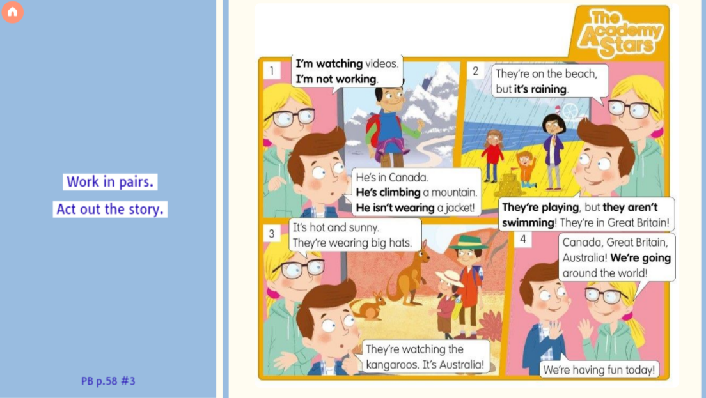

Slide 27
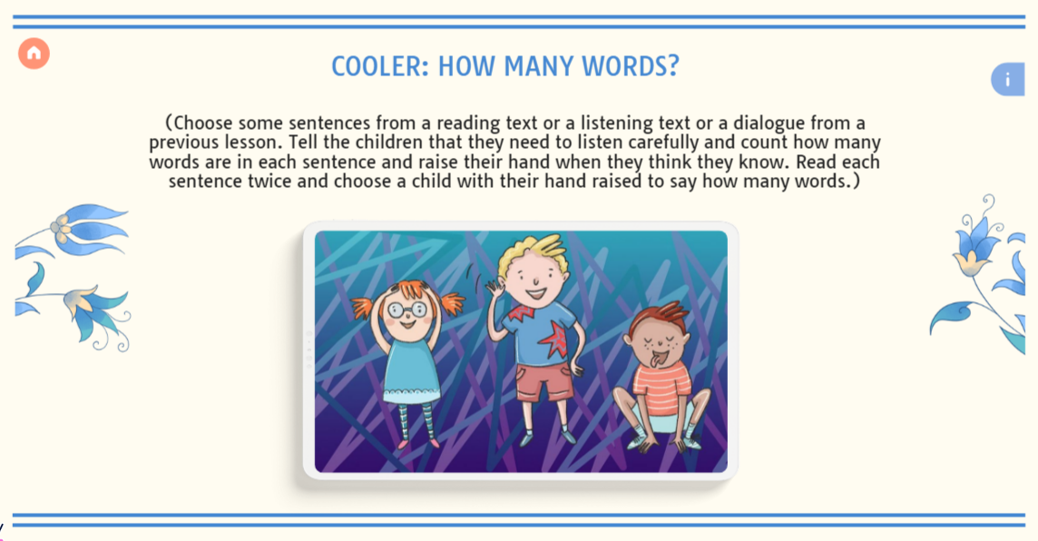

Slide 28


Slide 29
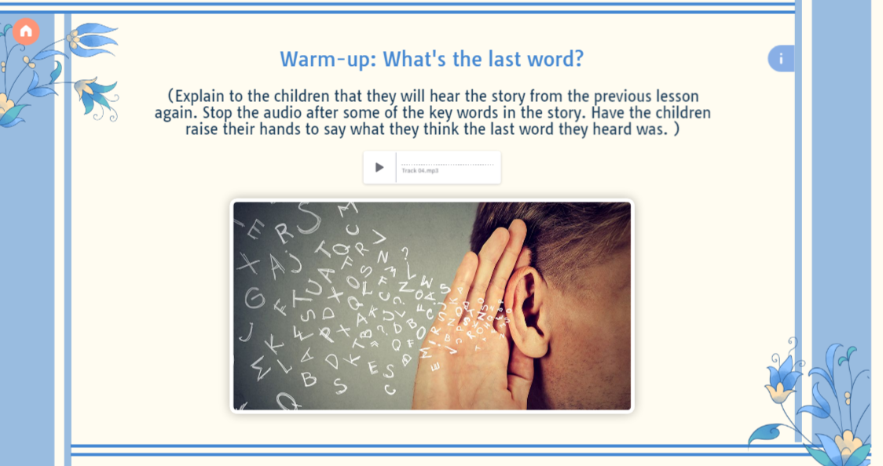

Slide 30
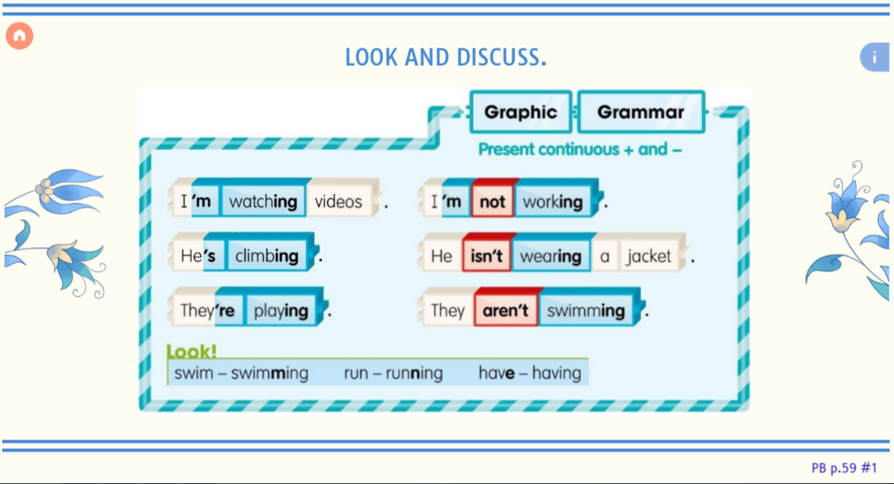

Slide 31
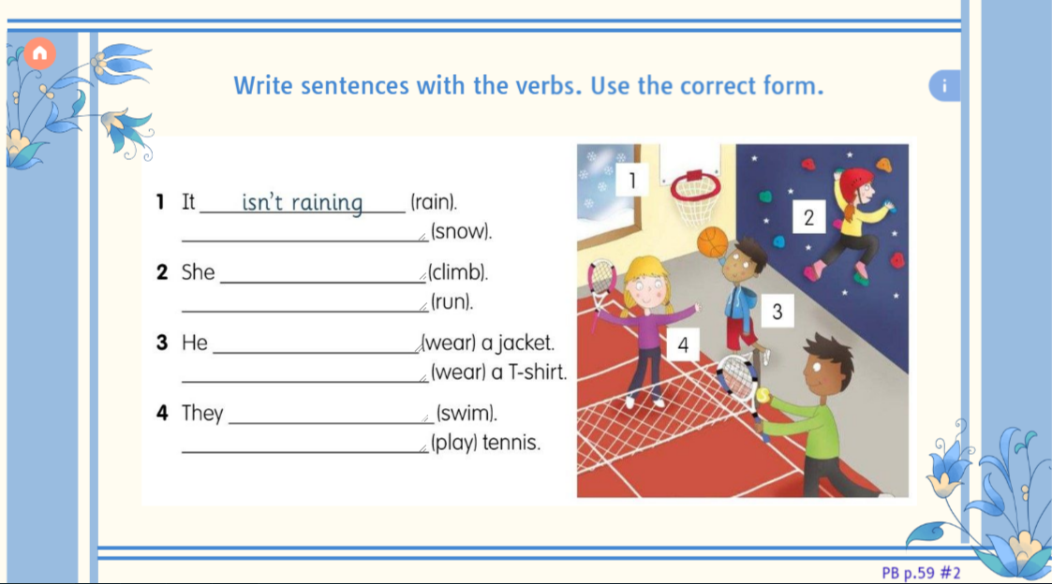

Slide 32
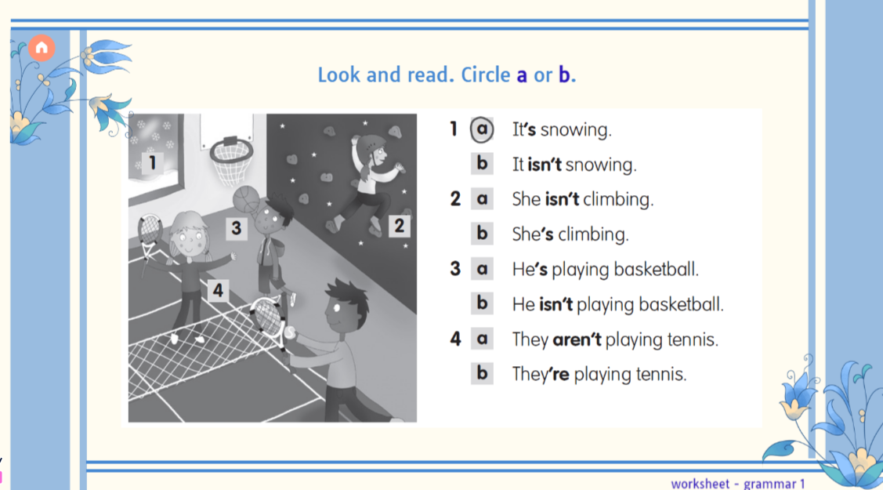

Slide 33
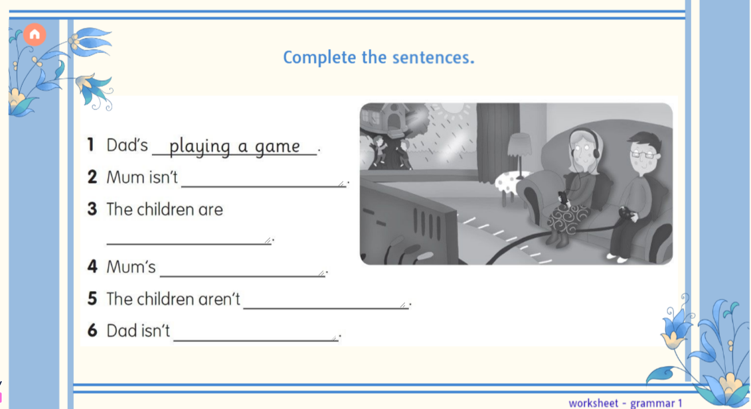

Slide 34
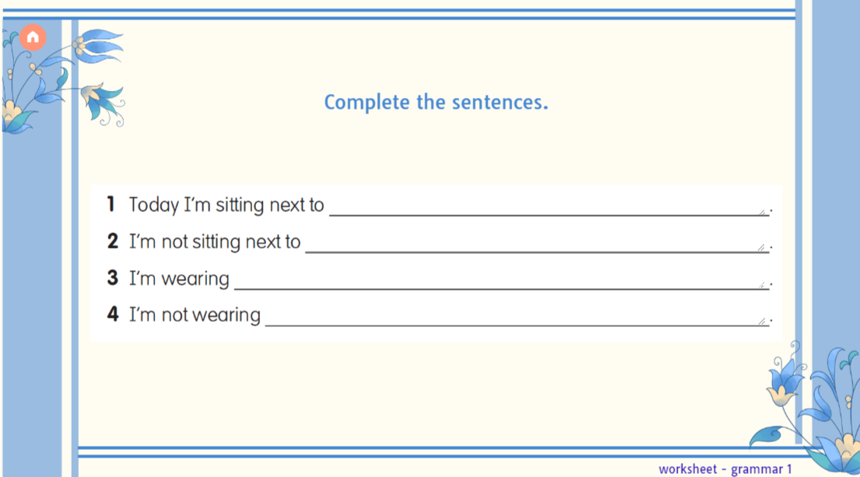

Slide 35
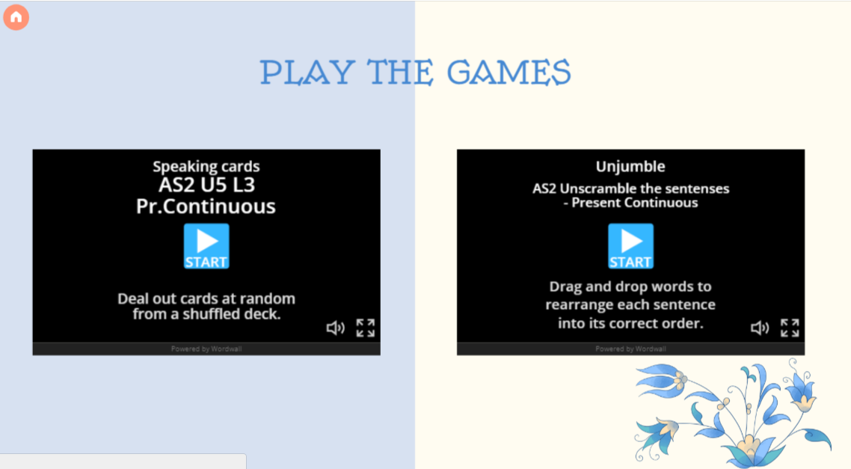

Slide 36
https://wordwall.net/resource/45070877/as2-u5-l3-prcontinuous

Slide 37
https://wordwall.net/resource/8118784/as2-unscramble-the-sentenses-present-continuous

Slide 38
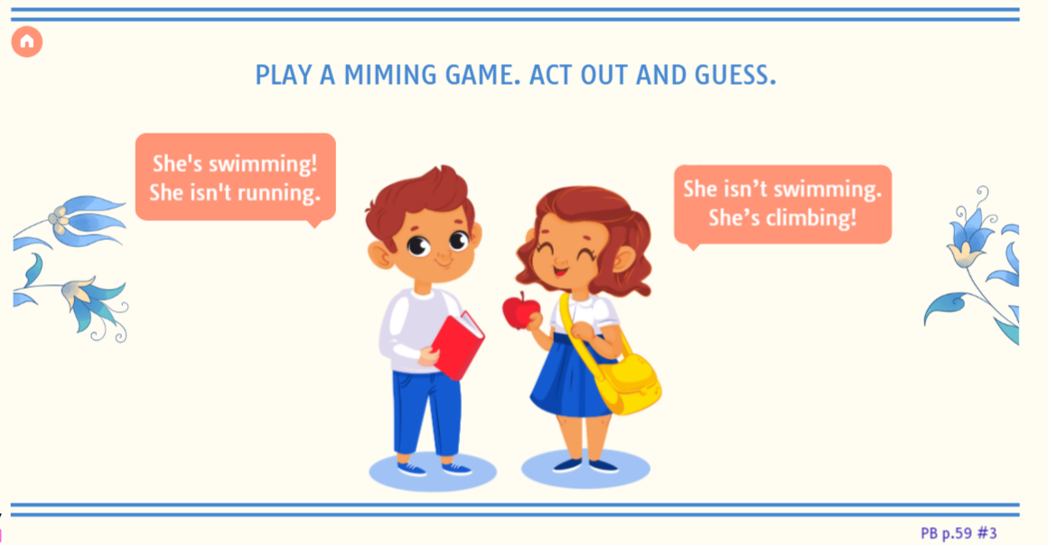

Slide 39


Slide 40
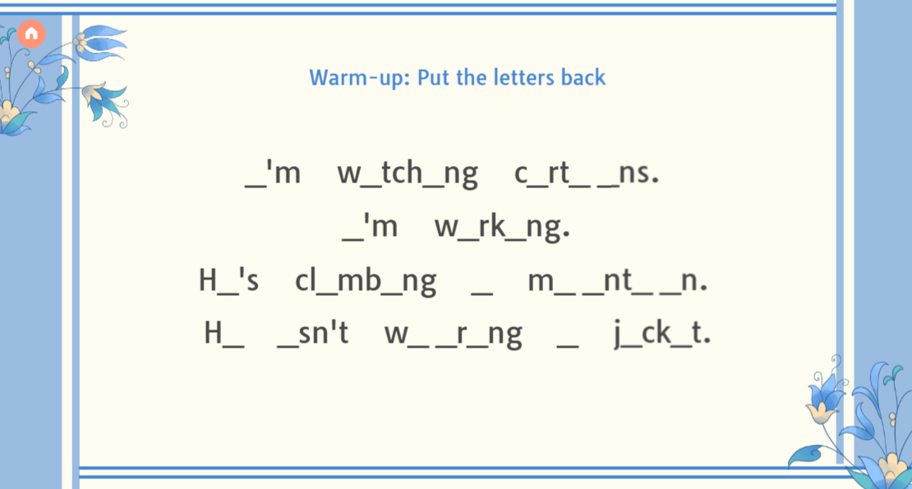

Slide 41
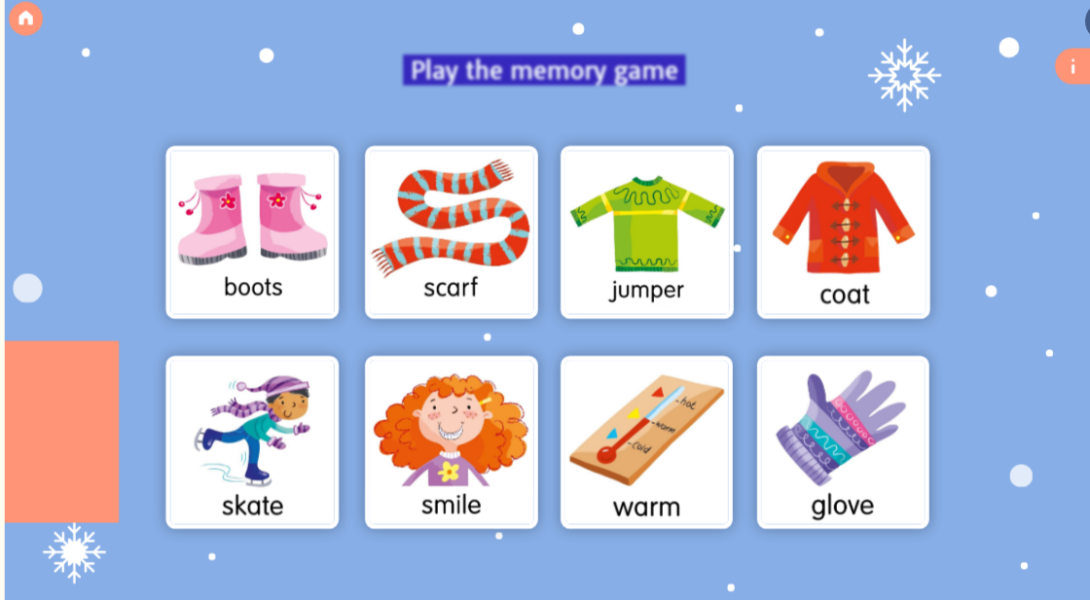

Slide 42
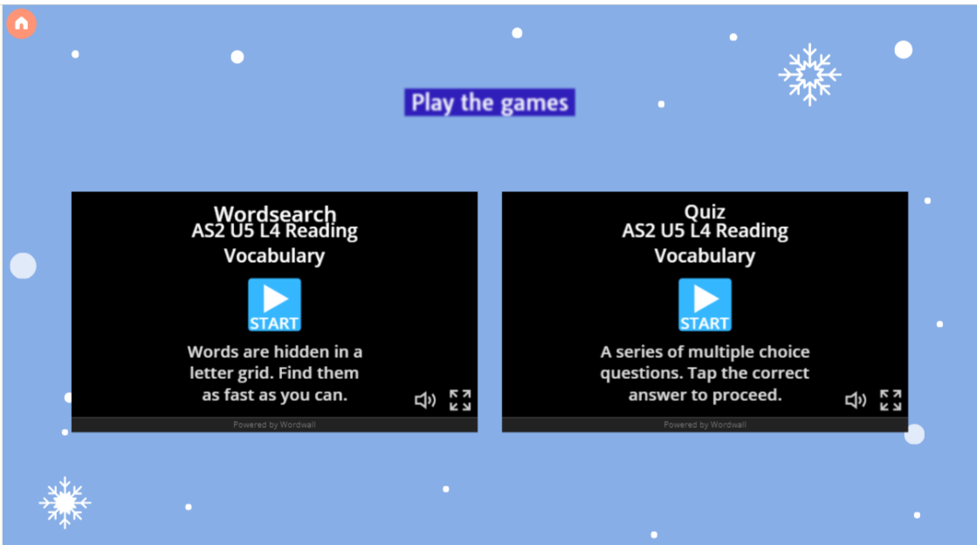

Slide 43
https://wordwall.net/resource/17456272/as2-u5-l4-reading-vocabulary

Slide 44
https://wordwall.net/resource/65776582/as2-u5-l4-reading-vocabulary

Slide 45


Slide 46
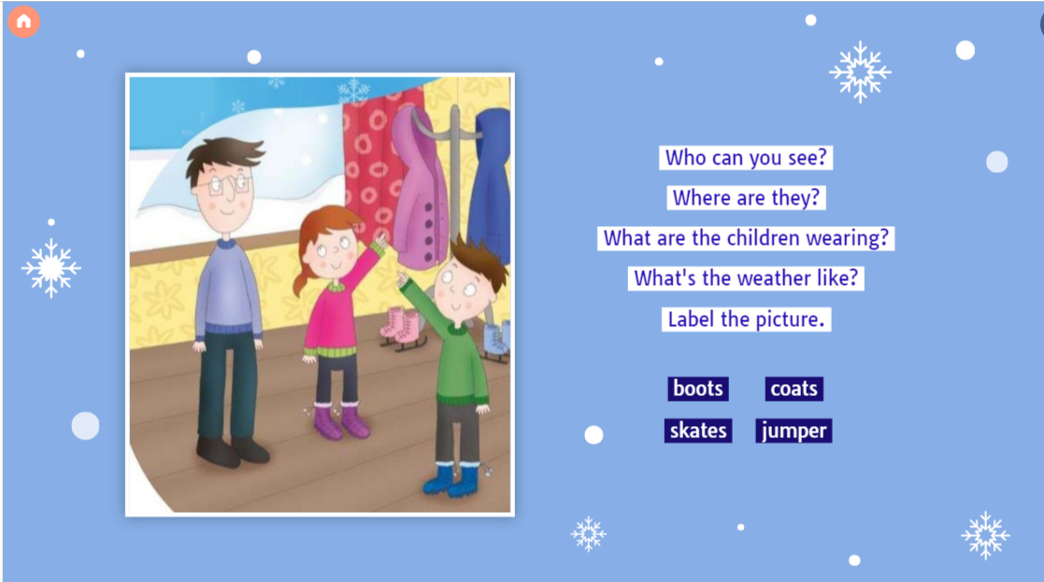

Slide 47
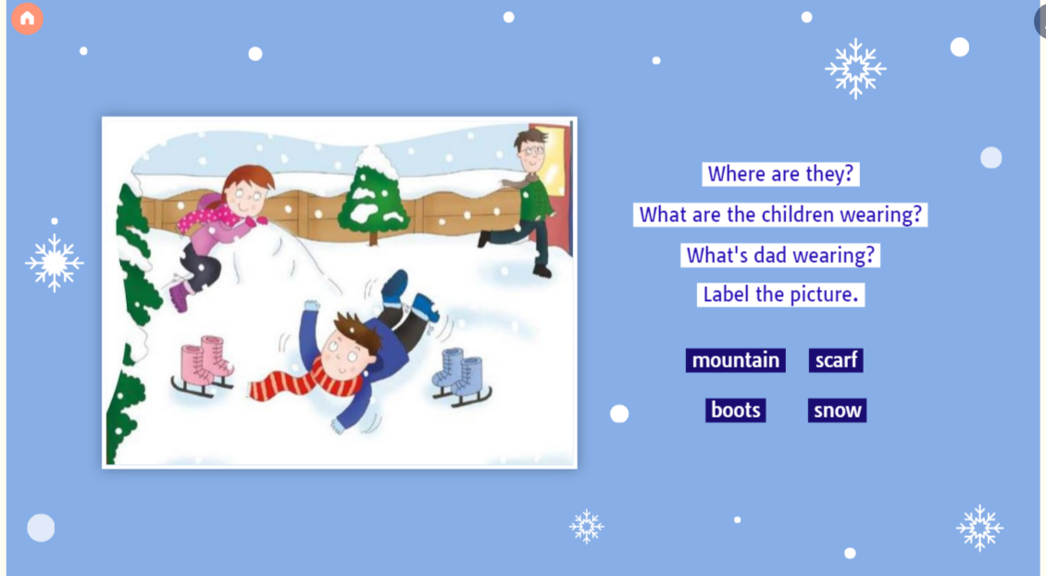

Slide 48
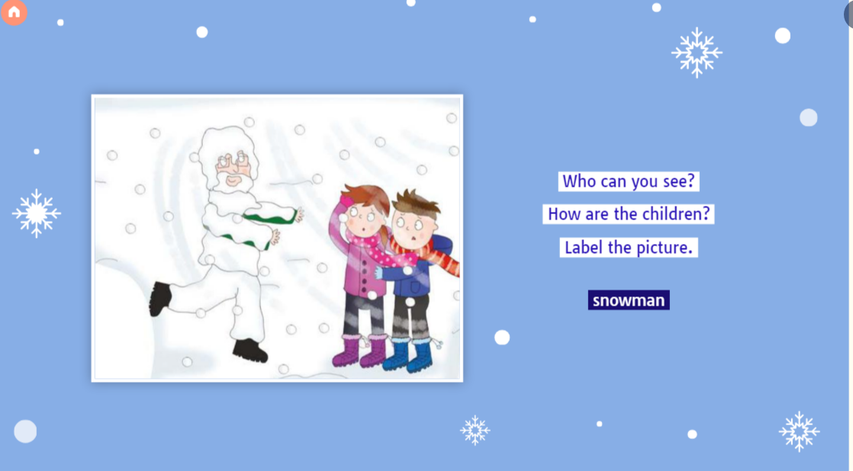

Slide 49
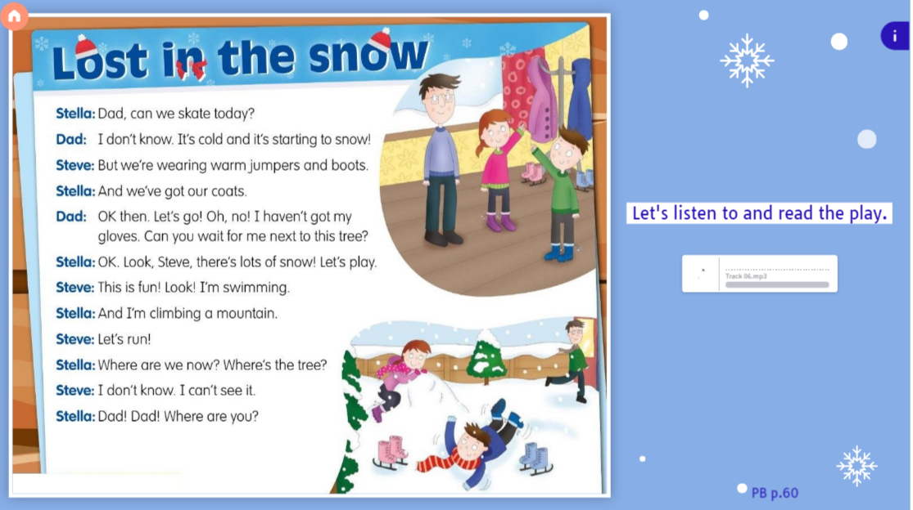

Slide 50
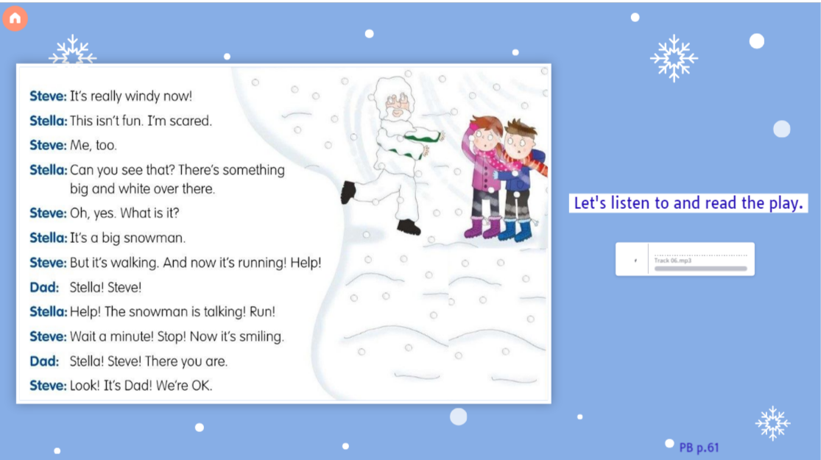

Slide 51
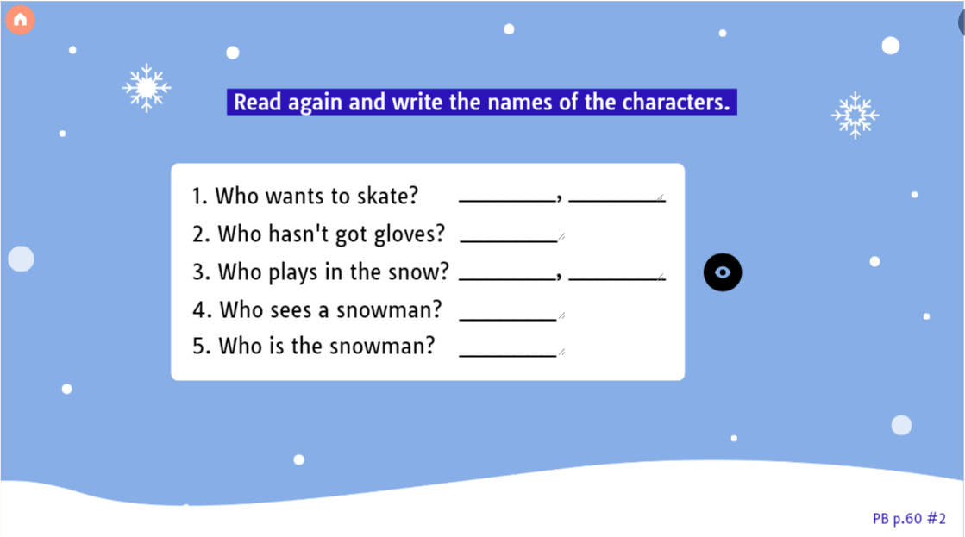

Slide 52
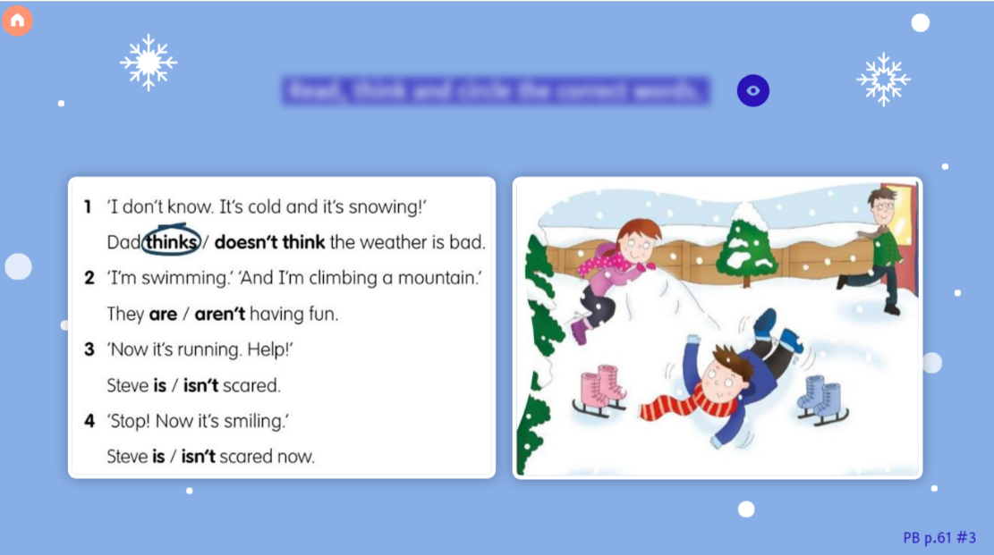

Slide 53
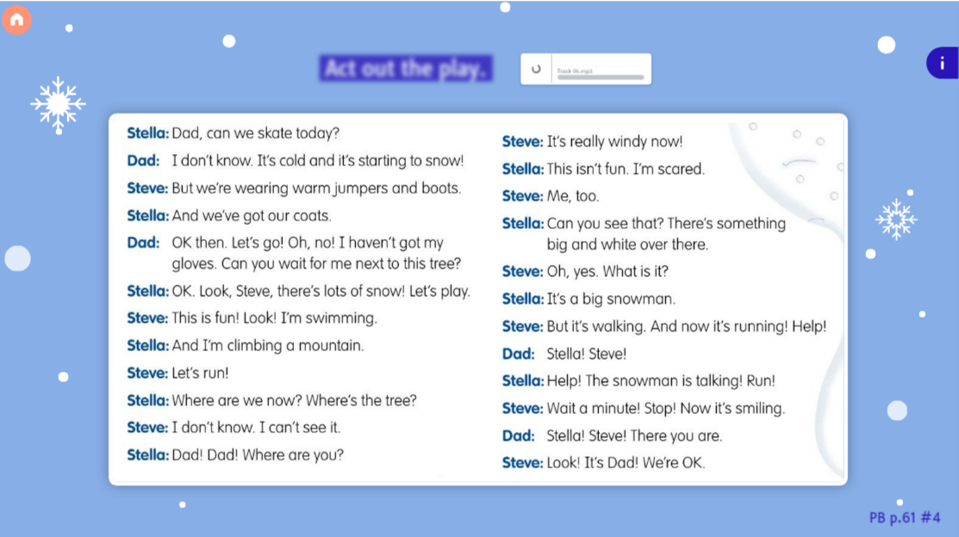

Slide 54


Slide 55
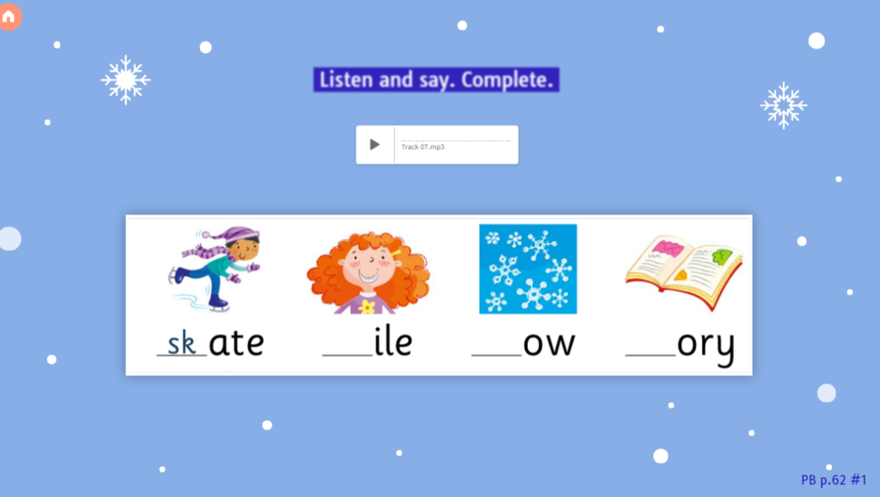

Slide 56
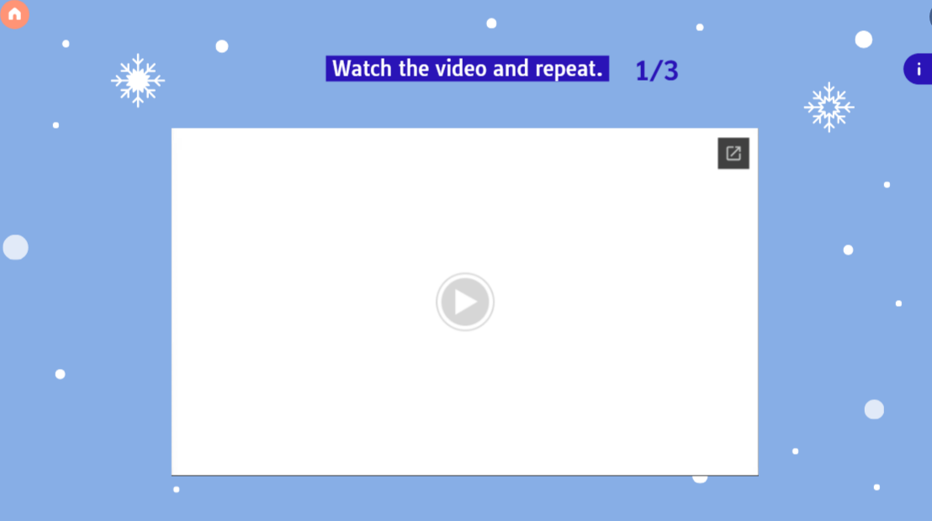

Slide 57
https://lh3.googleusercontent.com/u/0/drive-viewer/AKGpihabaku_wJ9w1SEZhEmv6q243fc88AKuTzN2OljfmiYXjiqoZnpY3IcCHJ1opQk4A_E7_K5mwf9UgVSARxRxk2F-rBC-32rcIQ=w1920-h1080-k-rw-v1-pd

Slide 58
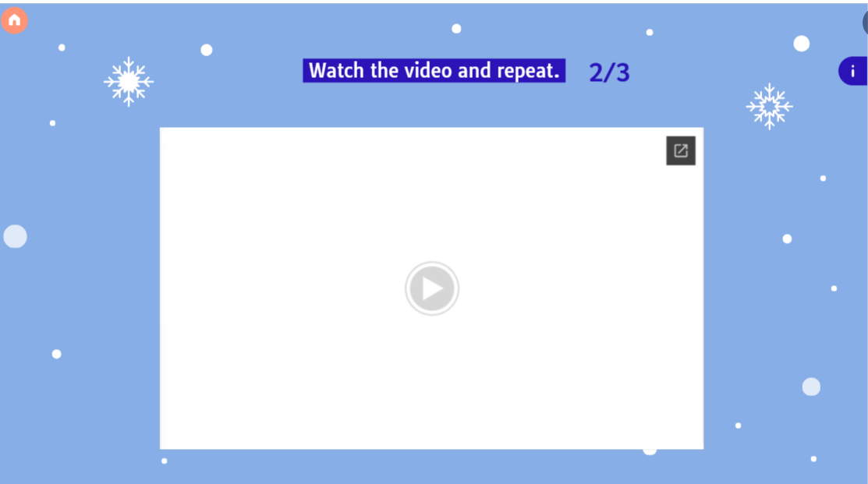

Slide 59
https://lh3.googleusercontent.com/u/0/drive-viewer/AKGpihZ0SXt50EDeMi03Wn2ymbgnGOE_Yr9lTfKgO5wj9lLJYNCRG_xfk7JZM3QfuzQbA7PCnX-eV6bfGc5_CAcJgK814MViE-aEvsk=w1920-h1080-k-rw-v1-pd

Slide 60
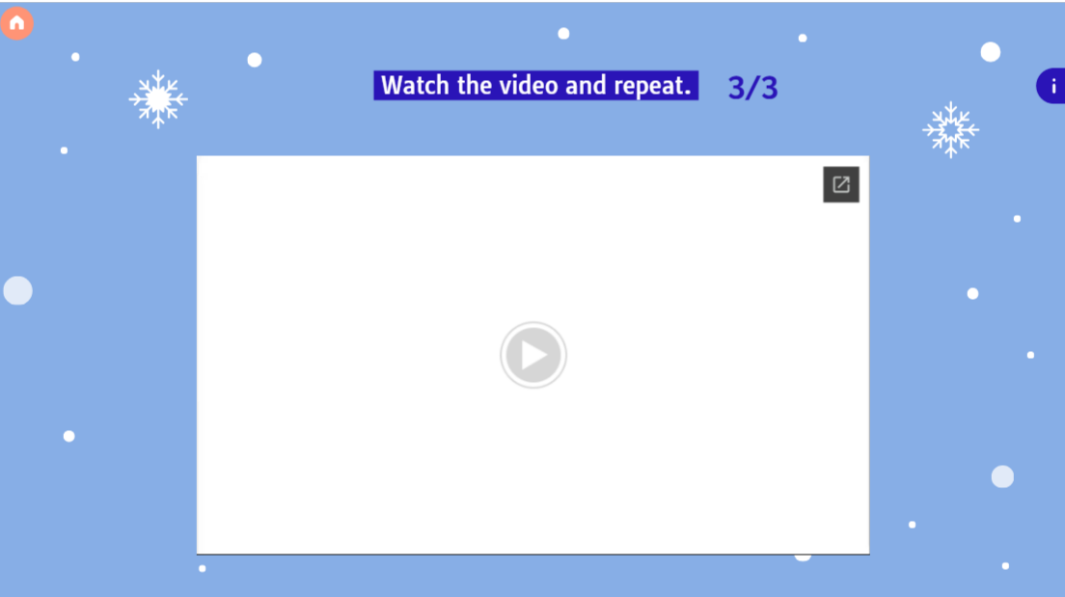

Slide 61
https://lh3.googleusercontent.com/u/0/drive-viewer/AKGpihbK468ftoix3TBqn9qRUBtOH-mCH9zMzcQY0kQou4_bDz5lApOeT59DqX8E8ajBpbkg0HKcuD-Q-ewF-eOHQY25kDlX5_4Gan0=w1920-h1080-k-rw-v1-pd

Slide 62
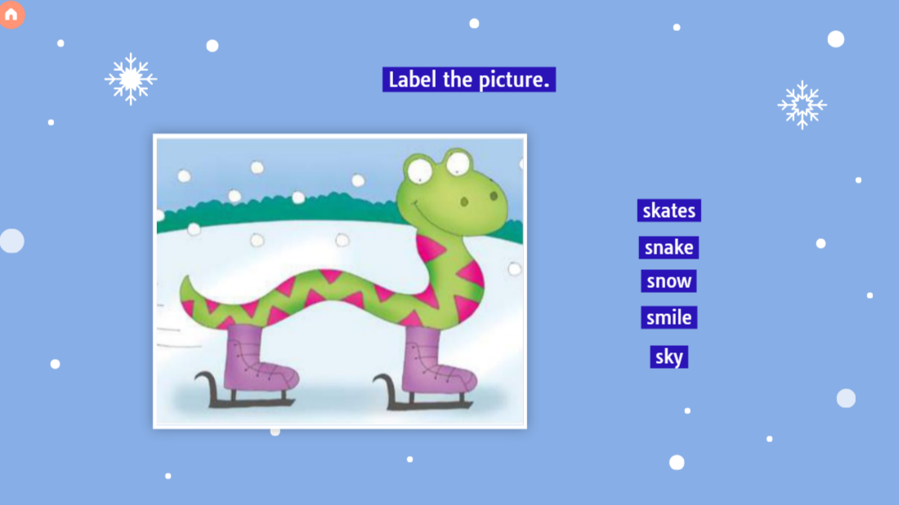

Slide 63
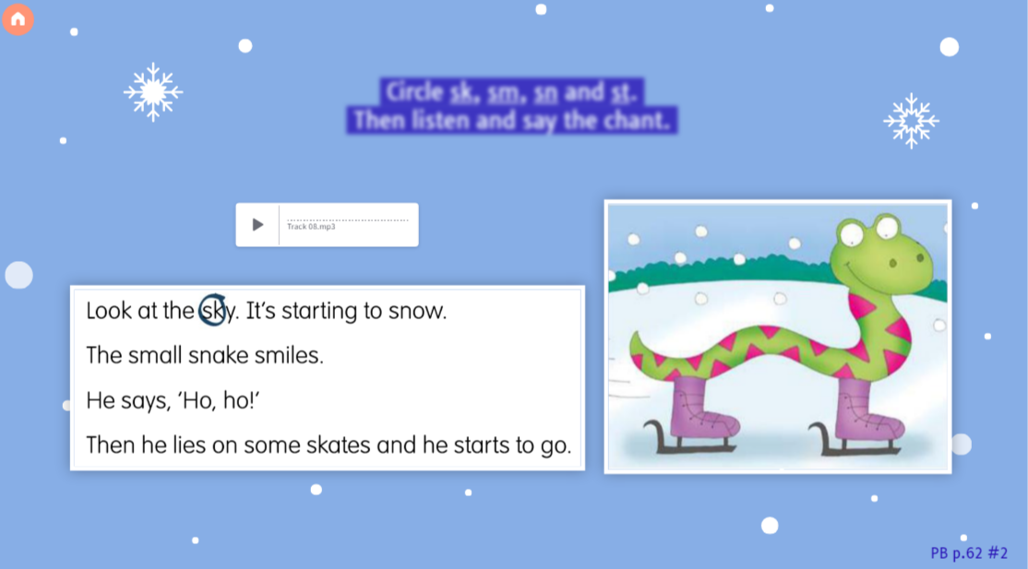

Slide 64
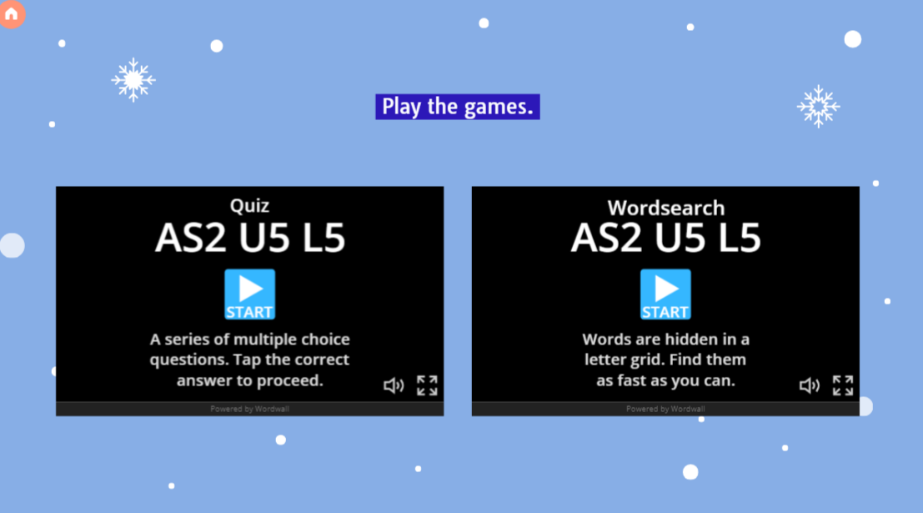

Slide 65
https://wordwall.net/resource/65839128/as2-u5-l5

Slide 66
https://wordwall.net/resource/65839208/as2-u5-l5

Slide 67
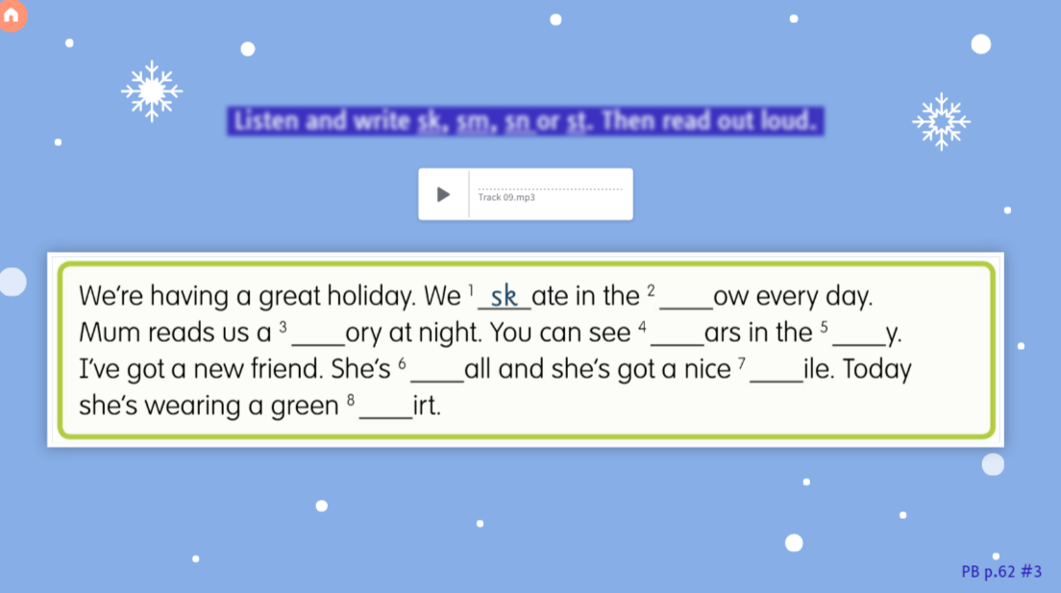

Slide 68
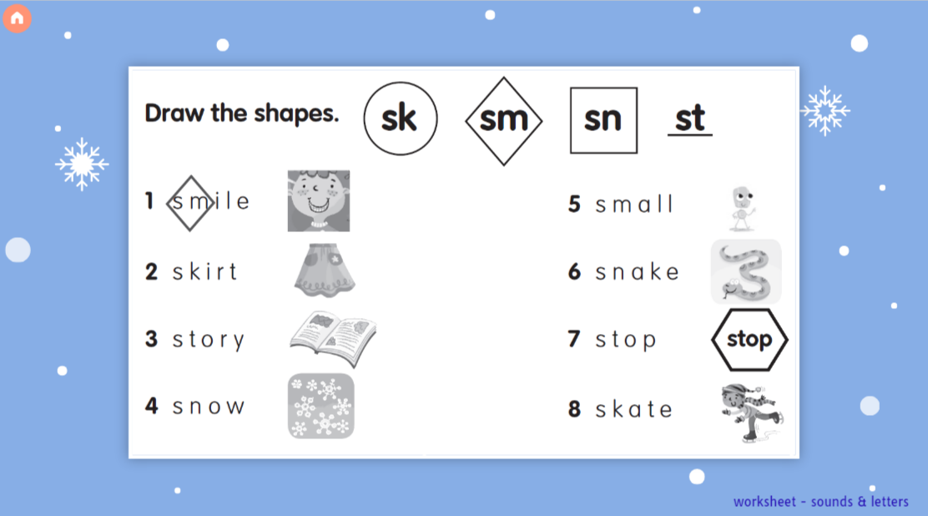

Slide 69
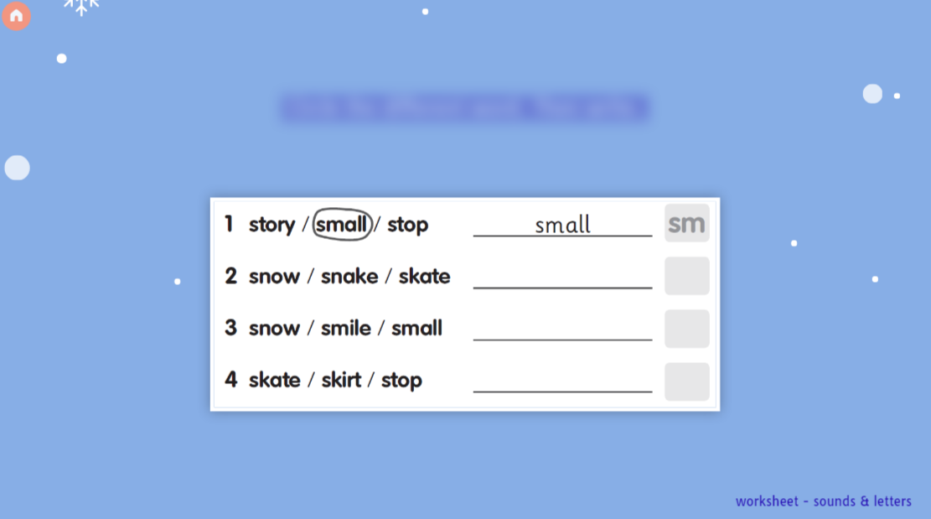

Slide 70
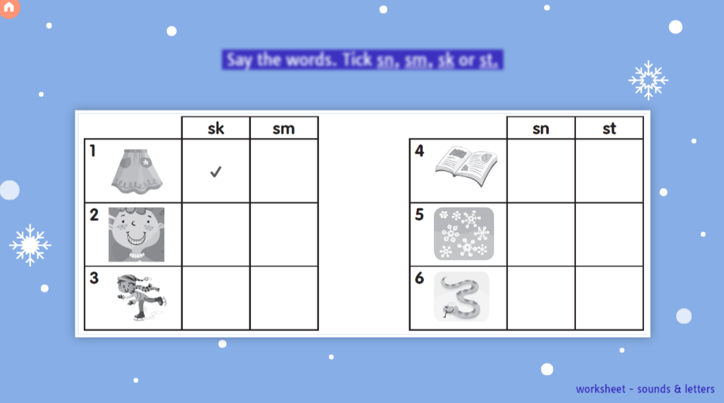

Slide 71


Slide 72
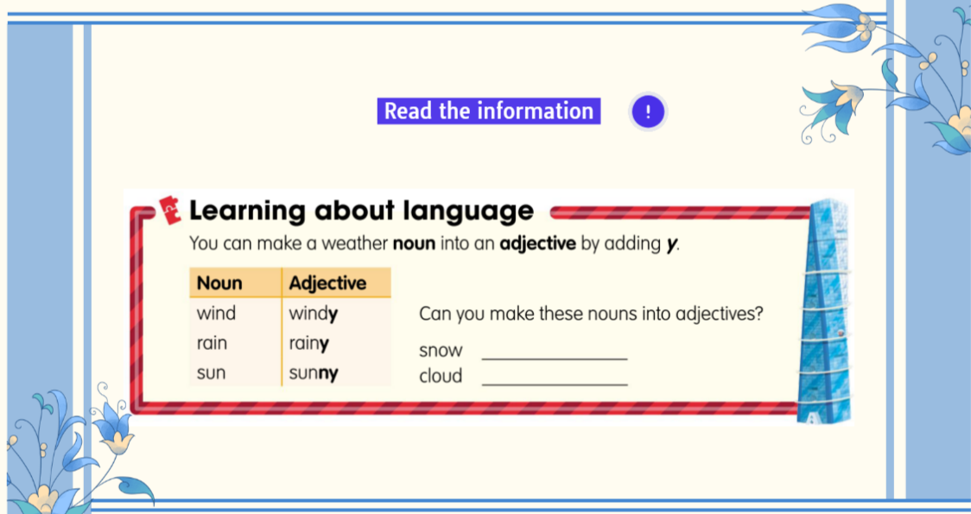

Slide 73


Slide 74
https://wordwall.net/resource/47898811/as2-u5-l4-noun-adjective

Slide 75
https://wordwall.net/resource/65840323/as2-u5-l5-ltl

Slide 76


Slide 77


Slide 78


Slide 79


Slide 80
https://www.youtube.com/watch?v=qvqkeo25Q9U&embeds_referring_euri=https%3A%2F%2Fview.genial.ly%2F658093c9777b3300144e4c3d&source_ve_path=OTY3MTQ&feature=emb_imp_woyt

Slide 81


Slide 82


Slide 83


Slide 84


Slide 85
https://wordwall.net/resource/17579973/as2-u5-gr2

Slide 86
https://wordwall.net/resource/65846885/as2-u5-l6-prcontinuous

Slide 87


Slide 88


Slide 89


Slide 90


Slide 91


Slide 92


Slide 93
https://www.youtube.com/watch?v=Jn7uAsLWXpk

Slide 94


Slide 95


Slide 96


Slide 97


Slide 98


Slide 99


Slide 100


Slide 101


Slide 102


Slide 103


Slide 104


Slide 105


