Slide 1
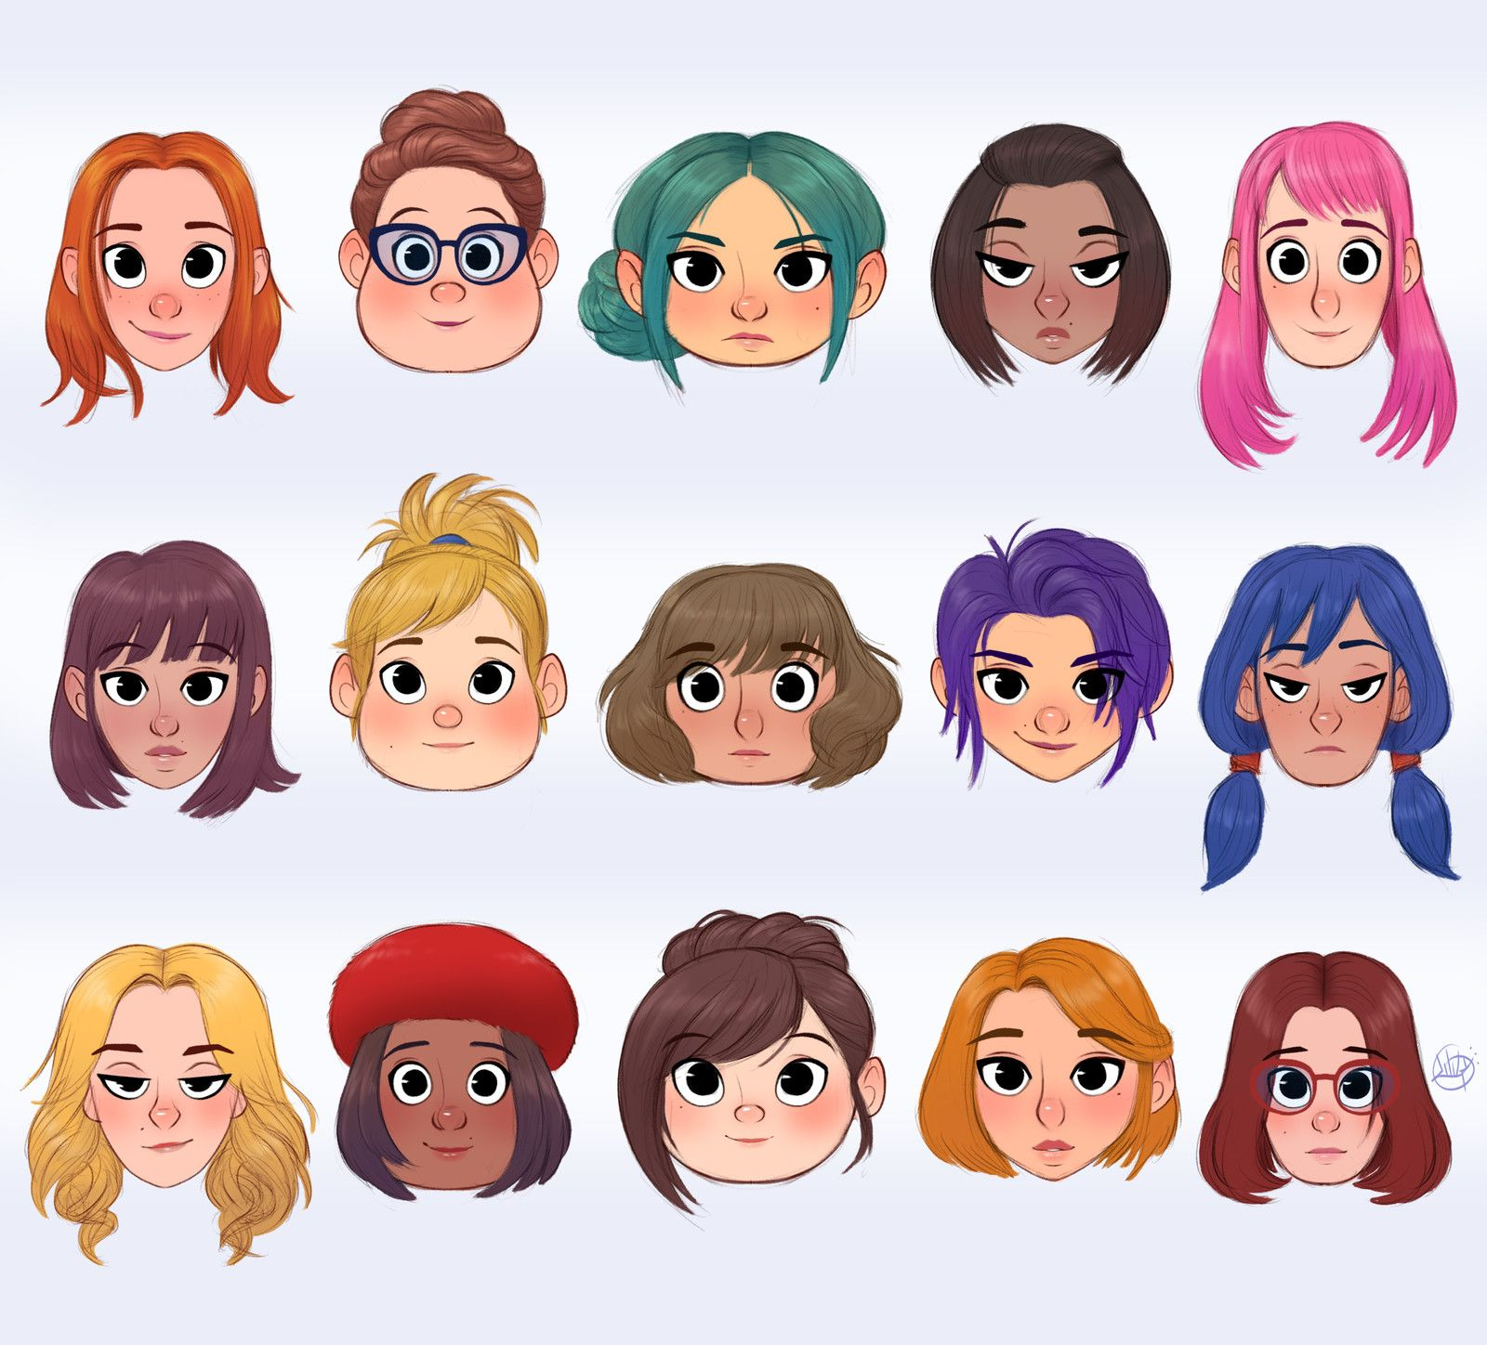



IrinaPapakhinac

Slide 2

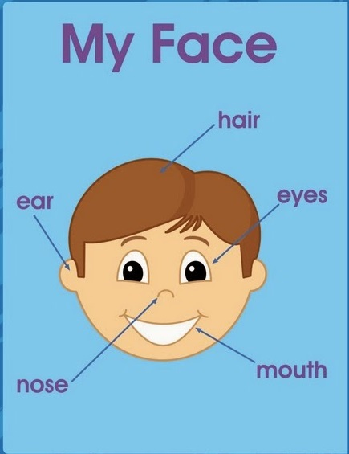
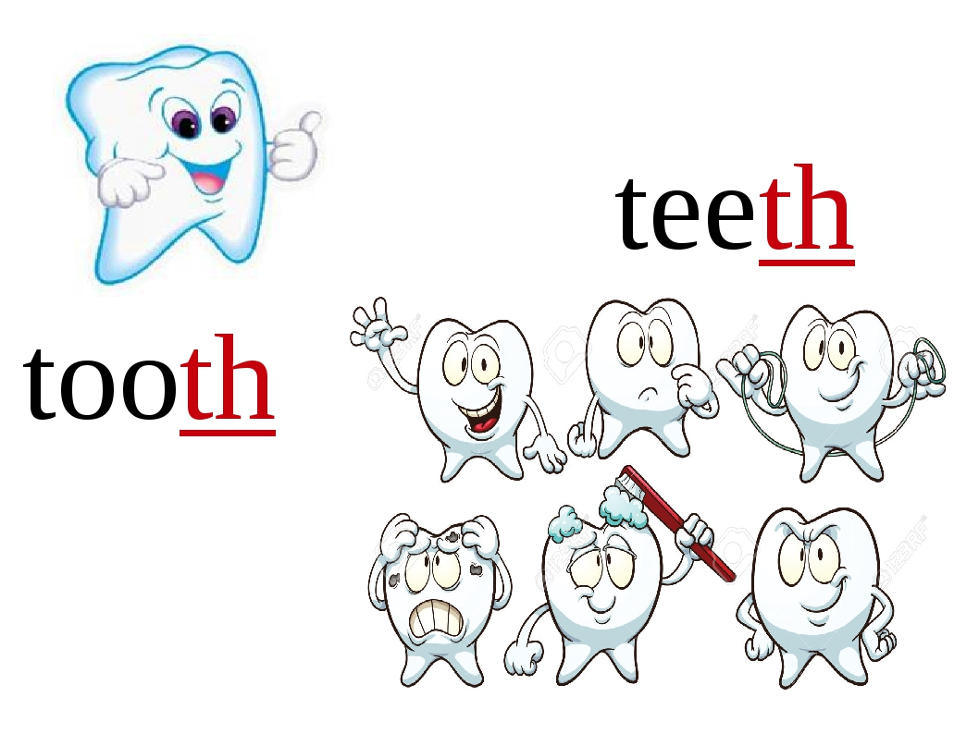
IrinaPapakhinac

Slide 3
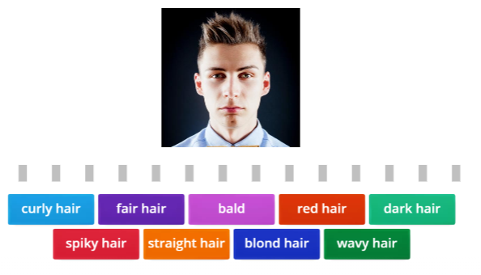
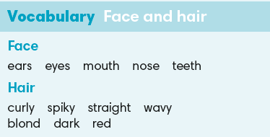

IrinaPapakhinac

Slide 4
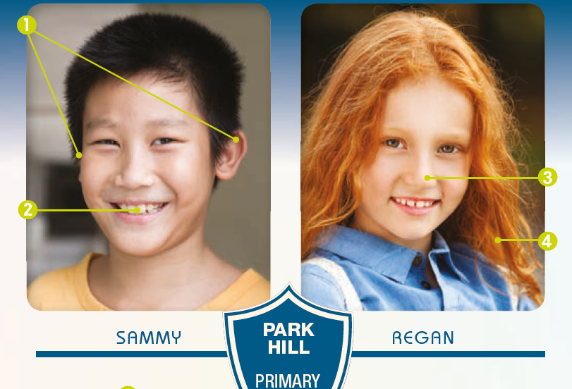
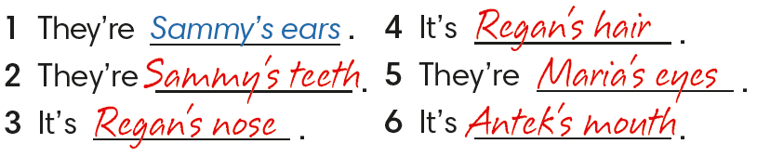
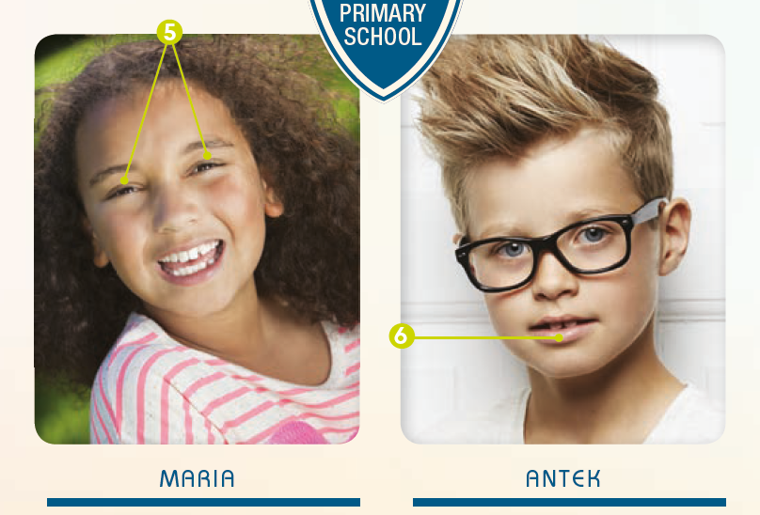
Find numbers 1 – 6 in the photos
and say whose features they are.
IrinaPapakhinac

Slide 5
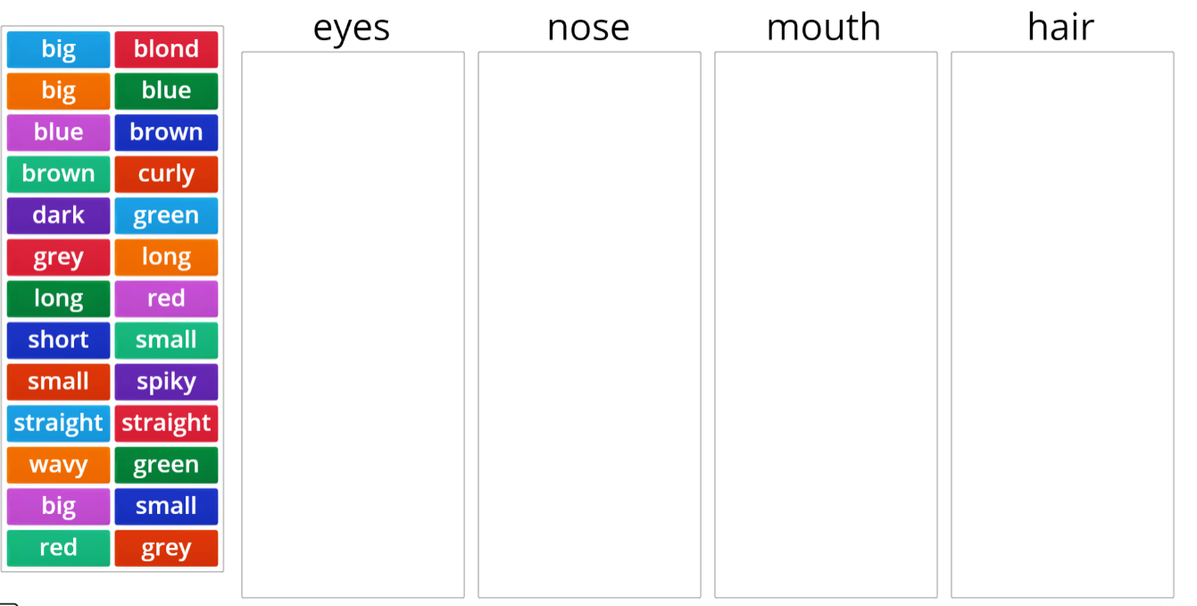
IrinaPapakhinac

Slide 6
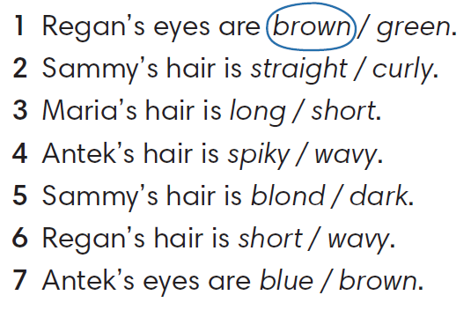
IrinaPapakhinac

Slide 7
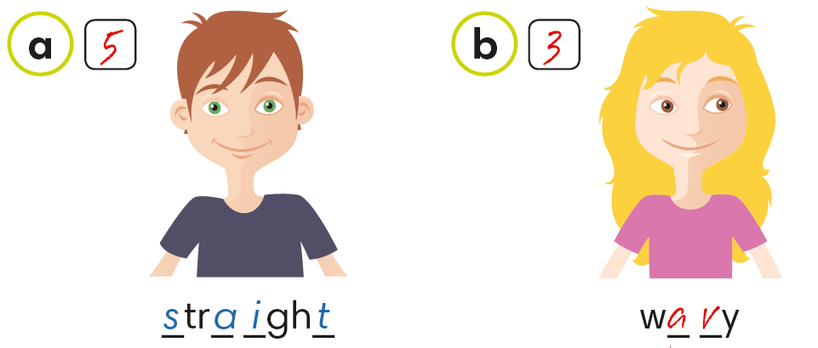
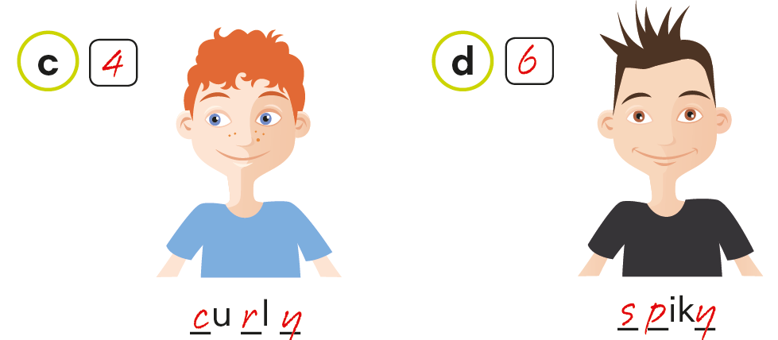
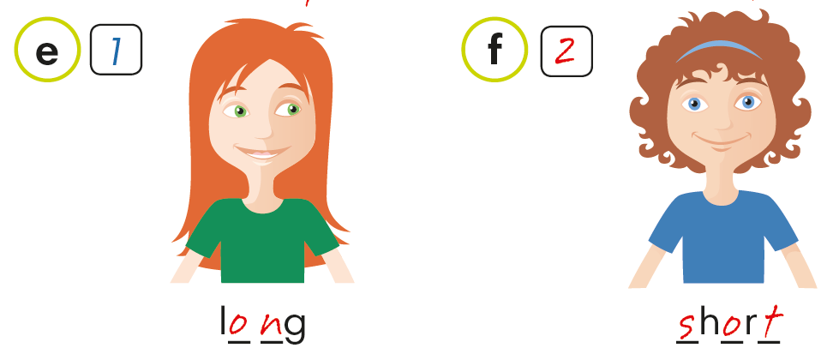
Look at the children’s hair. Complete the words.
Listen and number the pictures.
IrinaPapakhinac

Slide 8


Tell about your hair and eyes.
IrinaPapakhinac

Slide 9

Tell about these kids’ hair.
IrinaPapakhinac

Slide 10
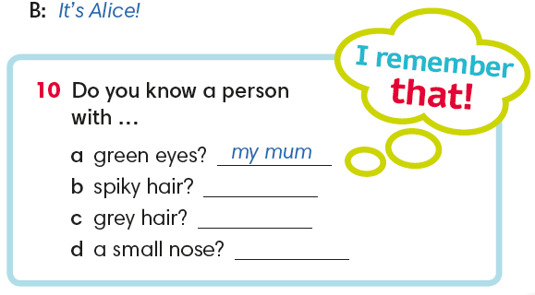
IrinaPapakhinac

Slide 11
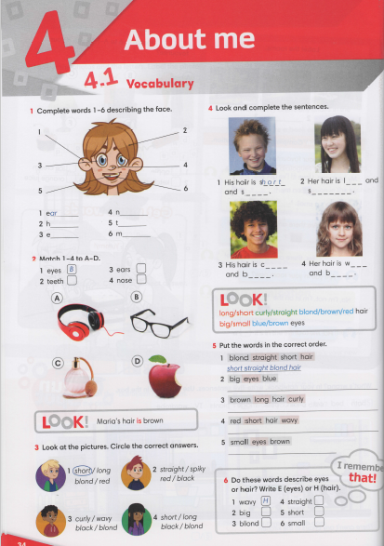


IrinaPapakhinac

Slide 12


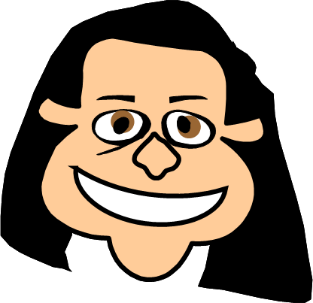
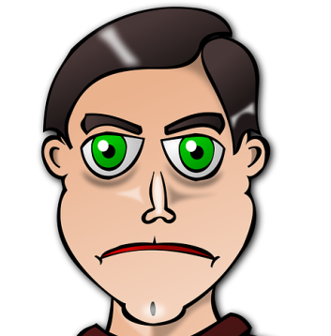
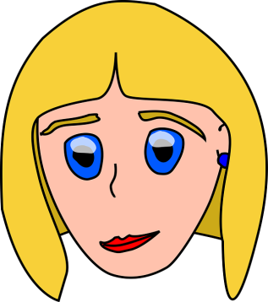

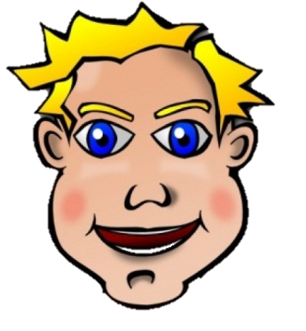
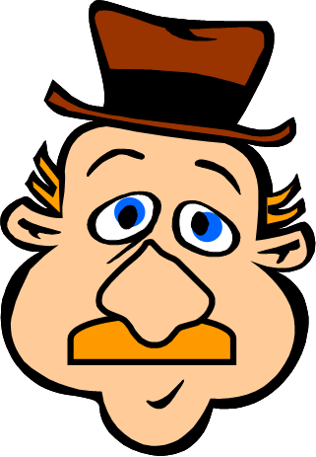
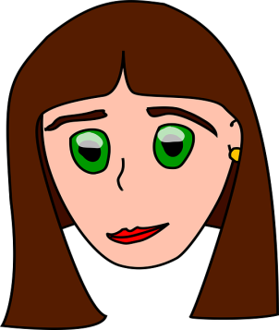
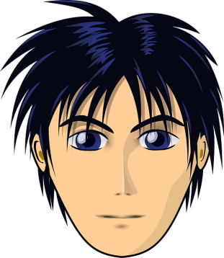
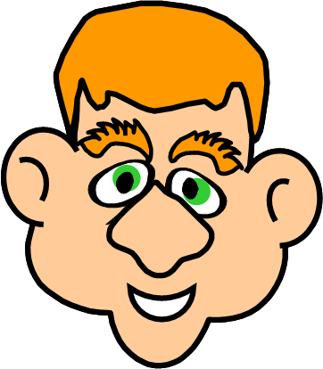
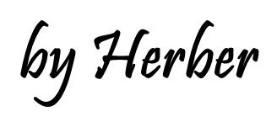

Slide 13
CHARLES
PETER
MARGE
MEGAN
JENNY
GREG
PAUL
JOHN
This person has got green eyes, short straight red hair,
a big nose and big ears. Who is it?
1/6
IrinaPapakhinac

Slide 14


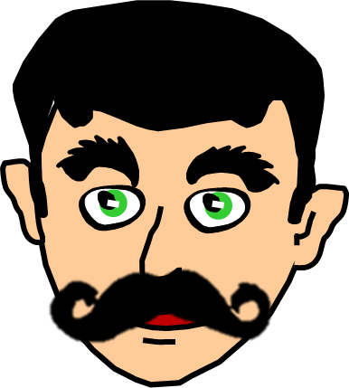
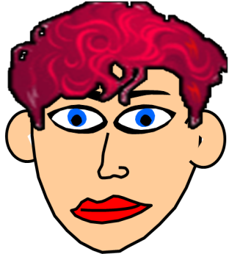

BETTY
PAUL
NORA
MEGAN
JENNY
GEORGE
JAMES
JOHN
This person has got big blue eyes, short curly red hair, a small nose and big ears. Who is it?
2/6
IrinaPapakhinac

Slide 15



BETTY
GREG
ROSE
MEGAN
NORA
GEORGE
JENNY
JOHN
This person has got green eyes, long curly brown hair and a small nose. Who is it?
3/6
IrinaPapakhinac

Slide 16

BETTY
GREG
NORA
MEGAN
JOHN
LISA
JENNY
GEORGE
This person has got green eyes and short straight black hair. Who is it?
4/6
IrinaPapakhinac

Slide 17
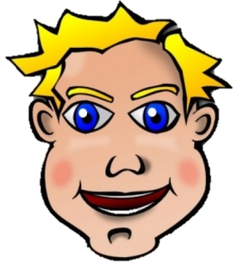
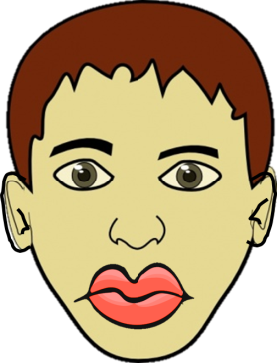
BETTY
GREG
JOHN
MEGAN
ROBERT
LISA
JENNY
ROSE
This person has got blue eyes, short spiky blond hair and a big mouth. Who is it?
5/6
IrinaPapakhinac

Slide 18
BETTY
GREG
MARGE
MEGAN
ROBERT
LISA
JENNY
NORA
This person has got brown eyes, short spiky black hair, a small nose and a small mouth. Who is it?
6/6
IrinaPapakhinac

Slide 19
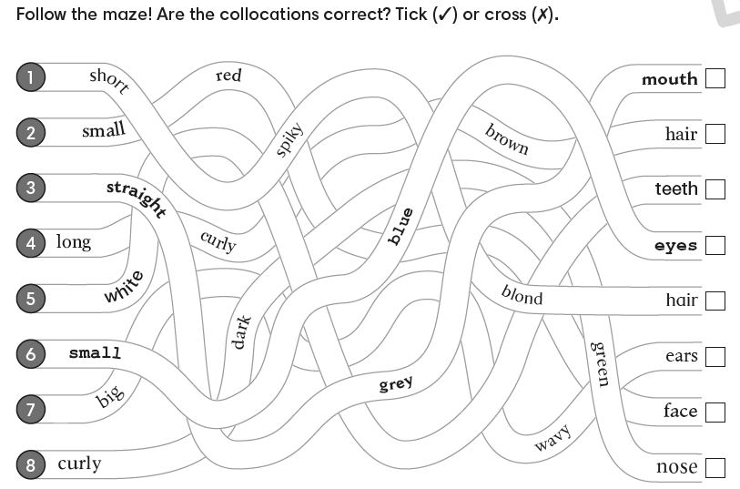
IrinaPapakhinac

