Slide 1
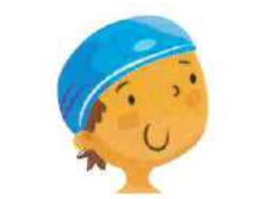
I have to / has to wear a swimming cap.

Slide 2
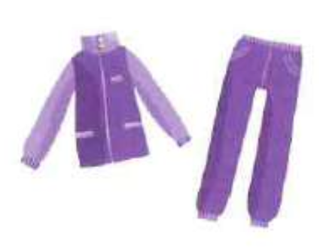
You have to / has to wear a tracksuit.

Slide 3
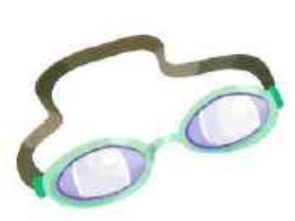
We have to / has to wear goggles.

Slide 4
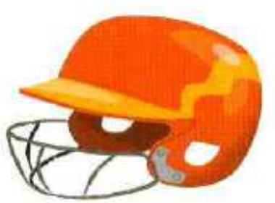
They have to / has to wear helmets.

Slide 5
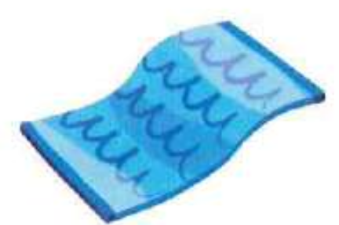
He have to / has to bring his towel.

Slide 6
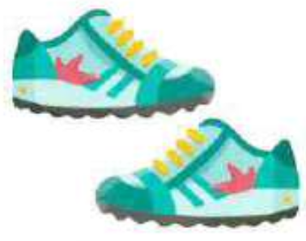
She have to / has to wear her trainers.

Slide 7
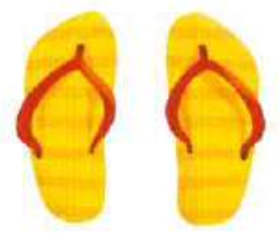
Tom have to / has to wear his flip-flops.

Slide 8
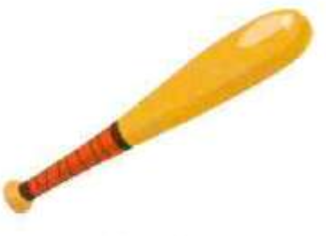
Kate have to / has to bring a bat.

Slide 9
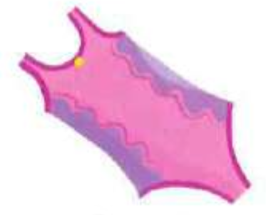
I have to / has to wear a swimming costume.

Slide 10

The kids have to / has to bring gloves.

