Slide 1
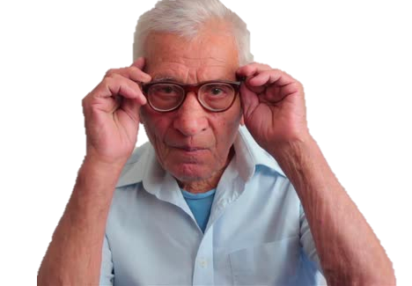
GLASSES
By Artem Morozov

Slide 2

WHAT WAS HE DOING?
TIME’S UP

Slide 3
HE WAS RIDING A BIKE!

Slide 4

WHAT WAS SHE DOING?
TIME’S UP

Slide 5
SHE WAS COOKING!

Slide 6

WHAT WAS SHE DOING?
TIME’S UP

Slide 7
SHE WAS
JUMPING!

Slide 8

WHAT WAS SHE DOING?
TIME’S UP

Slide 9
SHE WAS DRIVING A CAR!

Slide 10

WHAT WAS HE DOING?
TIME’S UP

Slide 11
HE WAS CLIMBING!

Slide 12

WHAT WAS HE DOING?
TIME’S UP

Slide 13
HE WAS PLAYING FOOTBALL!

Slide 14
Thanks!

