Slide 1



IrinaPapakhina

Slide 2




IrinaPapakhina

Slide 3

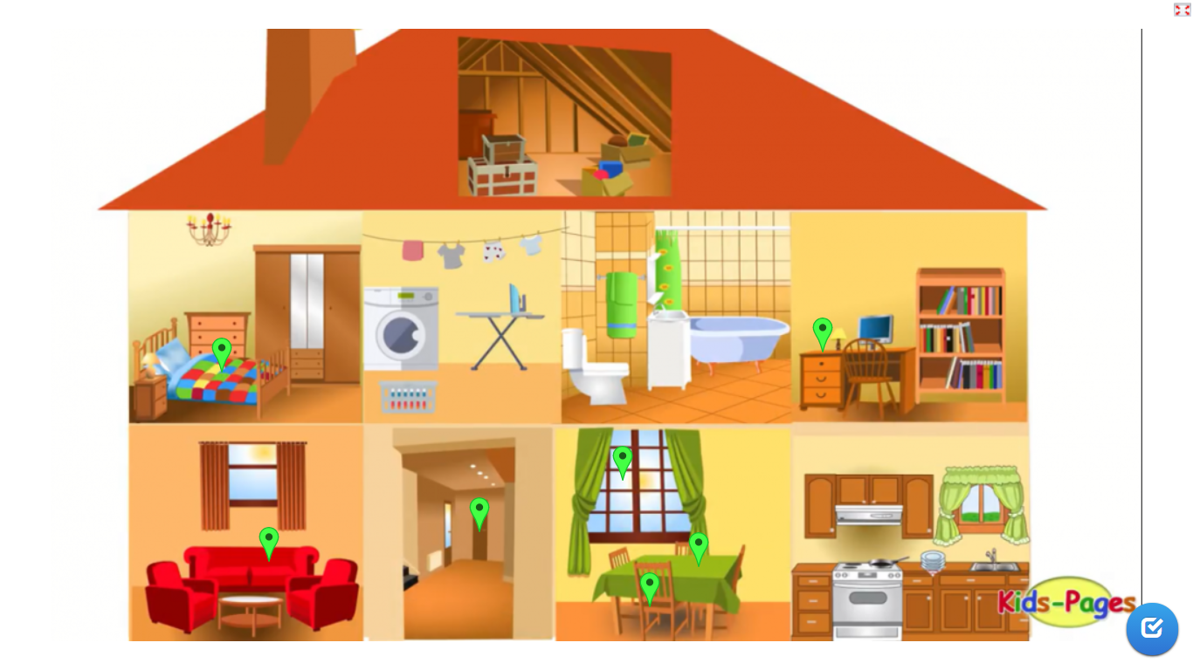
IrinaPapakhina

Slide 4
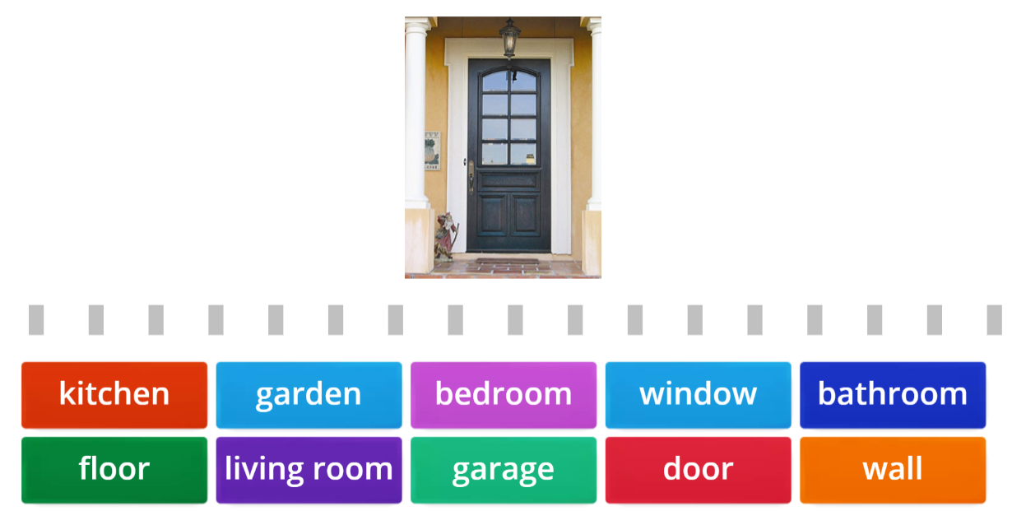

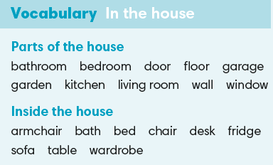
IrinaPapakhina

Slide 5
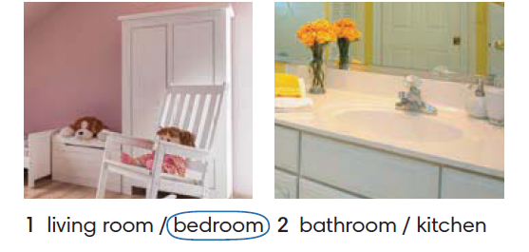
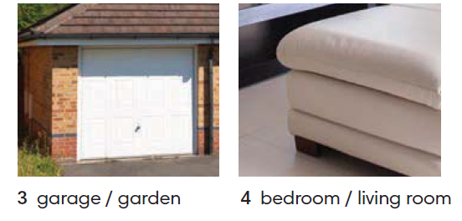
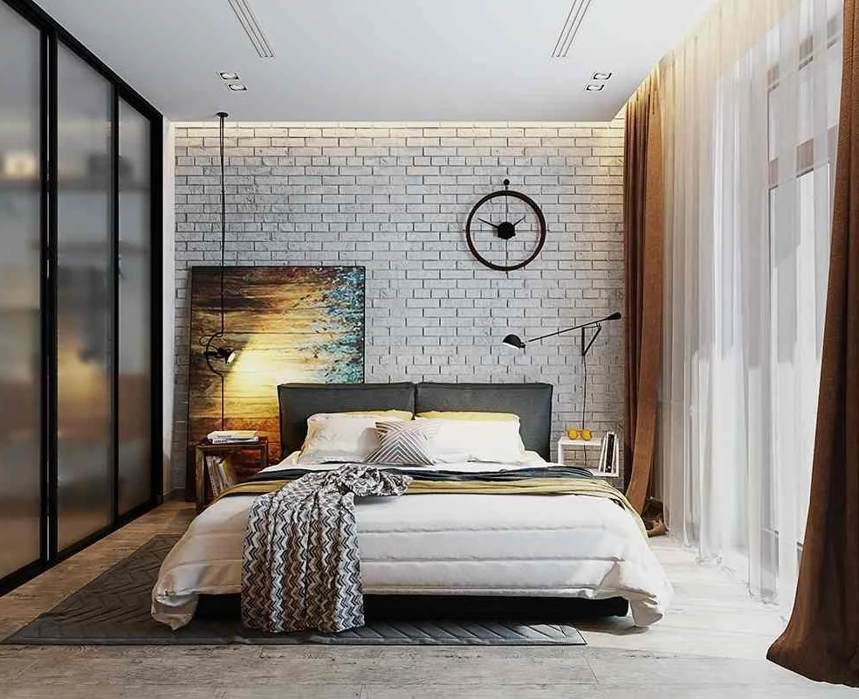
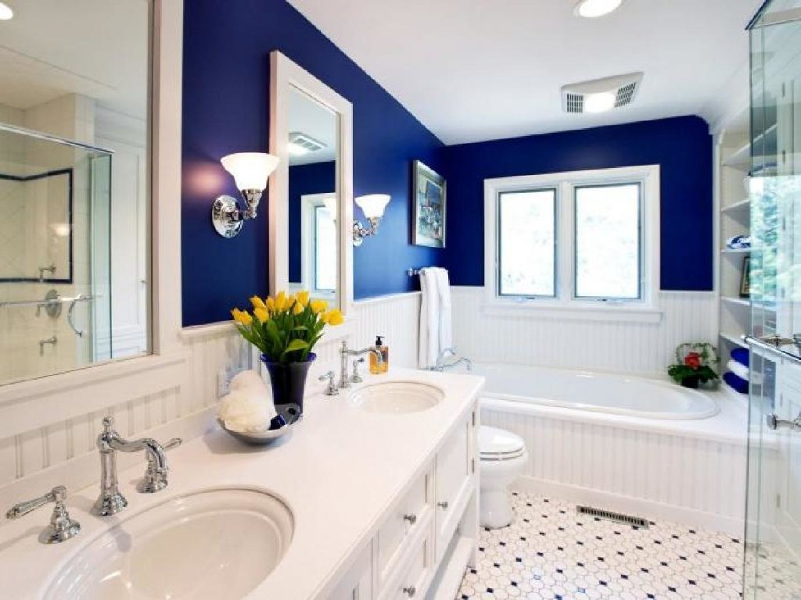
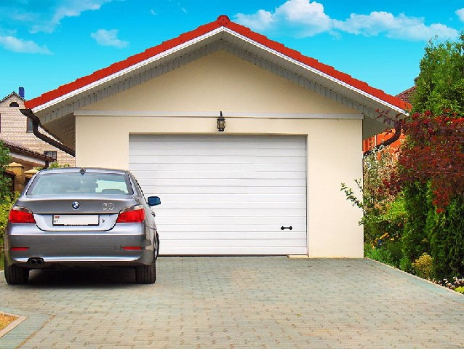

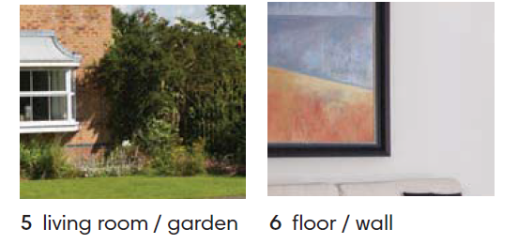
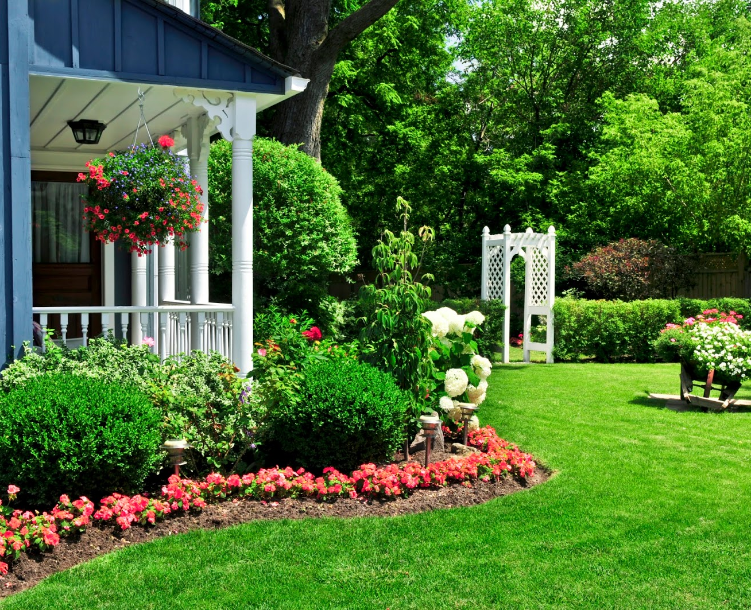
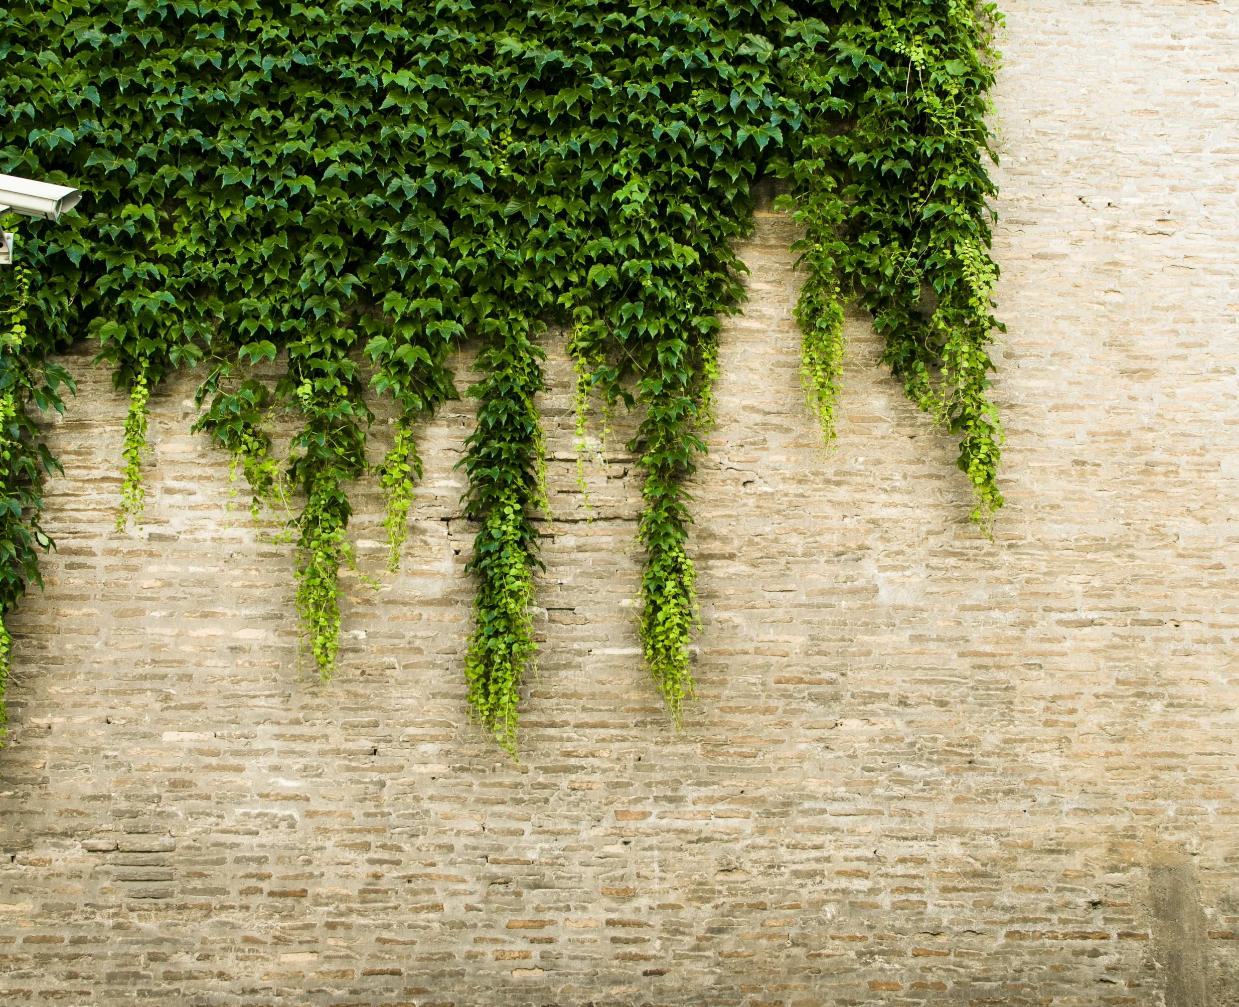
Circle the correct answer.
IrinaPapakhina

Slide 6
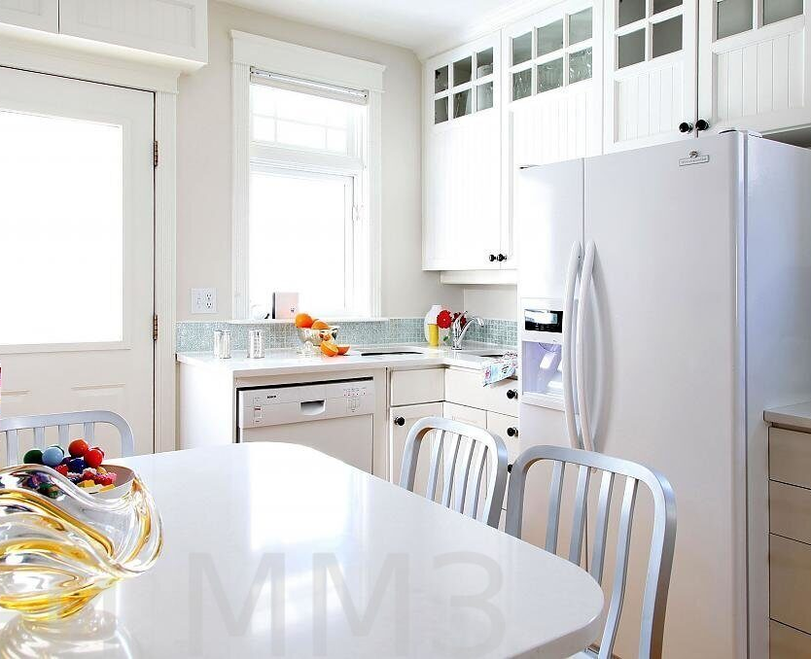
Listen to the sound.
Where are you?
1.
2.
3.
4.
5.
6.
In the living room.
In the kitchen.
In the garage.
In the bedroom.
In the garden.
In the bathroom.
IrinaPapakhina

Slide 7
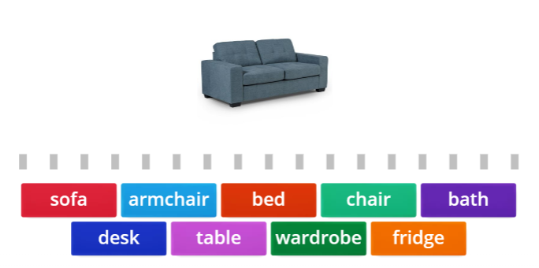
IrinaPapakhina

Slide 8
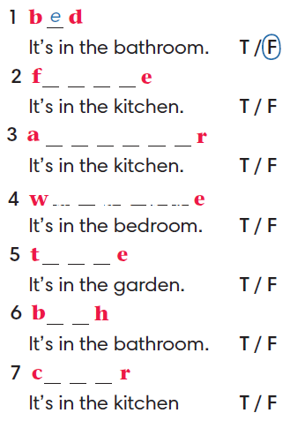
Complete the words.
2. Read the sentences, look at the photos
and circle true (T) or false (F). Correct the false sentences.
r i d g
r m c h a i
a r d r o b
a b l
a t
h a i
IrinaPapakhina

Slide 9
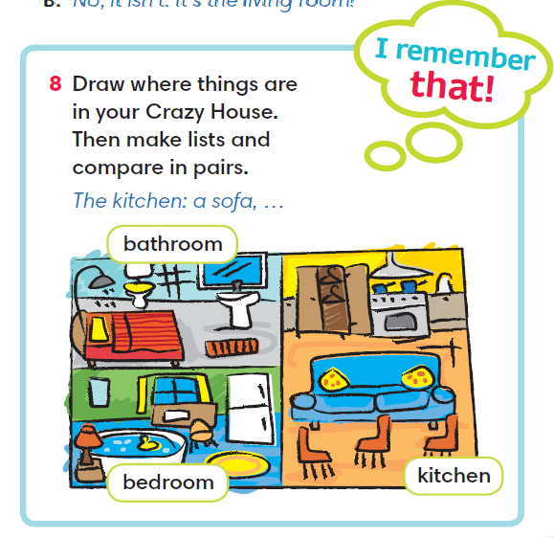
IrinaPapakhina

Slide 10
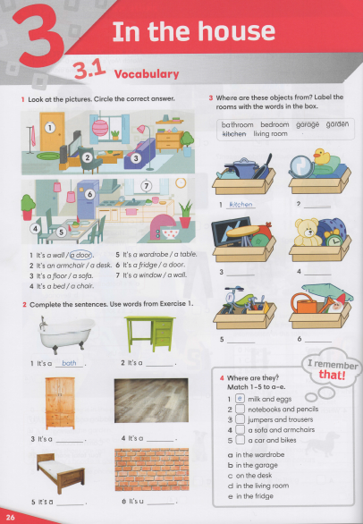


IrinaPapakhina

Slide 11
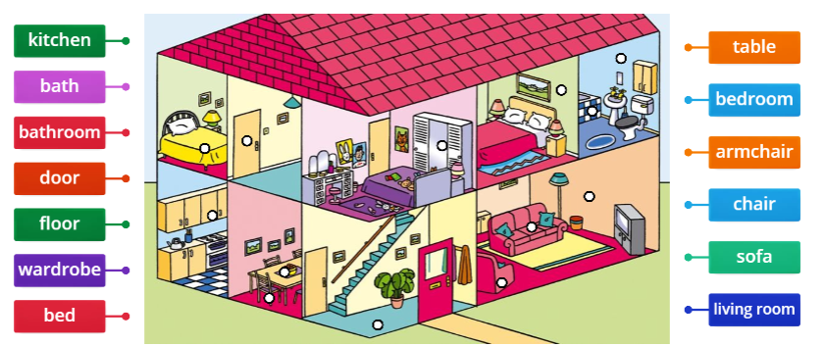
IrinaPapakhina

