Slide 1
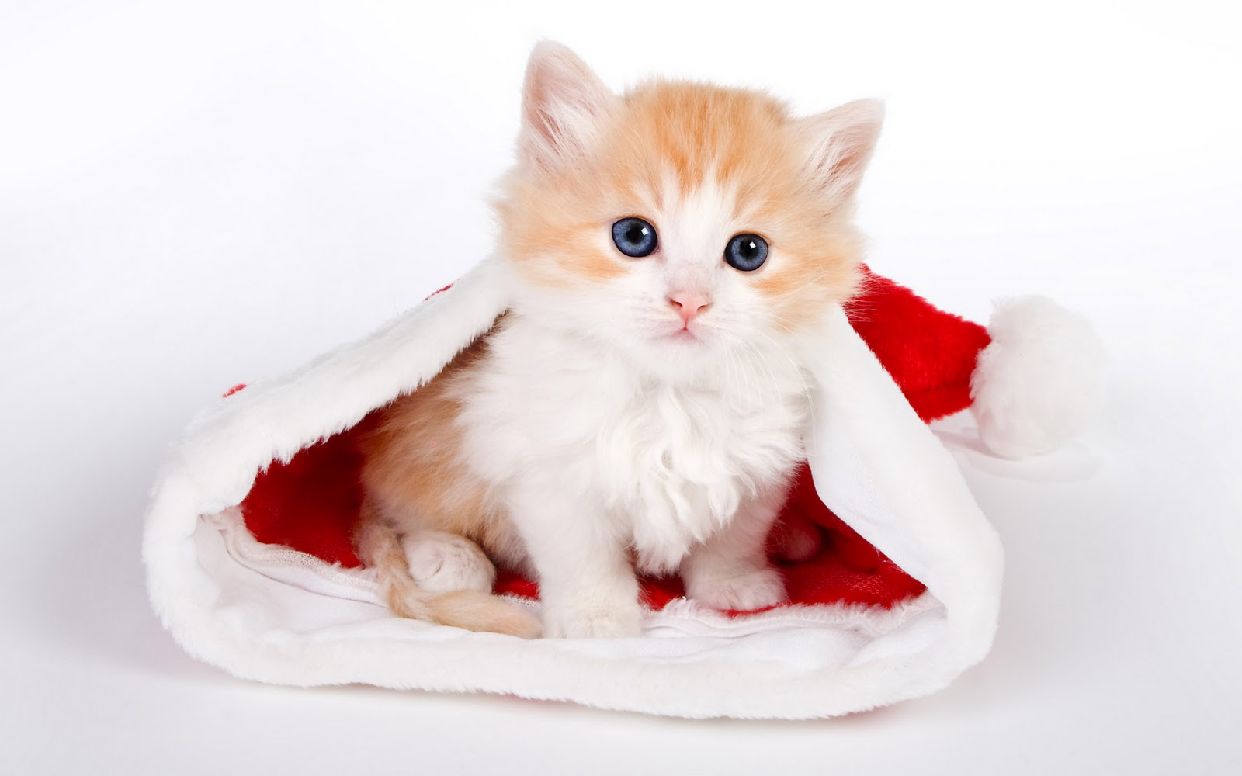
The kitten is ___ the hat.
Prepositions of Place
Part 1
Learn!
in
in
on
behind

Slide 2
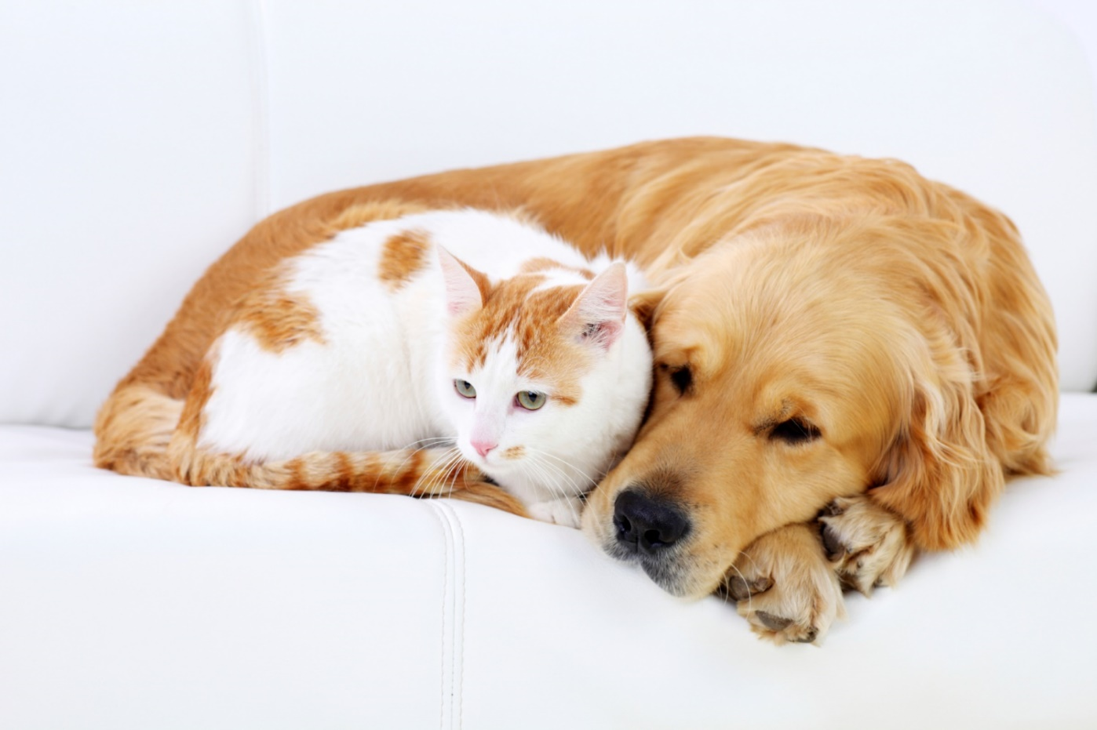
The cat lies ________ the dog.
next to
next to
behind
between

Slide 3
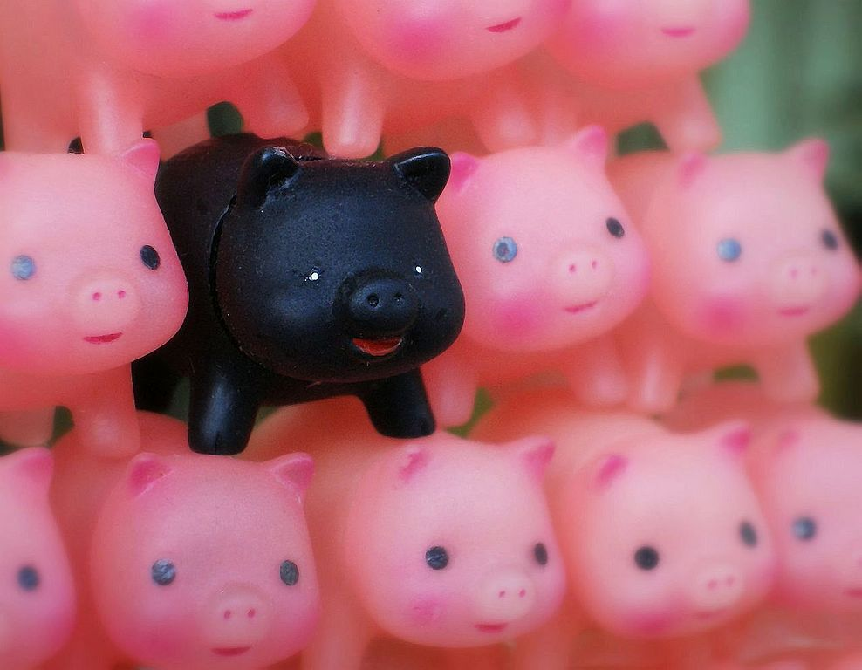
There is one black piglet ________ the pink ones.
among
behind
among
in front of

Slide 4
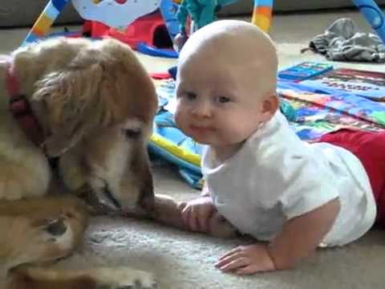
The baby is _________ the dog.
opposite
on
under
opposite

Slide 5
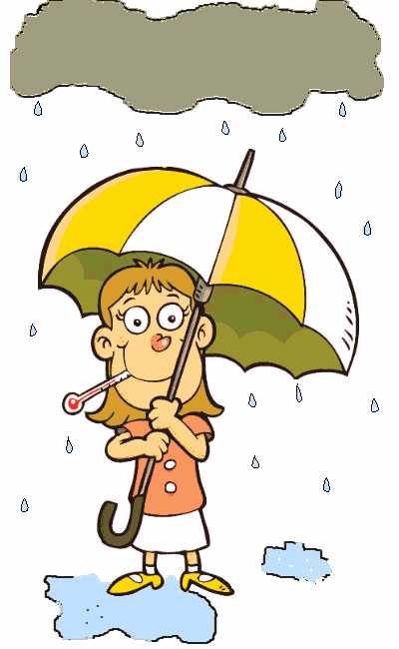
The girl is _______ the umbrella.
under
in front of
under
behind

Slide 6
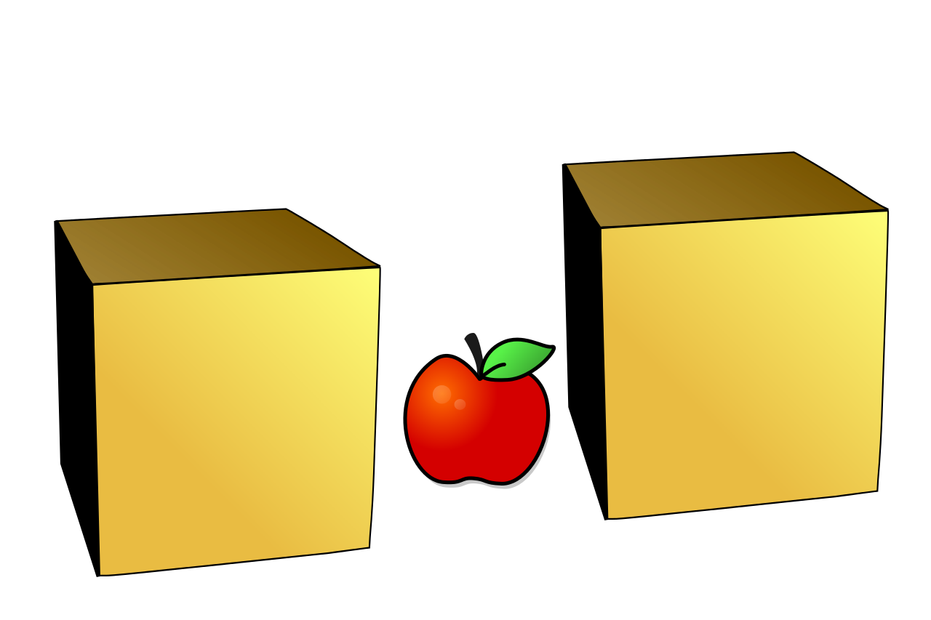
The apple is _________ the boxes.
between
between
among
opposite

Slide 7
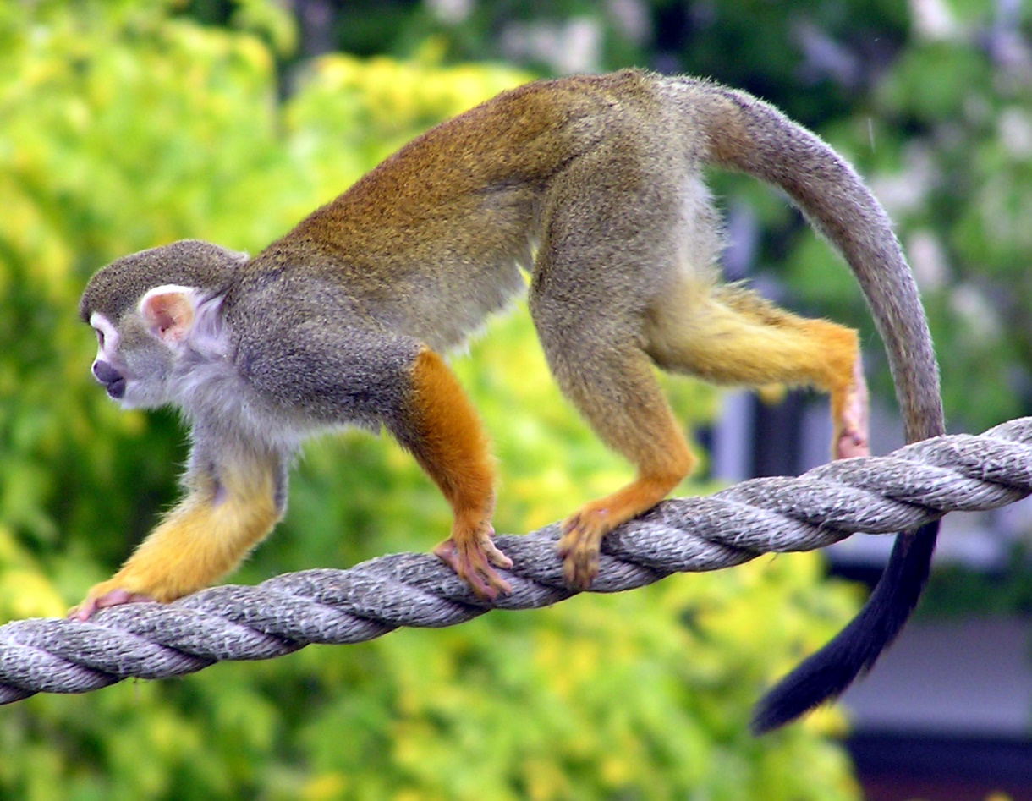
The monkey is ______ the rope.
on
in
next to
on

Slide 8
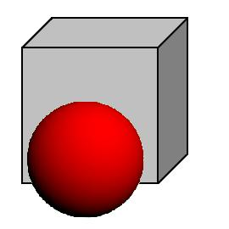
The ball is _________ the box.
in front of
behind
among
in front of

Slide 9

The girl is ________ the books.
behind
behind
among
in front of

Slide 10
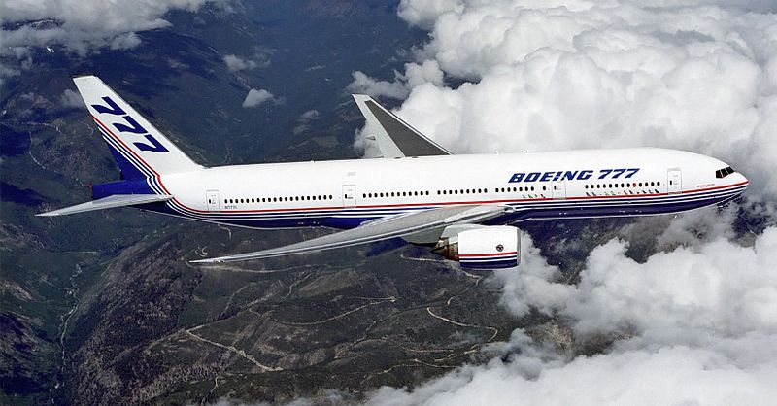
The plane flies ________ the clouds.
above
behind
above
in front of

Slide 11
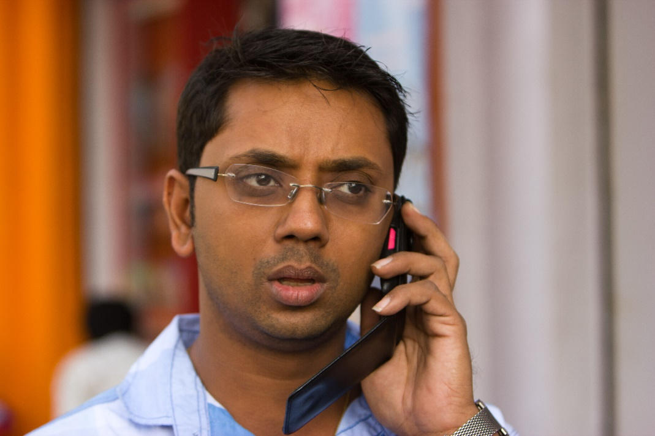
He is _______ the phone.
on
in front of
above
on

Slide 12
Let’s try again!
Can you say the full sentences about the same pictures?
Let’s go to the Part 2!

Slide 13
The girl is under the umbrella.
Part 2 Test
Say or write full sentences about the pictures!
Don’t forget to use the prepositions!

Slide 14

The girl is behind the books.

Slide 15
The baby is opposite the dog.

Slide 16
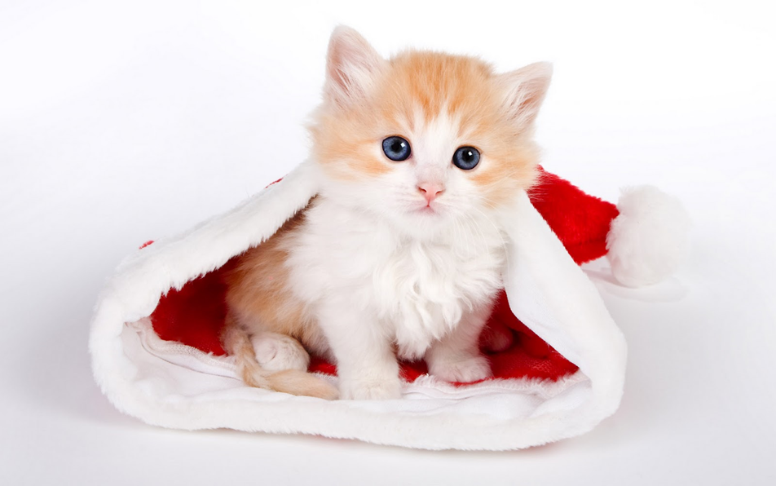
The kitten is in the hat.

Slide 17
The plane flies above the clouds.

Slide 18
The apple is between the boxes.

Slide 19
He is on the phone.

Slide 20
There is one black piglet among the pink ones.

Slide 21
The monkey is on the rope.

Slide 22

The cat lies next to the dog.

Slide 23
Great job!

