Slide 1
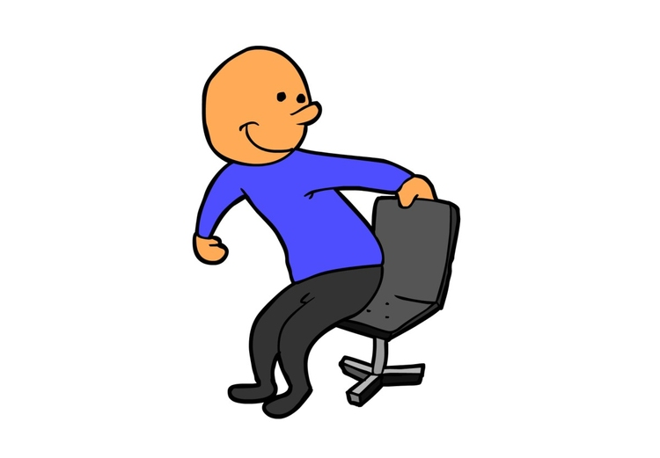
Are you sitting?
Yes, I am. No, I’m not.

Slide 2
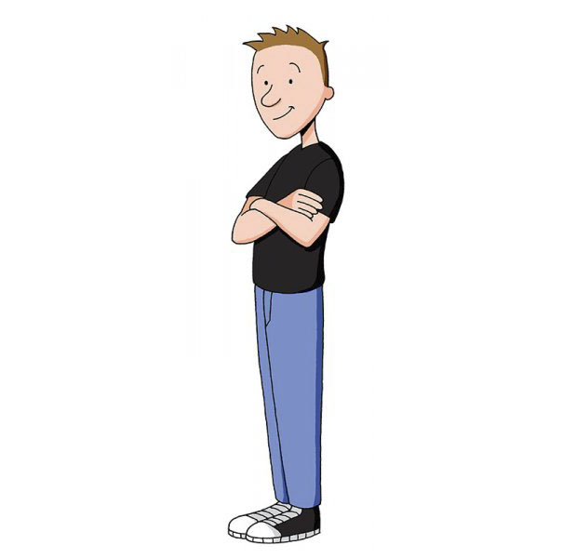
Are you standing?
Yes, I am. No, I’m not.

Slide 3
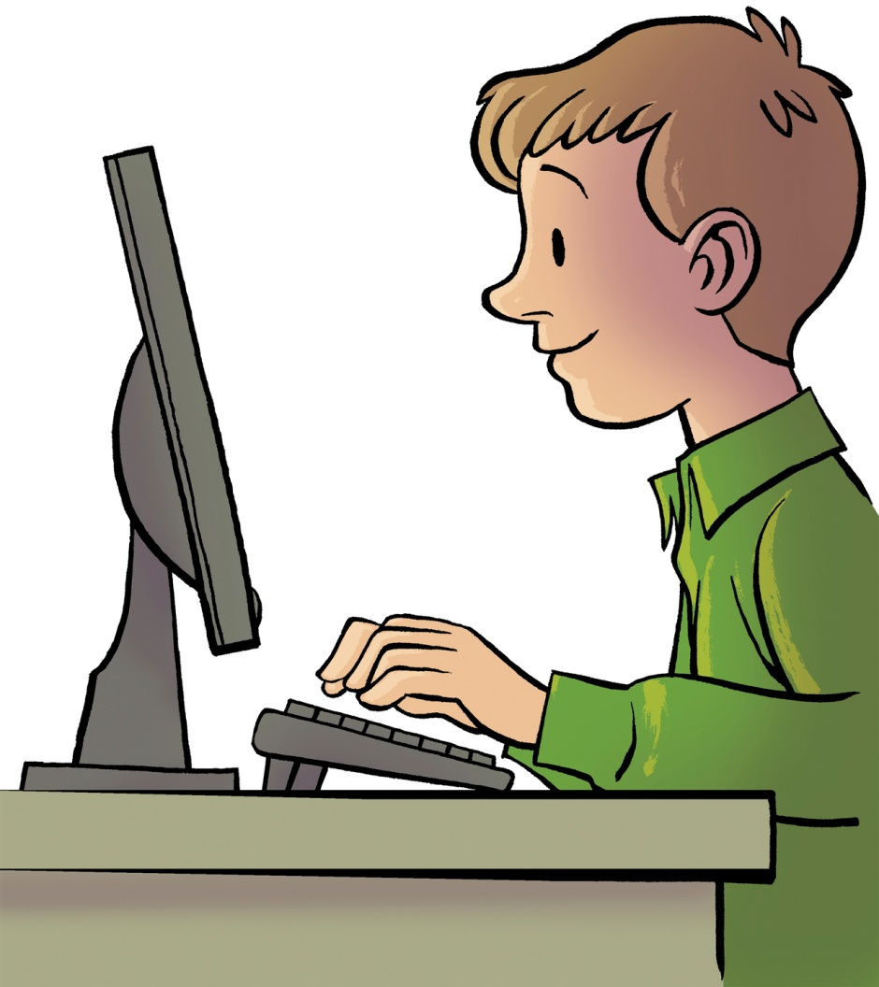
Are you looking at the screen?
Yes, I am. No, I’m not.

Slide 4
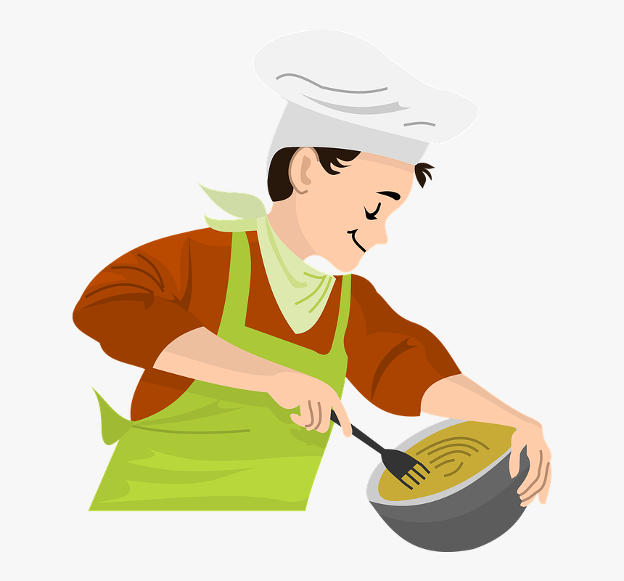
Are you cooking?
Yes, I am. No, I’m not.

Slide 5
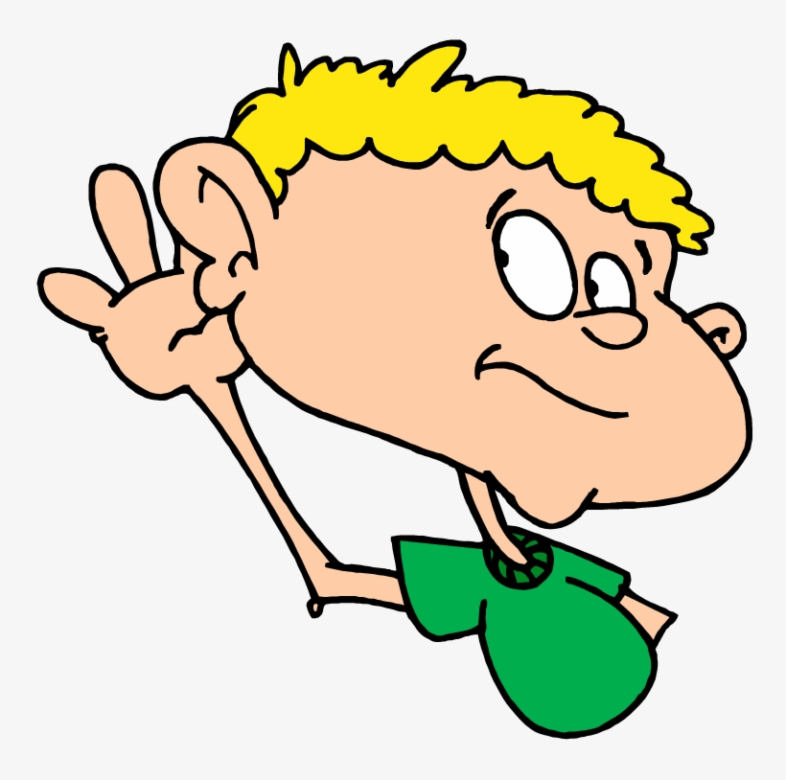
Are you listening to me?
Yes, I am. No, I’m not.

Slide 6
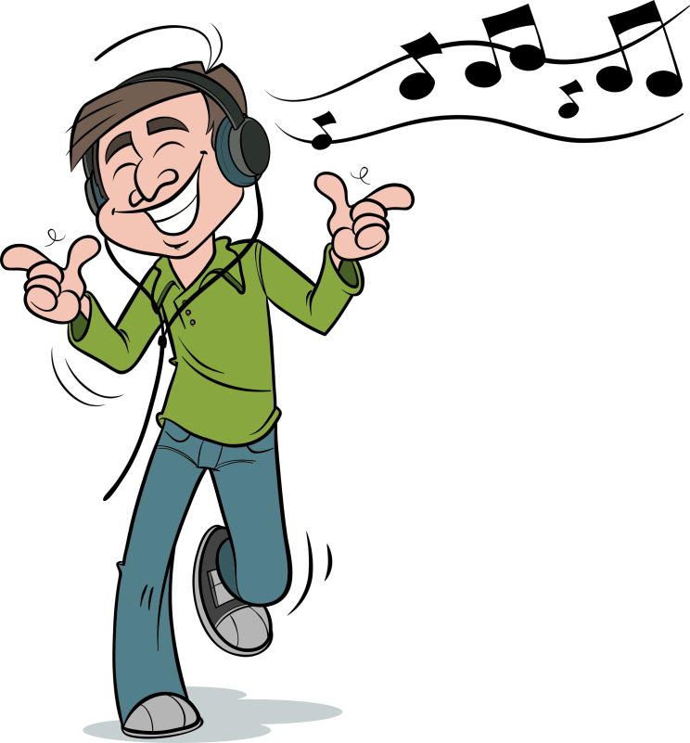
Are you listening to music?
Yes, I am. No, I’m not.

Slide 7
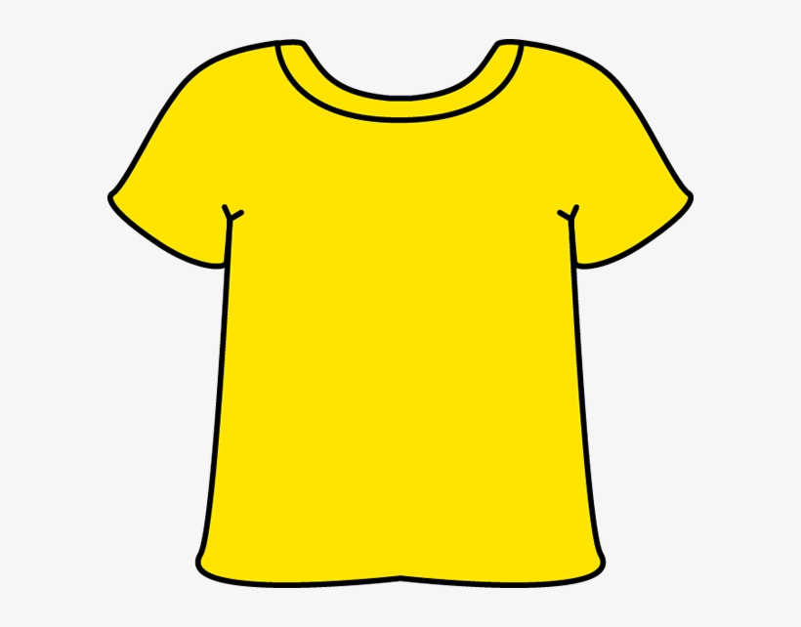
Are you wearing a T-shirt?
Yes, I am. No, I’m not.

Slide 8
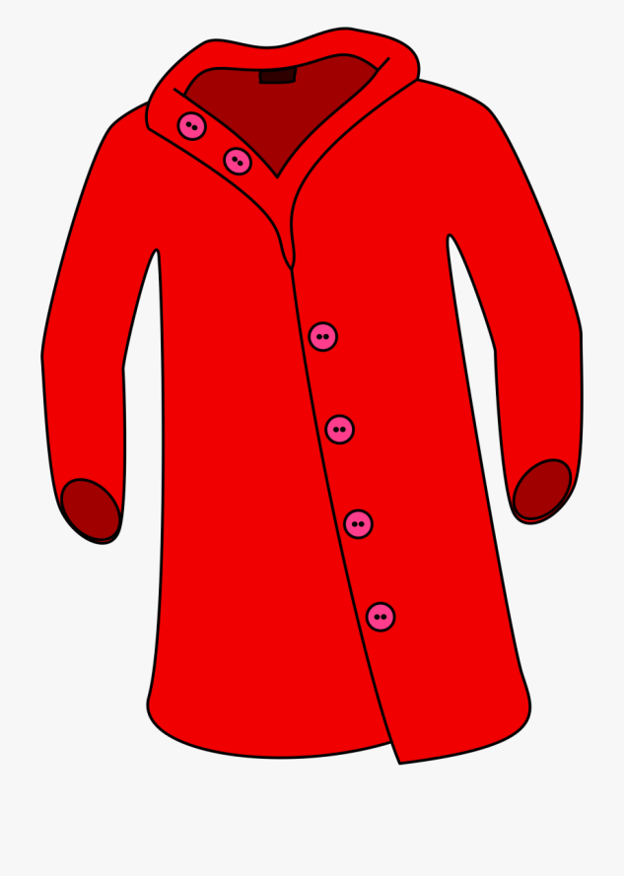
Are you wearing a coat?
Yes, I am. No, I’m not.

Slide 9
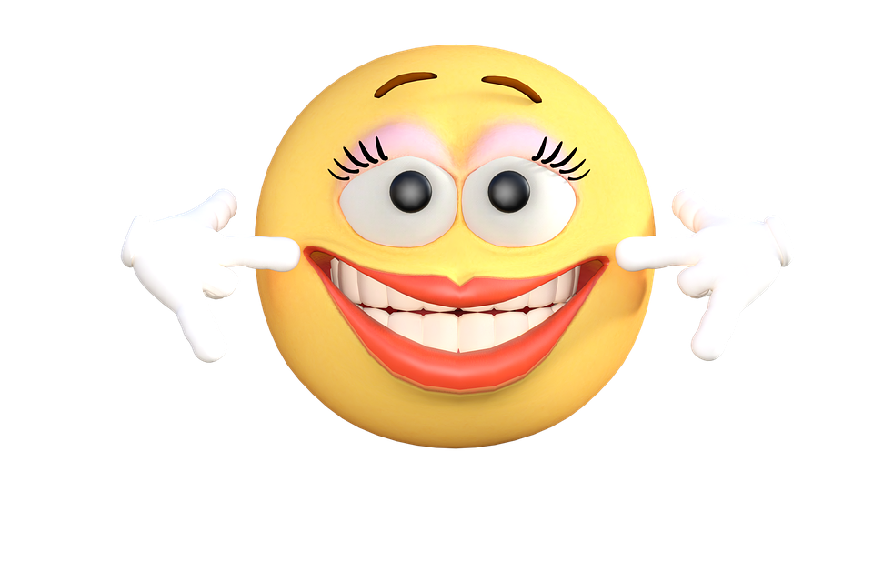
Are you smiling?
Yes, I am. No, I’m not.

Slide 10
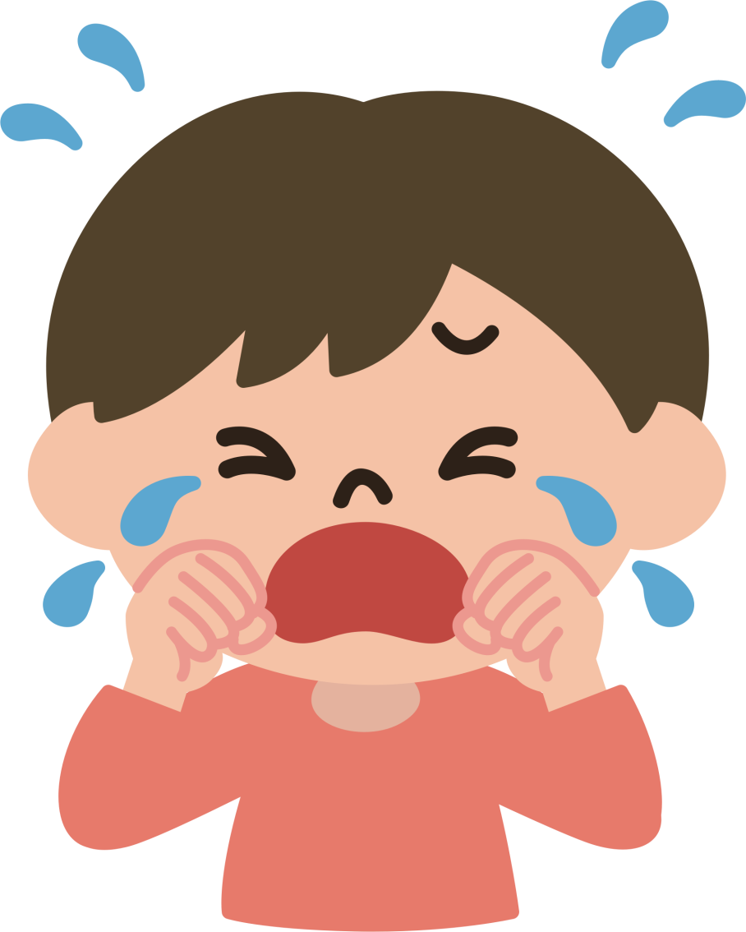
Are you crying?
Yes, I am. No, I’m not.

