Slide 1
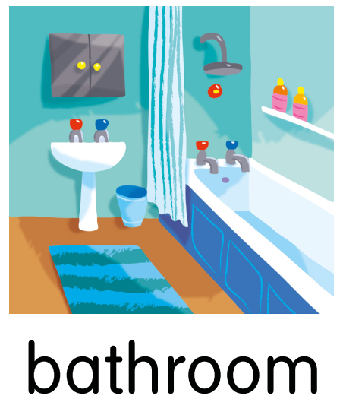
Yesterday I was in the … at 8 o’clock.

Slide 2
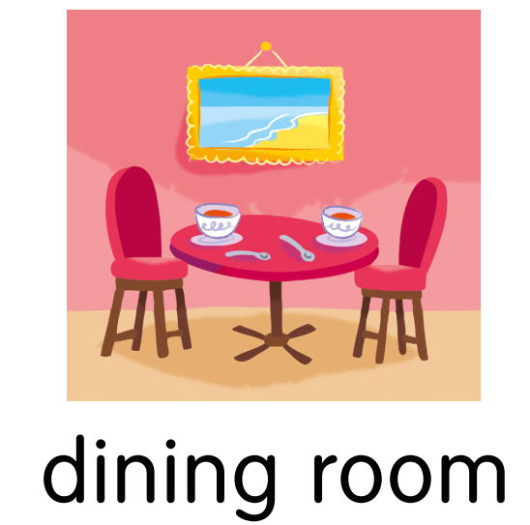
Yesterday Linda was in the … at 9 o’clock.

Slide 3
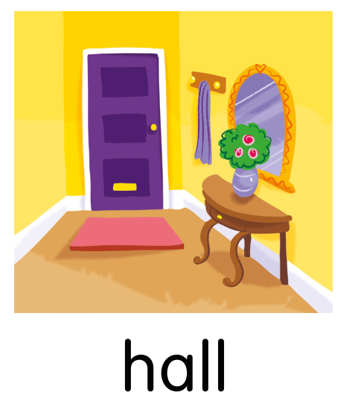
Yesterday Sam was in the … at 11 o’clock.

Slide 4
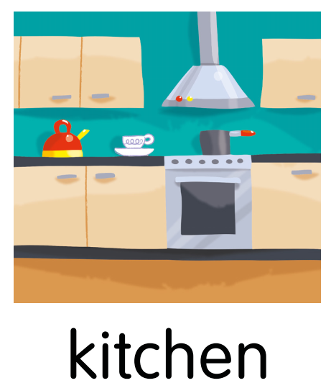
Yesterday I was in the … at 10 o’clock.

Slide 5
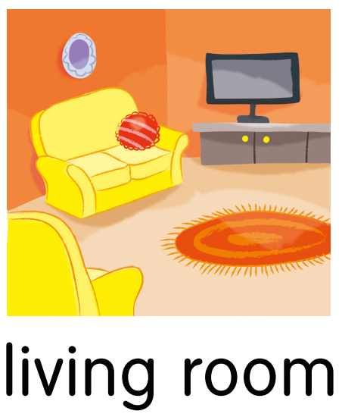
Yesterday Kate was in the … at 12 o’clock.

Slide 6

Yesterday the cat was on the … at 1 o’clock.

Slide 7
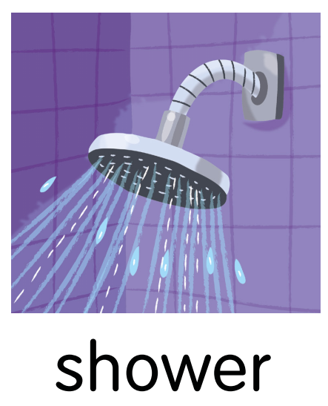
Yesterday Grandma was in the … at 3 o’clock.

Slide 8
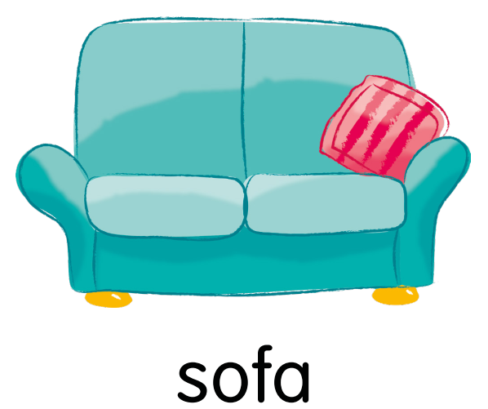
Yesterday Grandpa was on the … at 5 o’clock.

