Slide 1
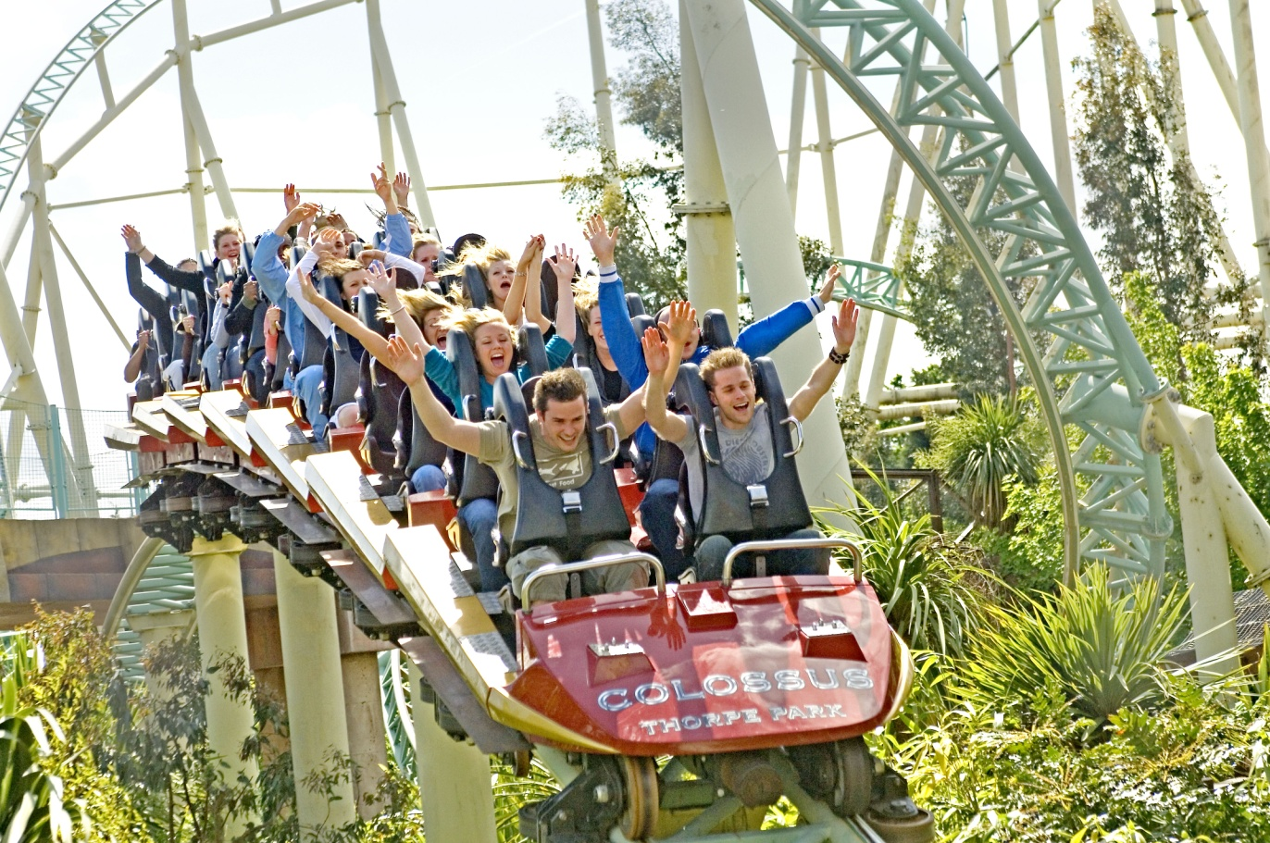
1. Peter and Sam were on the rides yesterday.
2. They were with Peter’s sisters.
3. They were there in the afternoon.
4. It was sunny.

Slide 2
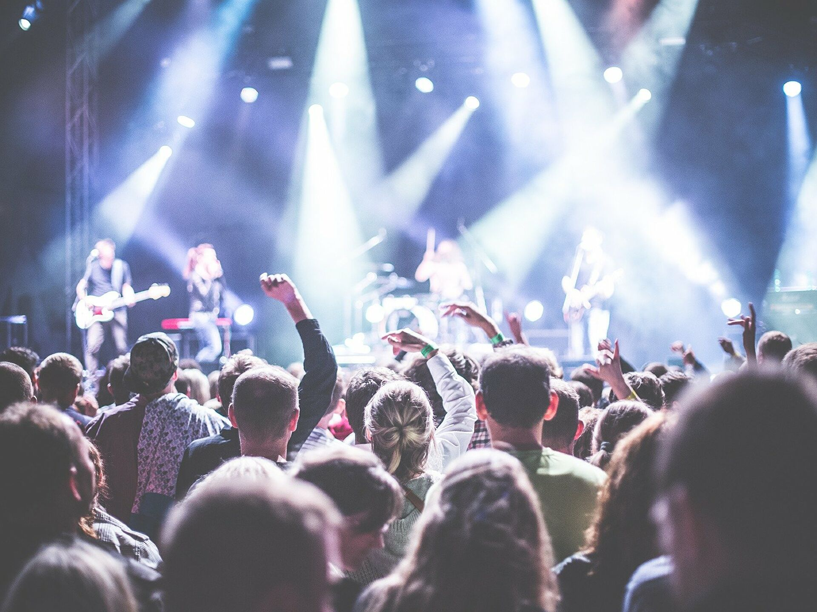
Ben was at the concert last Saturday.
He was with his classmates.
He was there at night.
It was cool.

Slide 3
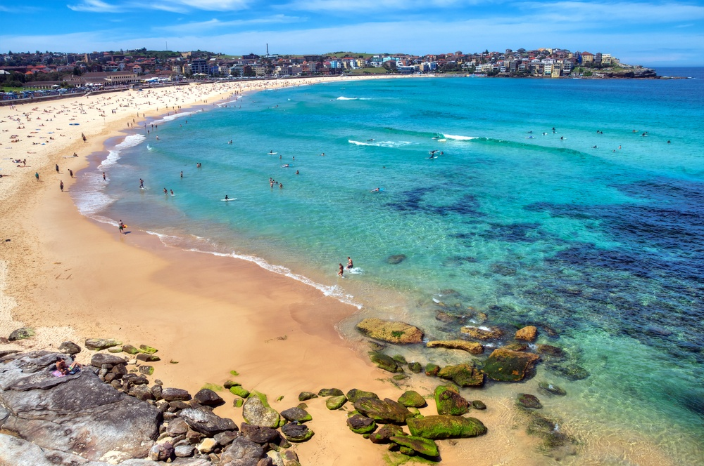
I was on the beach yesterday.
I was with my friends.
I was there in the evening.
It was hot and sunny.

Slide 4
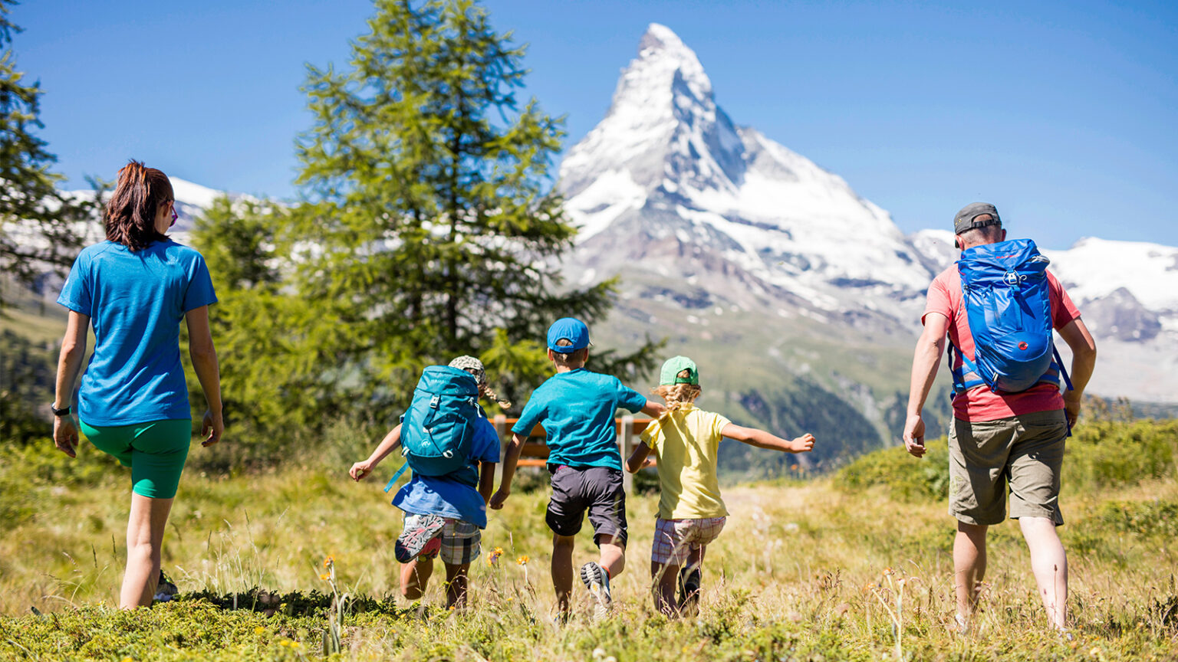
The Smiths were in the mountains in May.
They were with their children.
They were there in the afternoon.
It was warm.

Slide 5
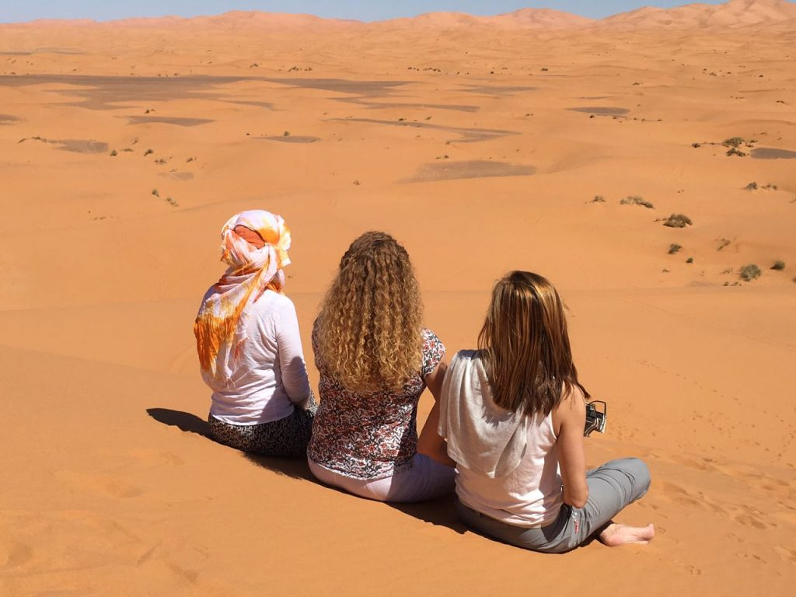
Mary was in the dessert last Friday.
She was there with her friends.
She was there in the morning.
It was hot.

Slide 6
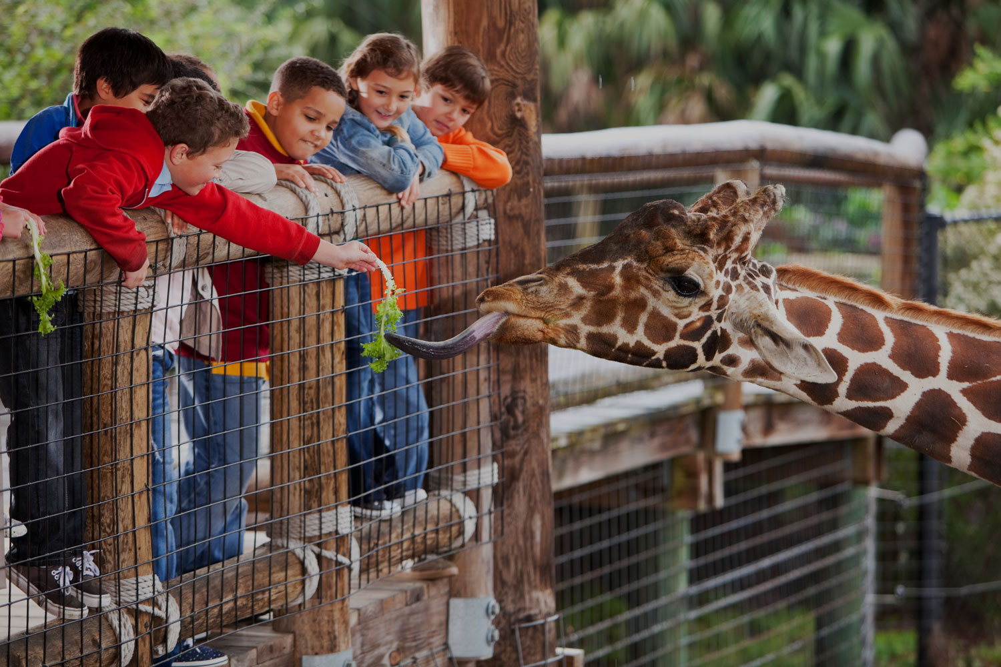
We were at the zoo yesterday.
We were there with our classmates.
We were there in the afternoon.
It was warm.

Slide 7
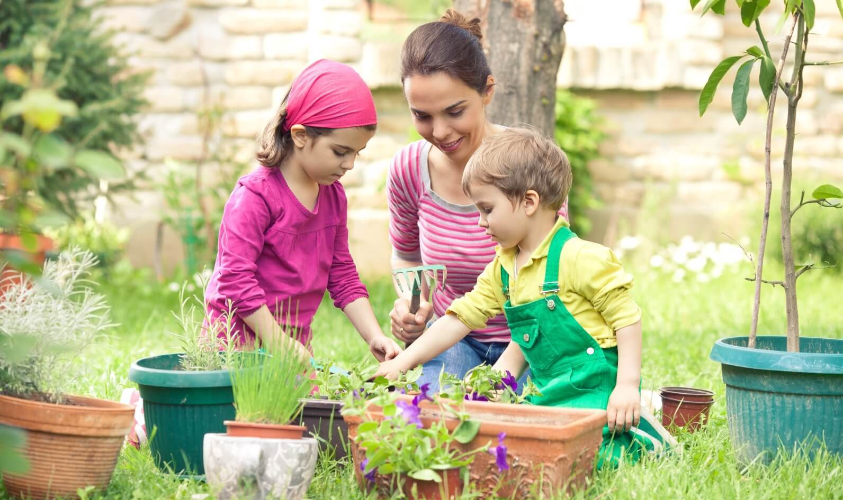
1. I was in the garden last Saturday.
2. I was with my neighbours.
3. I was there in the morning.
4. It was sunny and windy.

Slide 8
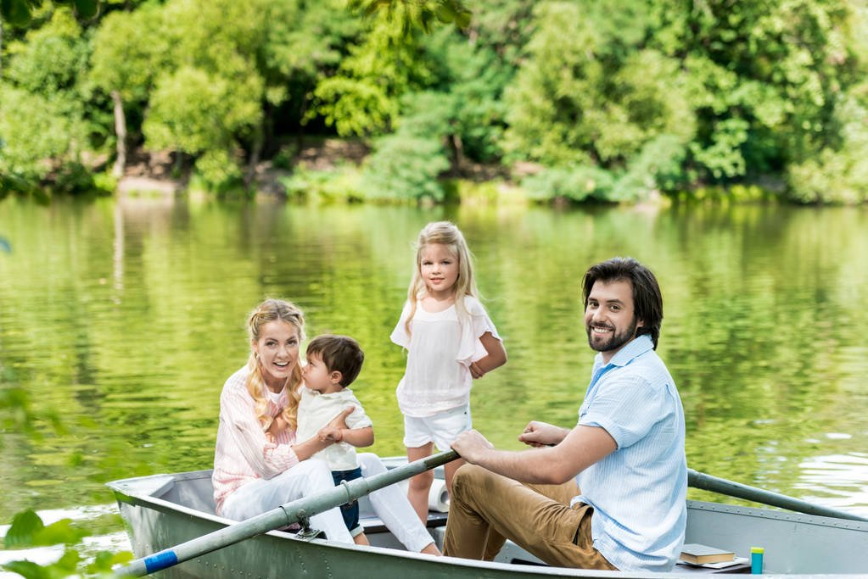
Ben and Linda were on the lake last Sunday.
They were with their family.
They were there all day.
It was warm and sunny.

Slide 9
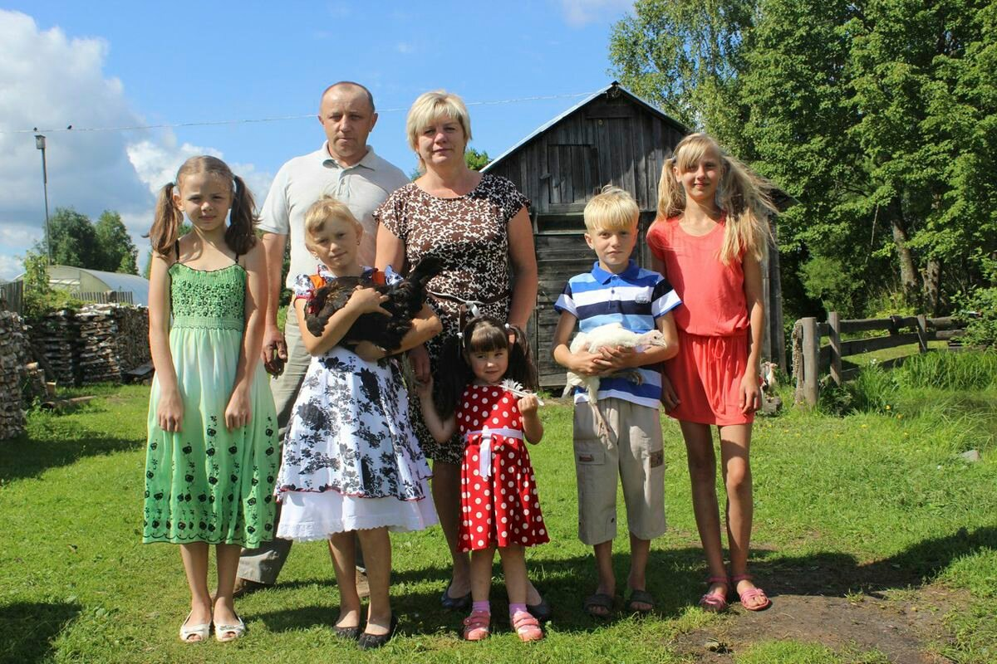
Kate was in the village last summer.
She was with her grandparents.
She was there all summer.
It was hot and sunny.

Slide 10
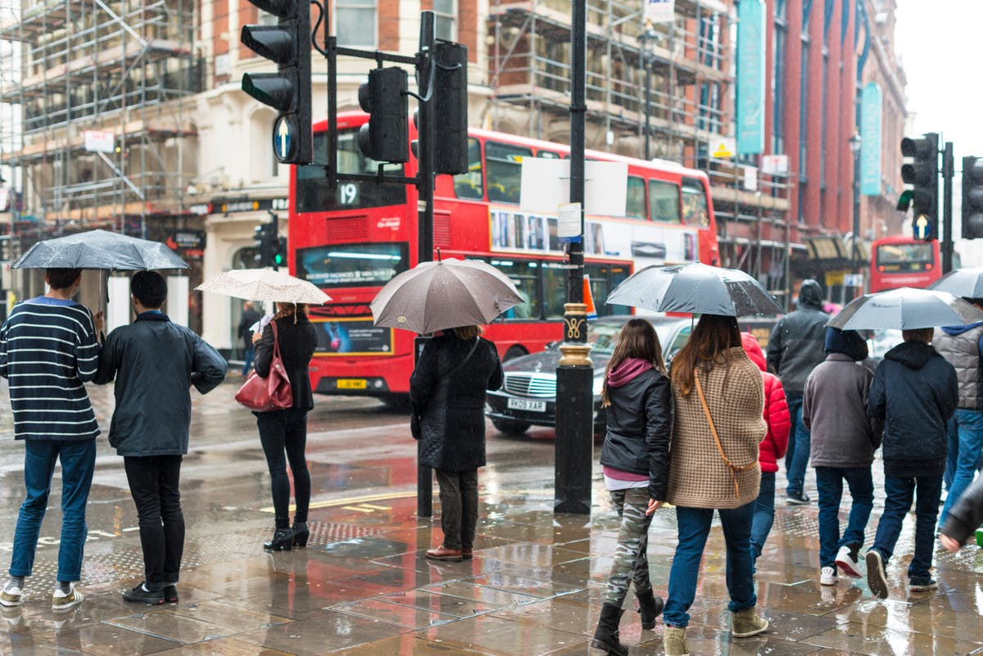
Sam was in London last autumn.
He was with his friend.
He was there all the weekend.
It was rainy.

