Slide 1
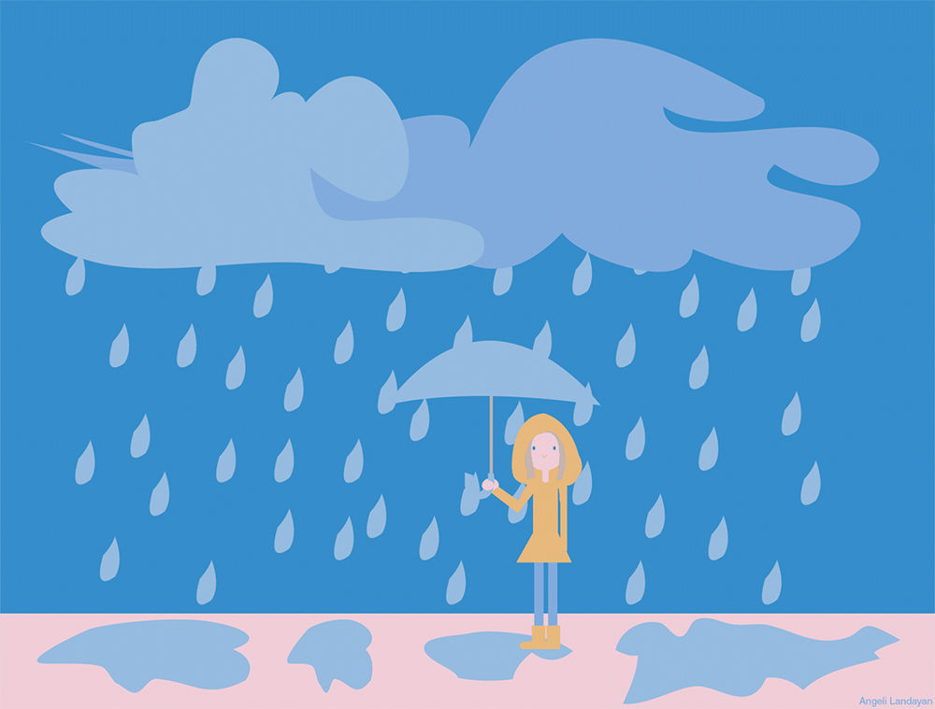
It / raining / is

Slide 2
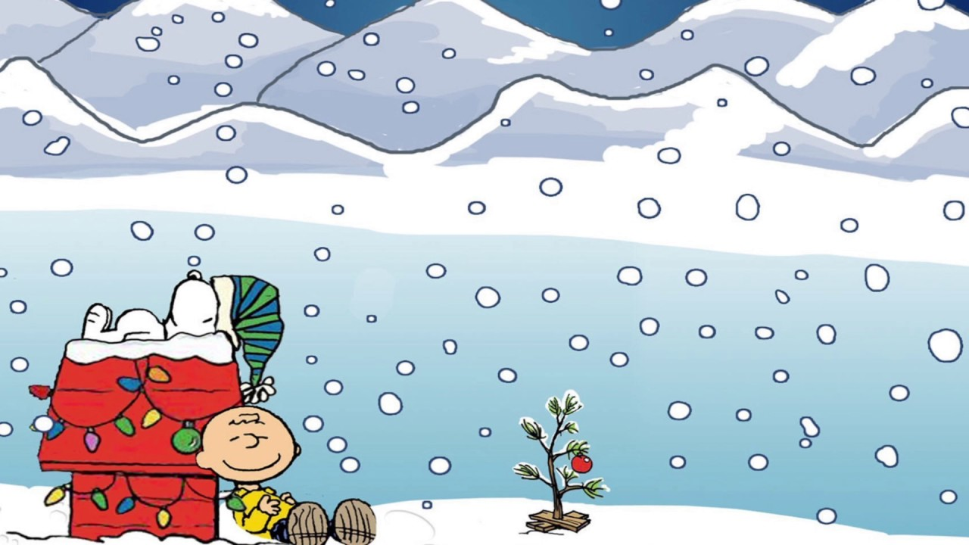
isn’t / snowing / It

Slide 3
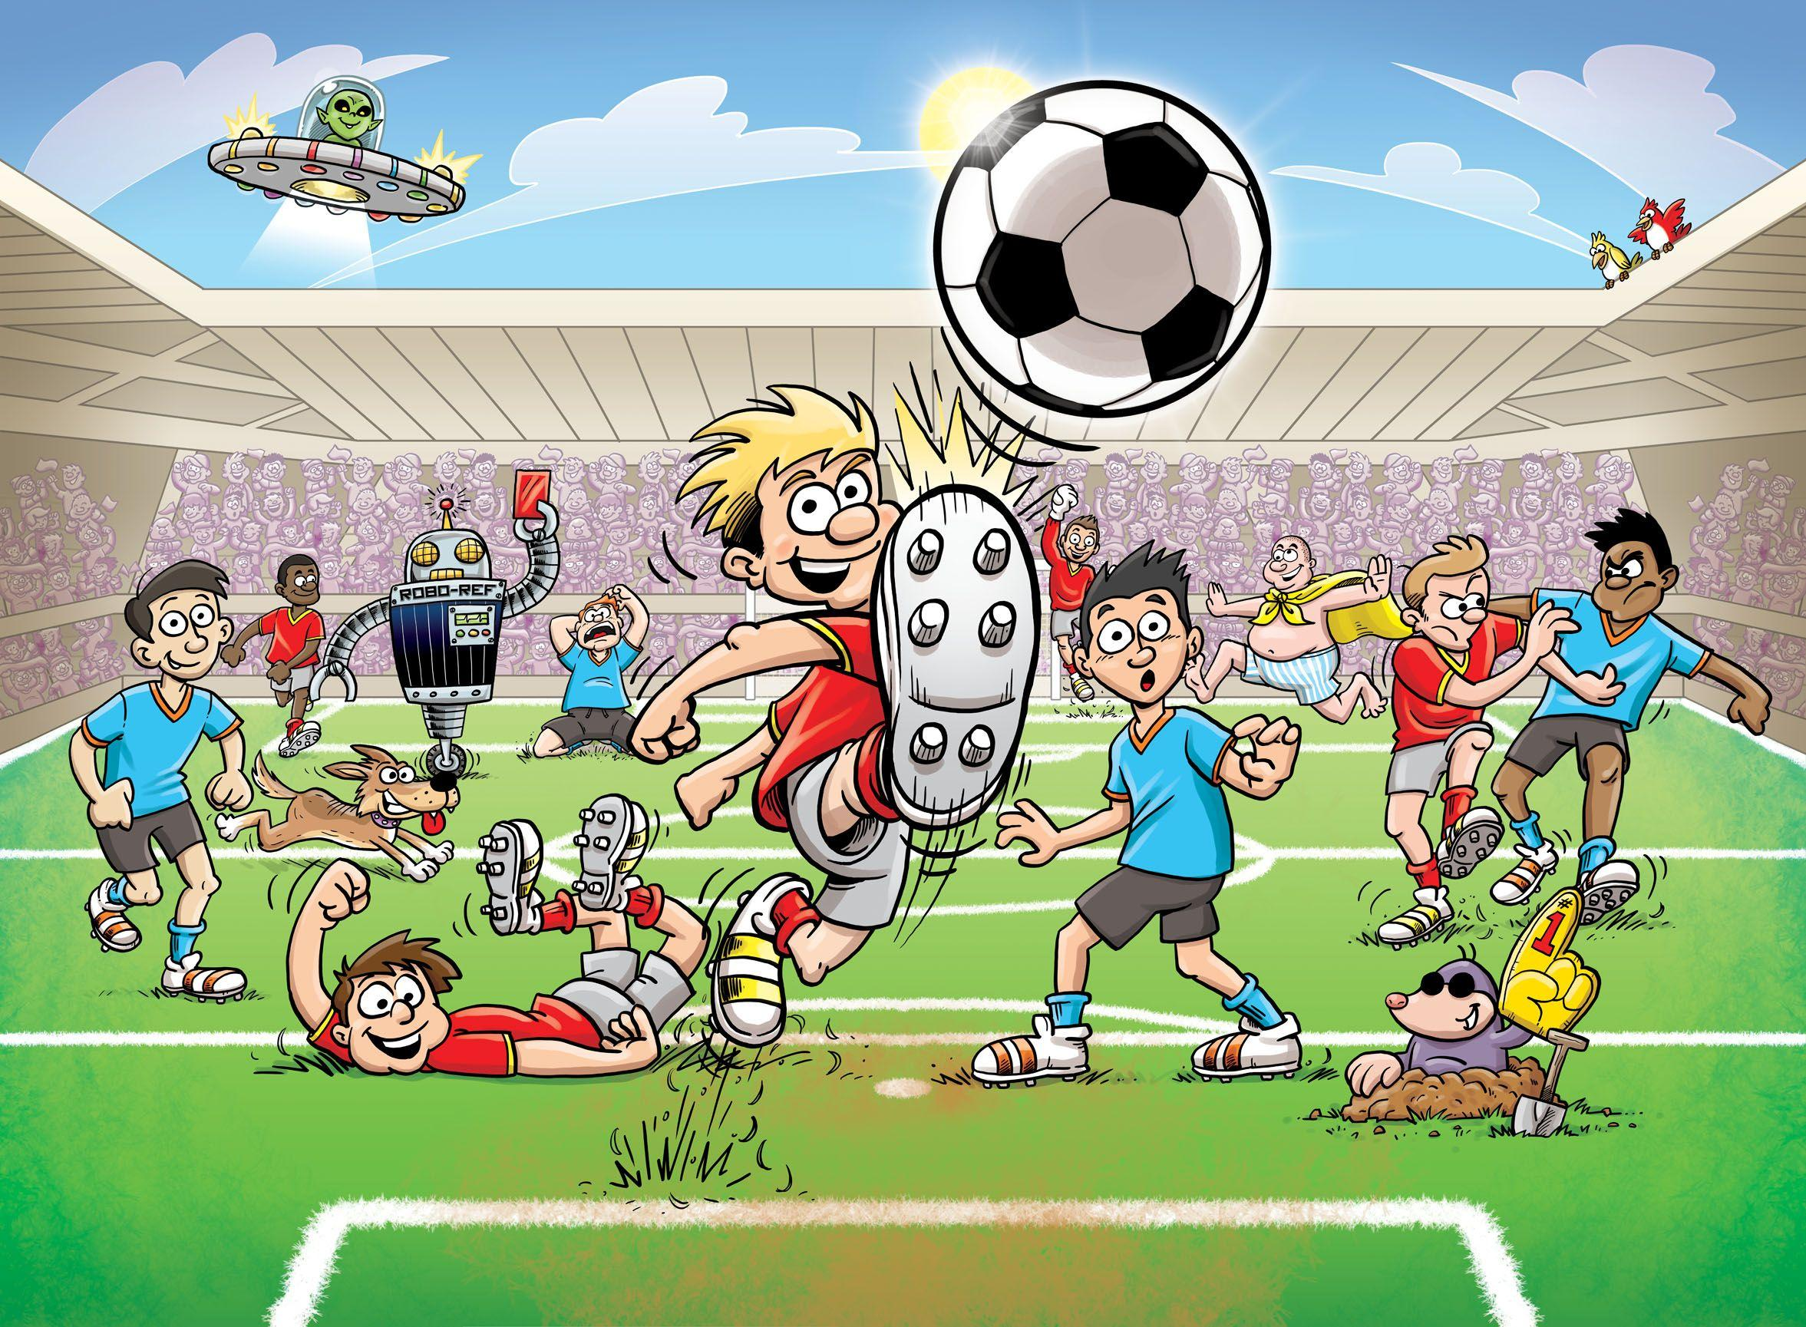
We / football / are / playing

Slide 4
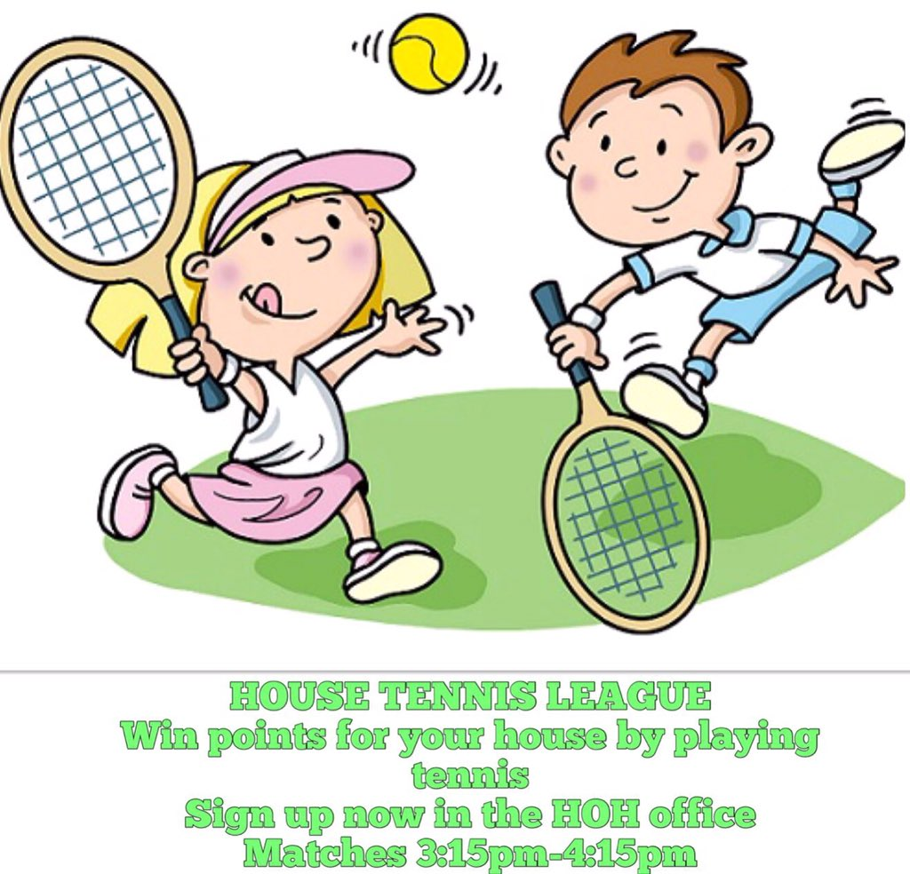
playing / aren’t / tennis / We

Slide 5

are / watching / TV / They

Slide 6

watching / videos / aren’t / They

Slide 7
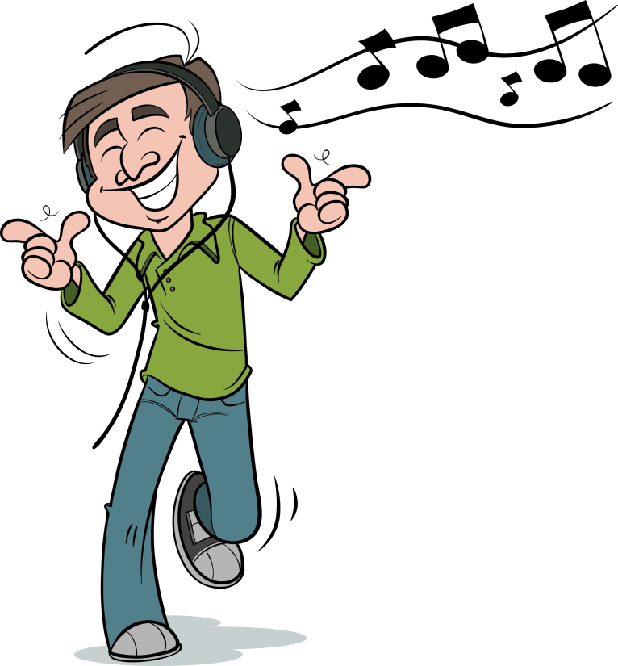
He / music / is / listening / to

Slide 8

wearing / isn’t / a / hat / He

Slide 9
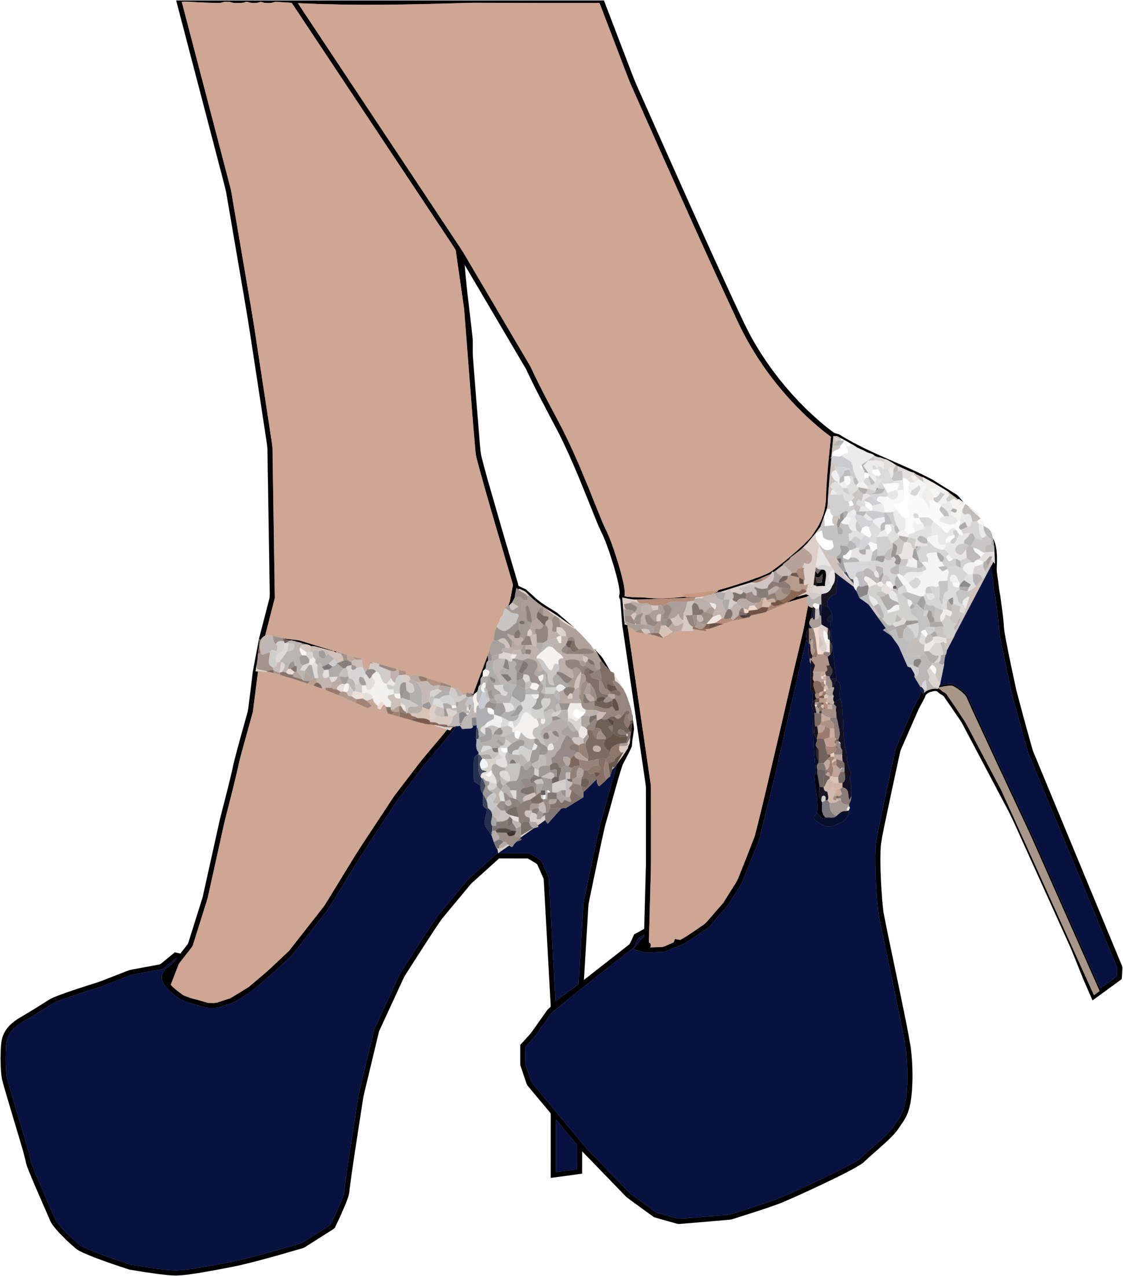
‘m / wearing / shoes / I

Slide 10

I / not / fun / having / ‘m

