Slide 1

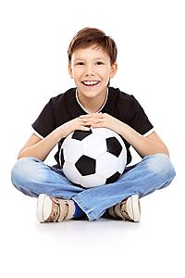
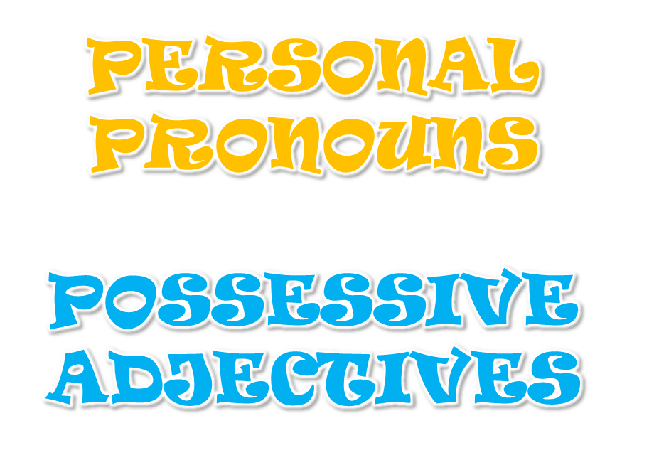
by HERBER

Slide 2
PERSONAL PRONOUNS/POSSESSIVE ADJECTIVES
I have got a ball.
It’s my ball.

Slide 3
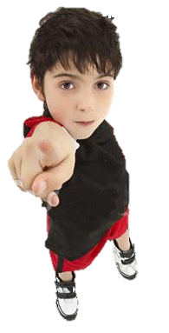
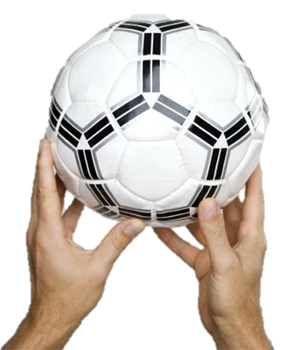
PERSONAL PRONOUNS/POSSESSIVE ADJECTIVES
You have got a ball.
It’s your ball.

Slide 4
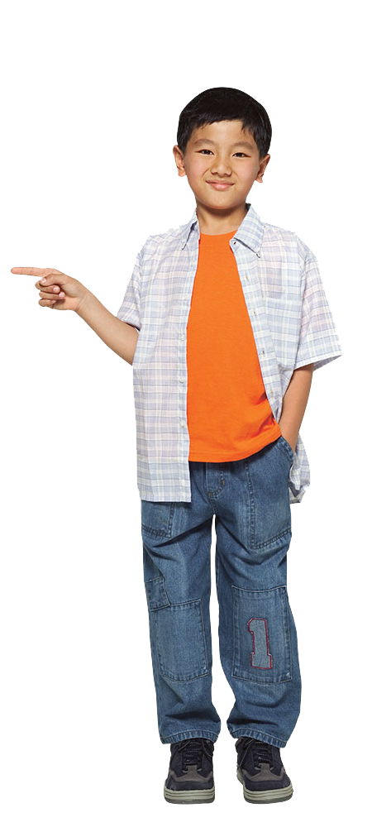
PERSONAL PRONOUNS/POSSESSIVE ADJECTIVES
He has got a ball.
It’s his ball.

Slide 5
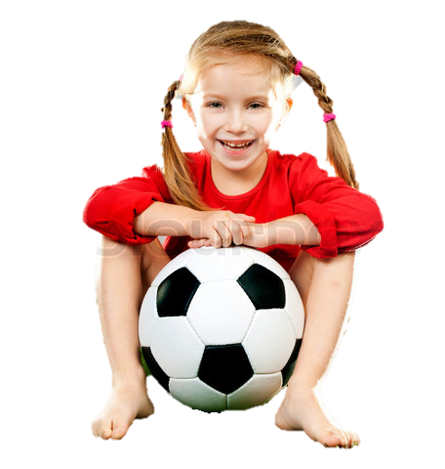
PERSONAL PRONOUNS/POSSESSIVE ADJECTIVES
She has got a ball.
It’s her ball.

Slide 6
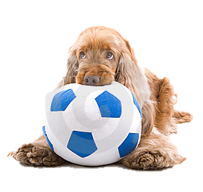
PERSONAL PRONOUNS/POSSESSIVE ADJECTIVES
It has got a ball.
It’s its ball.

Slide 7
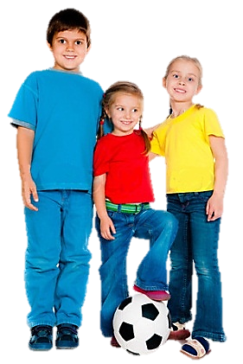
PERSONAL PRONOUNS/POSSESSIVE ADJECTIVES
We have got a ball.
It’s our ball.

Slide 8
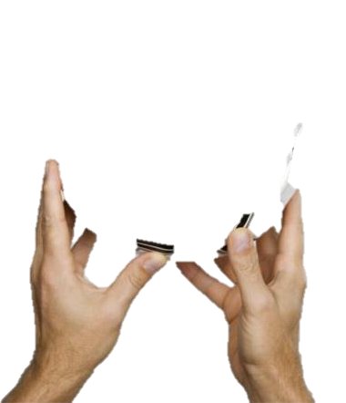
PERSONAL PRONOUNS/POSSESSIVE ADJECTIVES
You all
have got a ball.
That’s your ball.

Slide 9
PERSONAL PRONOUNS/POSSESSIVE ADJECTIVES
They have got a ball.
It’s their ball.

Slide 10
PERSONAL PRONOUNS/POSSESSIVE ADJECTIVES
I
your
you
her
he
our
their
she
it
my
your
we
his
you
its
they
Click the possessive pronouns to complete the chart

Slide 11
PERSONAL PRONOUNS/POSSESSIVE ADJECTIVES
I
your
you
her
he
our
their
she
my
it
your
we
his
you
its
they
Click the possessive pronouns to complete the chart

Slide 12
PERSONAL PRONOUNS/POSSESSIVE ADJECTIVES
I
your
you
her
he
our
their
she
my
it
your
we
his
you
its
they
Click the possessive pronouns to complete the chart

Slide 13
PERSONAL PRONOUNS/POSSESSIVE ADJECTIVES
I
your
you
her
he
our
their
she
my
it
your
we
his
you
its
they
Click the possessive pronouns to complete the chart

Slide 14
PERSONAL PRONOUNS/POSSESSIVE ADJECTIVES
I
your
you
her
he
our
their
she
my
it
your
we
his
you
its
they
Click the possessive pronouns to complete the chart

Slide 15
PERSONAL PRONOUNS/POSSESSIVE ADJECTIVES
I
your
you
her
he
our
their
she
my
it
your
we
his
you
its
they
Click the possessive pronouns to complete the chart

Slide 16
PERSONAL PRONOUNS/POSSESSIVE ADJECTIVES
I
your
you
her
he
our
their
she
my
it
your
we
his
you
its
they
Click the possessive pronouns to complete the chart

Slide 17
PERSONAL PRONOUNS/POSSESSIVE ADJECTIVES
I
your
you
her
he
our
their
she
my
it
your
we
his
you
its
they
Click the possessive pronouns to complete the chart

Slide 18
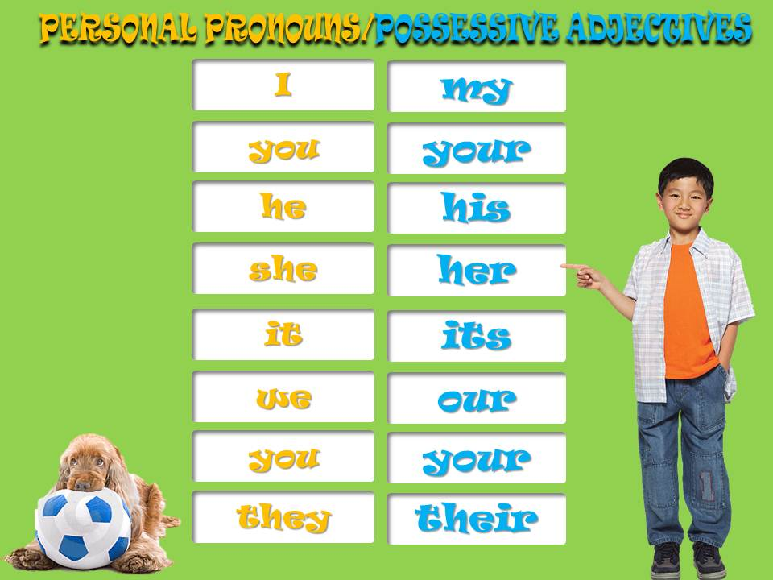
REMEMBER

Slide 19
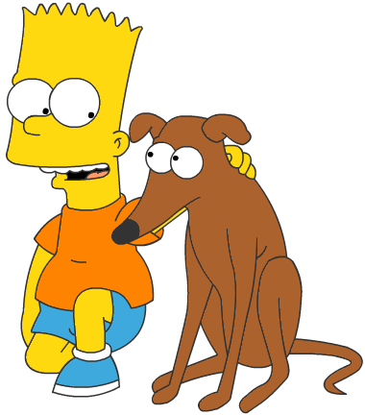
POSSESSIVE ADJECTIVES
This is Bart’s dog.
It’s _________ dog.
my
your
his
her
its
our
Complete the sentences

Slide 20
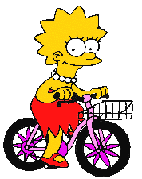
POSSESSIVE ADJECTIVES
This is Lisa’s bike.
It’s _________ bike.
my
your
his
her
its
our
Complete the sentences

Slide 21
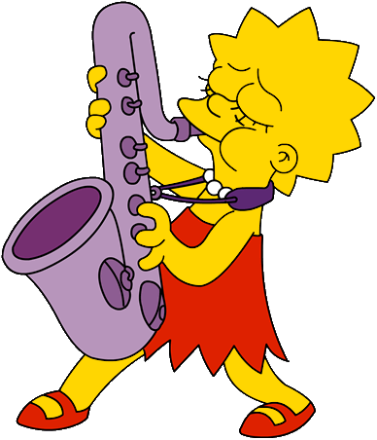
POSSESSIVE ADJECTIVES
I have got a saxophone.
It’s _______ saxophone.
my
your
his
her
its
our
Complete the sentences

Slide 22
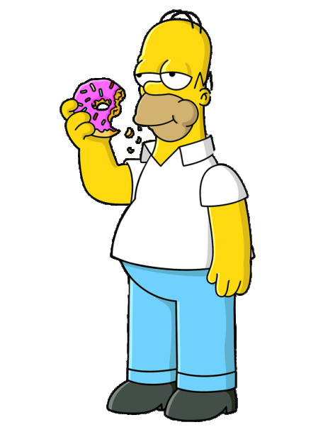

POSSESSIVE ADJECTIVES
Dad, you have got a doughnut.
It’s _______ doughnut.
my
your
his
her
its
our

Slide 23
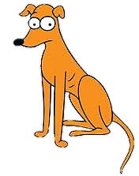
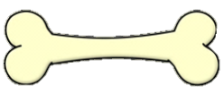
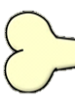
POSSESSIVE ADJECTIVES
The dog has got a bone.
It’s _______ bone.
my
your
his
her
its
our

Slide 24
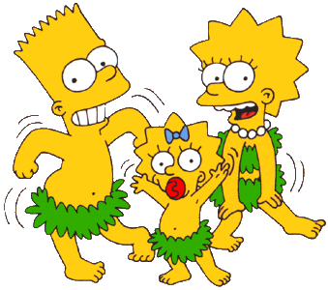
POSSESSIVE ADJECTIVES
Bart and I have got a sister.
It’s _______ sister.
my
your
his
her
its
our

Slide 25
BYE BYE!

