Slide 1
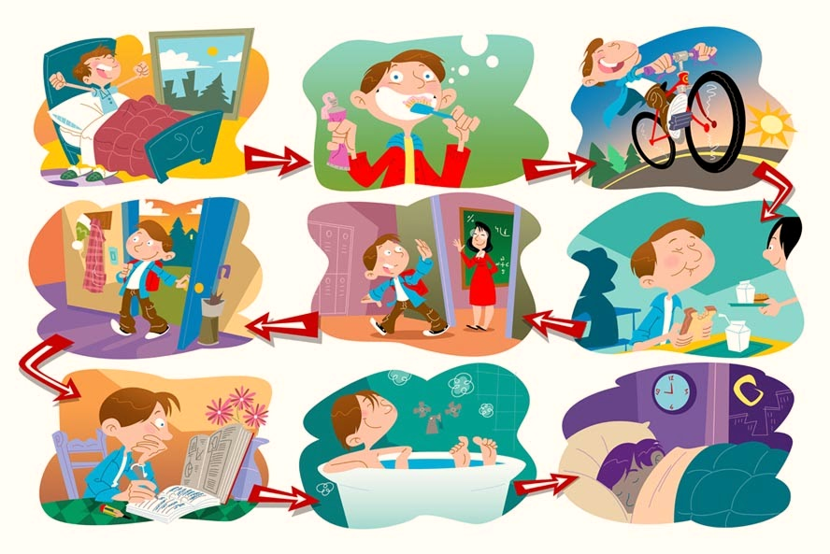



IrinaPapakhinac

Slide 2


IrinaPapakhinac

Slide 3
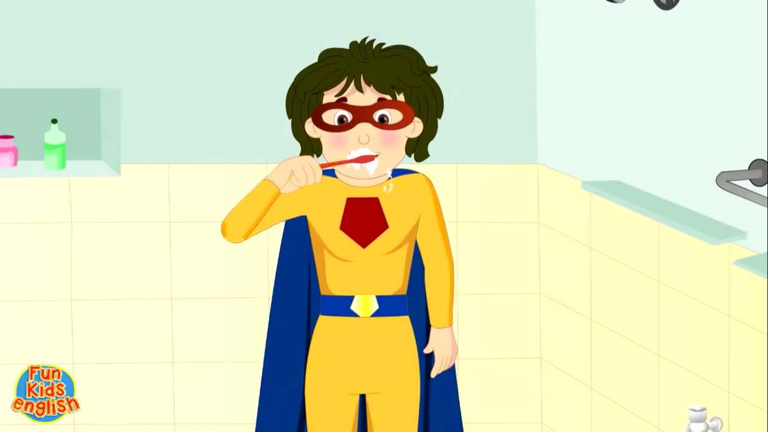

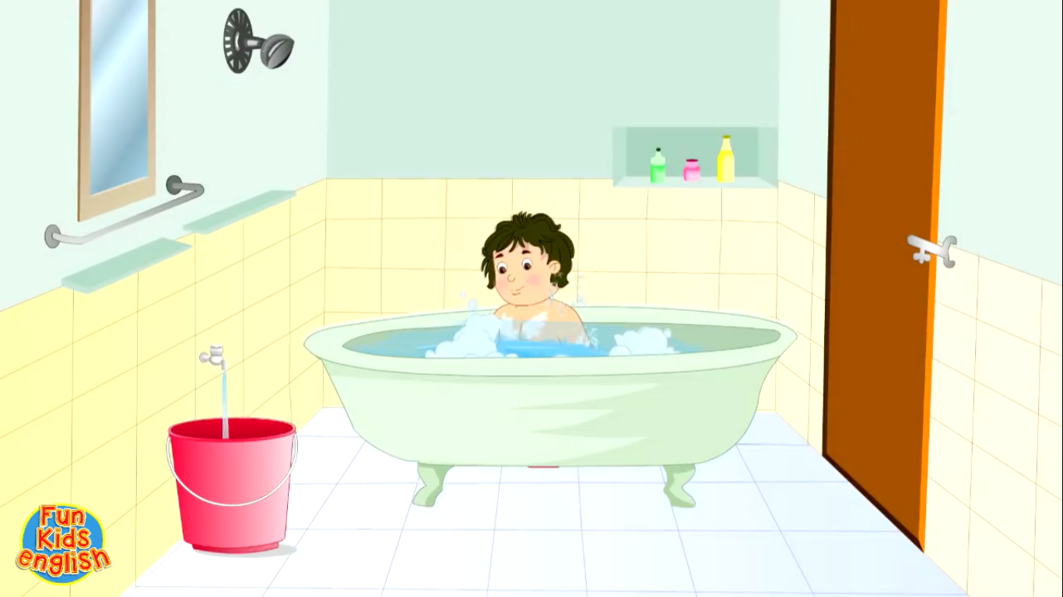
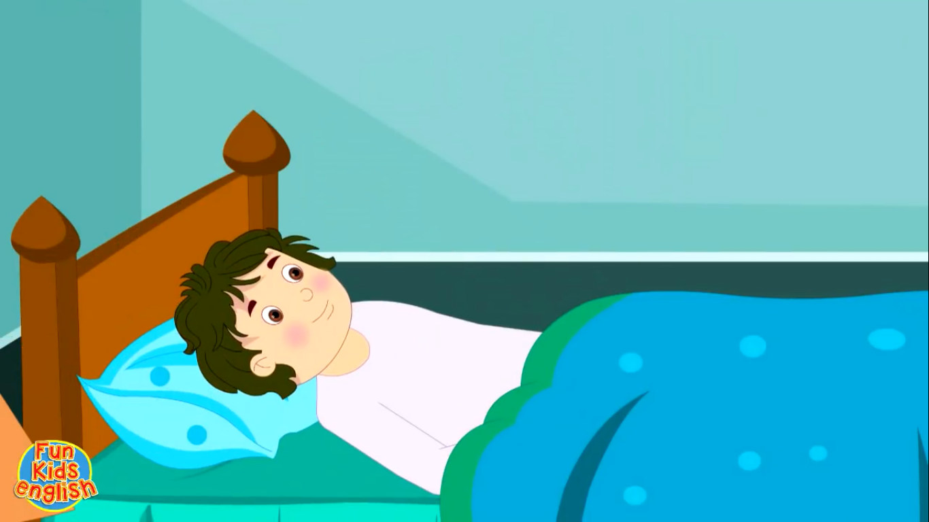
brush teeth
ride a bike
Which of these activities do you do every day?
have a bath
go to bed
IrinaPapakhinac

Slide 4
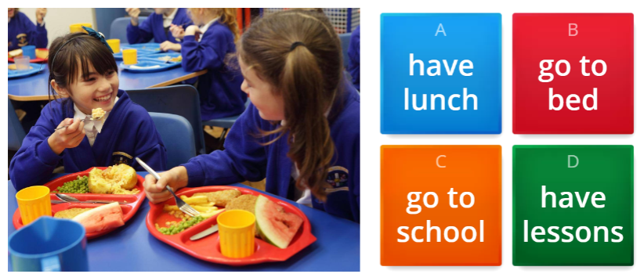
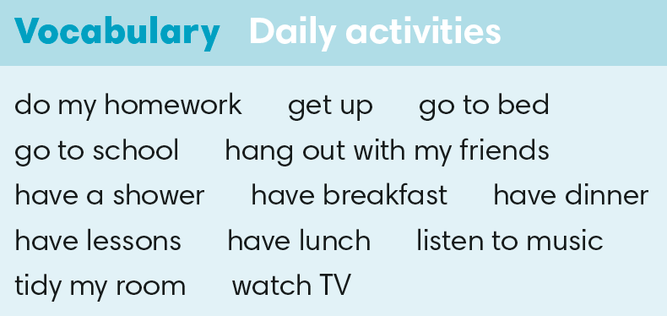

IrinaPapakhinac

Slide 5
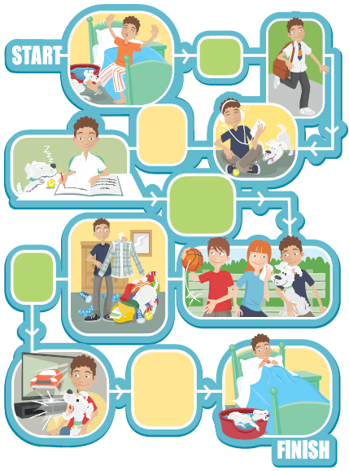
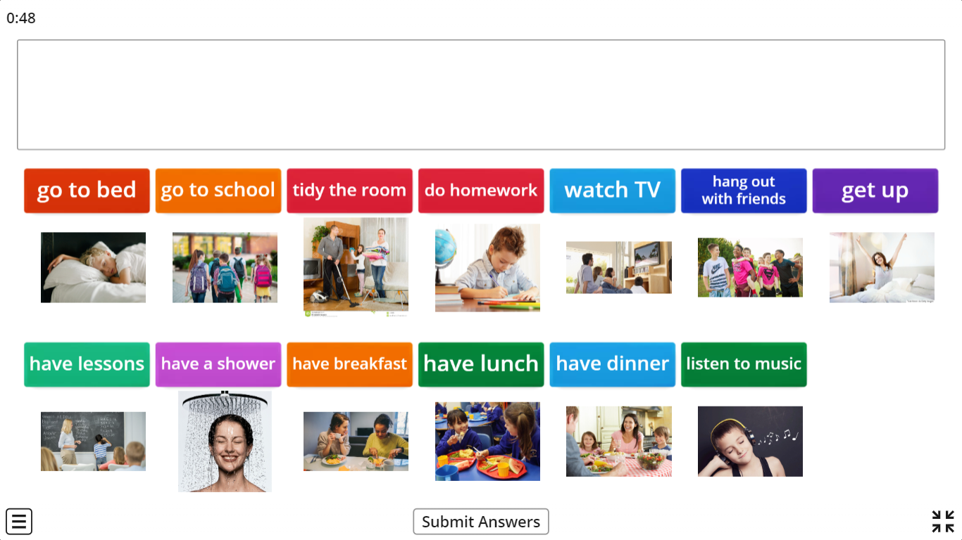
1
2
4
3
6
5
7
8
IrinaPapakhinac

Slide 6
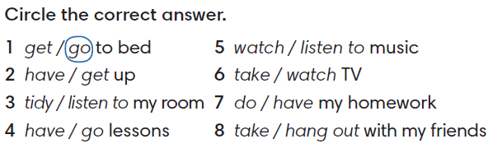
IrinaPapakhinac

Slide 7
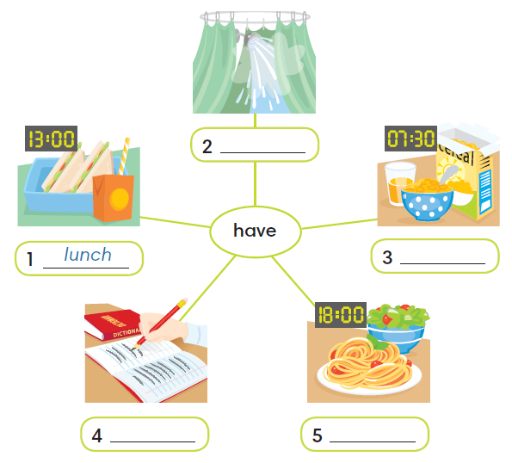
lessons
dinner
a shower
breakfast
IrinaPapakhinac

Slide 8

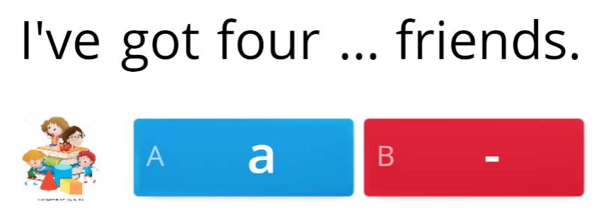
IrinaPapakhinac

Slide 9

4
2
1
6
5
3
IrinaPapakhinac

Slide 10
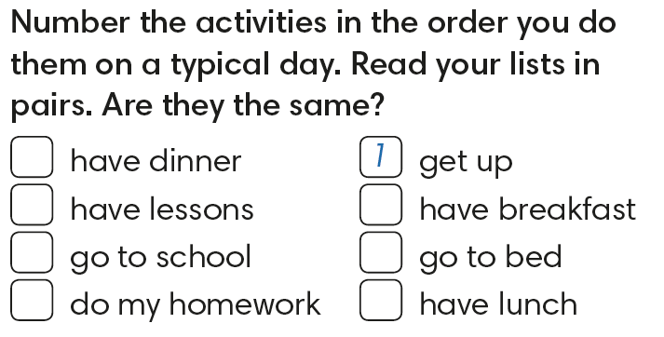
IrinaPapakhinac

Slide 11
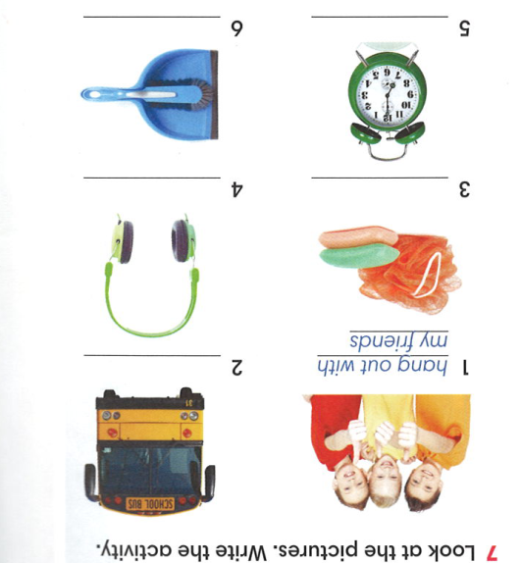
go to school
have a shower
listen to music
get up
tidy my room
IrinaPapakhinac

Slide 12
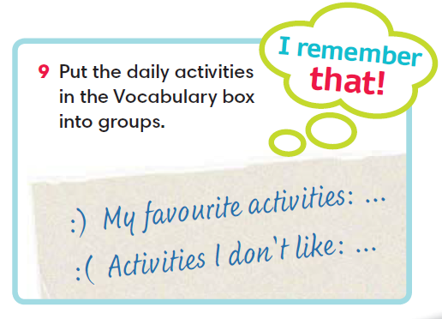

IrinaPapakhinac

Slide 13
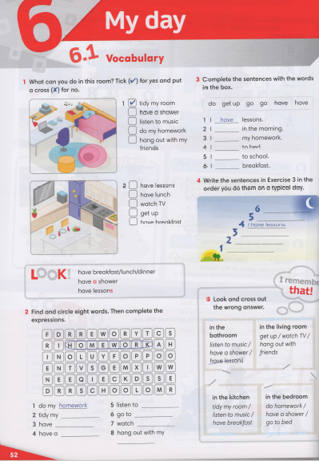


IrinaPapakhinac

Slide 14

IrinaPapakhinac

