Slide 1
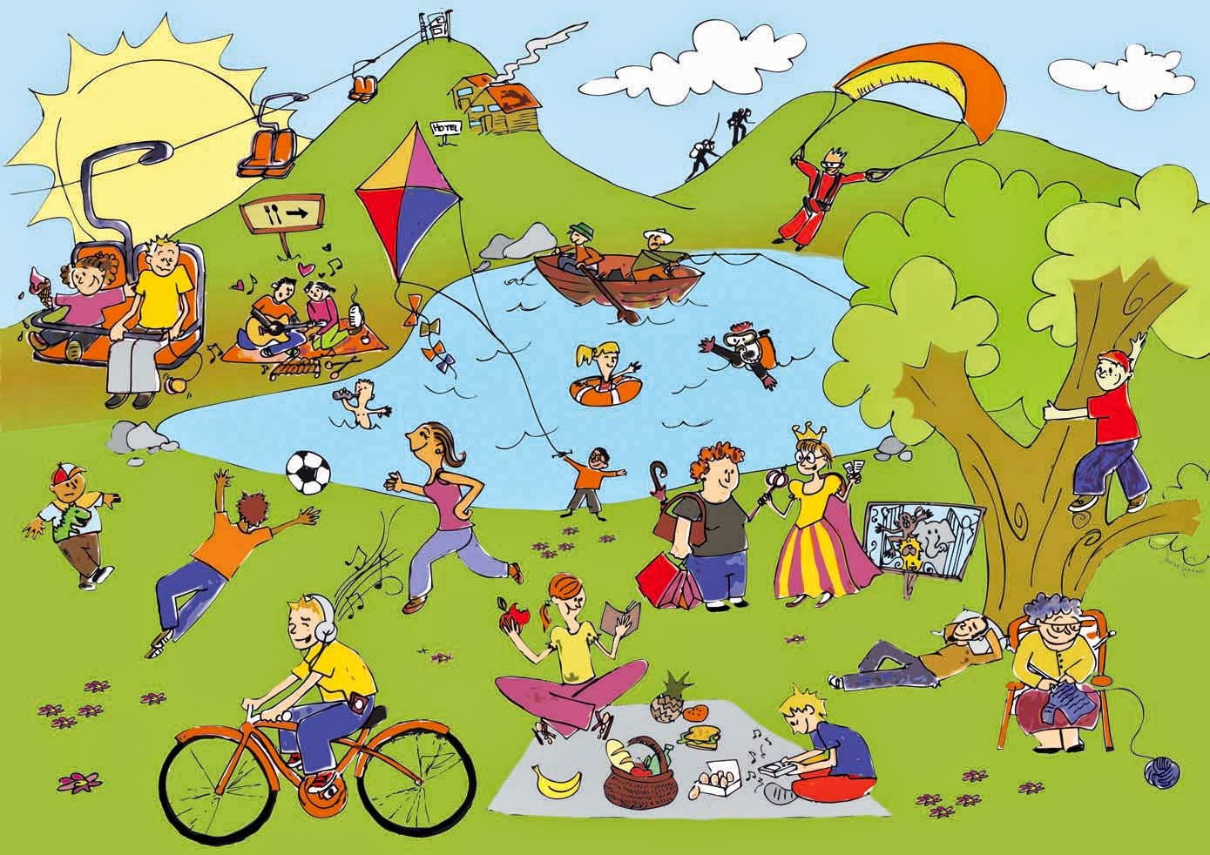



IrinaPapakhinac

Slide 2

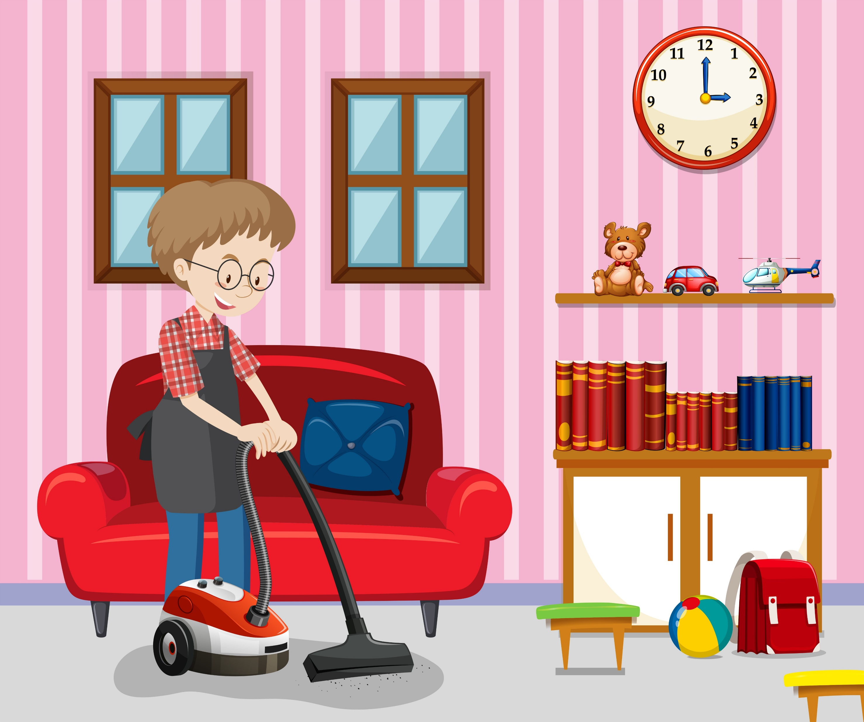
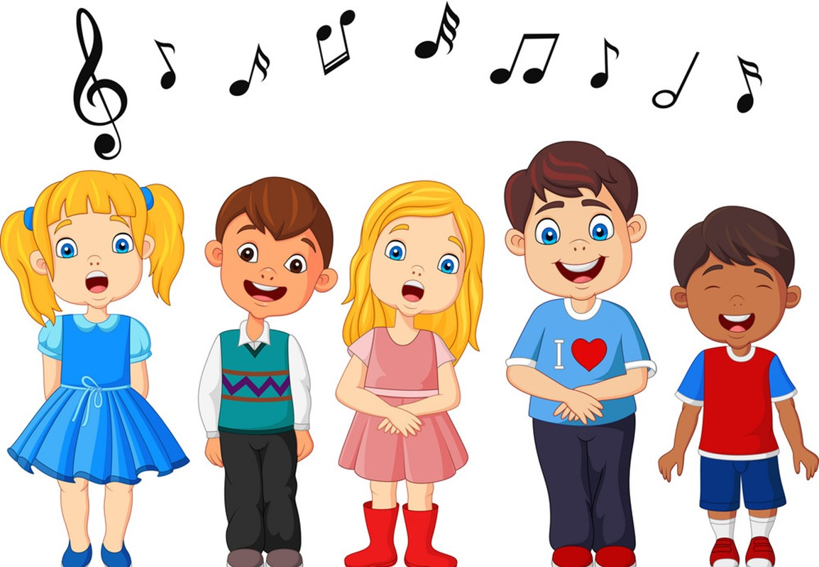
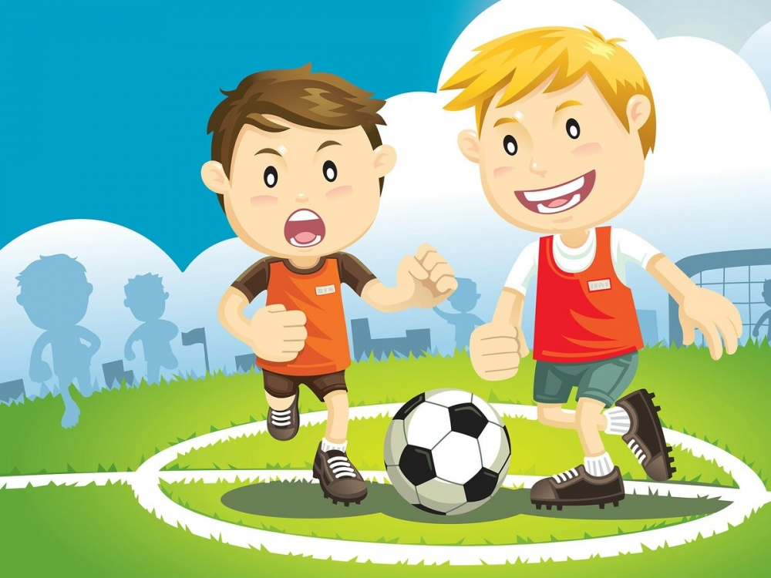
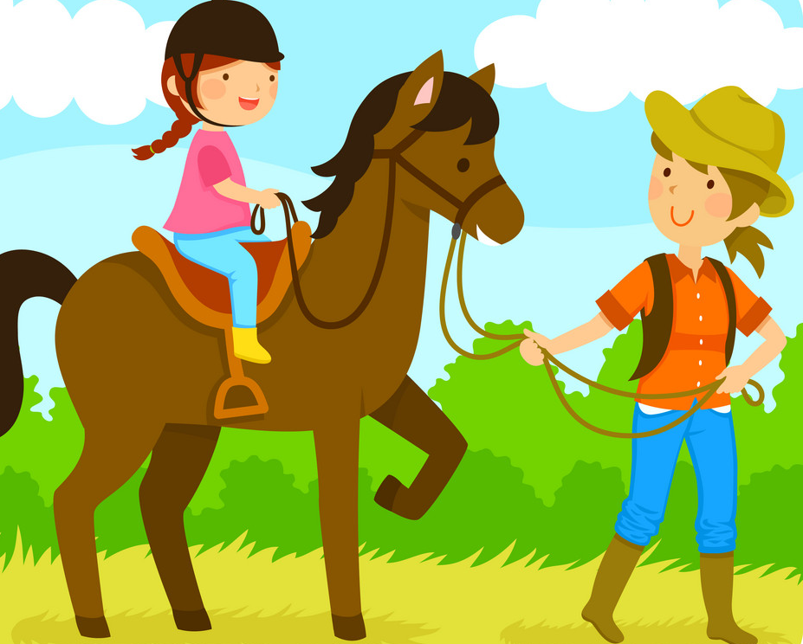
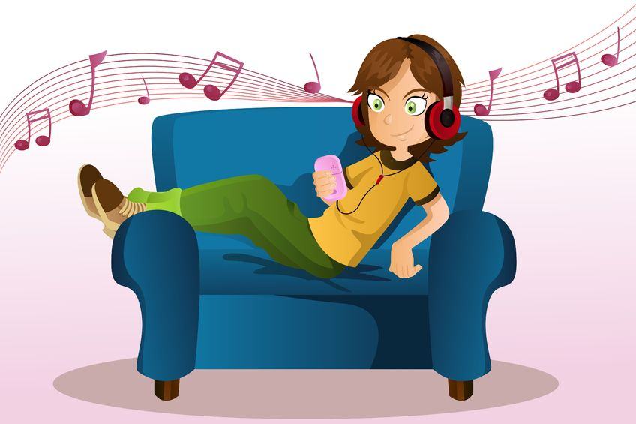
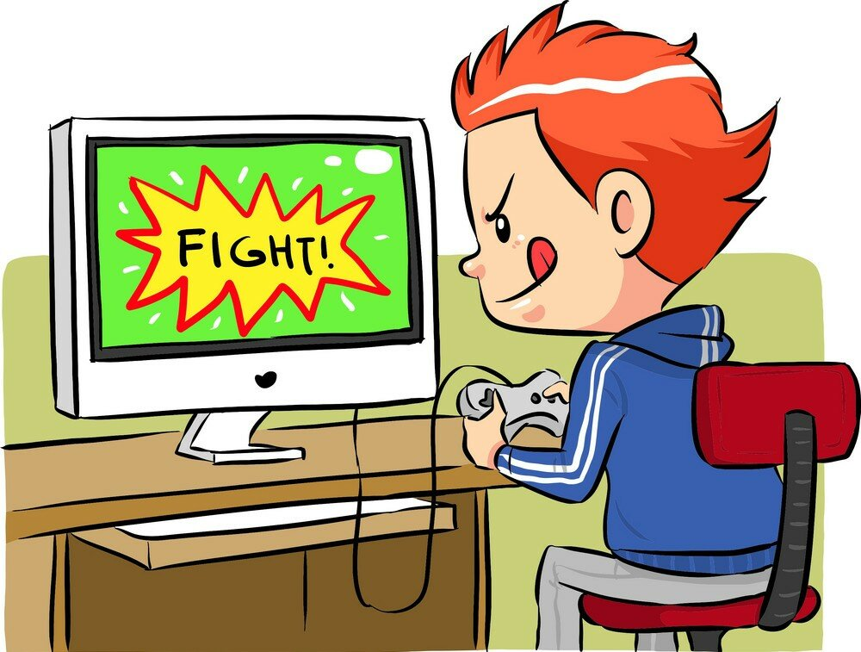
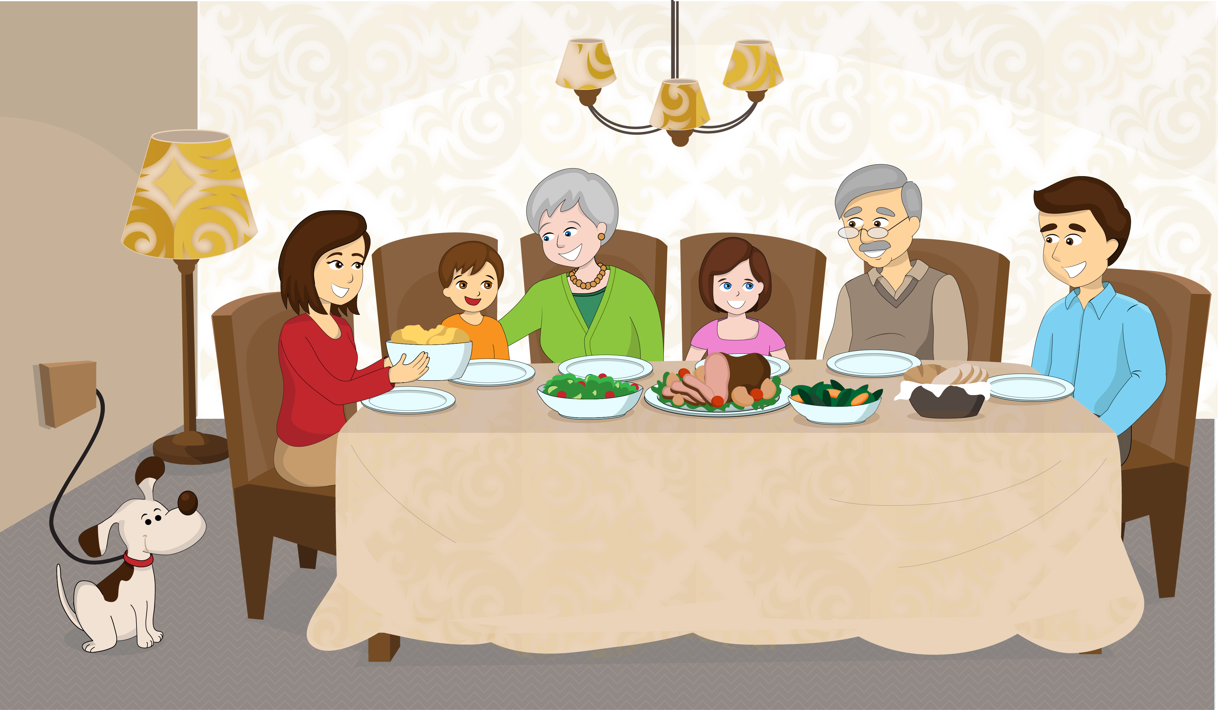
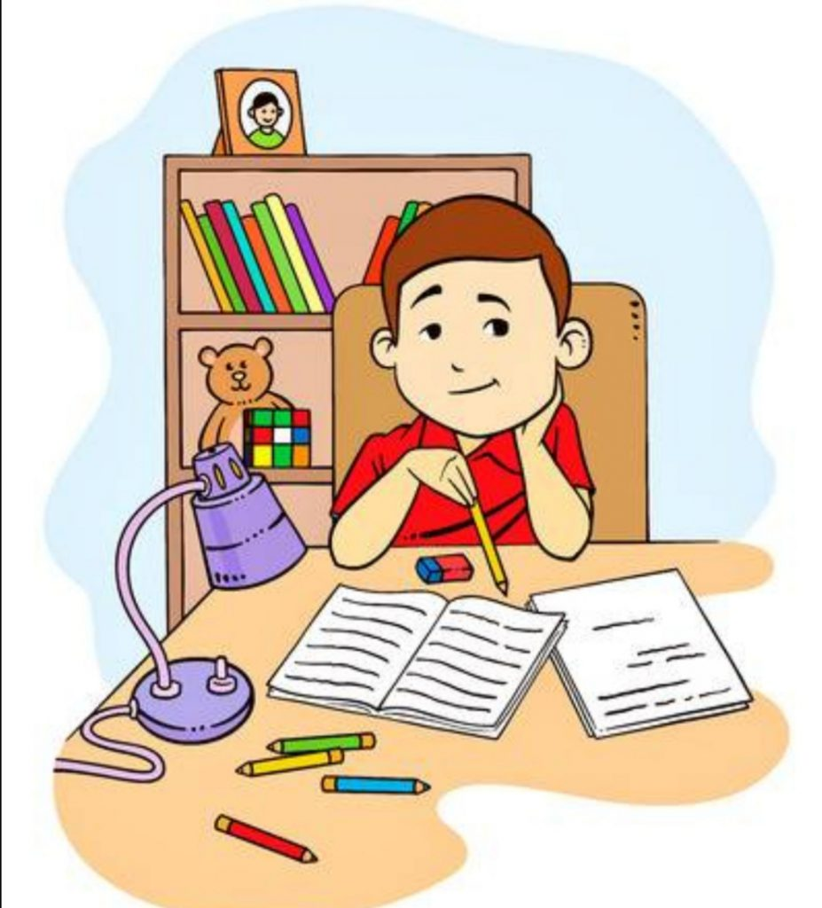
What do they usually do at the weekend?
Which of these activities do you do at the weekend?
1
2
3
4
He tidies his room.
They sing songs.
They play football.
She rides a horse.
5
6
7
8
She listens to music.
He plays computer games.
They have lunch with their family.
He does his homework.
IrinaPapakhinac

Slide 3
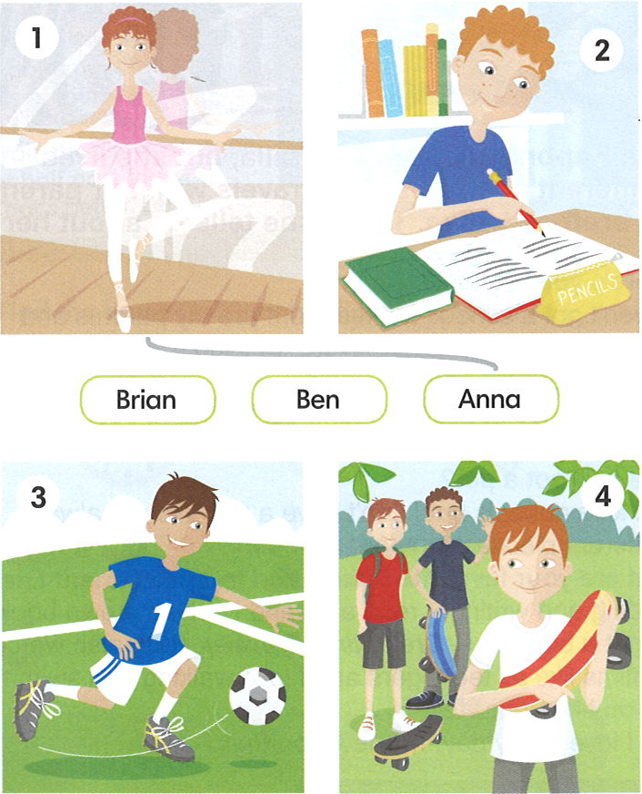

What is their typical Saturday?
Listen and match the names to the pictures.
There is one extra picture.
IrinaPapakhinac

Slide 4
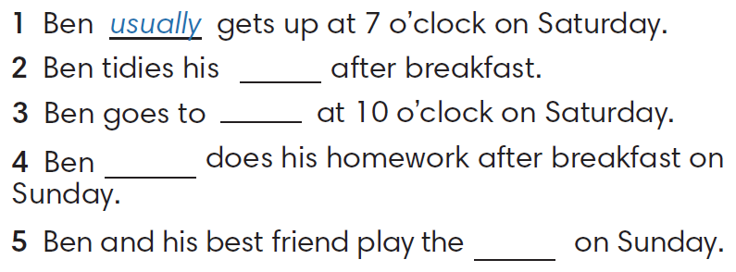
Listen to Ben talking about his weekend.
Complete the sentences with the words in the box.
usually
bed
always
guitar
room
IrinaPapakhinac

Slide 5
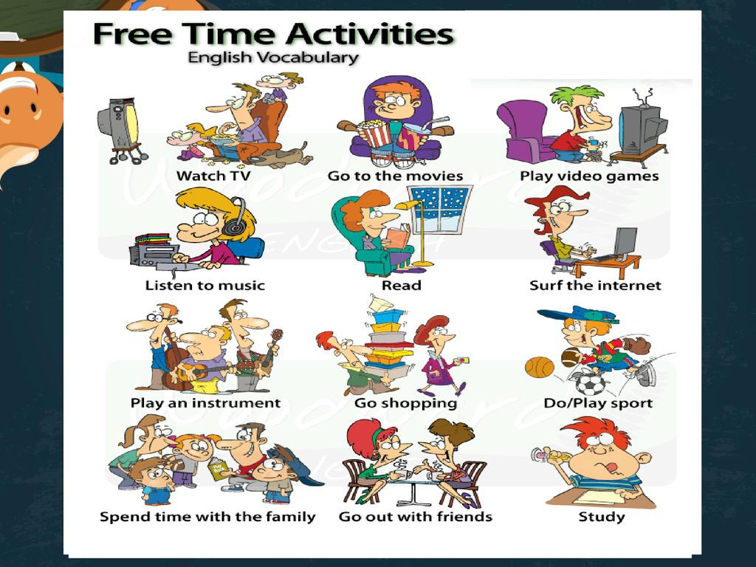
1. Talk about your typical weekends.
Say what you
always
usually
often
sometimes
never
do at the weekend.
2. Tell the group about one student.
The others guess who it is!
IrinaPapakhinac

Slide 6
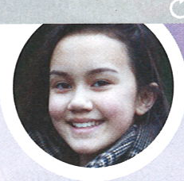
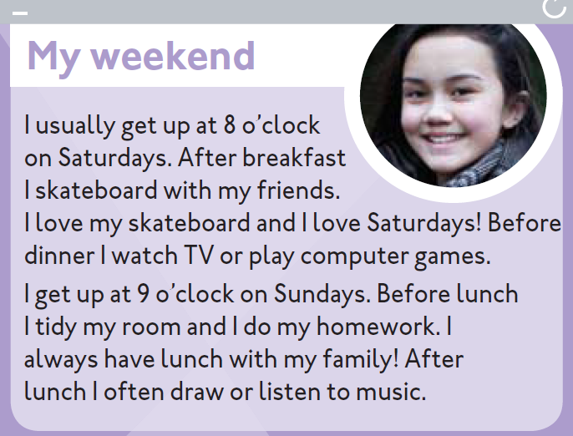
Read Lian’s blog.
1. Which is her favourite day,
Saturday or Sunday?
2. What does she do on Saturday?
3. What does she do on Sunday?
IrinaPapakhinac

Slide 7
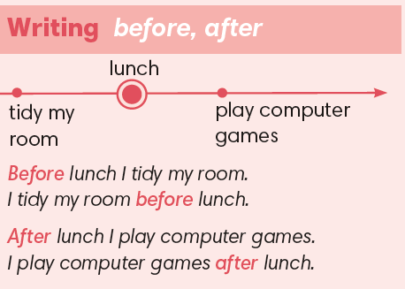
IrinaPapakhinac

Slide 8
Number the activities in the order correct order.
On Saturday Lian
gets up
has breakfast
skateboards with friends
has dinner
watches TV or plays computer games
On Sunday Lian
gets up
has lunch
tidies her room
does her homework
draws or listens to music
1
2
3
5
4
1
4
2
3
5
IrinaPapakhinac

Slide 9
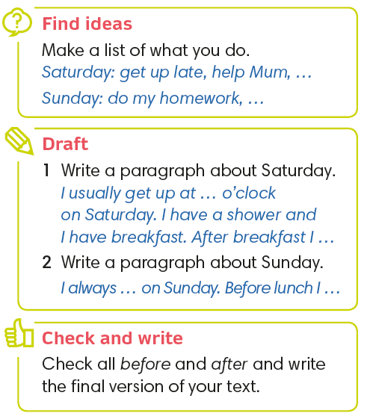

IrinaPapakhinac

Slide 10
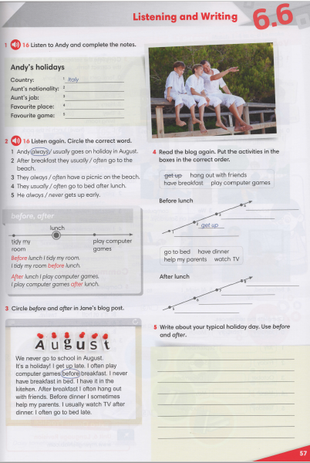
IrinaPapakhinac

Slide 11
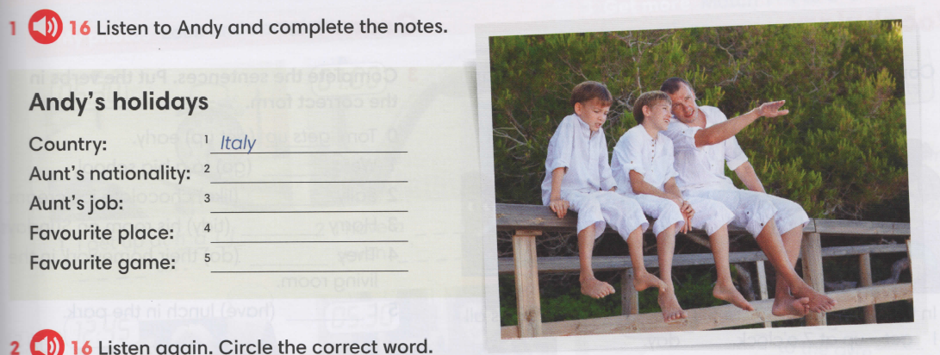
British
teacher
beach
CATCH
IrinaPapakhinac

Slide 12
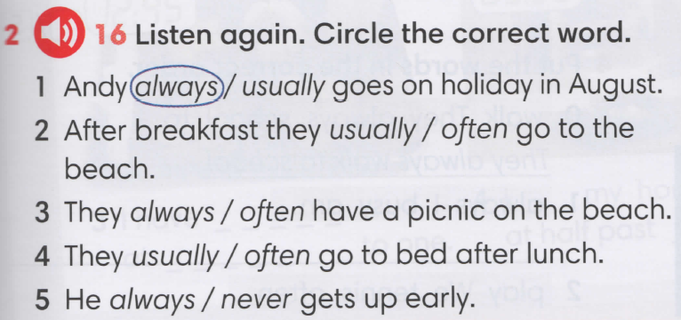
IrinaPapakhinac

