Slide 1
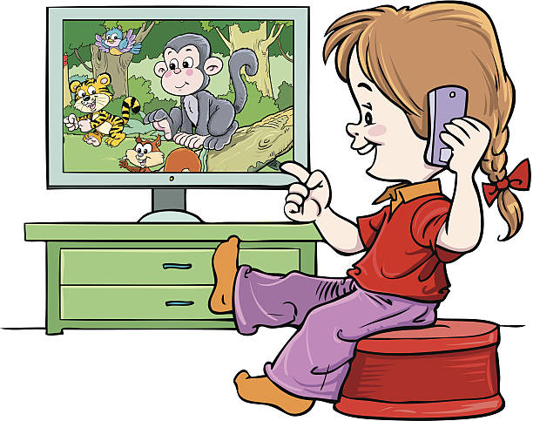
I am watching cartoons.
What are you watching?

Slide 2
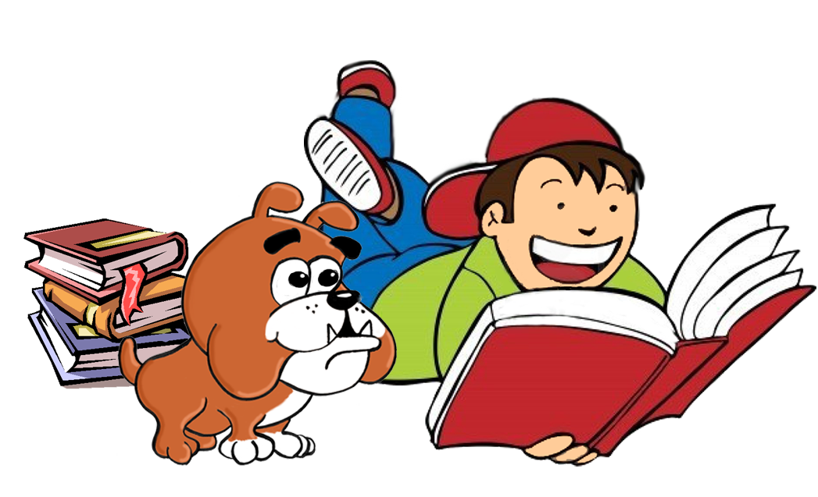
We are reading a story.

Slide 3

They are listening to pop.

Slide 4
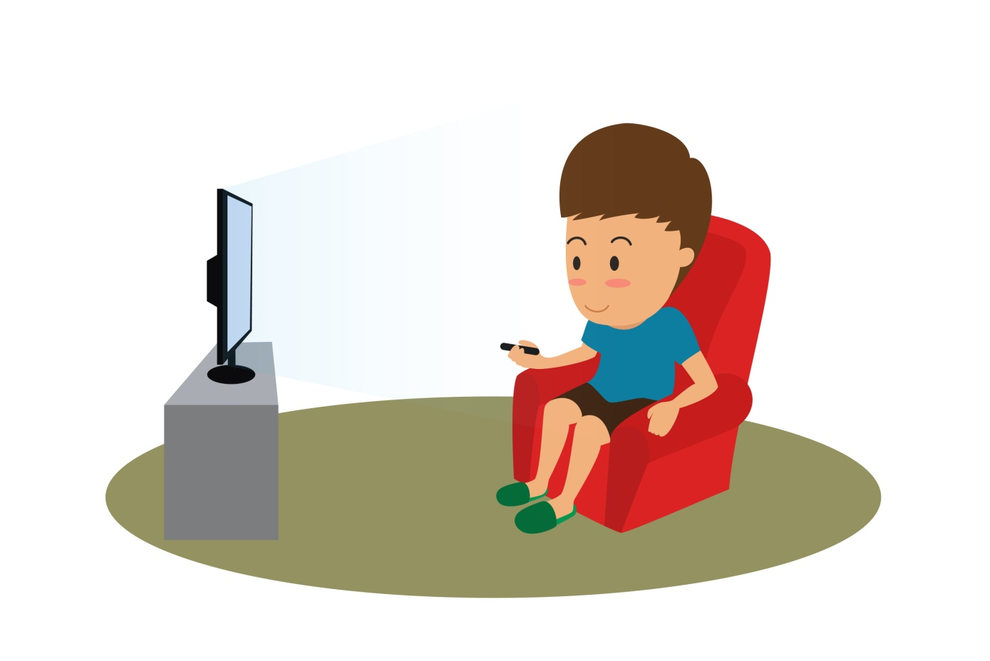
He is watching a film.

Slide 5

She is reading a comic.

Slide 6
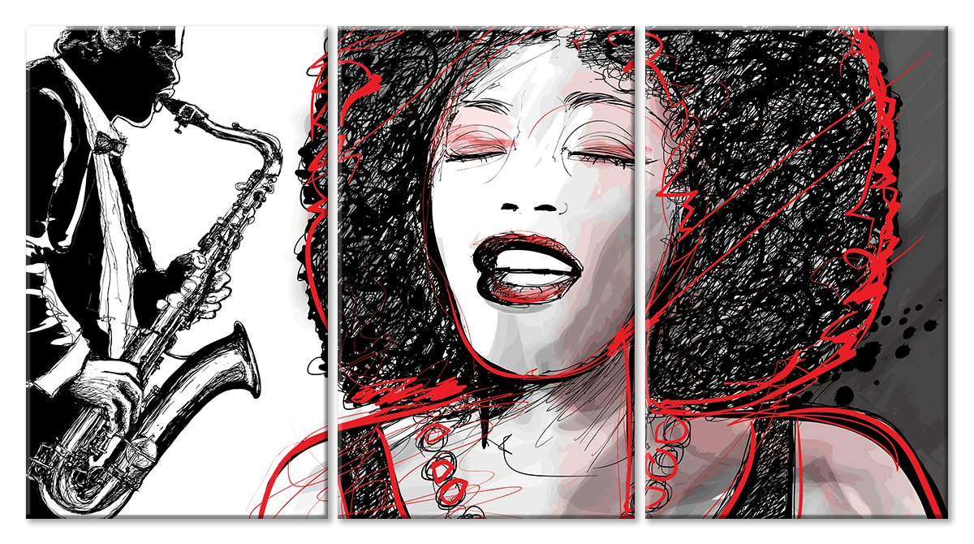
I am listening to jazz.

Slide 7
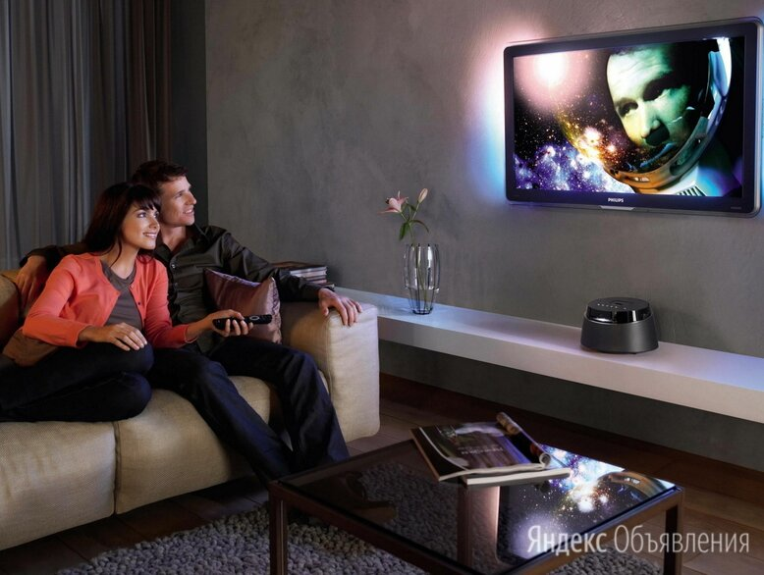
We are watching a video.

Slide 8

They are reading a newspaper.

Slide 9
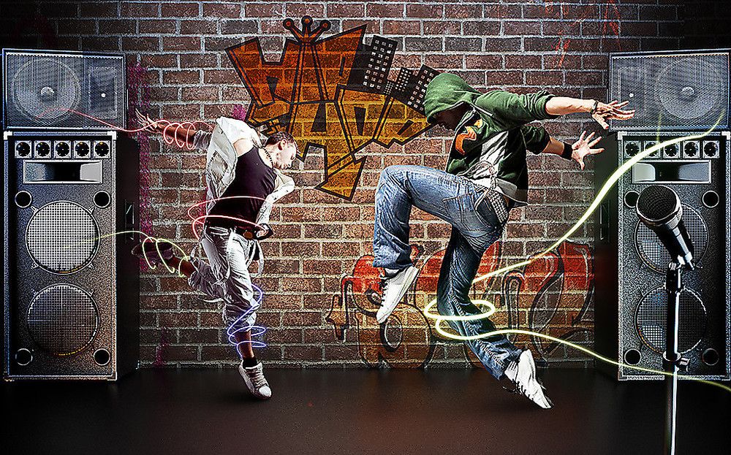
He is listening to hip hop.

Slide 10
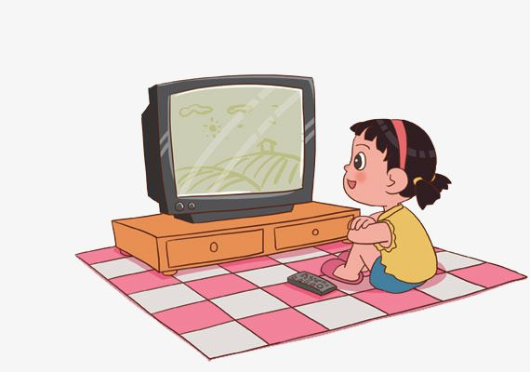
She is watching a musical.

