Slide 1



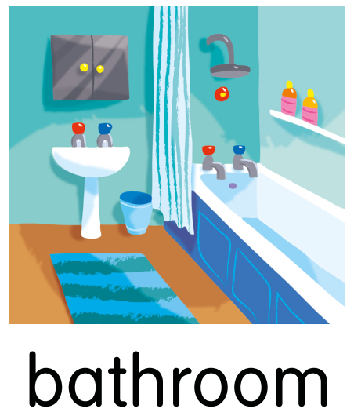
Yesterday I was in the … at 8 o’clock.
I wasn’t in the …

Slide 2
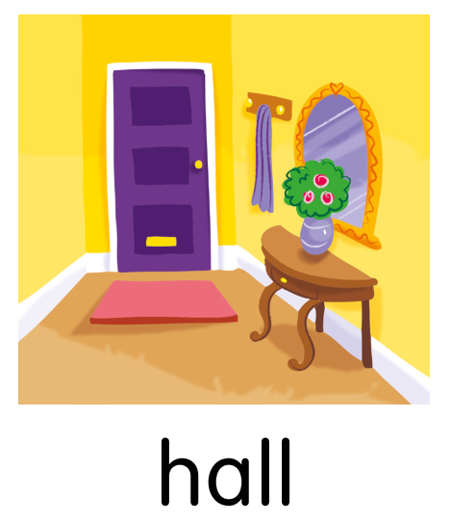
Yesterday Linda was in the … at 9 o’clock.
She wasn’t in the …

Slide 3
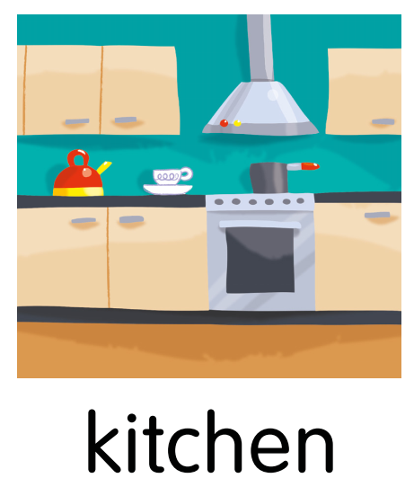
Yesterday Sam was in the … at 11 o’clock.
He wasn’t in the …

Slide 4
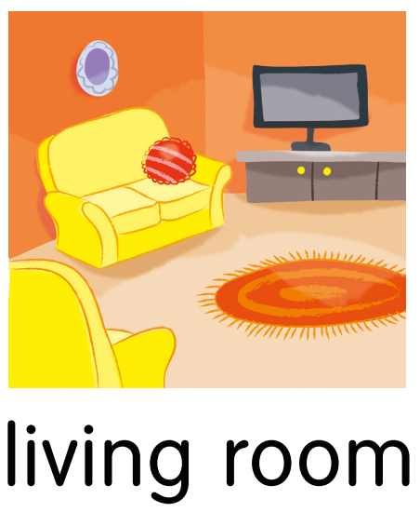
Yesterday I was in the … at 10 o’clock.
I wasn’t in the …

Slide 5
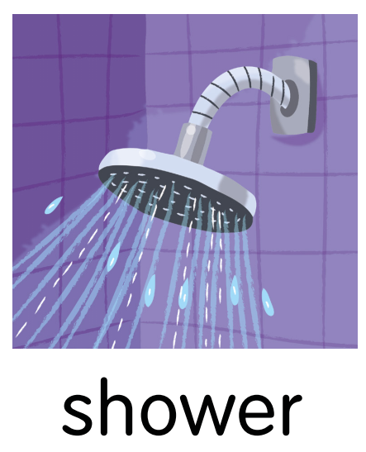
Yesterday Kate was in the … at 12 o’clock.
She wasn’t in the …

Slide 6

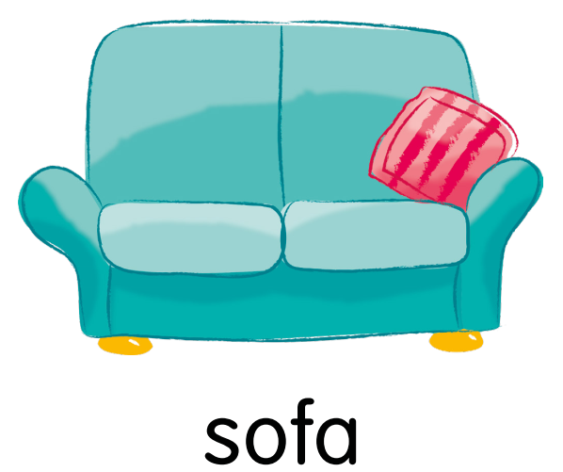
Yesterday the cat was on the … at 1 o’clock.
It wasn’t on the …

Slide 7
Yesterday Grandma was in the … at 3 o’clock.
She wasn’t in the …

Slide 8
Yesterday Grandpa was on the … at 5 o’clock.
He wasn’t in the …

