Slide 1
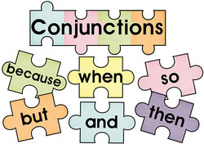

Slide 2
Conjunctions or conjunctive locutions
Words or expressions used to connect sentences.
One word conjunction (but, and, however etc)
Two or more words conjunctive locution (not only...but also, as if, as long as etc)

Slide 3
Conjunctions or conjuctive locutions
Express an idea when connecting two sentences.
CONDITION
1. We will play soccer,
IF
it doesn’t rain.
ADDITION
2. Peter bought a Hylux
AND
a new Civic

Slide 4
Conjunctions or conjuctive locutions
Express an idea when connecting two sentences.
OPPOSITION or ADVERSITY
Mark prefers black T-shirts,
BUT
his brother loves the white ones
TIME
2. I was sleeping deeply
WHEN
the phone rang

Slide 5
Conjunctions or conjuctive locution
Express an idea when connecting two sentences.
PLACE
1. That’s the famous Elm Street
WHERE
president Kennedy was shot dead in 1963.
COMPARISONS
2. Paul’s personality traits are exactly
LIKE
his father ‘s.

Slide 6
Conjunctions or conjuctive locutions
Attention: Some conjunctions or conjunctive locutions may express more than one idea.
TIME
1. George was sleeping
WHILE
Mike was preparing dinner.
OPPOSITION
2. Kathy is a daydreamer
WHILE
her sister is very realistic.

