Slide 1


Тема: «Wh-questions in Past Simple Tense»

Slide 2
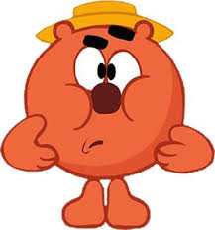
Warming up
Речевая разминка.
Let's remember the forms of irregular verbs.
Я кирпичик throw- threw-thrown,
Он в окошко fly-flew-flown,
Меня дядя catch-caught-caught,
К папе с мамой bring- brought-brought,
Я конечно say-said-said,
Что разбил окно сосед,
Он меня не hear-heard-heard,
Как на казнь меня ведет,
Я опасность feel-felt-felt,
И готов был kneel-knelt-knelt,
Ох и сильно мне попало,
Cost-cost-cost стекло немало!!!

Slide 3
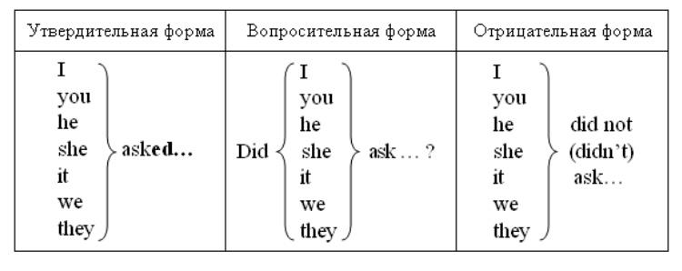
The Forms of Past Simple tense
General questions.
watched wanted listened asked went saw wrote drank
watch want listen ask go see write drink
watch want listen didn’t ask go see write drink

Slide 4
Wh- questions or
Special questions это вопросы которые задаются к отдельным членам предложения: подлежащему, сказуемому, дополнению, определению, обстоятельству. Специальный вопрос (кроме вопроса к подлежащему)начинается с вопросительного слова (when, what, where, which, who, why, whose, whom, how, how long, how many/much ), за которым следует вспомогательный или модальный глагол, подлежащее и смысловой глагол .

Slide 5
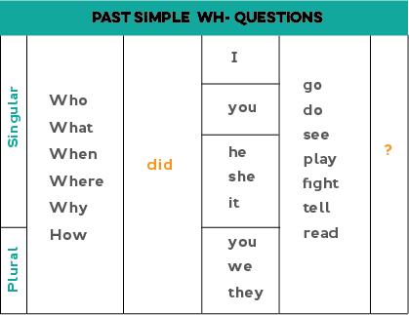
Whom
How
How many
Whose
Which

Slide 6
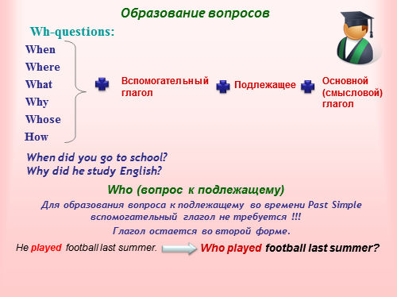

Slide 7
Subject questions
Вопрос к подлежащему не требует изменения прямого порядка слов.
Подлежащее заменяется вопросительным словом, которое выполняет в вопросе роль подлежащего. Вопросы к подлежащему начинаются с вопросительных местоимений :
Who – кто? | Who said him about it? Who woke up early yesterday?
What- что? | What was in his hands? What happened to you yesterday?

Slide 8

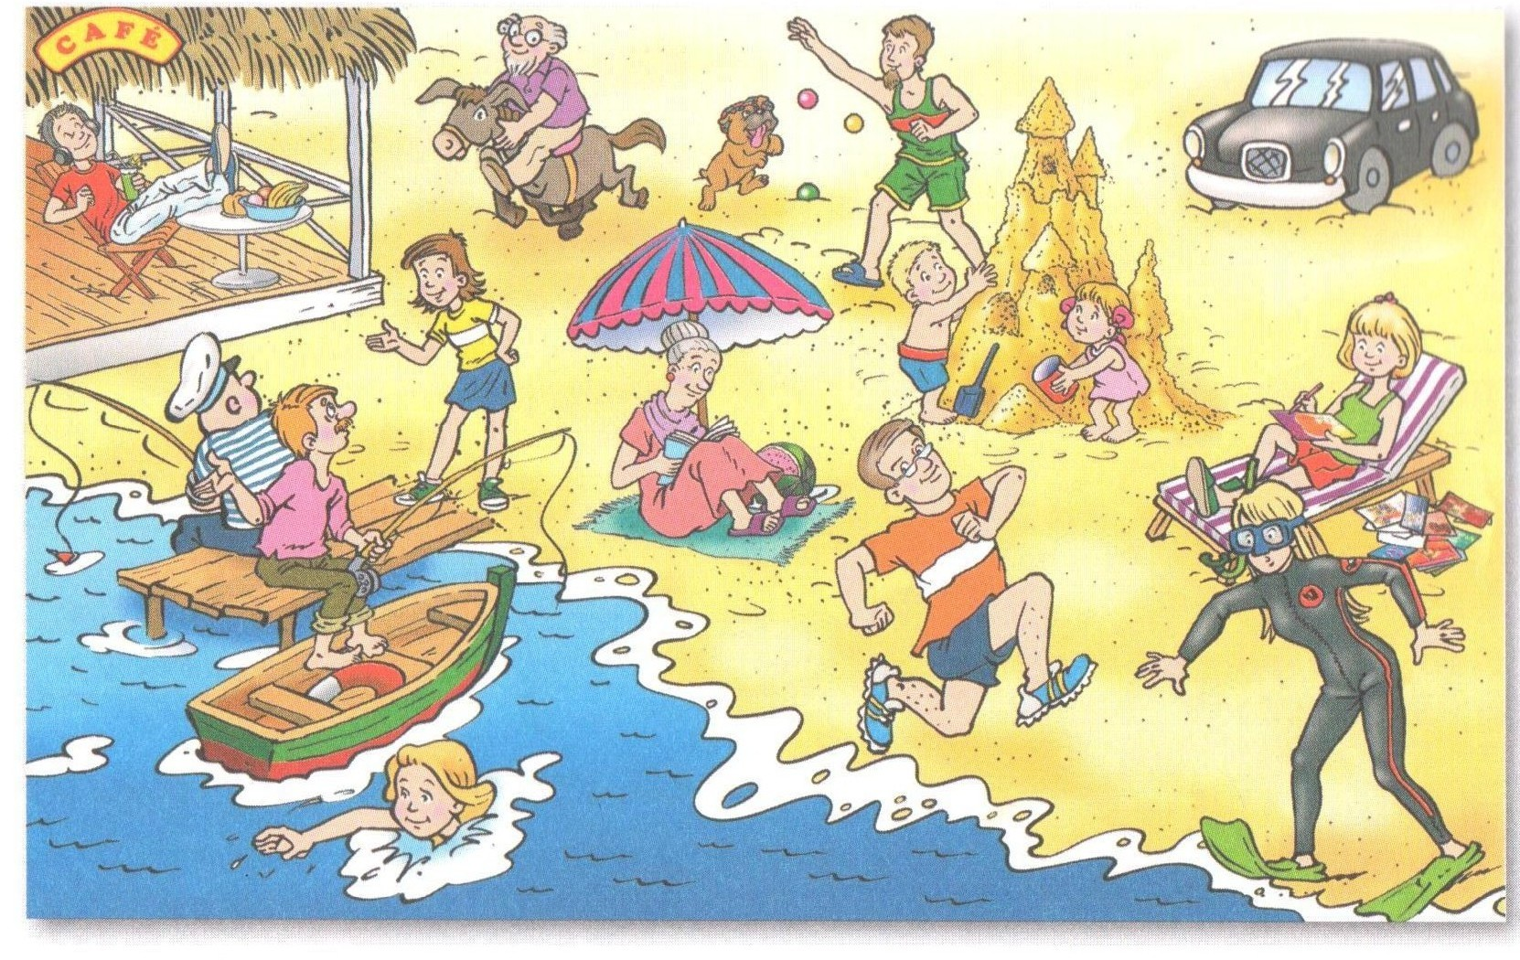
Look at this picture then answer the questions

Slide 9
Текст к аудиозаписи
Last summer the Glows had a day out at the seaside. Martha swam in the sea and Sam and Pam built a huge sandcastle. Vera read in the shade and Mandy wrote a lot of postcards. Rudolph hung out in the café and Helga spoke to two fishermen . Gordon rode a donkey and Vincent ran along the beach. Cynthia wore a wetsuit and Bernard threw balls for Bonehead.

Slide 10
Wh- words 0r question words
What? - Что? Какой? | What happened to Bonehead? But! What did Vincent do on the beach?
When? - Когда? | When did the Glows have the a day out at the seaside?
Where? – Где? | Where did they go? Where did Rudolph hang out?
Which? - Который? Какой? | Which sandcastle was the biggest?
Who? – Кто? | Who rode a donkey? Who swam in the sea?
Whom?- Кого? Кому? | Whom did Helga speak to?
Whose? – Чей? | Whose umbrella did Vera use?
Why? – Почему? | Why did Cynthia wear a wetsuit?
How? – Как? | How did Rudolph spend his time?
How long? – Как долго? Сколько? | How long were the Glows on the beach?
How many/much? -Сколько? | How many postcards did Mandy write?

Slide 11
Make wh- questions to these sentences beginning with the question words in brackets
We moved to London in June. (When…? Who …?)
We spent three weeks in London.(Where…? How long … ?)
You were late again. (Why…?)
He did his homework yesterday.(When? What? Who?)
I read this book last summer. (Who? When? What?)
Mary's parents moved to London two years ago ( Whose? Who? Where?)
My brother give me a lot of interesting books about animals (How many? What? Who?)
Harry bought his first car when he was nineteen(Who? What? When?)
He didn't like dogs because he was afraid of them (Why? What?)
Ann's garden was wonderful in summer . (Whose? What?When?)
Larry got up at half past ten on Saturday. (What time ? Who?)
We travelled to Ahulgo by bus (How?)
I have sandwich and cup of coffee for my breakfast (What? )

Slide 12

Goodbye!

