Slide 1

How are you feeling?

Slide 2
I’ve got measles

Slide 3
I’m tired

Slide 4
I’ve got a temperature

Slide 5
I’ve got a broken arm

Slide 6
I feel sick

Slide 7
I’ve got a cold

Slide 8
I’ve got a headache

Slide 9
I feel dizzy

Slide 10
I’ve got toothache

Slide 11
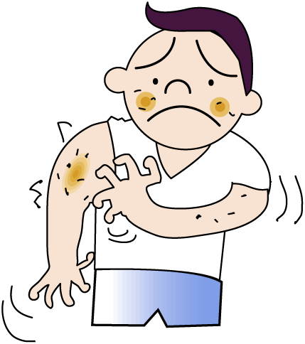
I’ve got an allergy

Slide 12

I’ve got a cough

Slide 13
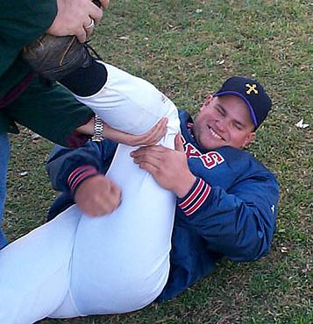
I’ve got cramp

Slide 14
I’ve got an earache

Slide 15
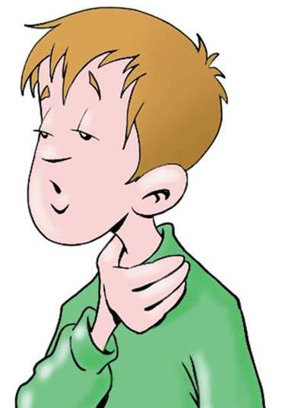
I’ve got a sore throat

Slide 16
I’ve got a backache

Slide 17
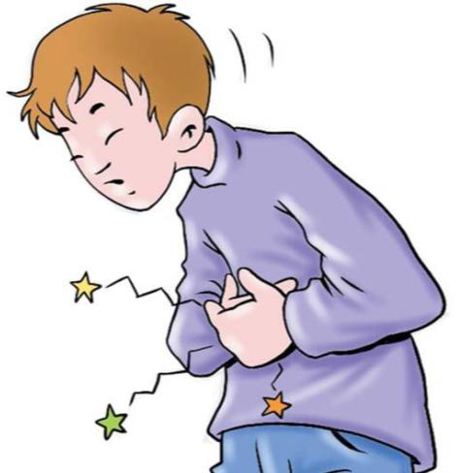
I’ve got a stomach ache

Slide 18
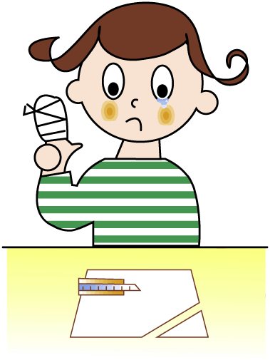
I’ve got a sore finger

Slide 19
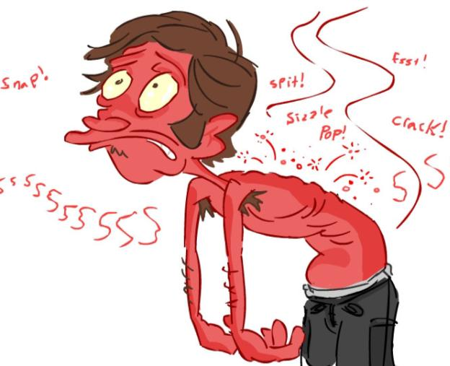
I’ve got sunburn

Slide 20
I’ve got asthma

Slide 21
I’ve got a stiff neck

Slide 22
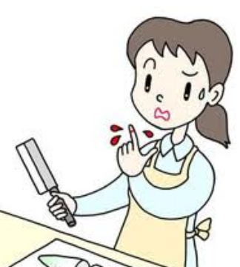
I’ve cut my finger

