Slide 1
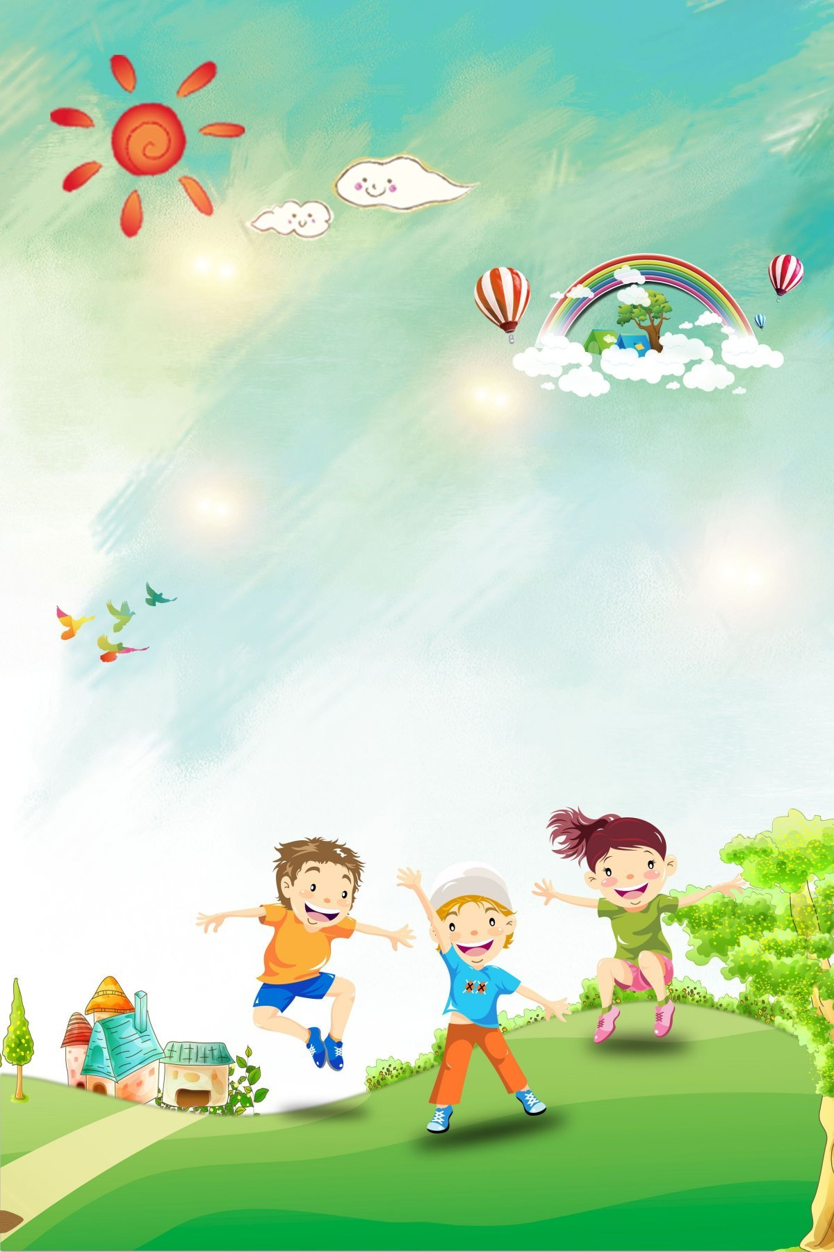

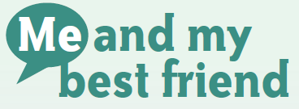


IrinaPapakhina

Slide 2

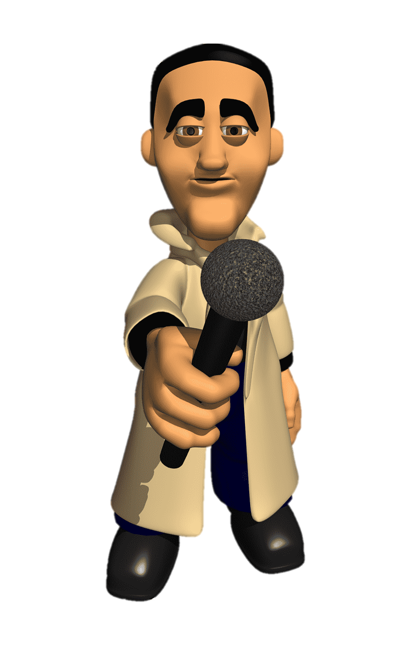
1. Do you listen to music on the radio?
2. Do you listen to radio shows?
3. Do you sometimes
call to radio shows?
IrinaPapakhina

Slide 3

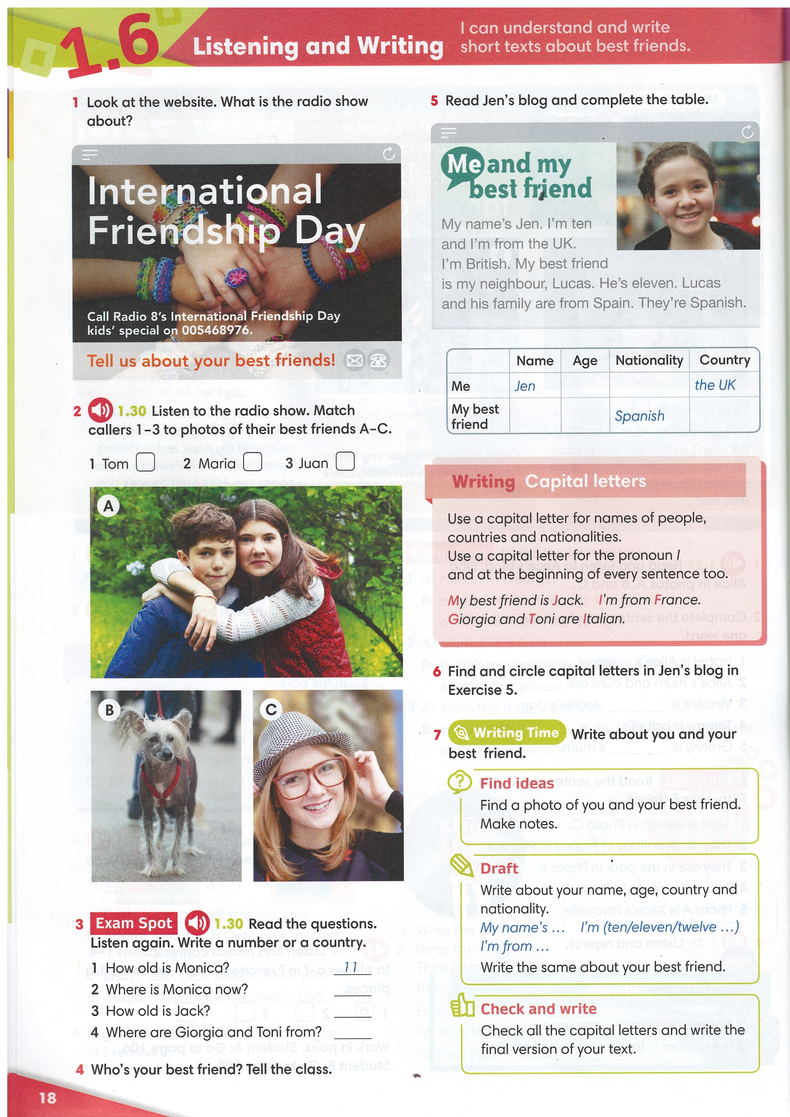
Look at the name of a radio show.
What is this radio show about?
IrinaPapakhina

Slide 4

Listen to the radio show.
Match callers 1 – 3 to photos of their best friends A – C.
IrinaPapakhina

Slide 5
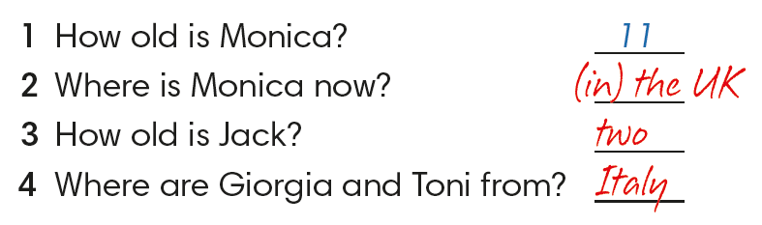
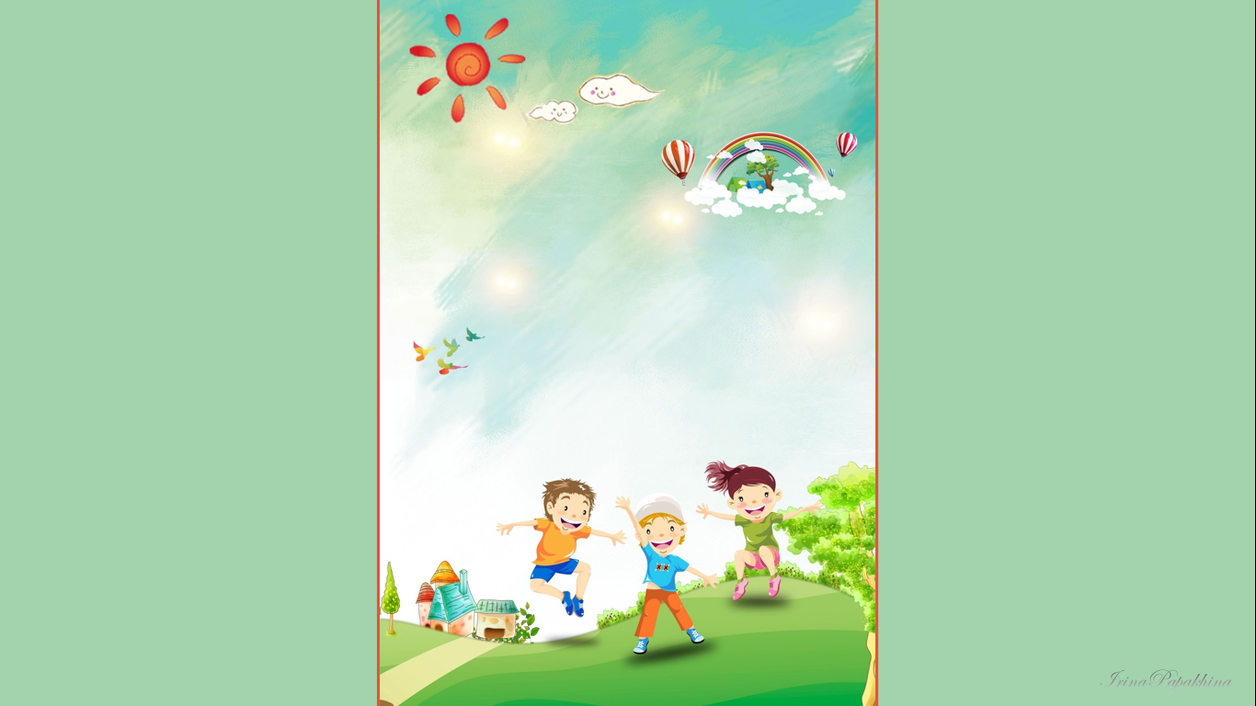
Listen again.
Read the questions.
Write a number or a country.
IrinaPapakhina

Slide 6
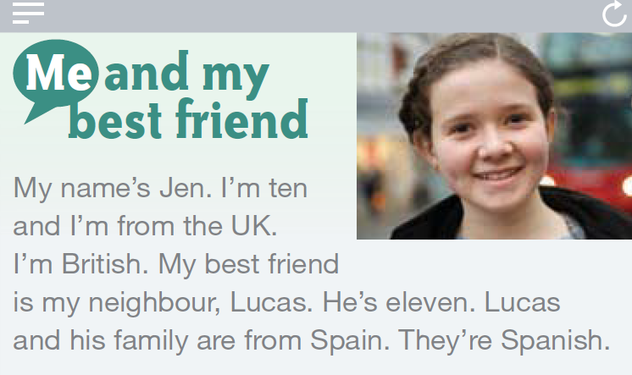
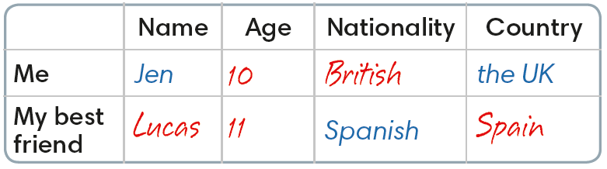
Read Jen’s blog and complete the table.
1
2
3
4
5
IrinaPapakhina

Slide 7
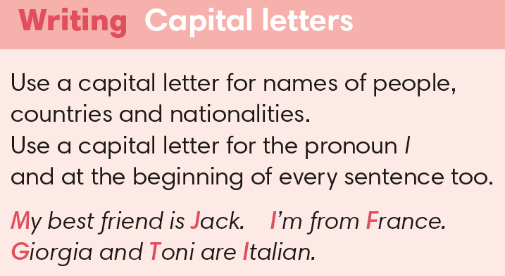
Find and circle
capital letters
in Jen’s blog.
IrinaPapakhina

Slide 8

Write about your best friend.
This is my best friend.
Your name, age, country.
My name’s … . I’m … and I’m from … .
Your best friend is your classmate /
neighbour / family member.
My best friend … (name) is my … . He / She is … .
Your friend’s name, age.
His / Her family are from … . They are … .
Your friend’s country / city, nationality.
IrinaPapakhina
IrinaPapakhina

Slide 9
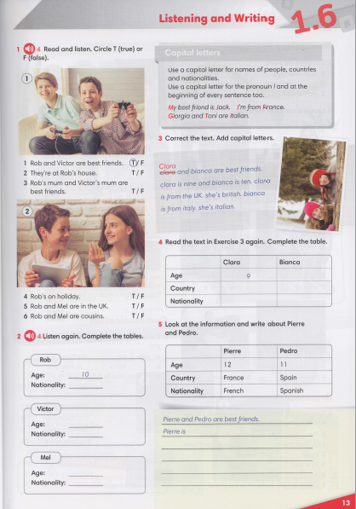

IrinaPapakhina

