Slide 1
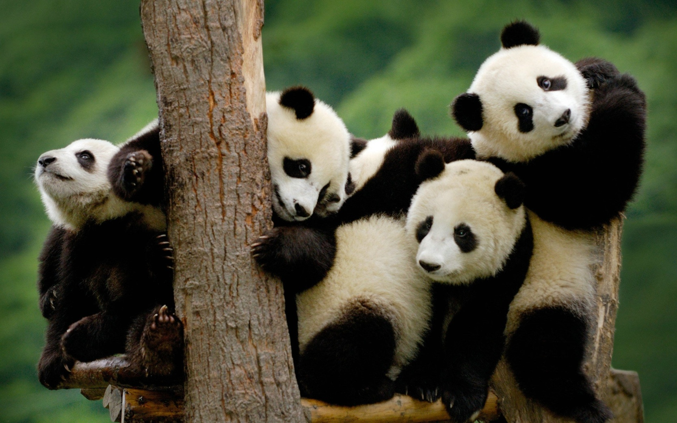
Are there any pandas?

Slide 2

Are there any bears?

Slide 3
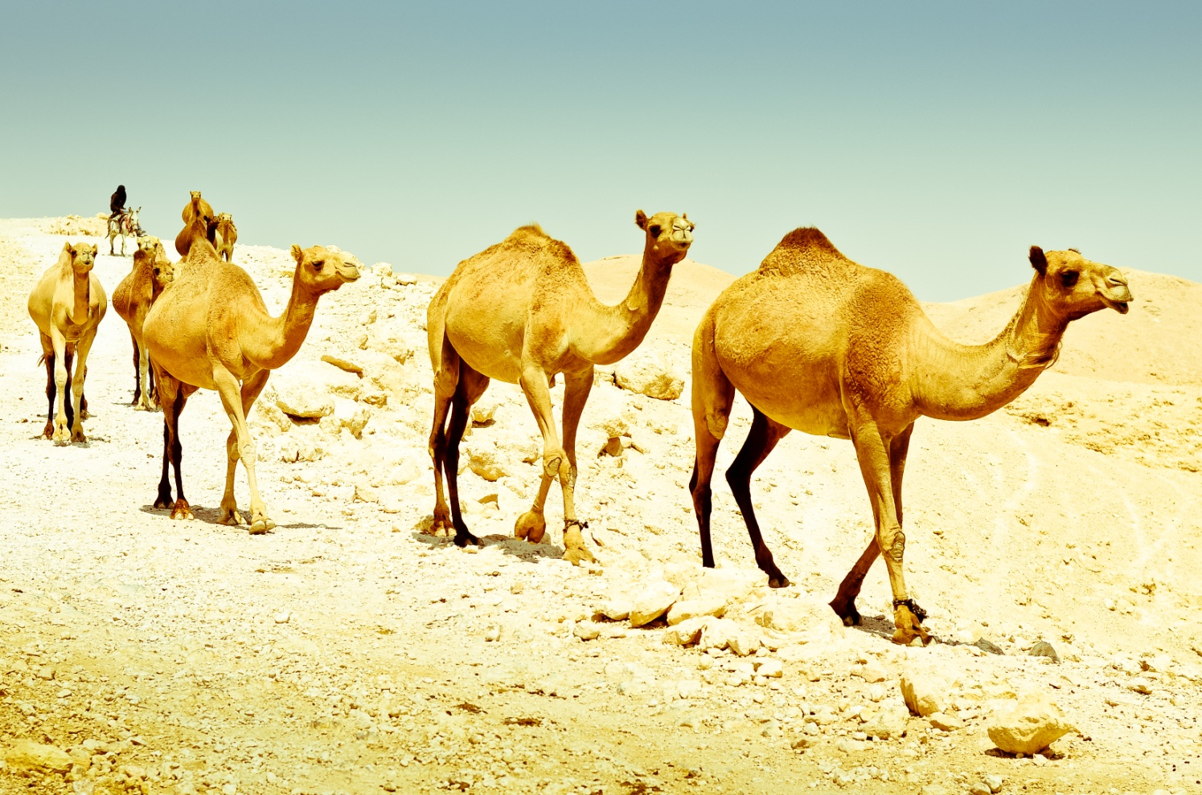
Are there any camels?

Slide 4

Are there any crocodiles?

Slide 5
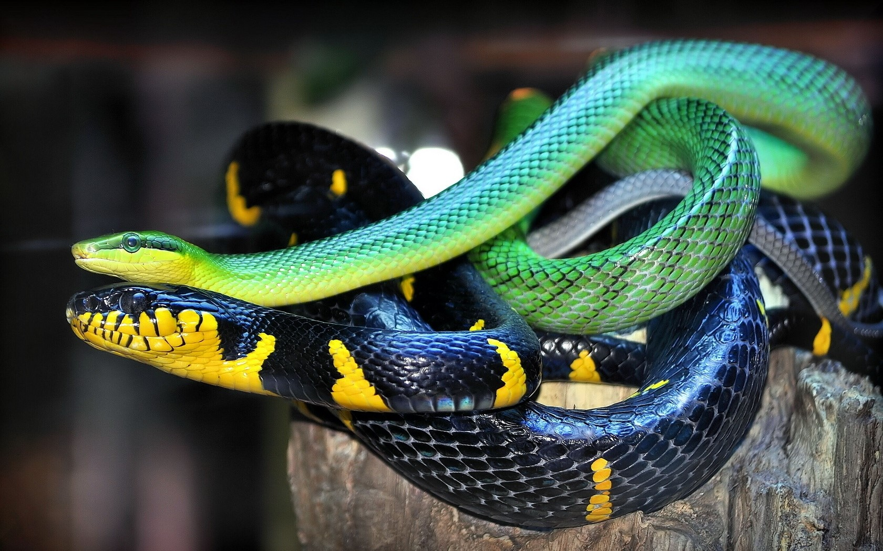
Are there any snakes?

Slide 6
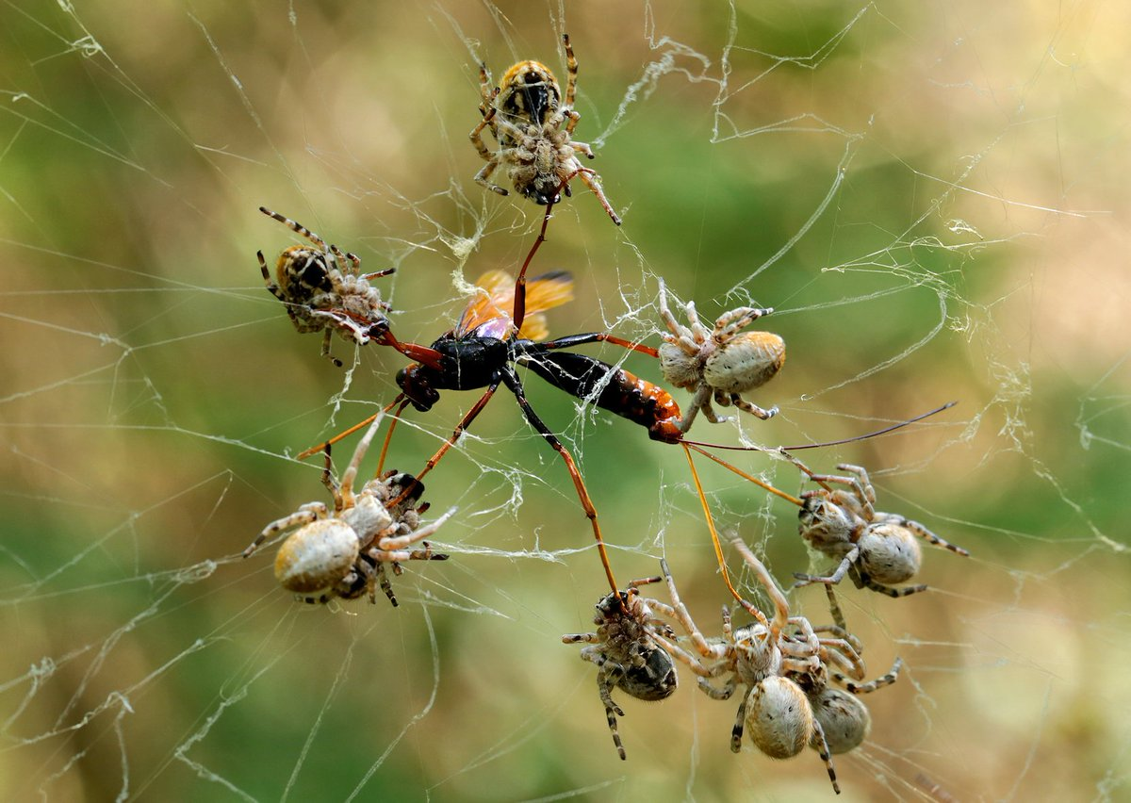
Are there any spiders?

Slide 7

Are there any kangaroos?

Slide 8
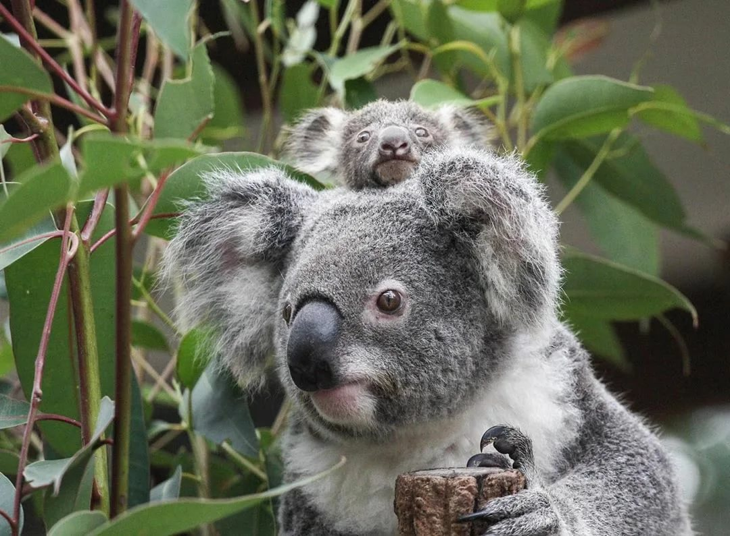
Are there any koalas?

Slide 9
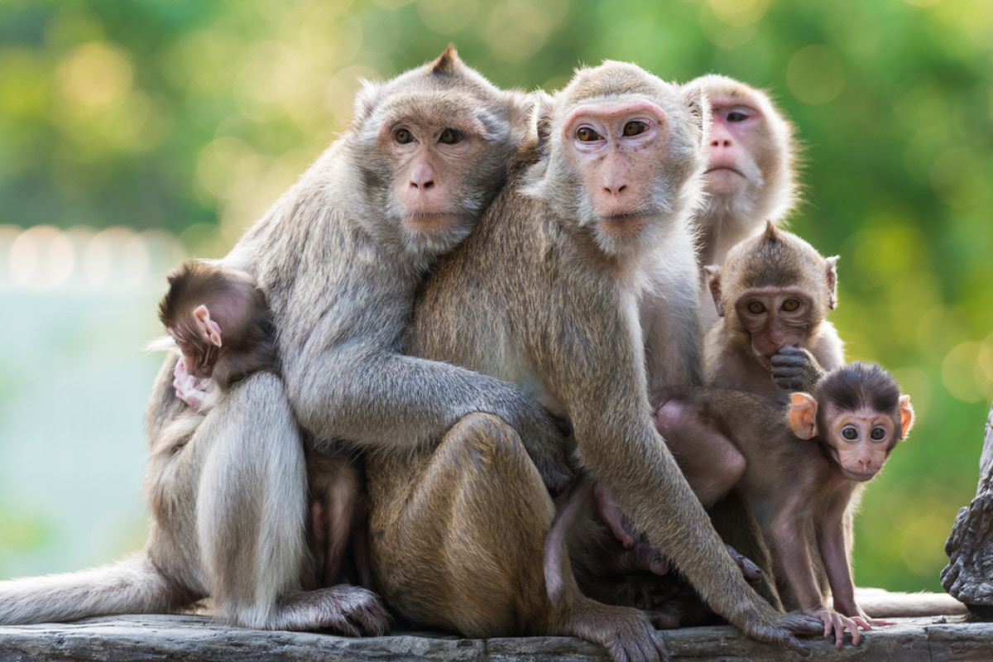
Are there any monkeys?

Slide 10

Are there any dogs?

Slide 11

Are there any cats?

Slide 12

Are there any elephants?

Slide 13

Are there any zebras?

Slide 14
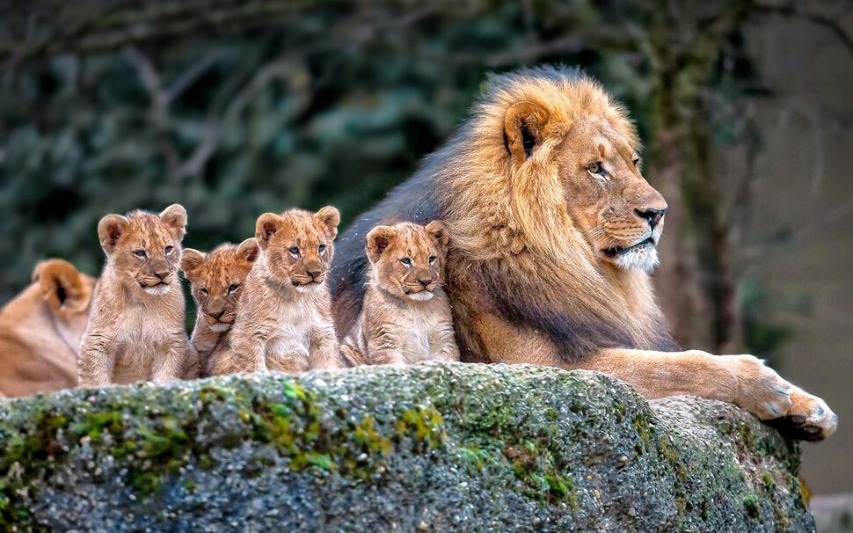
Are there any lions?

Slide 15
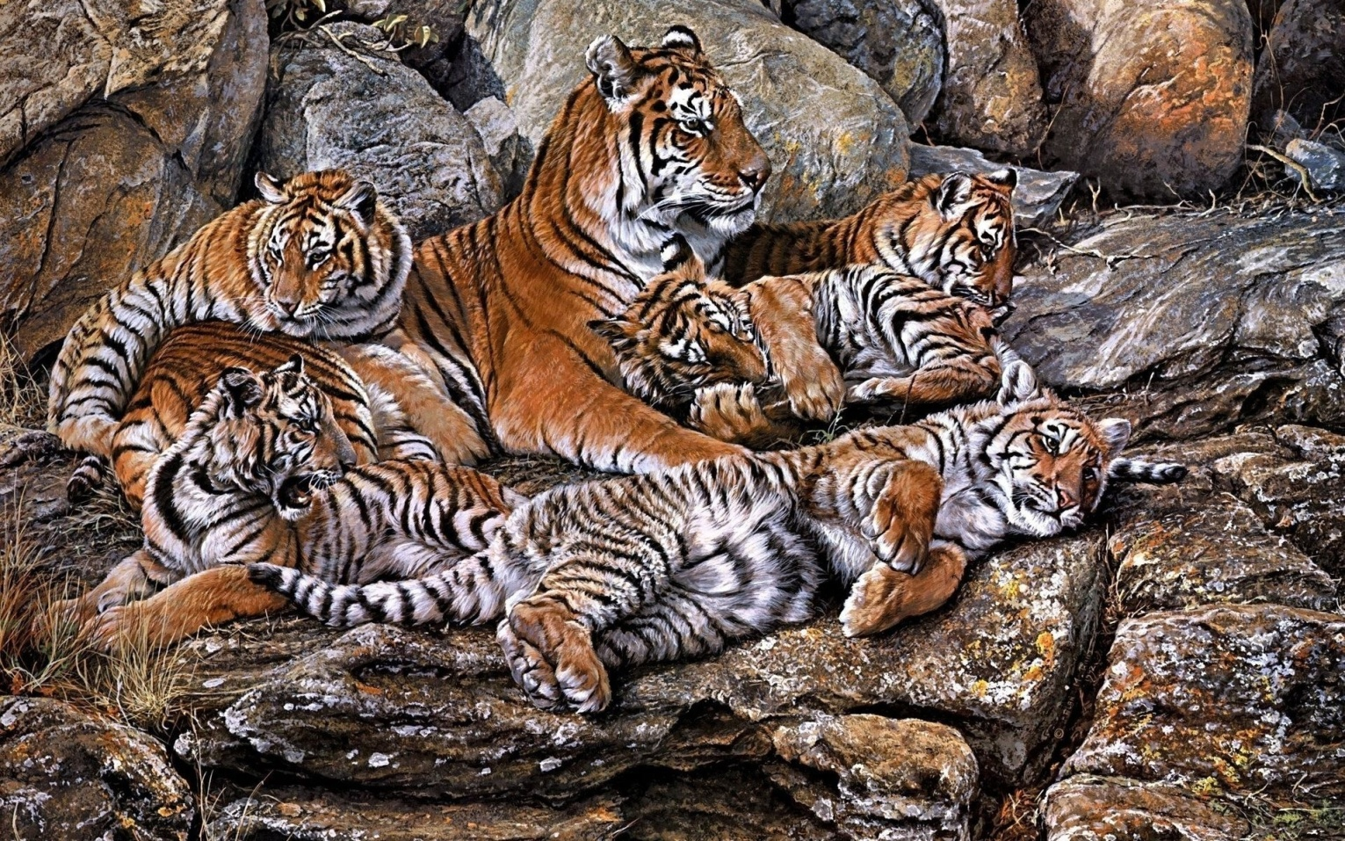
Are there any tigers?

Slide 16
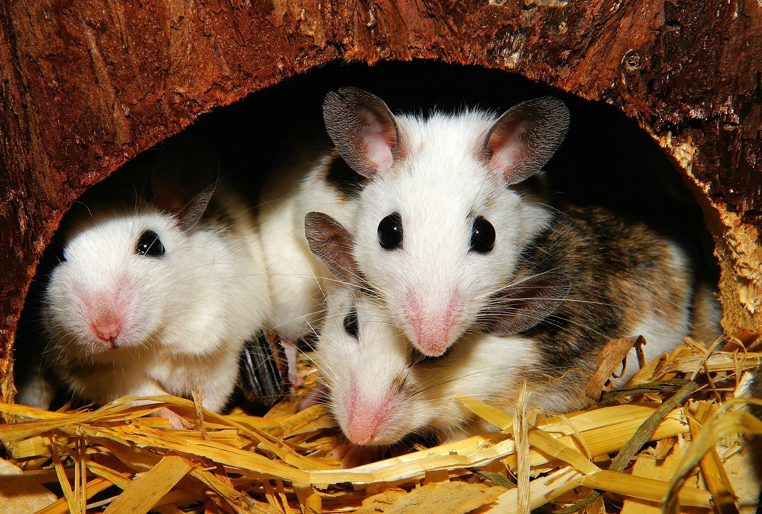
Are there any mice?

Slide 17

Are there any wolves?

Slide 18
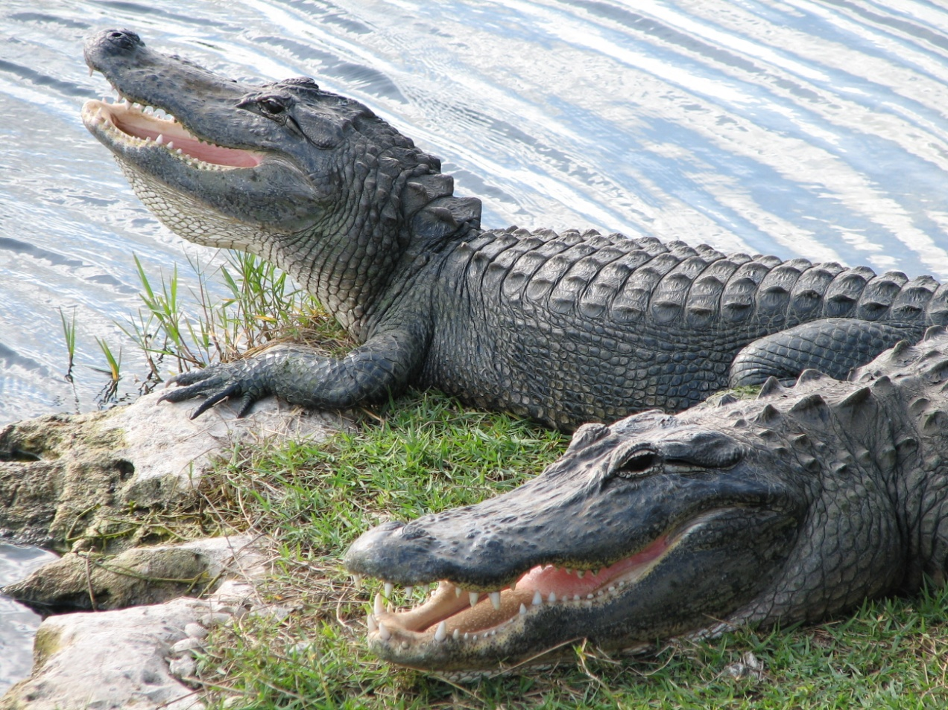
Are there any alligators?

Slide 19
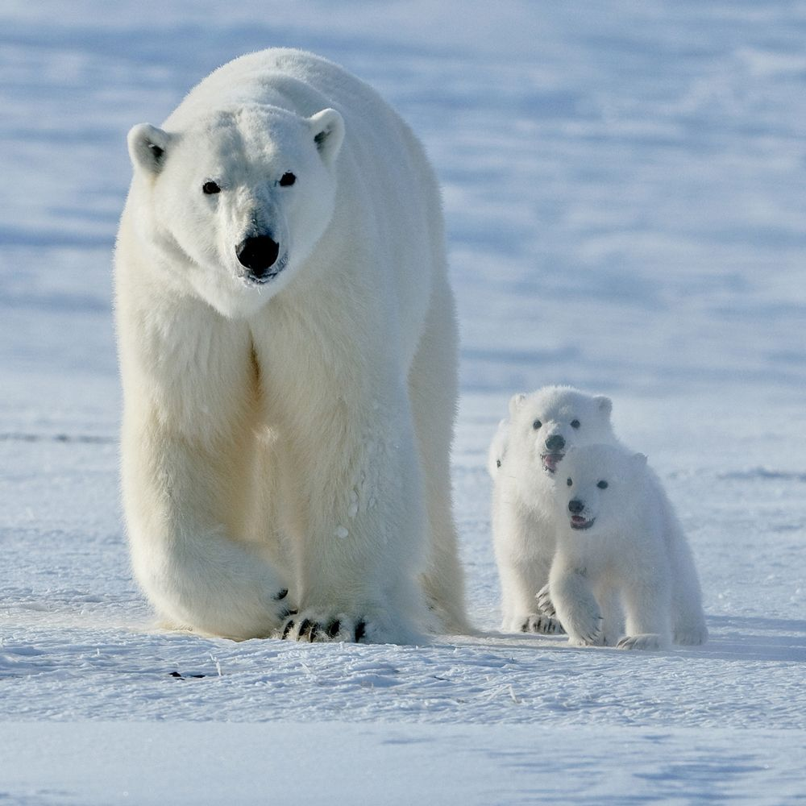
Are there any polar bears?

Slide 20
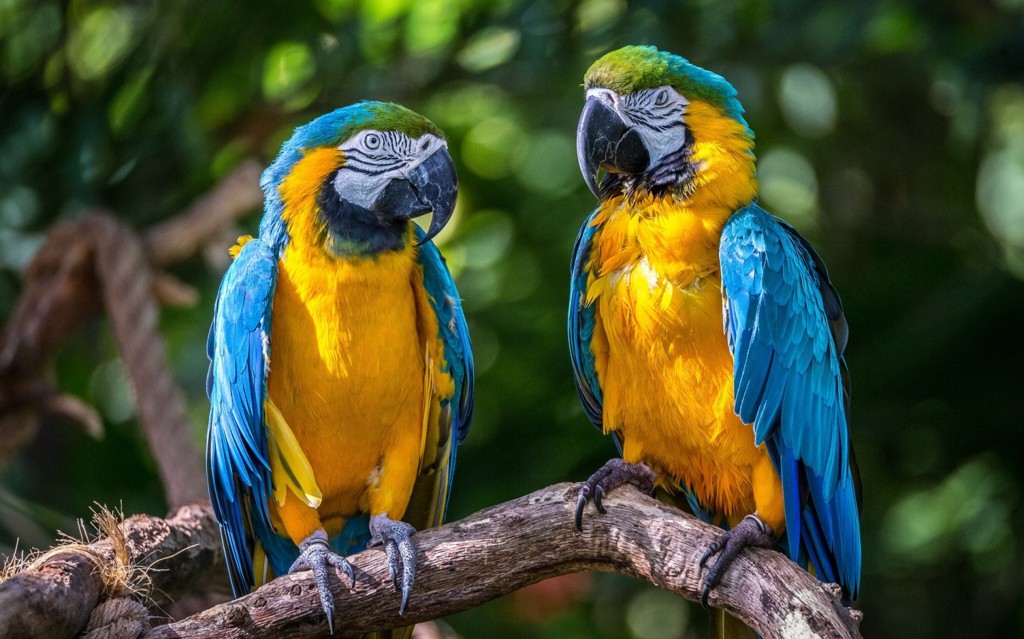
Are there any parrots?

