Slide 1
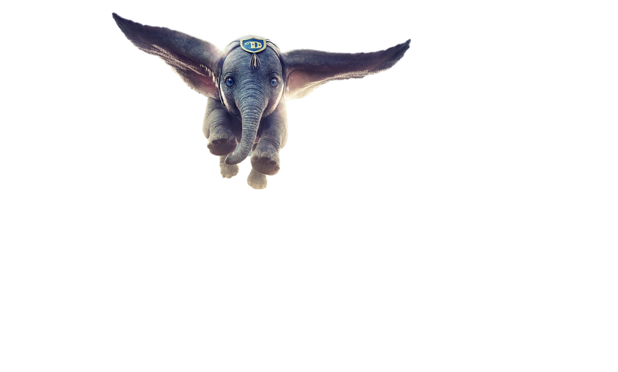

Slide 2

Where is the elephant?
1 – zoo
2 – park
3 – circus
4 – jungle

Slide 3
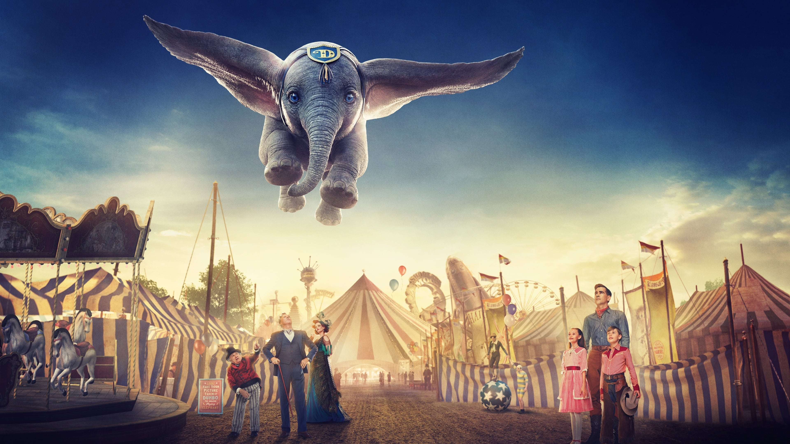

Slide 4

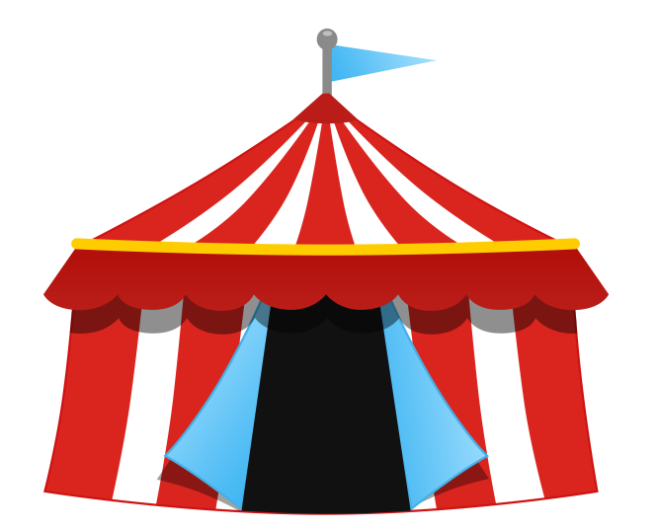
Animals
People
circus
Objects
Actions

Slide 5

Words

Slide 6
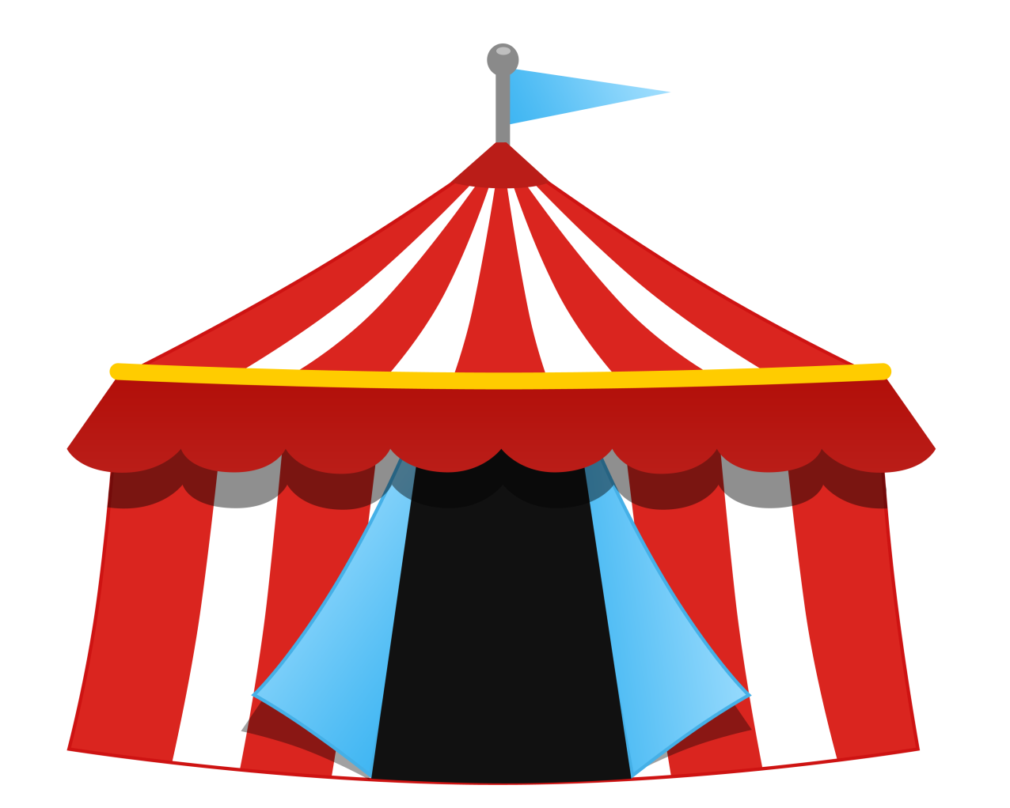
circus

Slide 7
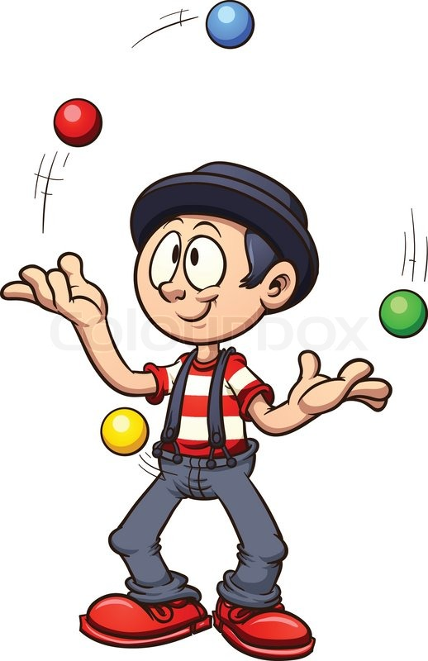
juggle

Slide 8
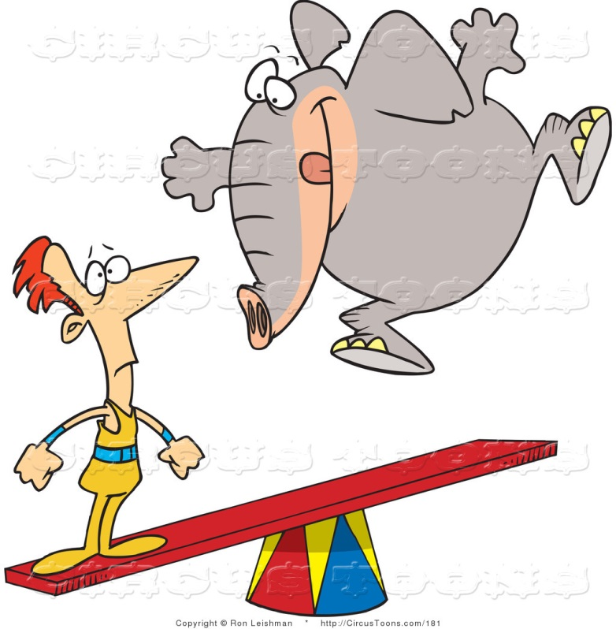
seesaw

Slide 9
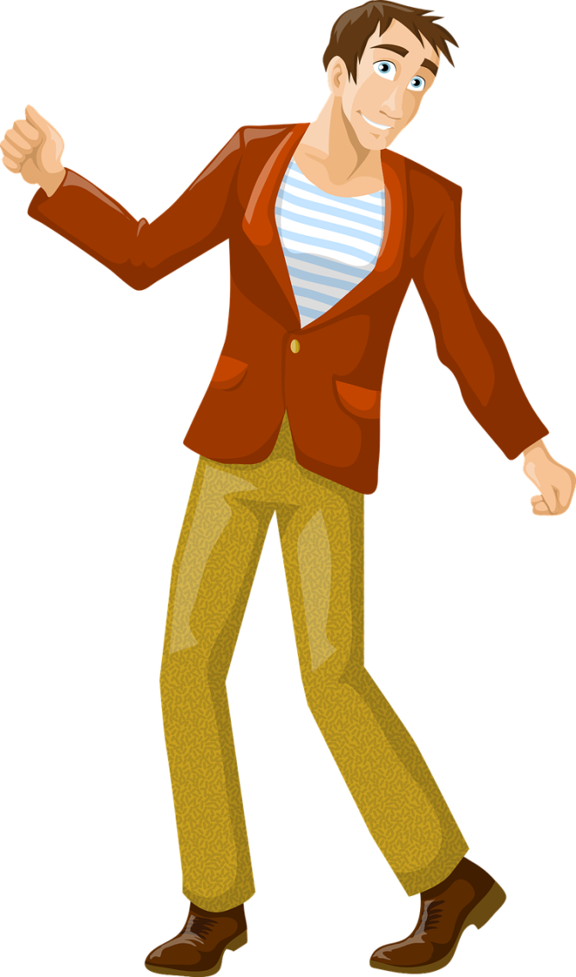
man

Slide 10

air

Slide 11
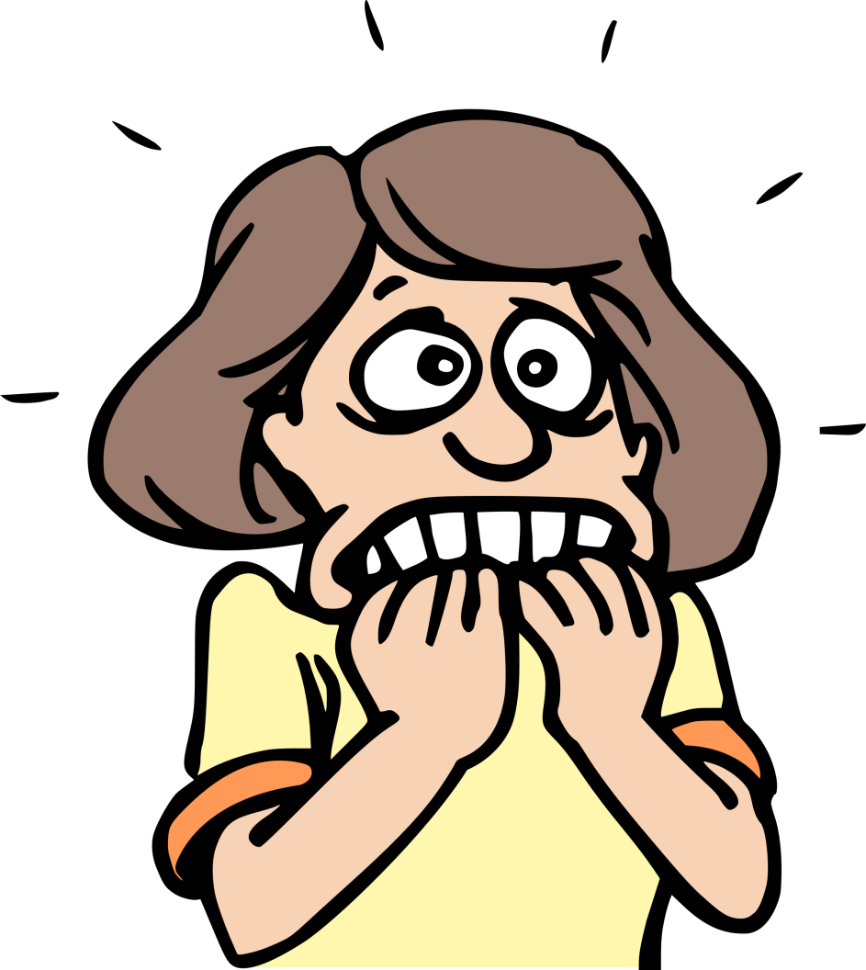
scared

Slide 12
What’s
missing?

Slide 13
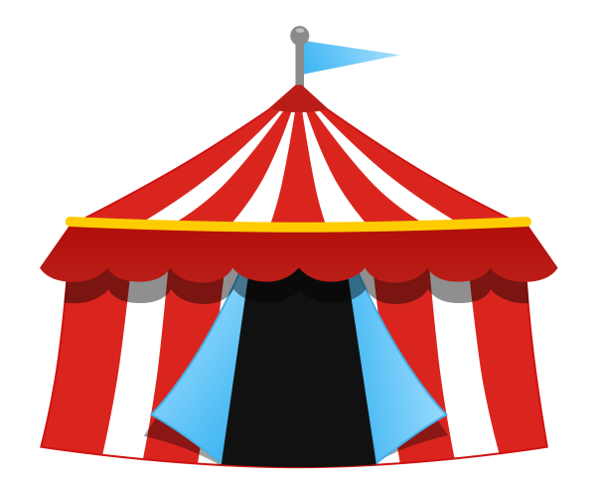





circus
seesaw
man
air
juggle
scared

Slide 14
circus
seesaw
man
air
juggle
scared

Slide 15
circus
seesaw
man
air
juggle
scared

Slide 16
circus
seesaw
man
air
juggle
scared

Slide 17
circus
seesaw
man
air
juggle
scared

Slide 18
circus
seesaw
man
air
juggle
scared

Slide 19
circus
seesaw
man
air
juggle
scared

Slide 20
seesaw
man
air
juggle
scared

Slide 21
seesaw
man
air
scared

Slide 22
seesaw
air
scared

Slide 23
air
scared

Slide 24
scared

Slide 25
Listen
and
match

Slide 26
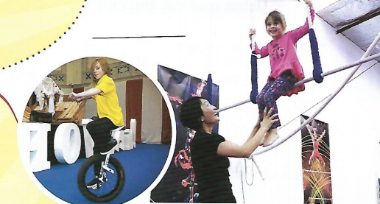
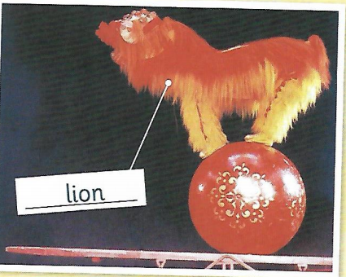

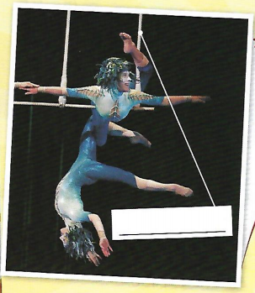
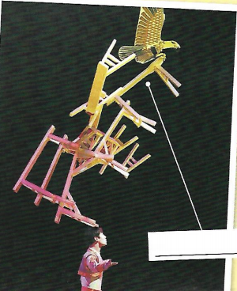
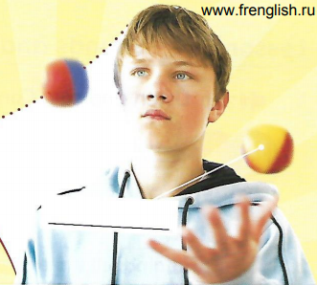
A
B
C
D
E

Slide 27
Listen
Open the boxes

Slide 28

Look! The lion is on the ball.
The ball is big.
It’s on the seesaw.
1
2
3

Slide 29
Look! It’s a swing. In the circus it’s called a ‘trapeze’.
A man is on the trapeze.
A man is under the trapeze.
1
2
3

Slide 30
What are they? They’re tables.
They’re all on his head!
Can you see the bird?
Look! It’s on the tables.
1
2

Slide 31
What’s this? It’s a circus school. It’s amazing!
1
2
The balls are in the air.
They’re red, yellow and blue.
This boy can juggle!
Can you juggle?
3

Slide 32
Where’s the girl?
She’s on the trapeze.
She’s happy!
The boy is on the bike.
He’s happy, too.
He isn’t scared!
1
2
3
4

Slide 33
Label the photos

Slide 34
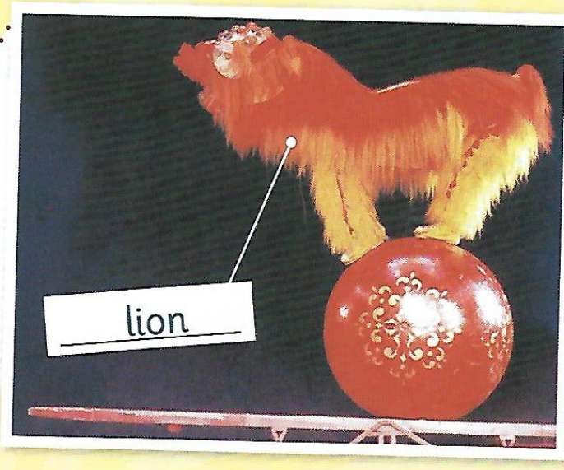
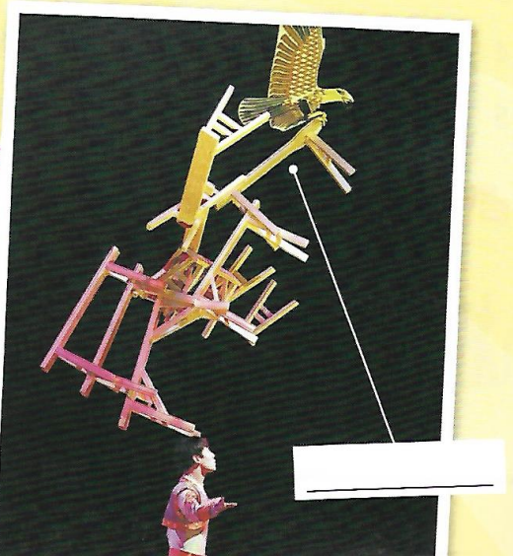
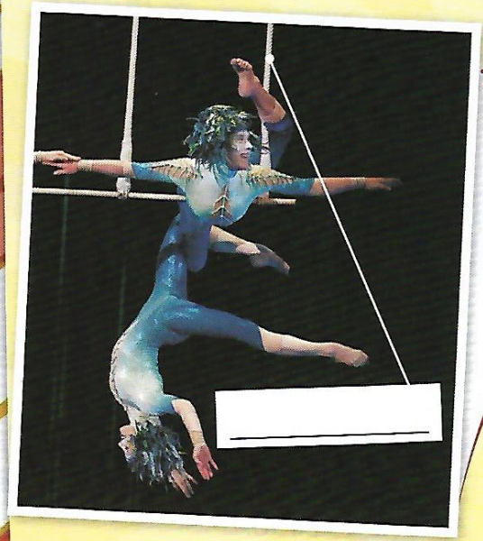
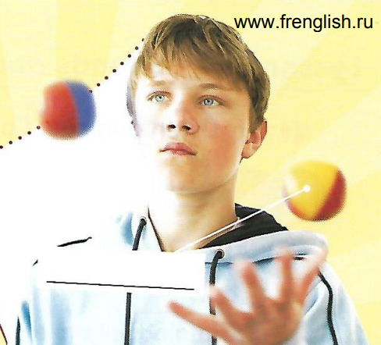
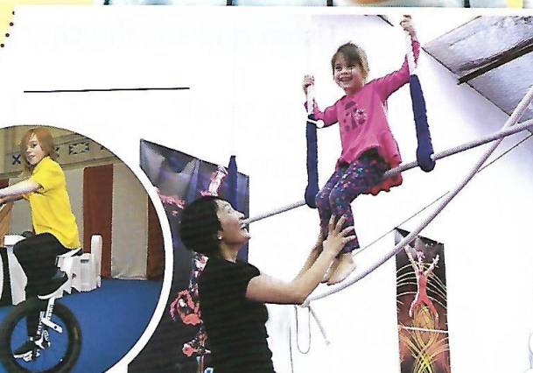

Slide 35
Find 2 questions
with Can

Slide 36
__________________________?
__________________________?

Slide 37
__________________________?
__________________________?
Can you see the bird

Slide 38
__________________________?
__________________________?
Can you see the bird
Can you juggle

Slide 39
Yes or No
Answer and open

Slide 40
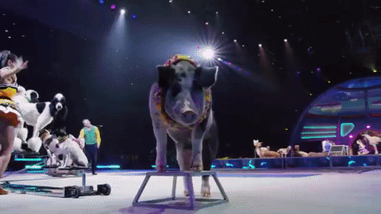
The lion
is
on the swing
The girl
is
happy
The boy
can
juggle
The boy
is
scared
The bird
is
on the seesaw
The ball
is
small
The tables
are
on the man’s leg
The balls
are
green
The ball
is
on the seesaw
The girl
is
on the bike
A man
is
under the trapeze

Slide 41
Tic
Tac
Toe

Slide 42
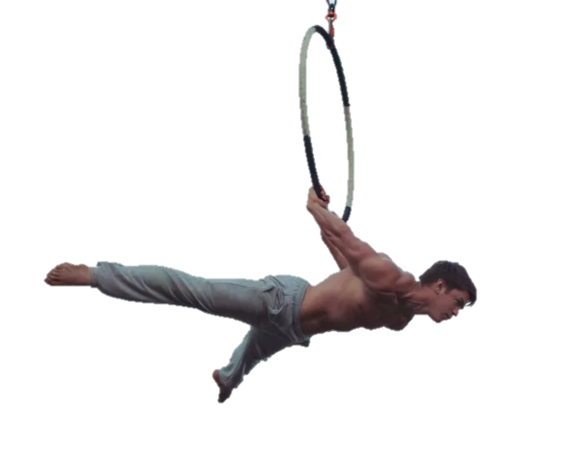
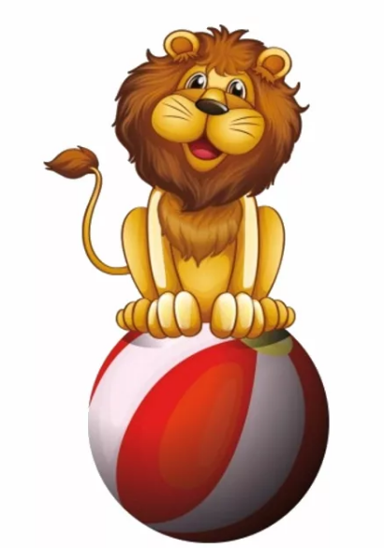
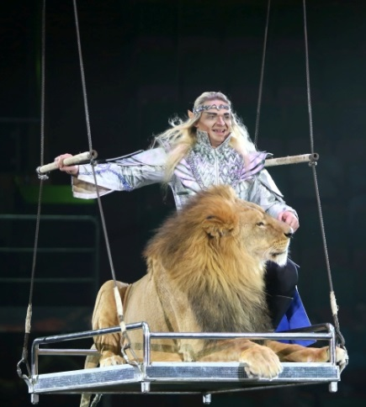
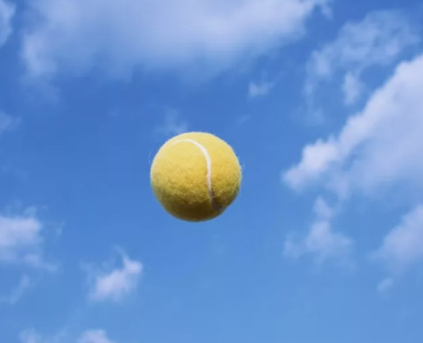

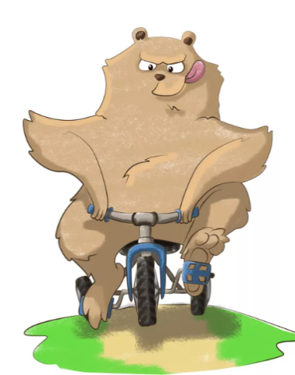
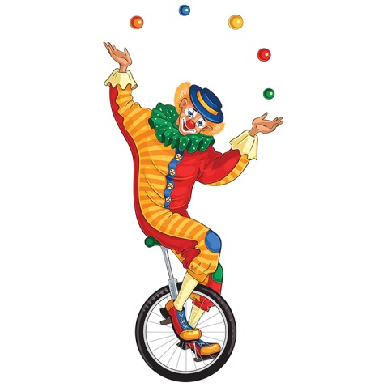
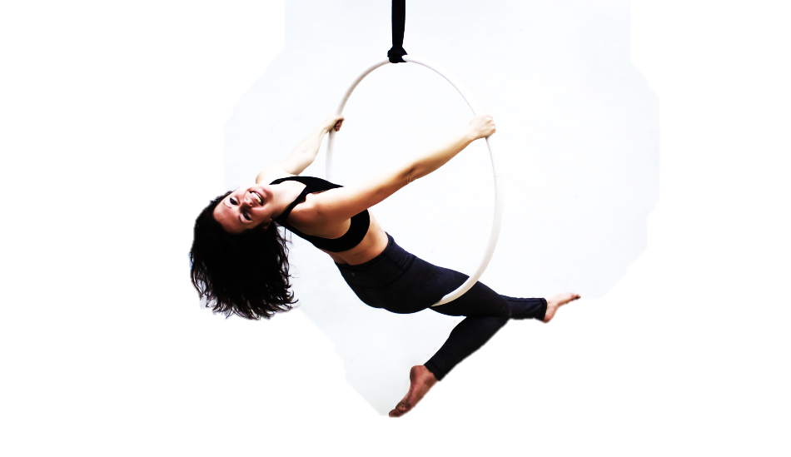


Slide 43

https://vk.com/public199859341

