Slide 1

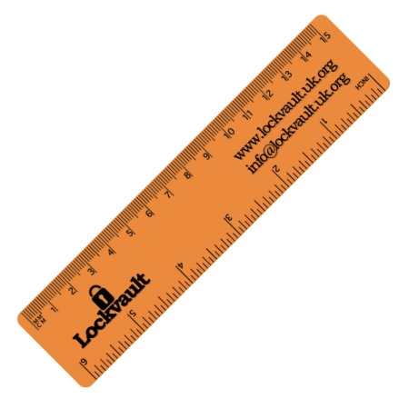




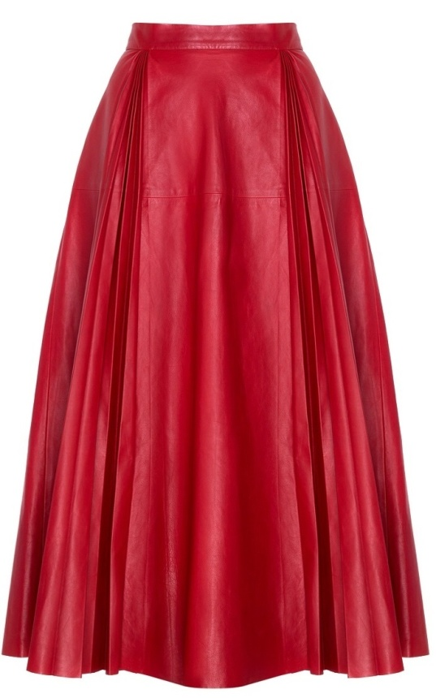

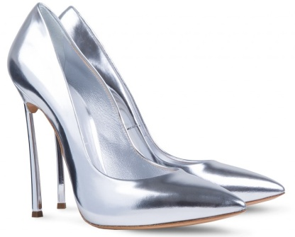
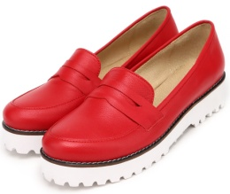
HAVE GOT vs.
HAVEN’T GOT
www.vk.com/egppt

Slide 2








Frank
1. Look what objects Frank has got in his backpack.
2. Think what objects he hasn’t got in his backpack.
www.vk.com/egppt

Slide 3

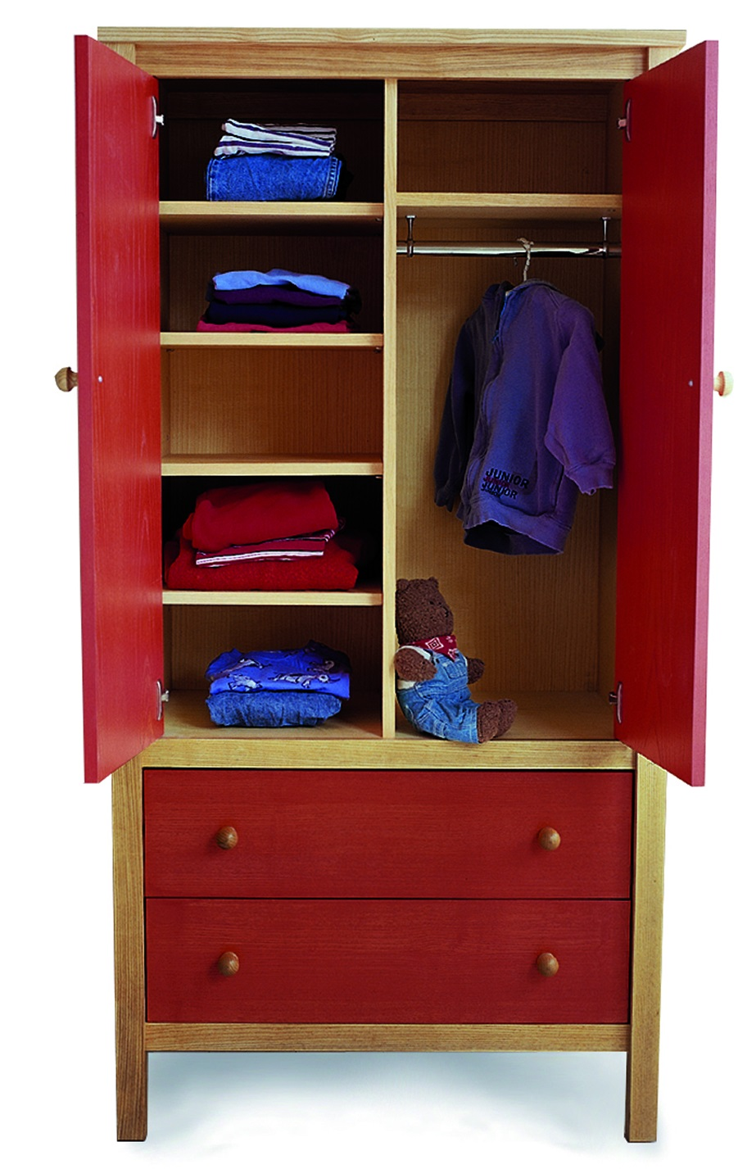


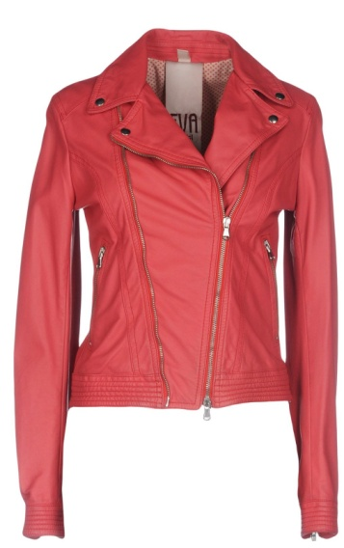

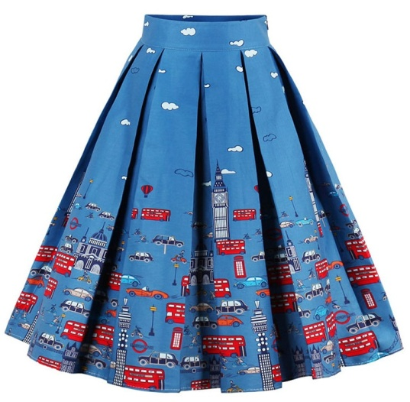

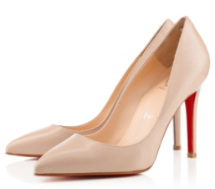
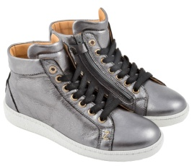
Sarah
1. Look what clothes Sarah has got in her wardrobe.
2. Think what clothes she hasn’t got in her wardrobe.
www.vk.com/egppt

Slide 4

1. Say what things you have got in your bedroom.
2. Think what things you haven’t got in your bedroom.
www.vk.com/egppt

Slide 5
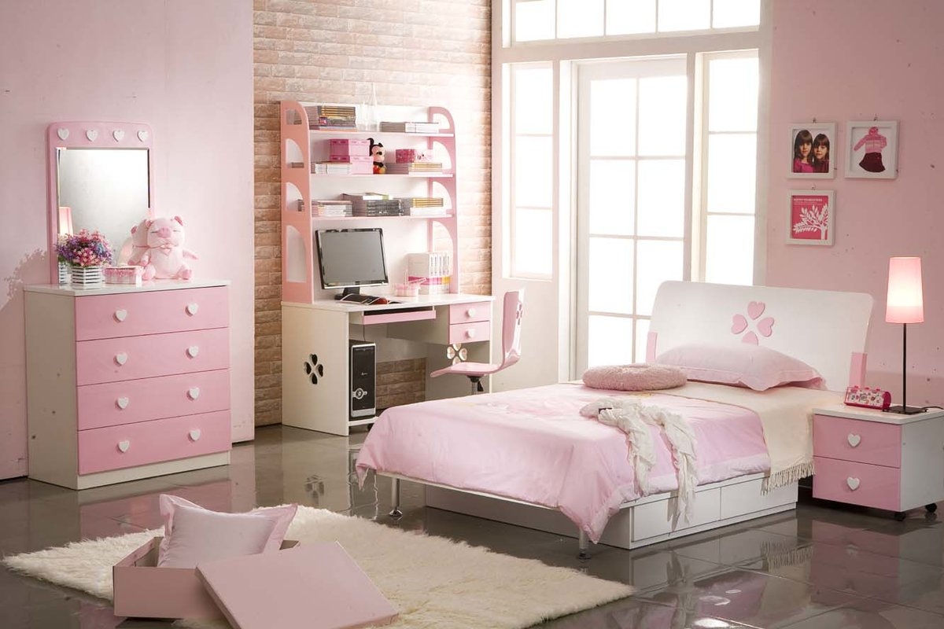
1. Say what things you have got in your bedroom.
2. Think what things you haven’t got in your bedroom.
www.vk.com/egppt

Slide 6
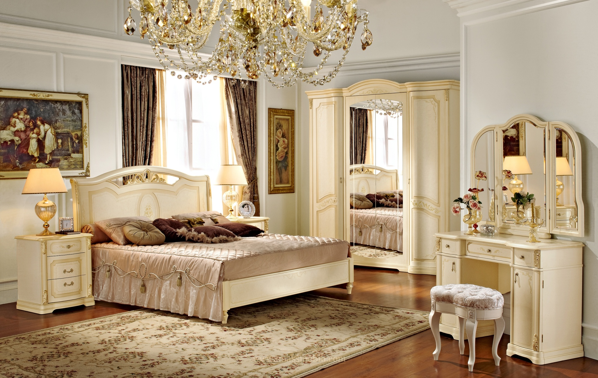
1. Say what things you have got in your bedroom.
2. Think what things you haven’t got in your bedroom.
www.vk.com/egppt

Slide 7

1. Say what things you have got in your bedroom.
2. Think what things you haven’t got in your bedroom.
www.vk.com/egppt

