Slide 1
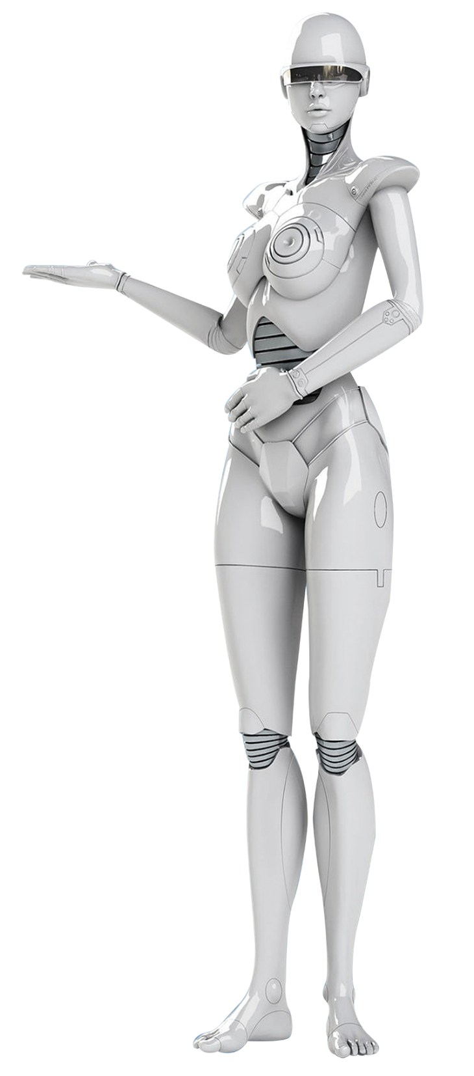
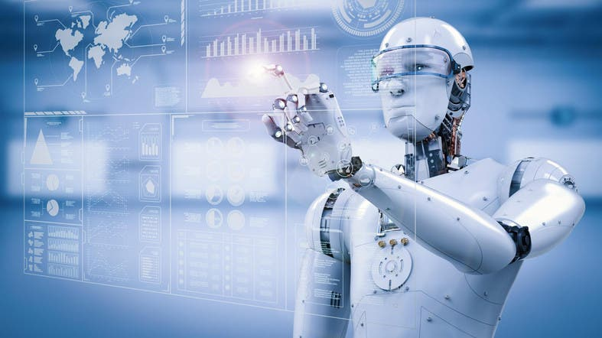


Slide 2


Future Simple
to be going to
Present Continuous
Present Simple

Slide 3
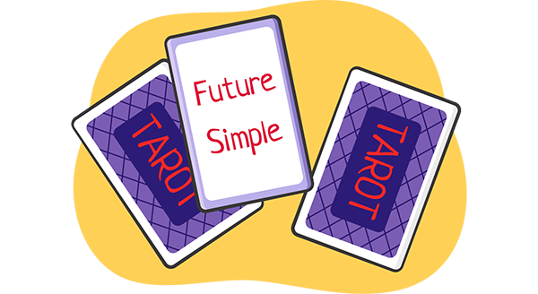






Future Simple
V1
will
I will swim tomorrow
I won’t swim tomorrow
Will I swim tomorrow?
Yes, I will
No, I won’t
V1
won’t
V1
?
Will
Yes,
will
No,
won’t

Slide 4

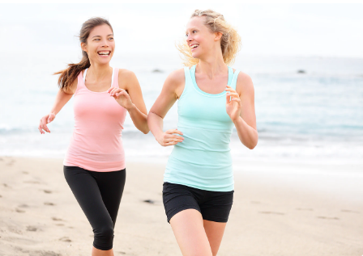
a sudden decision
- I feel so sleepy
- I will make a cup of coffee
predictions
(based on our opinion)
I`m sure, you will pass your exam
I’will love this film
You will have 2 children
— Let's have a party.
— That's a great idea.
We'll invite lots of people.
promises
- I promise, I will learn all the words

Slide 5
offers/ requests
Will you come to my party?
Will you have a cup of tea with me?
Will you help me with my homework?
Shall I read the story?
Shall we go to the park today?
Will you carry the bag for me?
MIND! Use shall (NOT will) with I and we for offers and suggestions when they are questions

Slide 6

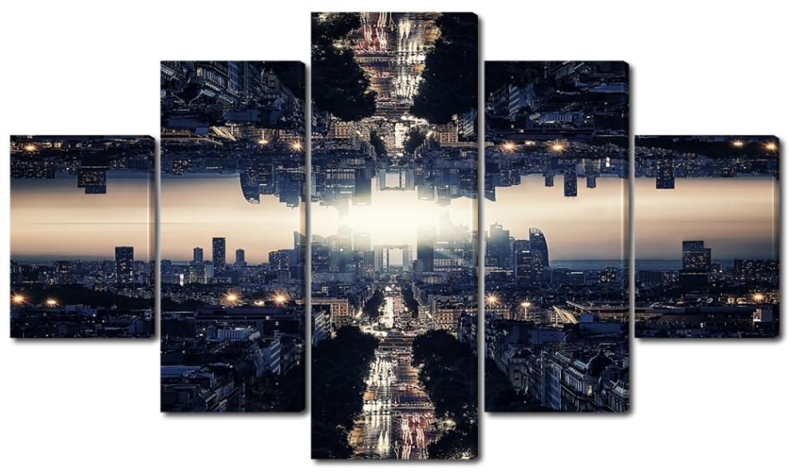
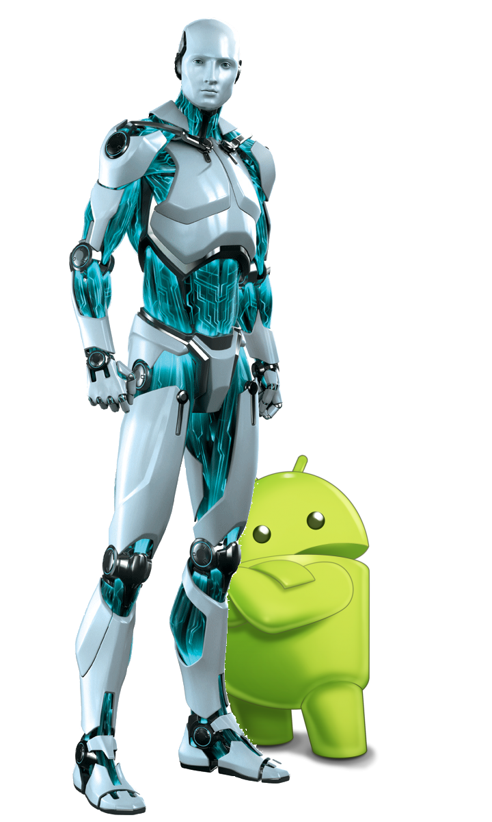
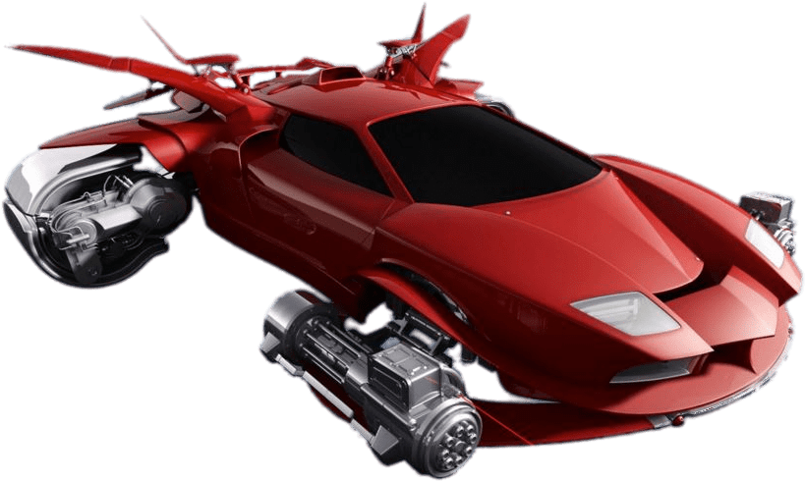

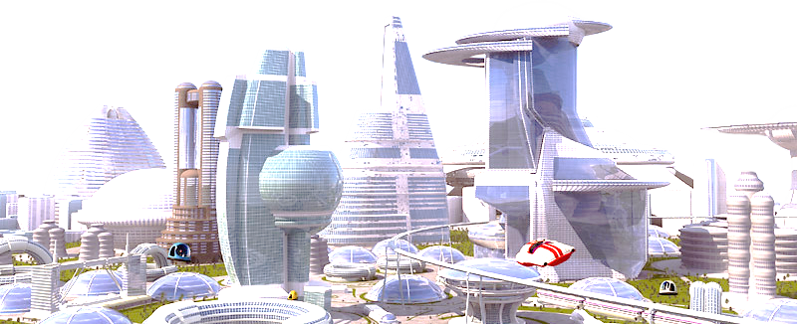
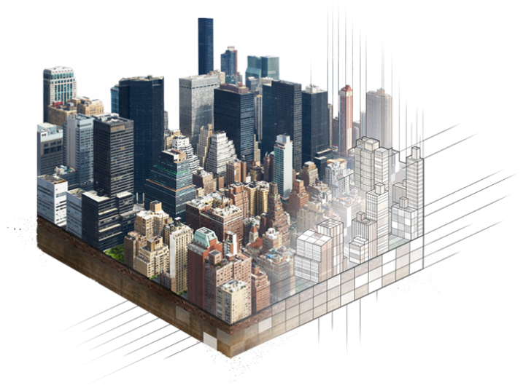
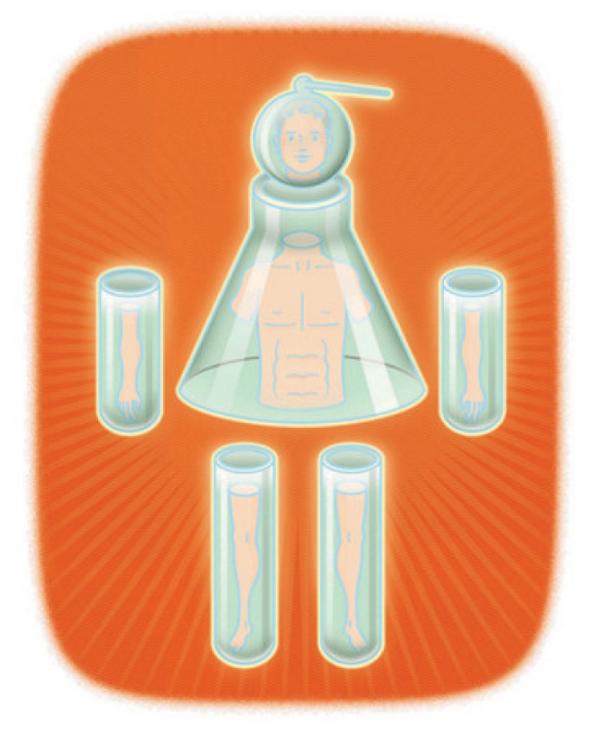
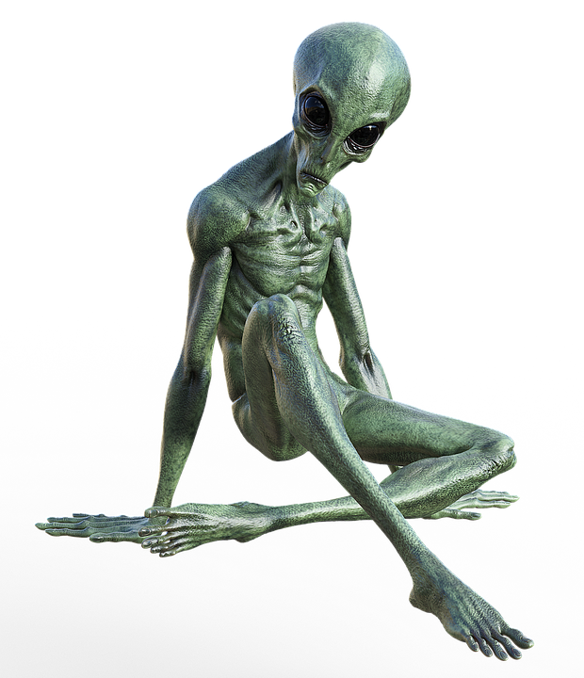
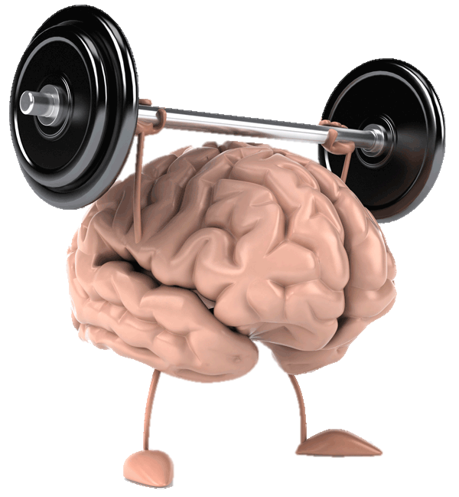
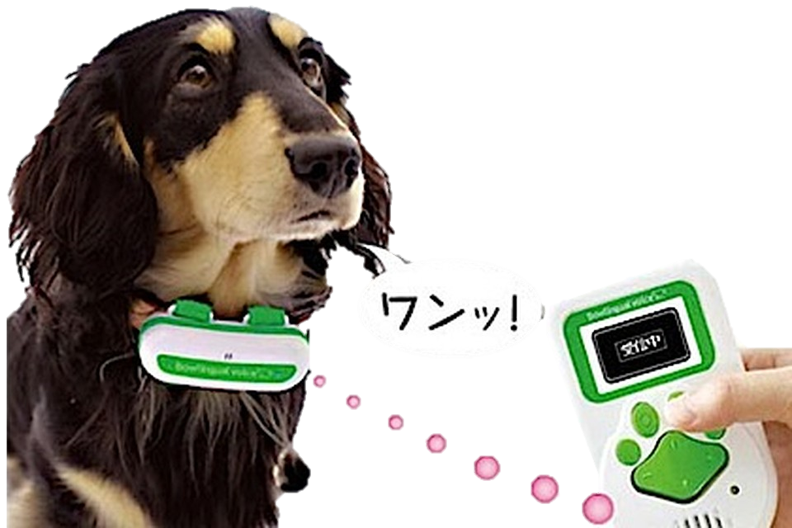
What will happen in the future?
animals
body parts
universes
aliens
brain
house
cars
robots

Slide 7
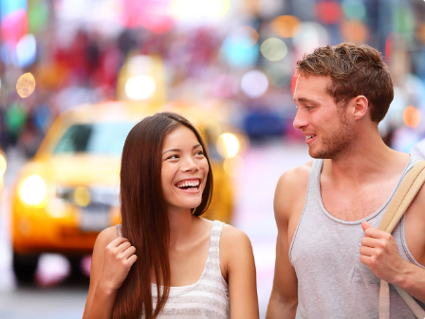
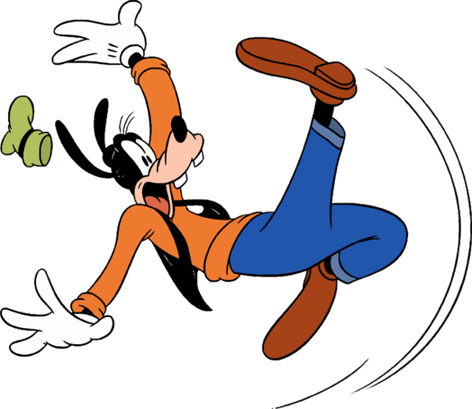
to be going to
infinitive
am
is
are
Later that day, Helen meets Dave:
intention (smth. planned before;
we have already decided to do)
When I finish school,
I’m going to enter the university
predictions
(based on evidence;
on what you see now)
- Sue and I have decided to have a party.
We're going to invite lots of people.
Watch out!
You are going to fall!

Slide 8
COMPARE:
She is going to travel
She isn’t going to travel
Is she going to travel?
Yes, she is
No, she isn’t
"Gary phoned while you were out." "OK.
I'll call him back."
“Gary phoned while you were out." "Yes, I know.
I'm going to call him back."
Ann is in hospital." "Oh really? I didn't know.
I'll go and visit her."
“Ann is in hospital." "Yes, I know.
I'm going to visit her this evening."
Sometimes there is not much difference between will and going to. For example, you can say:
I think the weather will be nice this afternoon.
I think the weather is going to be nice this afternoon.

Slide 9

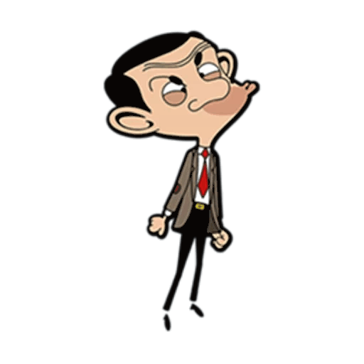
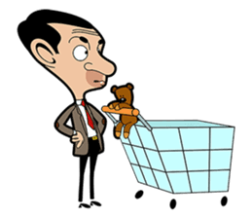
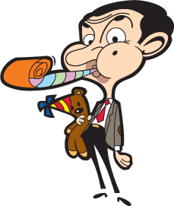
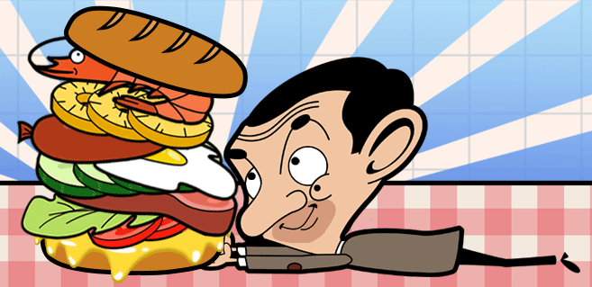
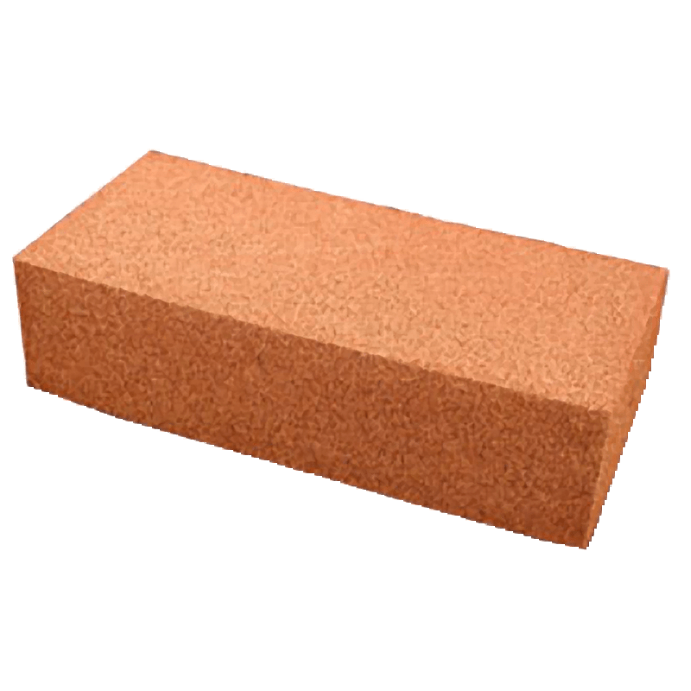
What is Mr Bean going to do?
He is going to buy products
He is going to celebrate his birthday
He is going to buy products
He is going to
(scream/
shriek/
yell/
cry)

Slide 10

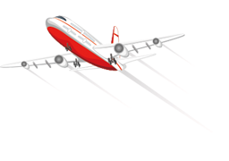
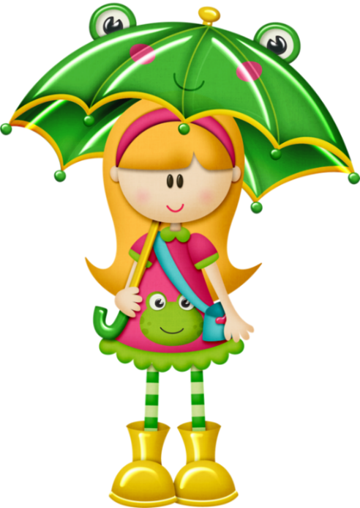
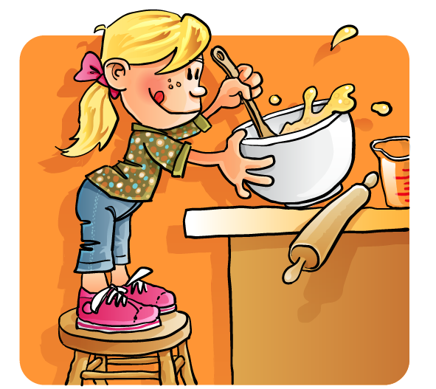
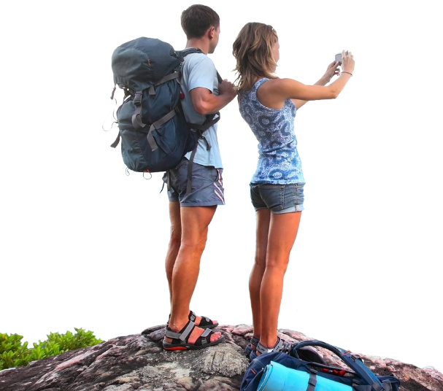
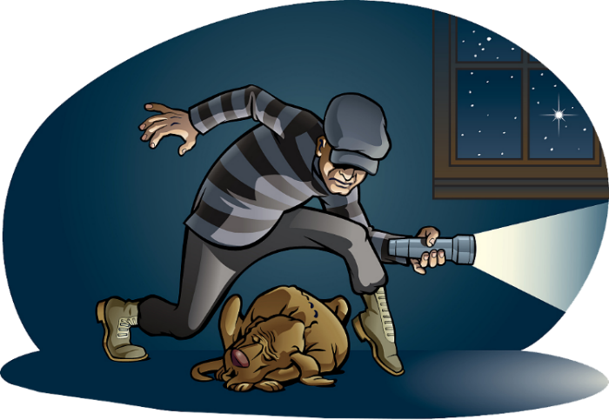

What is going to happen?
She is going to cook a cake
It is going to rain
He is going to rob a house
They are going to travel around the world

Slide 11
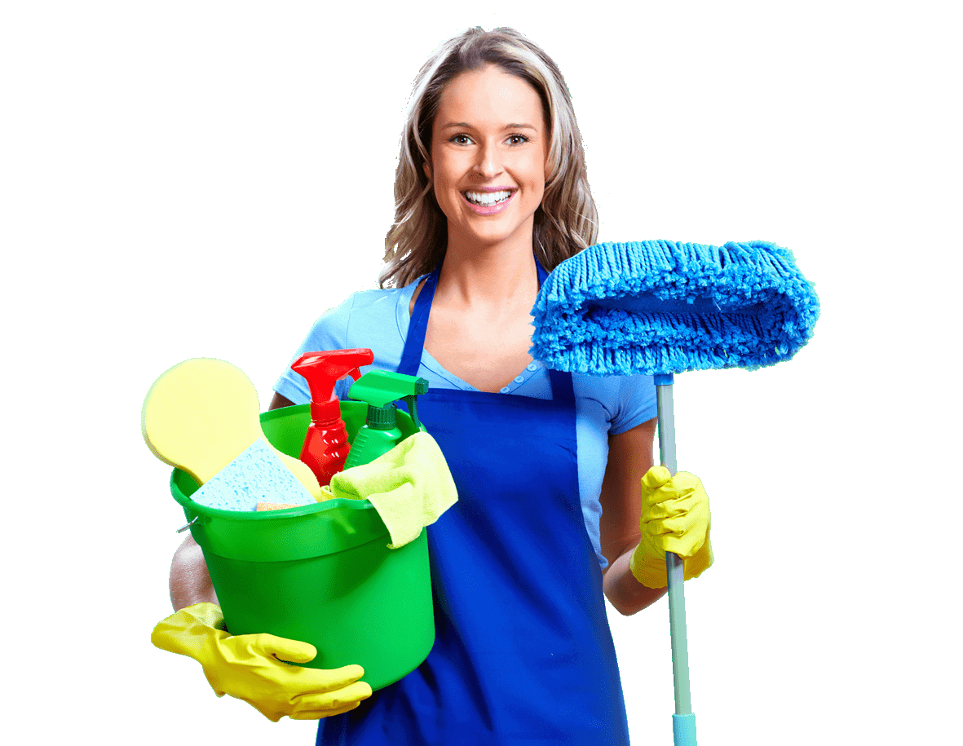
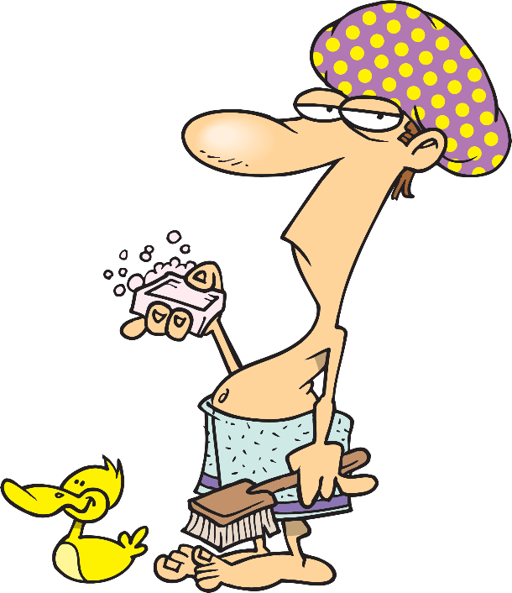
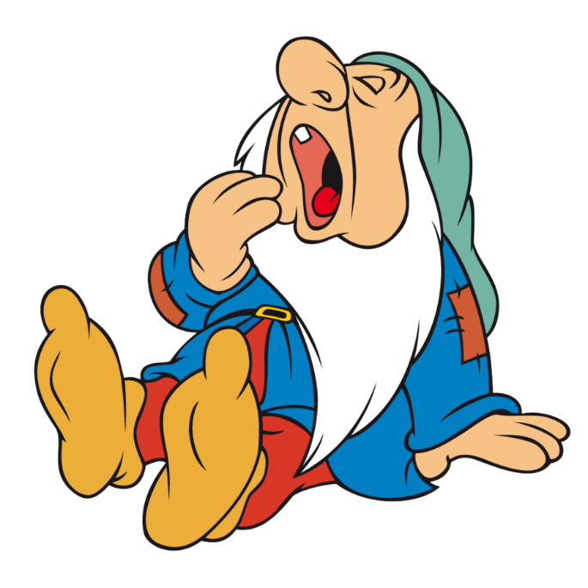
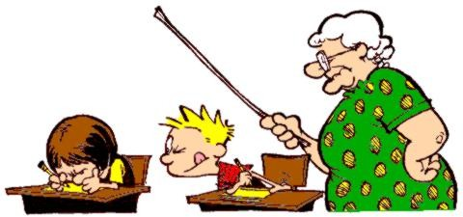
What is going to happen?
She is going to clean a flat
He is going to have/take a shower
He is going to cheat/ copy in his English test
The dwarf is going to sleep

Slide 12
Present Continuous
We are dancing now
We aren’t dancing now
Are we dancing now?
Yes, we are
No, we aren’t
Ving
am/ is/ are
Ving
am/ is/ are
not
Ving
?
Am/ Is/ Are
am/
is/
are
am not/
isn’t/
aren’t
Yes,
No,

Slide 13
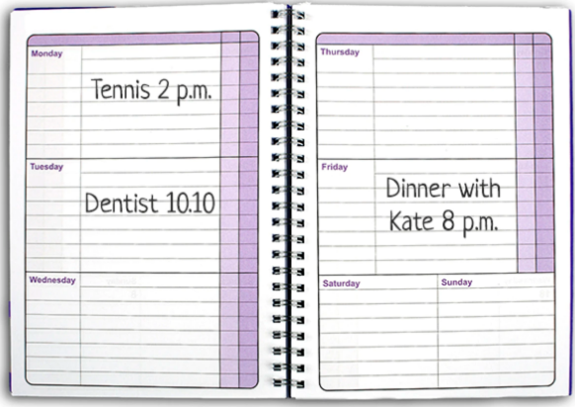
personal plans,
arrangements for the future
Ben’s diary
- Next Sunday I’m playing tennis with my friends
- Next month I’m flying to NY
Thursday
- What are you doing next weekend?
- I’m going to the theatre
Monday
Tuesday
Friday
What are Ben’s plans?
Wednesday
Saturday
Sunday

Slide 14
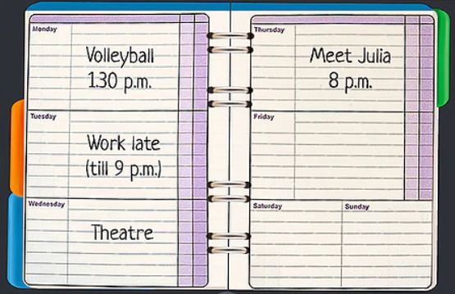
Tom wants you to visit him, but you are very busy. Look at your diary for the next few days and explain to him why you can't come
Thursday
Monday
T
Can you come on Monday evening
?
Tuesday
Friday
’m playing the volleyball at
1:30 p.m
Sorry, but I...
You
T
What about Tuesday evening then
?
Wednesday
Saturday
Sunday
am working till 9 p.m
You
No, not Tuesday. I ...
T
And Wednesday evening
?
’m going to the theatre
You
Unfortunately not. I...
T
Well, Are you free on Thursday
I’m afraid not. I...
’m going to meet Julia/
’m meeting Julia at 8 p.m
You

Slide 15
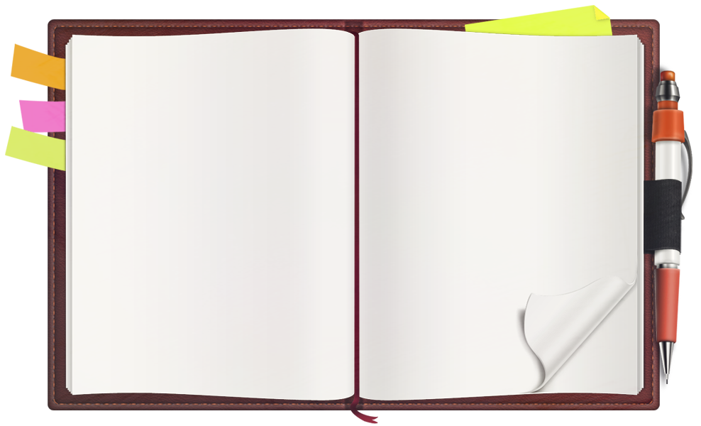

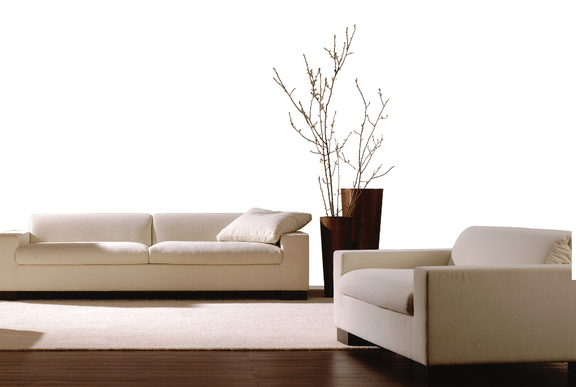

Have you arranged to do anything at these times?
Write sentences
about yourself.
Monday
Thursday
Tuesday
Friday
This evening...
Tomorrow morning...
Tomorrow evening...
Next Sunday...
On Friday...
On Saturday....
On Wednesday....
Wednesday
Saturday
Sunday

Slide 16

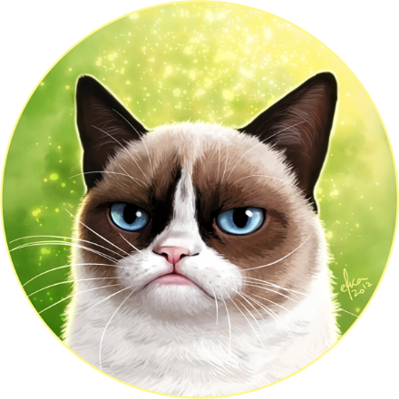
Present Simple
Grumpy Cat smileS
When you put +S
After HE, SHE and IT.
Yes, he DOES.
Grumpy Cat HAS fun
V1 (-s/ -es )
He/She/ It
V1
don’t/ doesn’t
?
V1
Do/ does
Yes,
No,
do/
does
don’t/
doesn’t

Slide 17
John and Merry wash dishes every day
John and Merry don’t wash dishes every day
Do John and Merry wash dishes every day?
Yes, they do
No, they don’t
Jill washes dishes every day
Jill doesn’t wash every day
Does Jill wash every day?
Yes, she does
No, she doesn’t
BUT!
timetable, schedules
- I’m flying tomorrow
- The film starts at 7 o’clock
personal arrangement for the near future
- The plane takes off at 5 p.m. tomorrow

Slide 18

What form do you use to talk about:
predictions based on evidence, what we see;
prediction based on our opinion;
promises;
offers;
personal arrangements for the near future;
decisions at the moment of speaking.
timetables, schedule
sudden decisions
be going to
will
will
shall
Pr. C
will
Pr. S
will

Slide 19
Match the sentences with their functions:
Shall I make you a cup of tea?
You’ll crash it again
Are you going to visit your parents?
I’m staying at mum’s tonight
I’ll be really careful
You are so thirsty. I’ll give you water
She comes at 8 p.m after work
Watch out! The ledder is going to fall down
promise
offer
timetable, schedule
arrangement
prediction
(X2)
sudden decision
plan or intention

Slide 20
timetable, schedule
Match the sentences with their functions:
We are meeting for dinner this evening
Shall I help you with your bags?
I’m going to Thailand
I’ll always take care of you
The bus arrives at 12:30
I think Ben will visit us tomorrow
Look at the clouds! It’s going to rain!
I’ll take the chocolate cake
prediction
based on evidence
sudden decision
promise
offer
arrangement
prediction
(no evidence)
general intention

Slide 21
promise
prediction
based on evidence
prediction
(no evidence)
sudden decision
timetable, schedule
offer
arrangement
general intention
will/shall | be going to + inf | Present Continuous | Present Simple

Slide 22
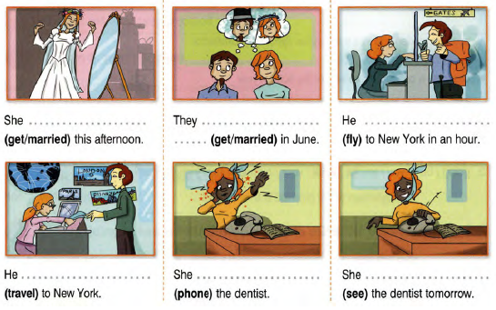
Fill in Present Continuous or to be going to
is getting married
are going to get married
is flying
is going to travel
is going to phone
is seeing

Slide 23
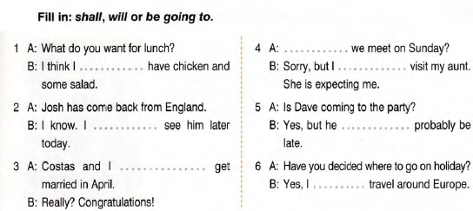
Shall
will
Shall
am going to
am going to
are going to
are going to

Slide 24
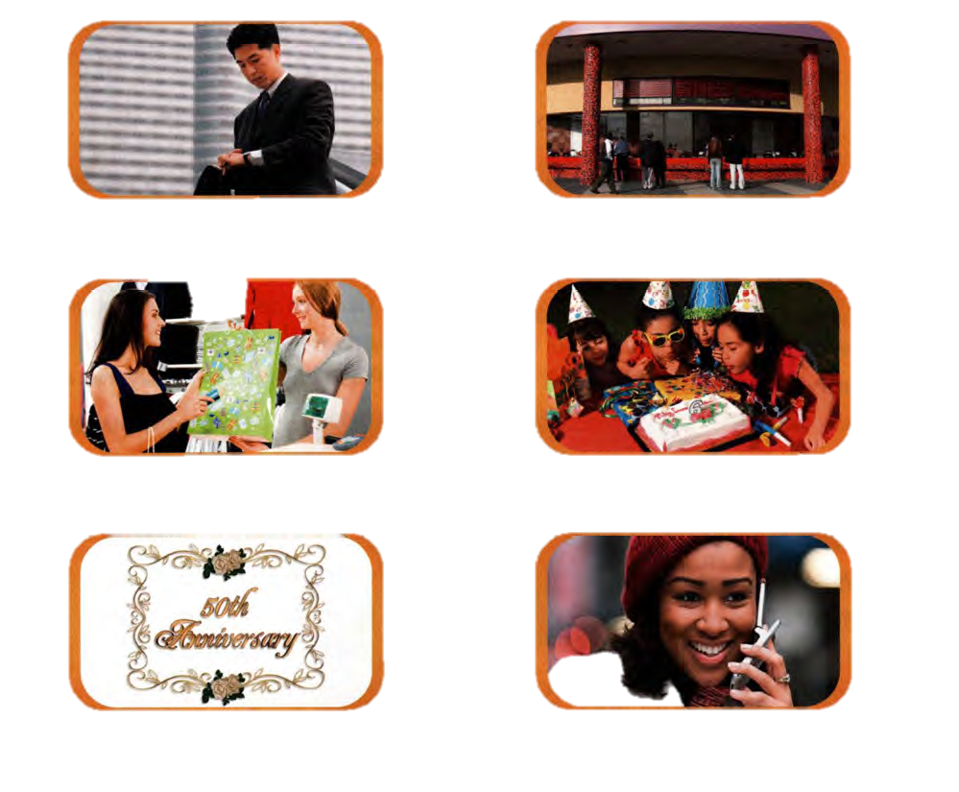
Look at the pictures and fill in with the verbs from the list in the Present Continuous, Future Simple, Present Simple and to be going to
●eat ● buy ● have ● start ● see ● bee
will be
1. I hope I ...............on time for the meeting
is going to eat
2. It’s lovely. I........................it
3. Anie ........................ some cake
will buy
starts
will see
are having
4. The film .............in 20 minutes
5. Ok, mum. I........... you at home, then
6. They.......................party for their 50th anniversary next Saturday

Slide 25
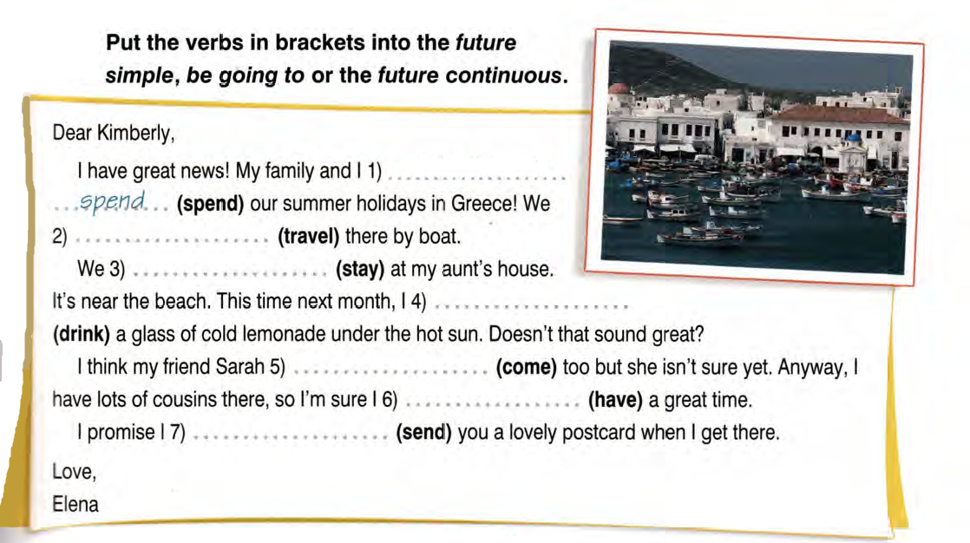

Slide 26
Oh, what a mess in here! Come on,
I ________ (help) you sort the files.
It’s okay, I_________ (do) it tomorrow.
_______you_________(meet) your friends tomorrow?
When _______the concert_________(begin)?
Sally ___________(make) a beautiful dinner tonight.
My parents _____________(come) us next week
Who ____________(make) John's birthday cake?
What ______you________(do) tomorrow evening?
You _________ (not finish) it in just one day.
Probably, my sister _________ (do) homework
Train __________(leave) at 3 p.m
Look! The vase _____________(fall)!
will help
will do
Are
meeting
does
begin
is going to make
are coming
is going to make
are
doing
won’t finish
will do
leaves
is going to fall

