Slide 1





IrinaPapakhinac

Slide 2

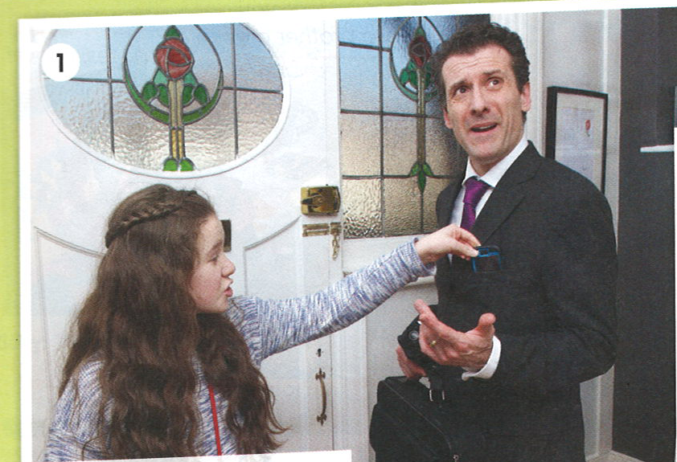

Look at the photo.
Who can you see in the photo?
Where are they?
Is it morning or evening&
Watch the video and check your answers.
IrinaPapakhinac

Slide 3
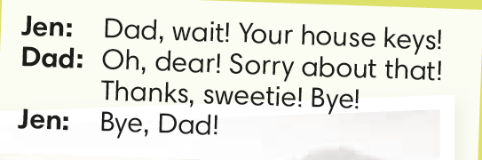
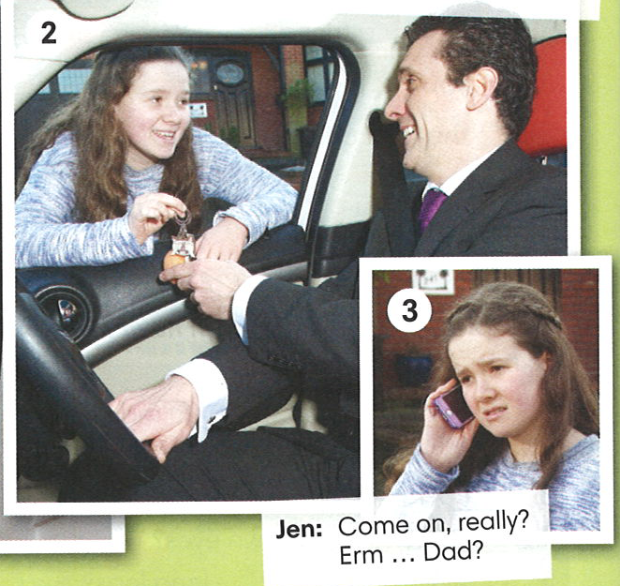
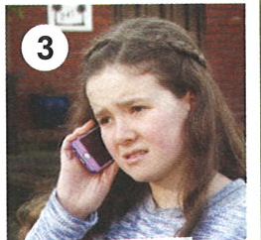
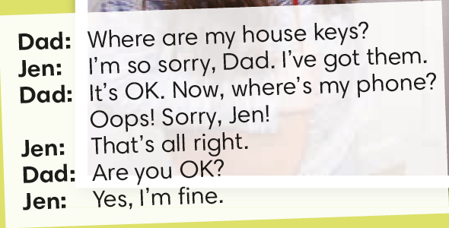
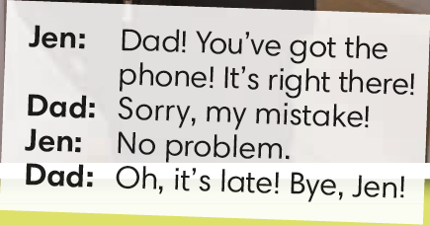
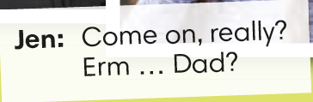
How can we say sorry?
How can we respond to an apology?
IrinaPapakhinac

Slide 4

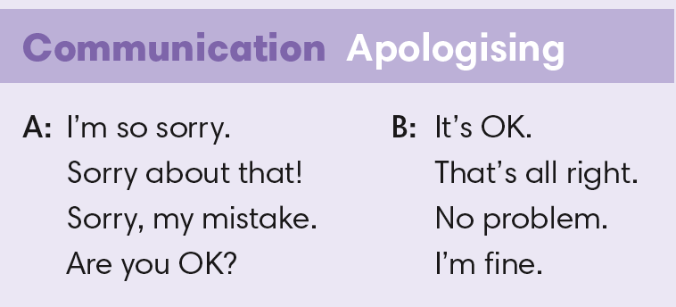
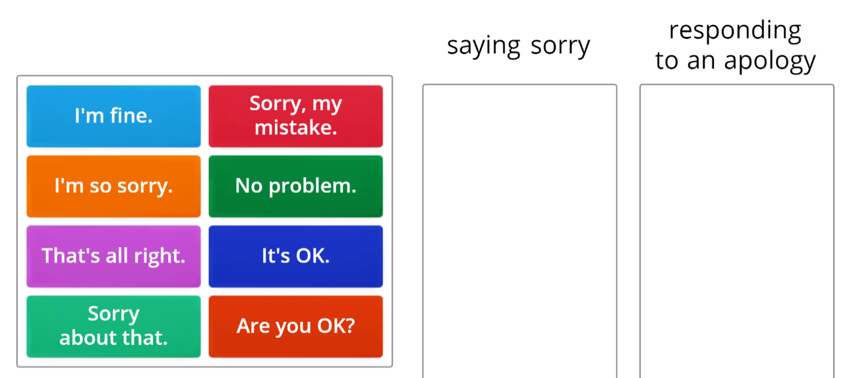
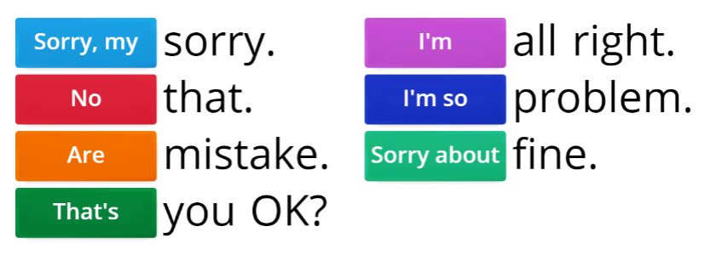
IrinaPapakhinac

Slide 5

IrinaPapakhinac

Slide 6
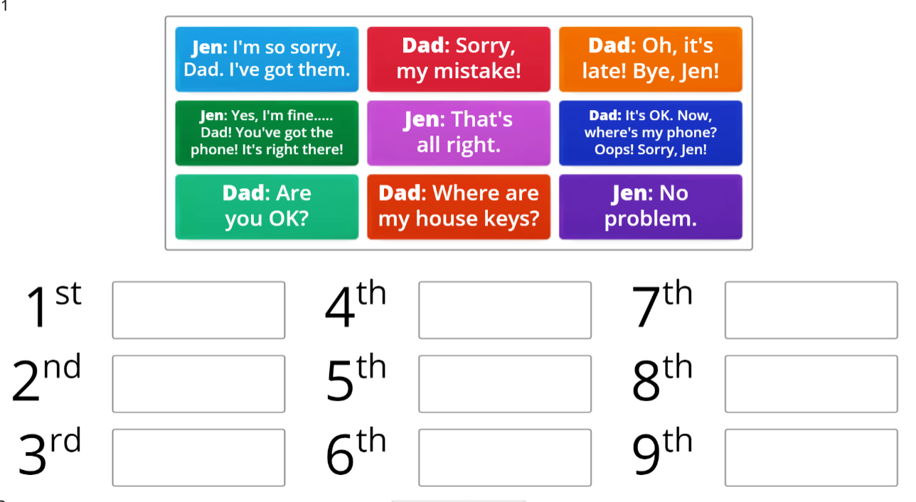
IrinaPapakhinac

Slide 7
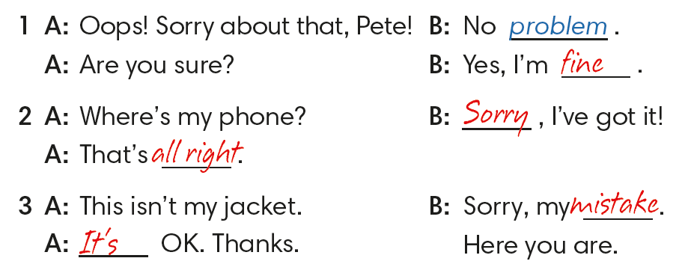
Complete the dialogue.
IrinaPapakhinac

Slide 8
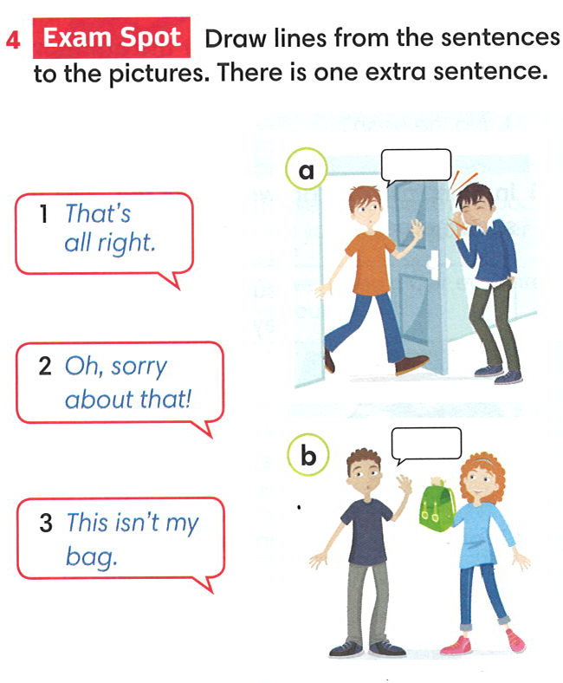
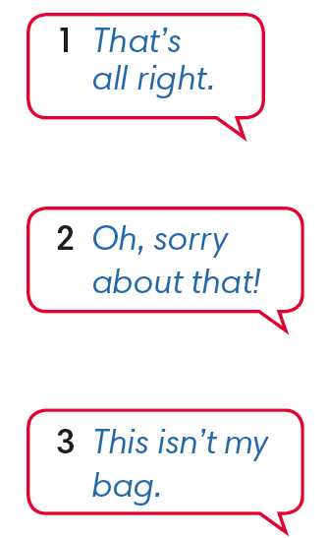
Match sentence to the pictures. There is one extra picture.
2
3
IrinaPapakhinac

Slide 9
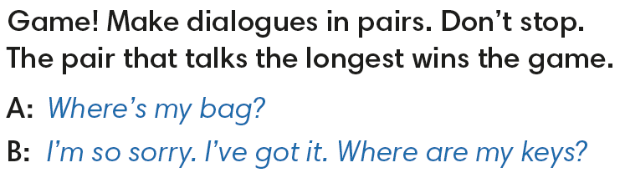

IrinaPapakhinac

Slide 10
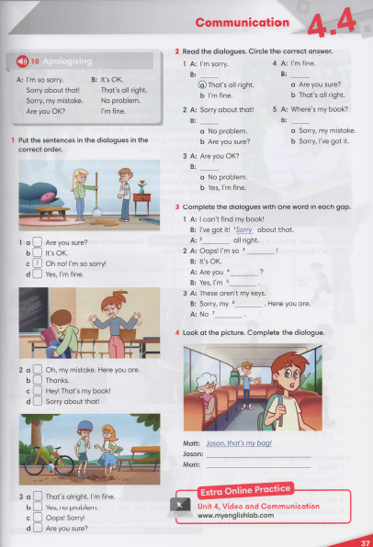


IrinaPapakhinac

Slide 11
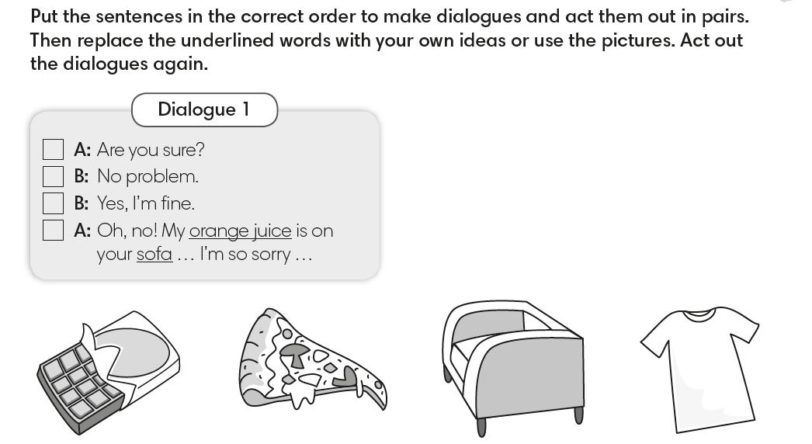
3
2
4
1
IrinaPapakhinac

Slide 12
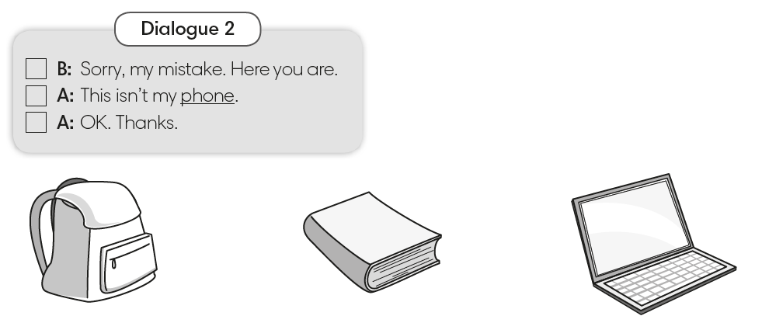
2
1
3
IrinaPapakhinac

Slide 13
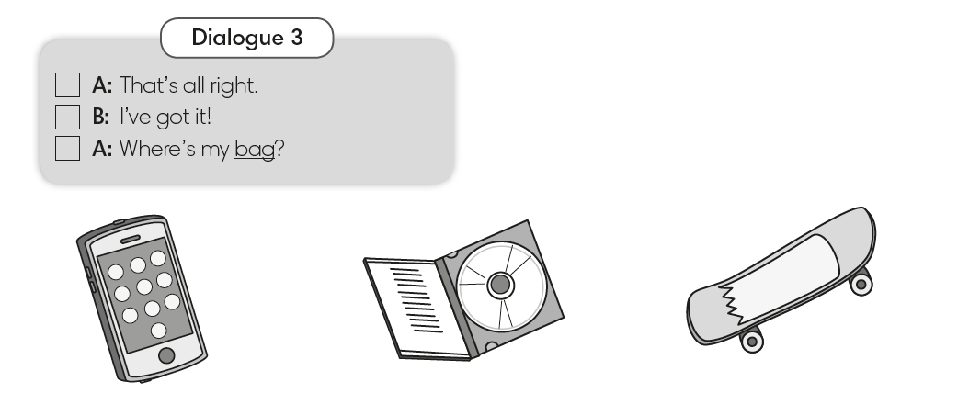
3
2
1
IrinaPapakhinac

