Slide 1
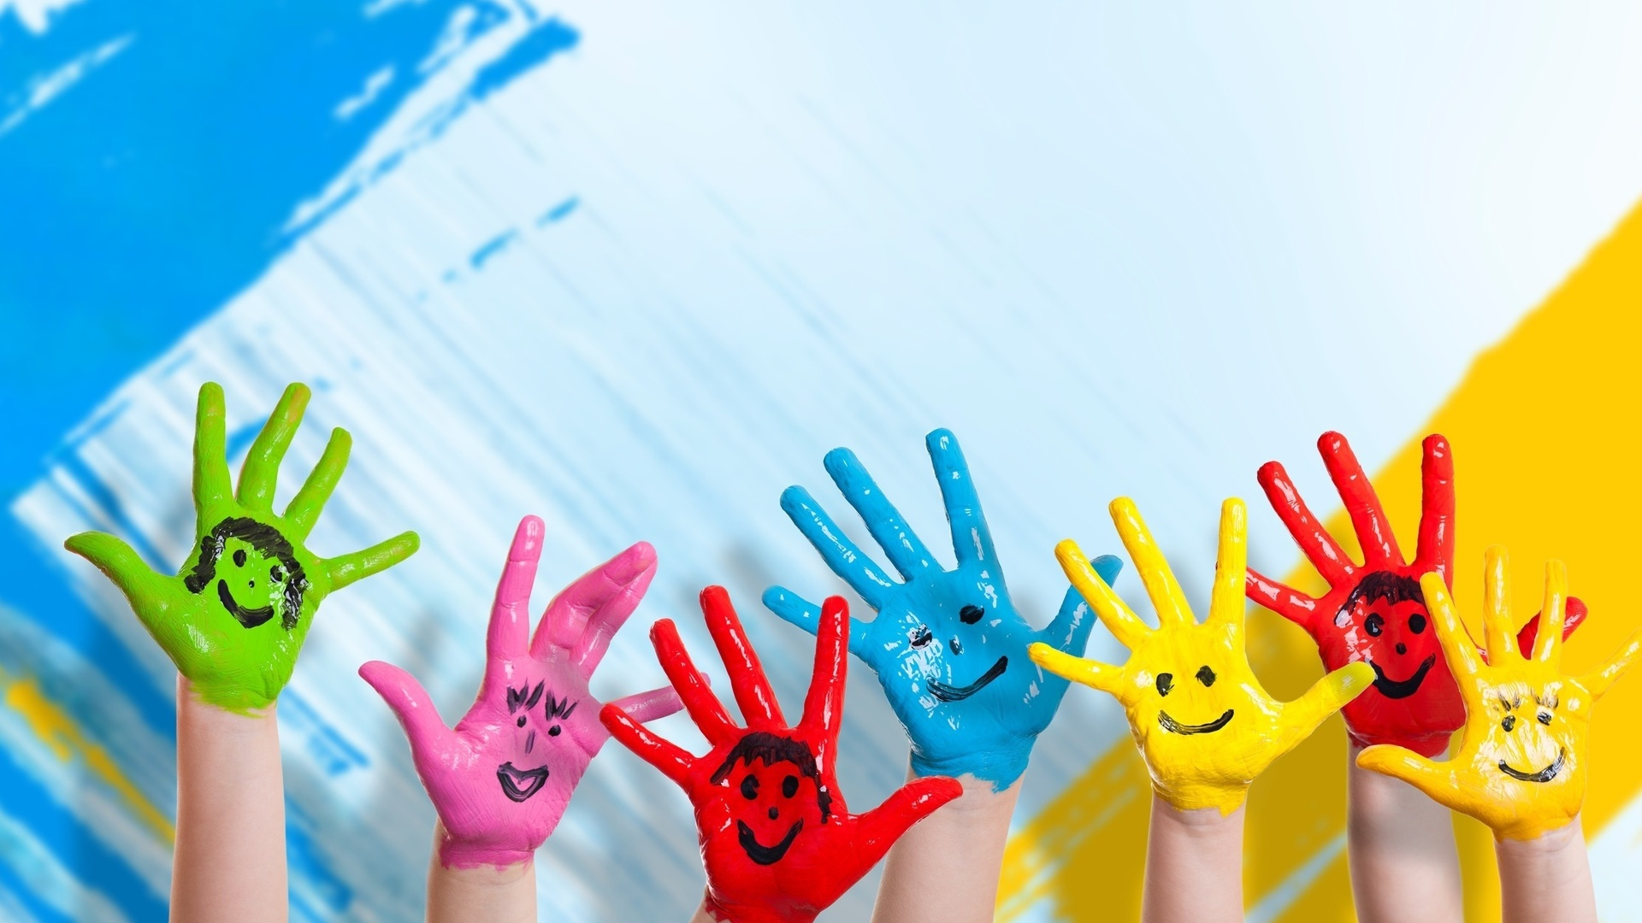



IrinaPapakhina

Slide 2



IrinaPapakhina
Notes:
1) T: Hello, my name is … What’s your name?
2) T: I can write my name. (writes) Can you write your name? Ss: write
3) Remember English words starting with the letters in the name
4) Spelling names

Slide 3
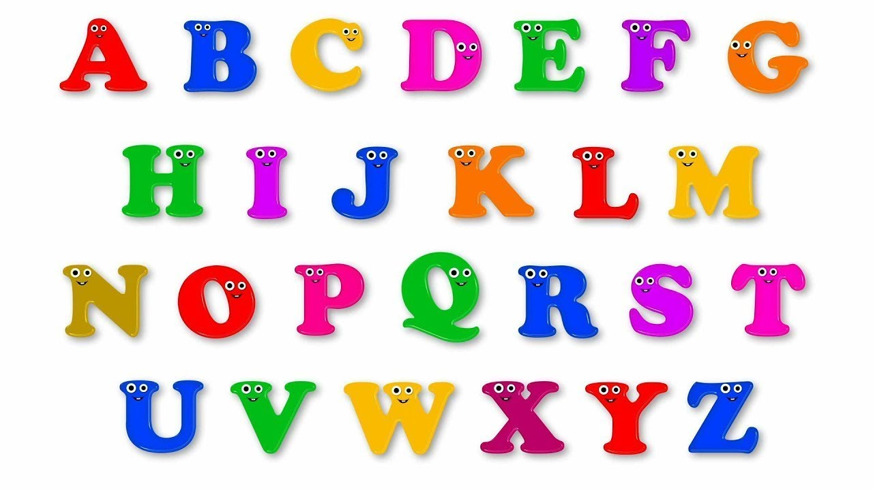
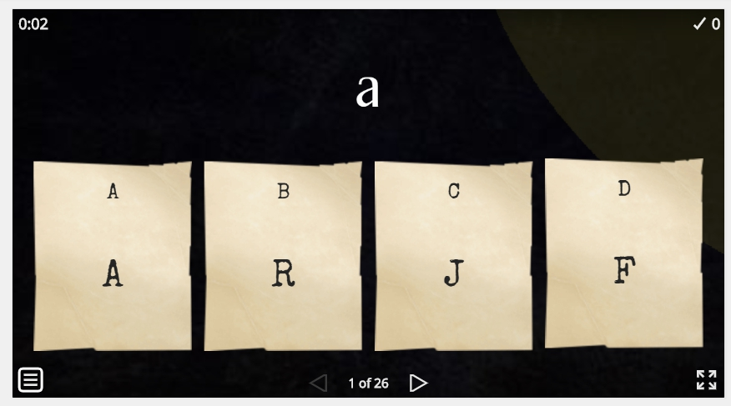
IrinaPapakhina

Slide 4
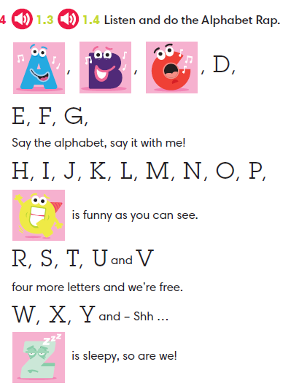

IrinaPapakhina

Slide 5
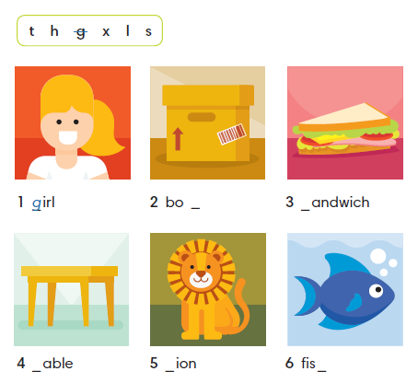
x
s
t
l
h
IrinaPapakhina

Slide 6
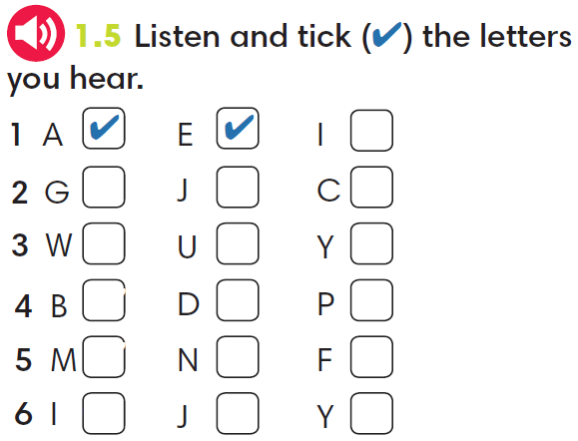

IrinaPapakhina

Slide 7
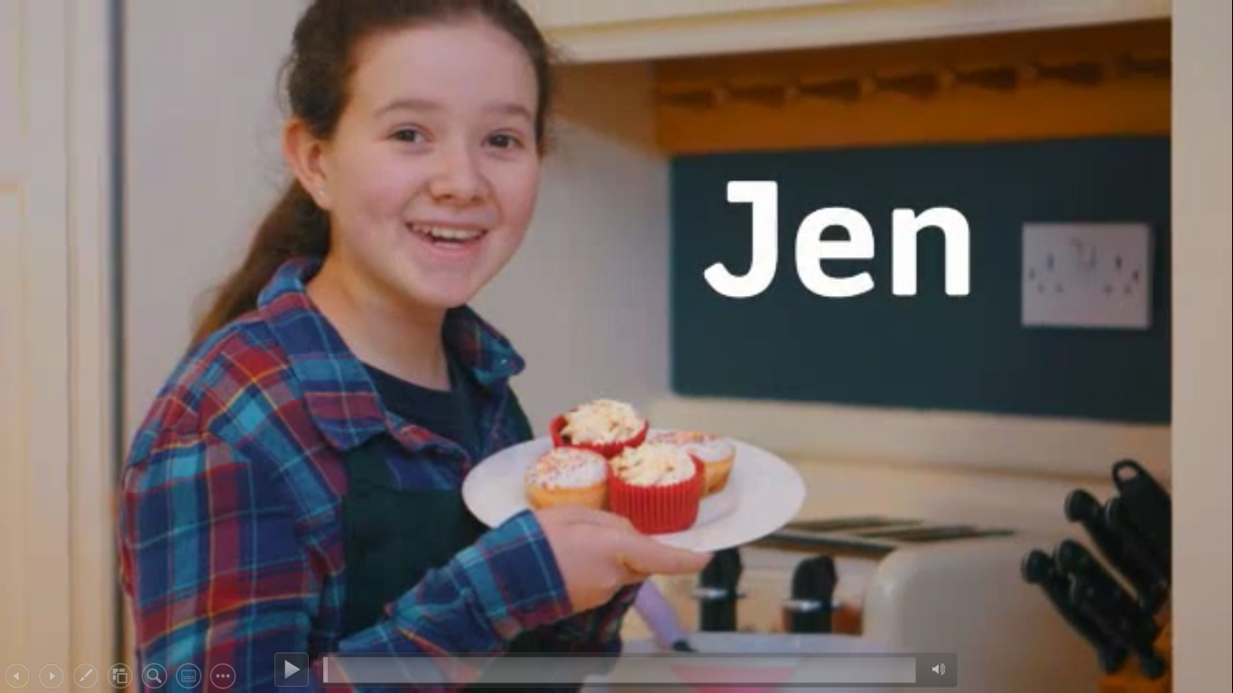
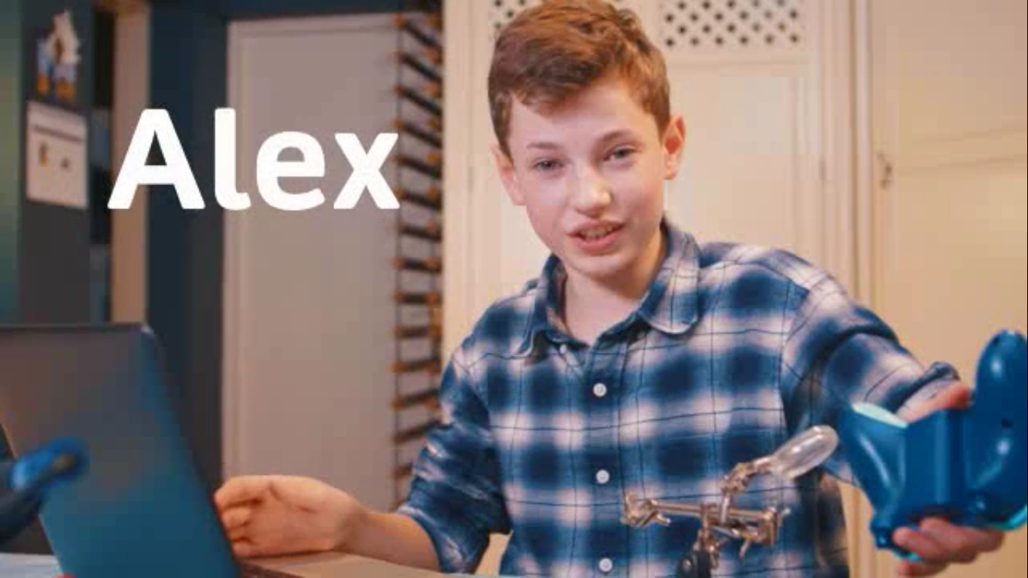
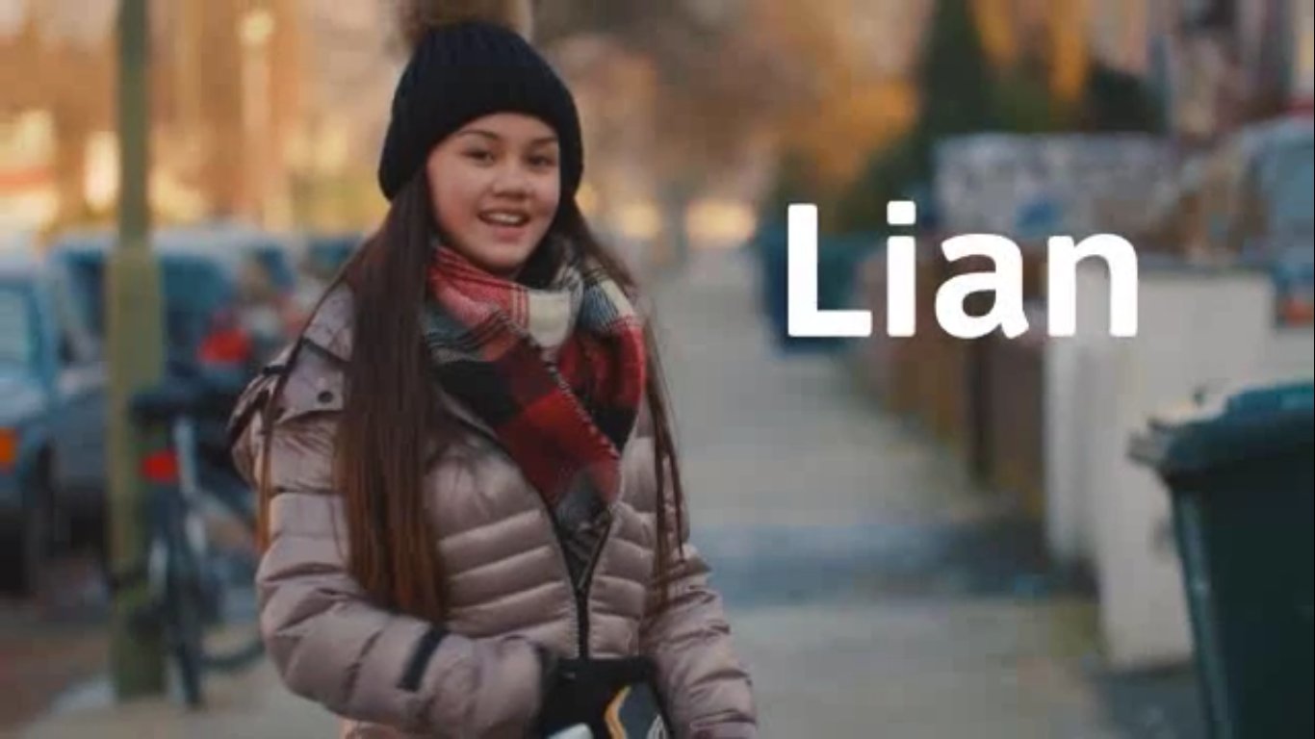
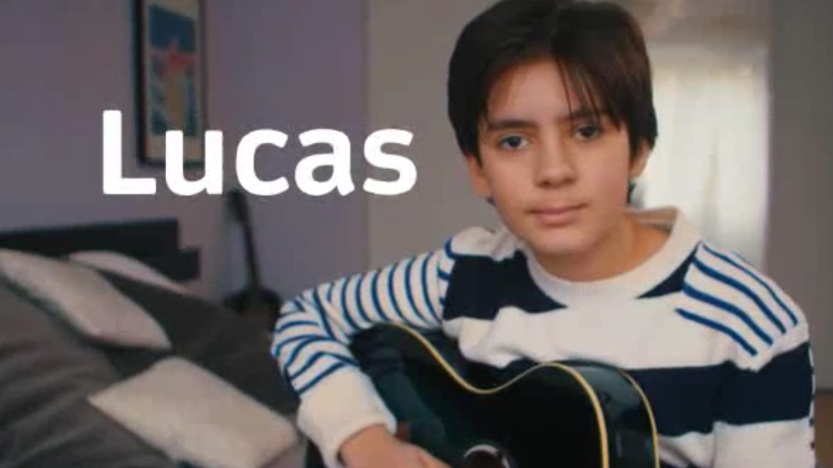
Meet new friends!
Can you spell their names?
IrinaPapakhina

Slide 8
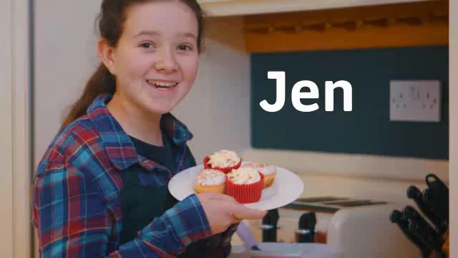
Watch the video.
Who is NOT from the UK?
IrinaPapakhina

Slide 9
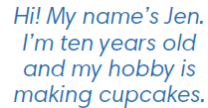
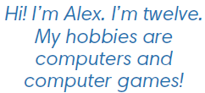
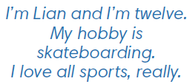
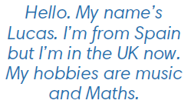
Match the names to hobbies.
Jen a) computers and computer games
Alex b) making cupcakes
Lian c) music and Maths
Lucas d) sports
Do you like these hobbies?
What is your hobby?
IrinaPapakhina

Slide 10
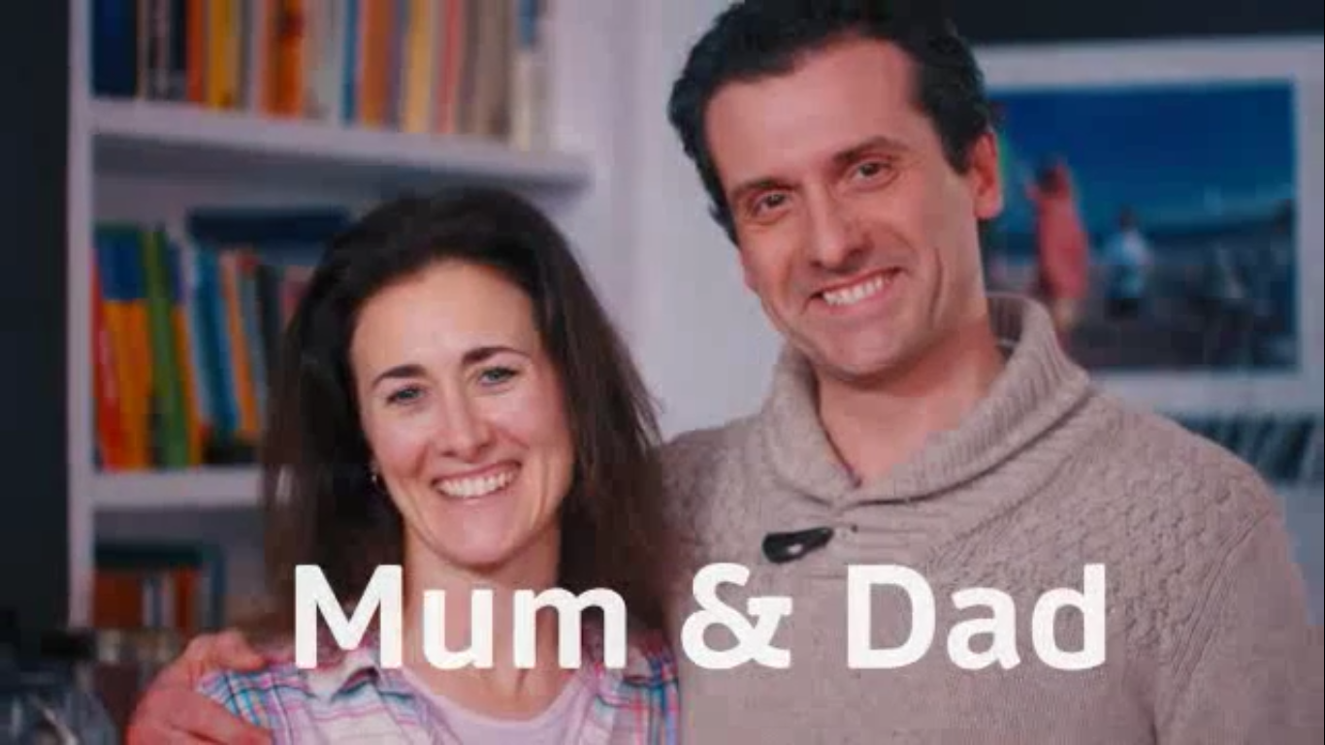


What are their names?
Whose mum and dad are they?
IrinaPapakhina

Slide 11

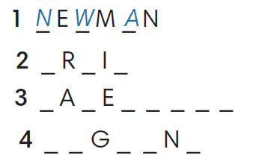
O
T
Z
C
V
N
D
I
S
H
H
I
G
I
S
IrinaPapakhina

Slide 12
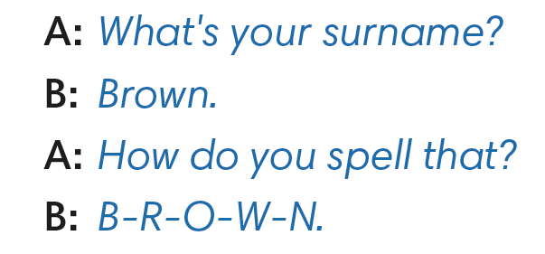
IrinaPapakhina

Slide 13
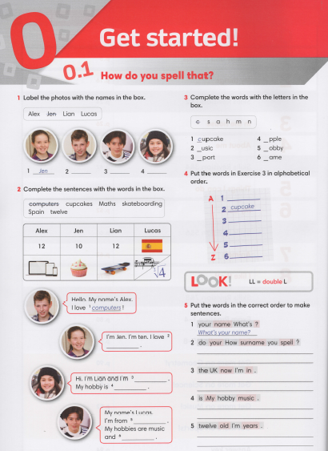
IrinaPapakhina

Slide 14
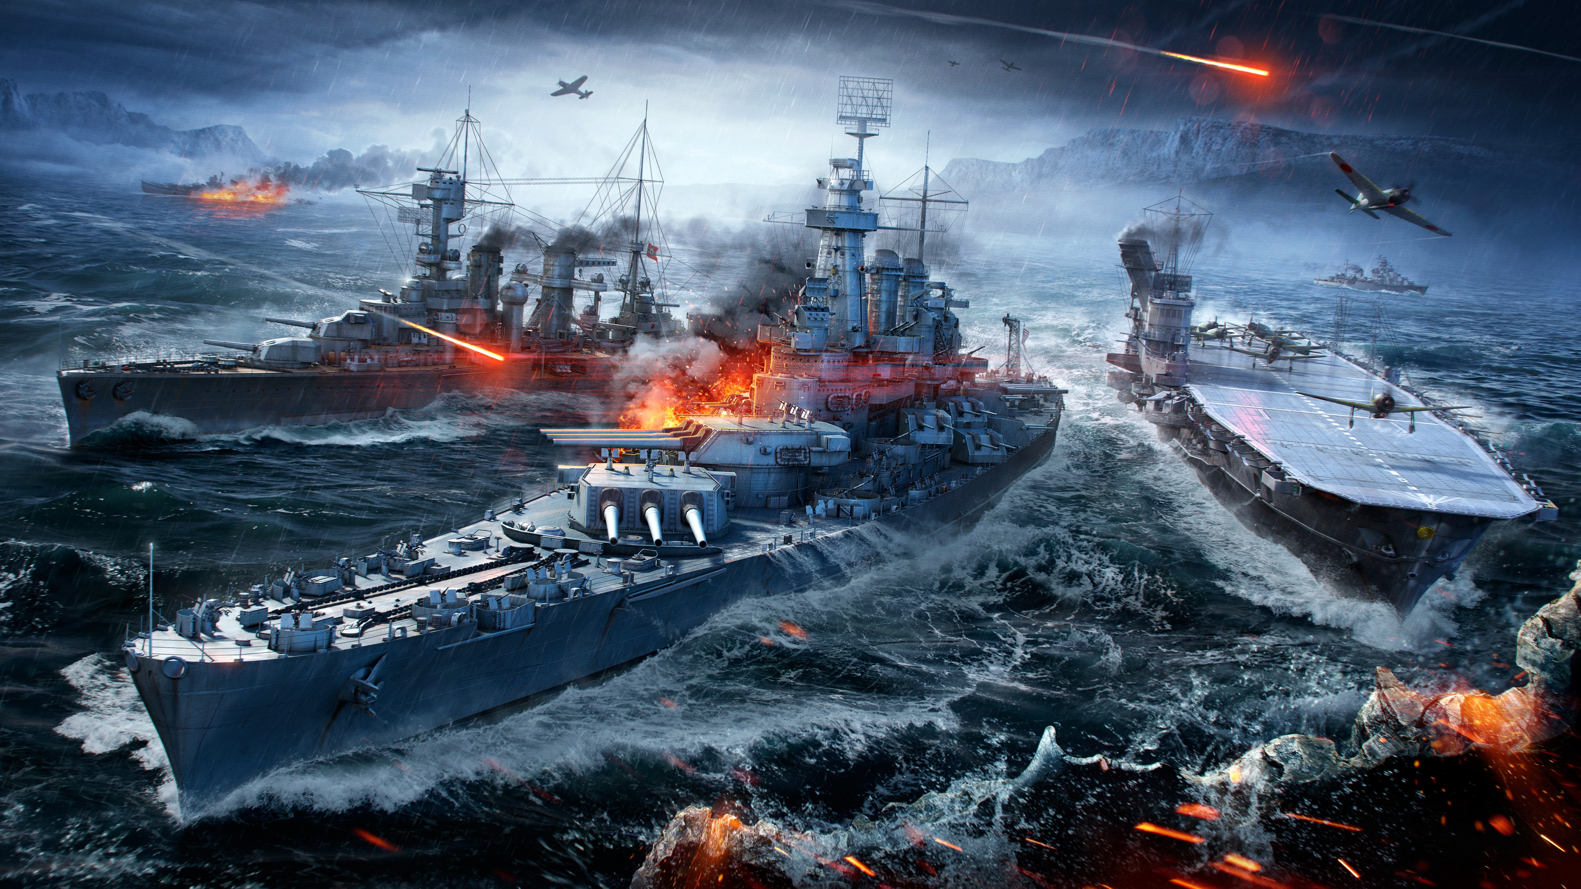

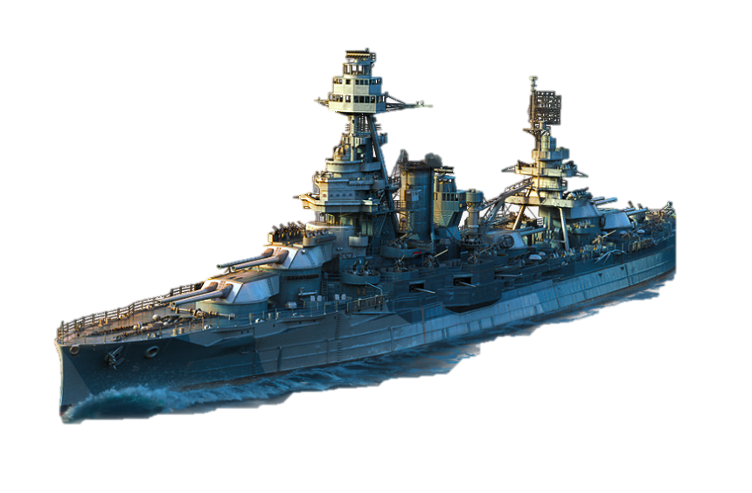
Find 10 ships
Aa
Bb
Cc
Dd
Ee
Ff
Gg
Hh
Ii
Ji
KK
Ll
Mm
Nn
Oo
Pp
Qq
Rr
Ss
Tt
Uu
Vv
Ww
Xx
Yy

Slide 15
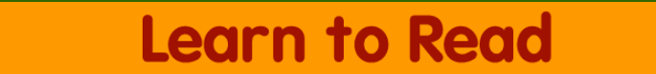
IrinaPapakhina

